Slide 1
SCMD:
Saccharomyces Cerevisiae Morphological Database
Taro L. Saito^{1,2}, Miwaka Ohtani^{1,2},
Hiroshi Sawai², Fumi Sano^{2,4},
Ayaka Saka^{2,4}, Daisuke Watanabe^{2,4},
Masashi Yukawa^{2,4},
Yoshikazu Ohya^{2,4} and Shinichi Morishita^{*,2,3}
Department of Computer Science, Graduate School of Information Science and Technology, University of Tokyo
２． Institute for Bioinformatics and Research and Development, Japan Science and Technology Corporation
３. Department of Computational Biology, Graduate School of Frontier Sciences, University of Tokyo
４． Department of Integrated Biosciences, Graduate School of Frontier Sciences, University of Tokyo

Slide 2
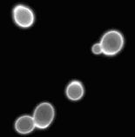
What is SCMD ?
SCMD is a collection of micrographs of budding yeast mutants.
Our image processing program, called CalMorph, clips individual cells from micrographs, then analyzes the characteristics of them.
Currently following number of yeast mutants and their micrographs are analyzed.
  Mutants analyzed: 4,495
  Micrographs Processed: 84,407 (x 3)
  Cells retrieved: 1,643,835

Slide 3


Micrographs
Three type of stains are used
to see
  Cell wall
    FITC-ConA
  Nucleus location
    DAPI
  Actin distribution
    Rh-ph
All micrographs can be seen in the viewer provided in SCMD
Cell wall
Nucleus
Actin
image processing

Slide 4
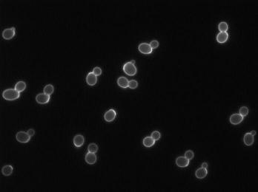
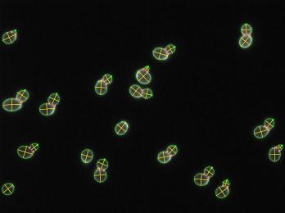
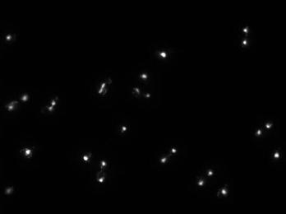
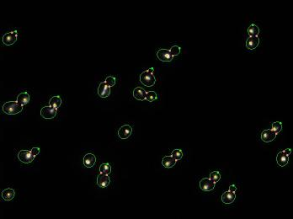
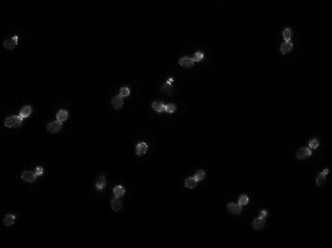
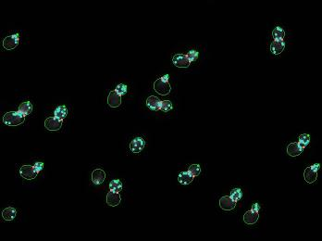
stain
FITC-ConA
DAPI
Rh-ph

Slide 5
Cell Parameters

Slide 6
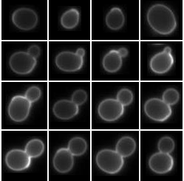
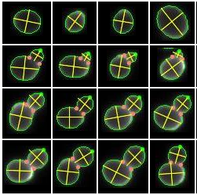
Categorizing by Bud Size
View of ‘group by bud size’
no bud
small
medium
large
yor202w his3

Slide 7
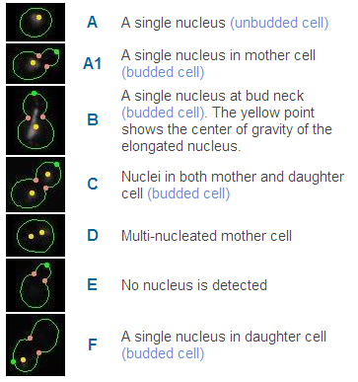
Nucleus Location Categories
We categorized the states of nucleus locations into 7 groups.
State A, A1, B, C are regular status.
State D, E, F seldom occur.

Slide 8
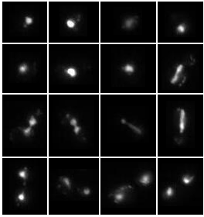
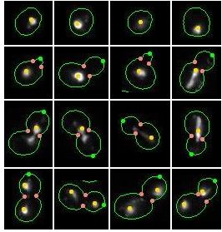
Categorizing by Nucleus Location
View of ‘group by nucleus location’
A
A1
B
C
ybl052c sas3

Slide 9
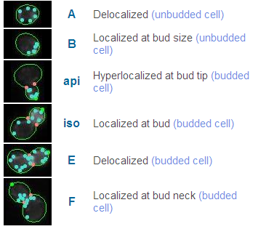





Actin Localization Categories

Slide 10
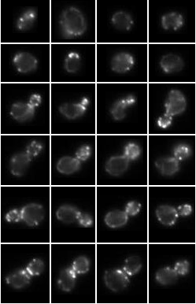
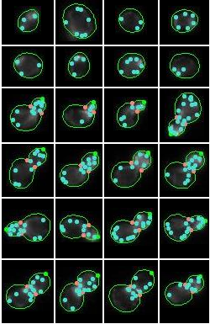
Categorizing by Actin Localization
View of ‘group by actin localization’
A
B
iso
api
E
F

Slide 11
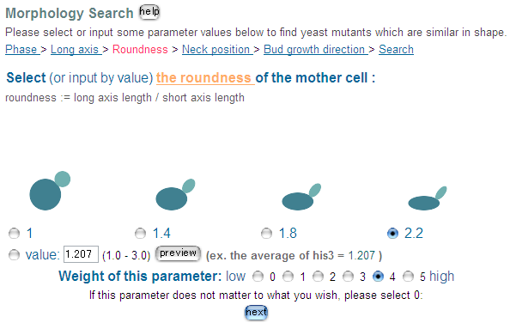
Morphology Search Interface

Slide 12
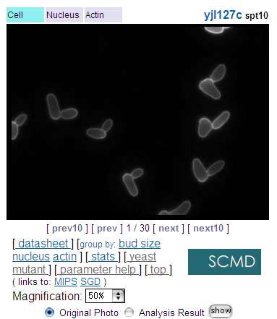
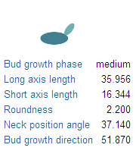
Searching Similar Shape Mutants
input shape
query result

