Slide 1
UTGB Shell
An Open-Source Browser Framework for the Integration of Biological Data
Taro L. Saito, Shin Sasaki, Budrul Ahsan and Shinichi Morishita
Department of Computational Biology
Graduate School of Frontier Sciences
University of Tokyo

Slide 2
What is UTGB Shell?
UTGB (University of Tokyo Genome Browser)
  http://ugenome.org/
UTGB Shell
  Web-Based Database Server Development Toolkit
  UTGB browsers are implemented using UTGB Shell
Features:
  AJAX based web interface
  Instant Setup
    Portable Web Server is included in the UTGB Shell.
  Database Connection Support:
    Commercial: SQL Server, Oracle, DB2, etc.
    Open Source: PostgreSQL, MySQL, SQLite, etc.
  Smart Data Mapping (XML, JSON, CSV, etc.)

Slide 3
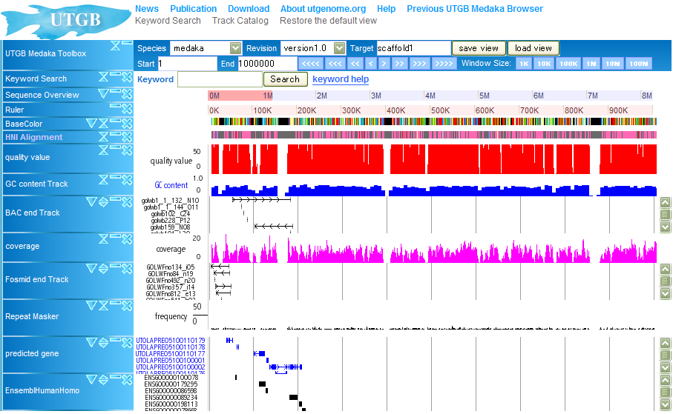
UTGB: Medaka Genome Browser

Slide 4
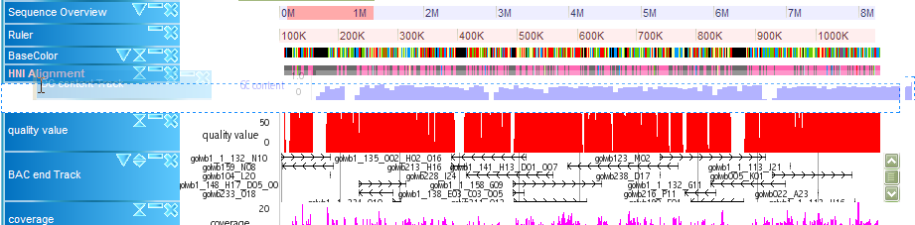
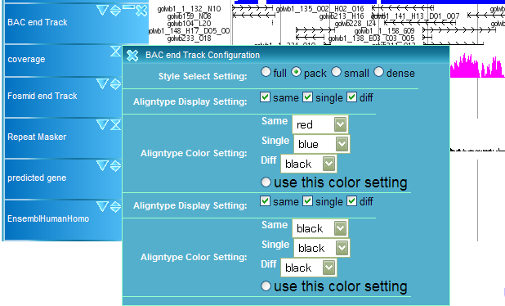
Interactive User Interface
Drag-Drop & Resizing of Tracks
  without reloading the entire pages
Interactive Track
Configuration
  No reload is required

Slide 5
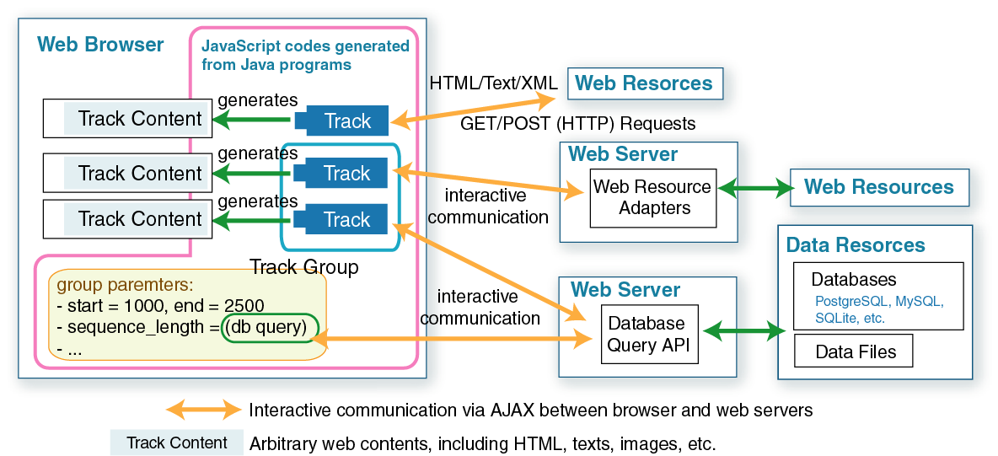
UTGB Framework
UTGB supports interactive communication with multiple web servers

Slide 6
How to implement your own track
Arbitrary web pages can be used as a track:
  Static contents
    HTML pages
  Dynamic contents (CGI programs, etc.)
    Perl, PHP, Java Servlet programs etc.
UTGB Shell has several utilities for rapid track development:
  Database Access via JDBC
    Java Database Connection
  Smart Mapping Between Database Data and Class Objects
  Graphic Drawing

Slide 7
Smart Mapping: Database ⇔ Object
Gene Table
Database access codes in UTGB are quite simple
  UTGB automatically converts database data into class objects
id | start | end | name
1 | 100 | 200 | A
2 | 200 | 300 | B
Class Object (Java)
// Get a database access to “mydb” database
DatabaseAccess db = UTGBMaster.getDatabaseAccess("mydb");
// Perform an SQL query to the database then bind the result to Gene class objects.
List<Gene> geneList =
db.query(Gene.class,
“select * from gene order by start");
class Gene {
private int id;
private int start;
private int end;
private String name;
public Gene(){}
public void setId(int id)
{ this.id = id; }
public void setName(String name)
{ this.name = name; }
// followed by other setters
….
}

Slide 8
Strong XML/JSON Data Support
XML, JSON
  Tree-Structured Data
XML/JSON to class object mapping is also supported in UTGB
<data>
<gene id=“1”>
<start>100</start>
<end>3000</end>
<name>A</name>
</gene>
<gene id=“2”>
<start>3500</start>
<end>7000</end>
</gene>
</data>
{“data”:
{“gene”:[
{ “id”:1,
“start”:100, “end”:3000},
{ “id”:”2”,
“start”:2, “start”:3500, “end”:7000}
]}}

Slide 9
UTGB Shell Commands
Create
  Create a new project for implementing your own track.
Action
  Add a new web action handler (CGI of a kind)
Server
  Start up the portable web server for debugging
DBinfo
  Displays database information
Deploy
  Deploy the web application to the remote web server

Slide 10
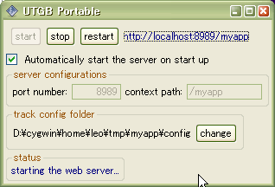
Rapid Development with UTGB Shell
Installation of UTGB
  Only Java 1.5 SDK is required in your system.
    Windows, Mac OS X (Tiger, Leopard), Linux are supported.
  UTGB automatically downloads other resources
  from the web.
“utgb create myapp”
  generates a web application template
“utgb action HelloWolrd”
  adds new web interface
    http://localhost:8989/myapp/HelloWorld
“utgb server”
  launches the web server in your local machine
    No installation of Apache, Tomcat, etc. is required.

Slide 11
UTGB Implementation
UTGB is implemented in Java
  using Google Web Toolkit (GWT) to produce AJAX (Asynchronous JavaScript + XML) based web interface codes.
  Source codes are managed via Subversion (source code version management system)
    Accessible from the web: http://utgenome.org/
UTGB is self-contained
  Portable web server (Tomcat)
  Database Engine (SQLite)
  No installation of web server and database system is required.
  UTGB is a ready-to-use development framework.

Slide 12
UTGB is An Open-Source Program
Source Code License
  Apache License Version 2.0
    Academic and business friendly open source license
It allows you to:
  Freely download and use this software, in whole or in part, for personal, company internal, or commercial purposes;
  Use this software in packages or distributions that you create.
It does not require you to:
  Include the source of this software itself, or of any modifications you may have made to it, in any redistribution you may assemble that includes it;
  Submit changes that you make to the software back to this software (though such feedback is encouraged).

