Slide 1
Market Overview
SPY
IWM
GOLD
CRYPTO

Slide 2
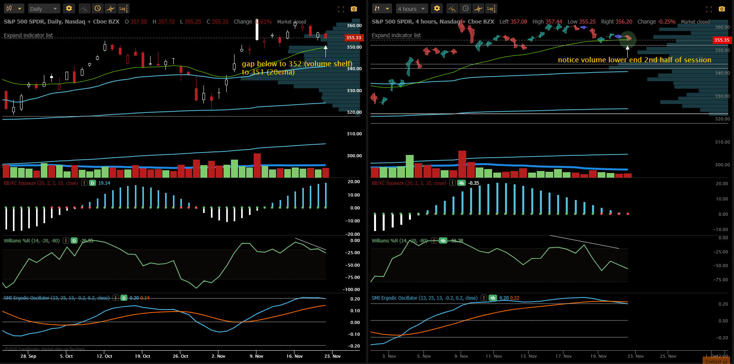
($SPY) Trend: Bearish sideways; raindrop on the 4h shows majority of trade volume on the sell side hovering right above the 20ema
William% (momentum) losing steam, below average trade volume for the past 8 sessions
Gap fill possible to the 352 and 351 if downtrend continuation, I don’t expect to see buyers stepping in next week due to historical thksgiving week trends; if we can push to 358 with strong volume (unlikely), 360 can trade

Slide 3
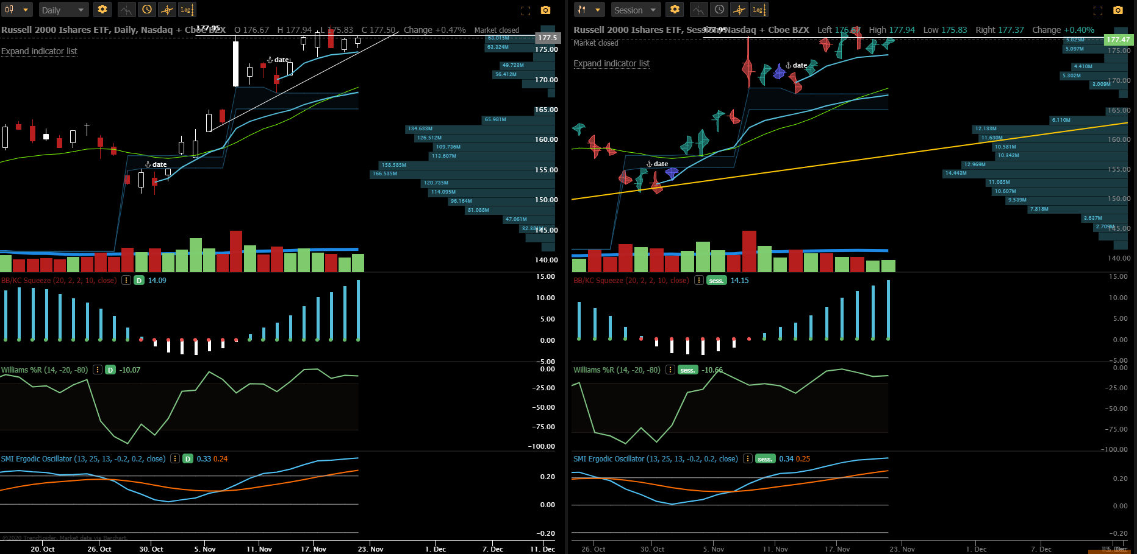
($IWM) tells a different story than spy; graph looking to break out to new highs with 178 serving as resistance and anchored vwap at 175 being respected as we make higher lows on the daily with the raindrop volume profile showing higher highs are being made
This ticker is an indicator for risk-on for the market (great for micros)

Slide 4
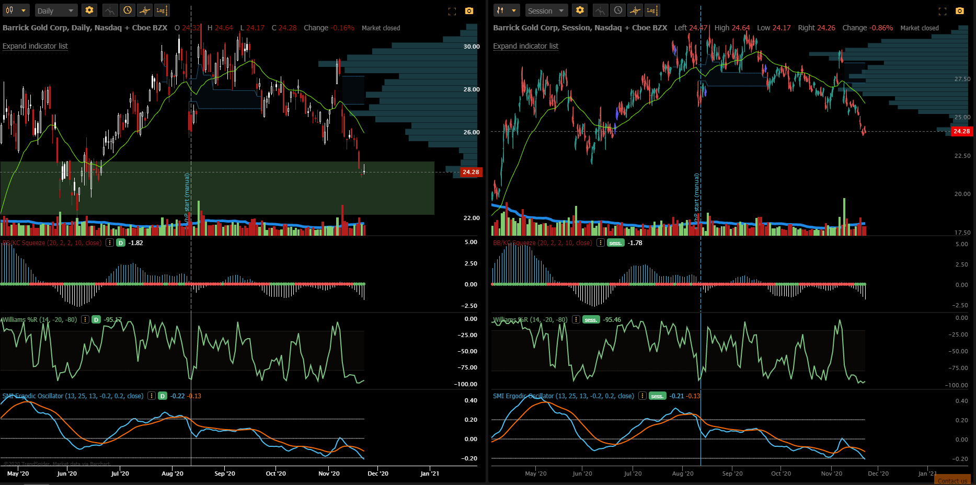
($GOLD) much selling but aligned with market trend (gold sells off, cash flows into risky assets i.e stocks or crypto)
Currently making higher lows on the daily but volume profile on the raindrop doesn’t show much conviction for this point to be an area of reversal; if crypto continues to make new highs, I expect to see gold down to the 22.00 region before any strong interest of buying comes

Slide 5
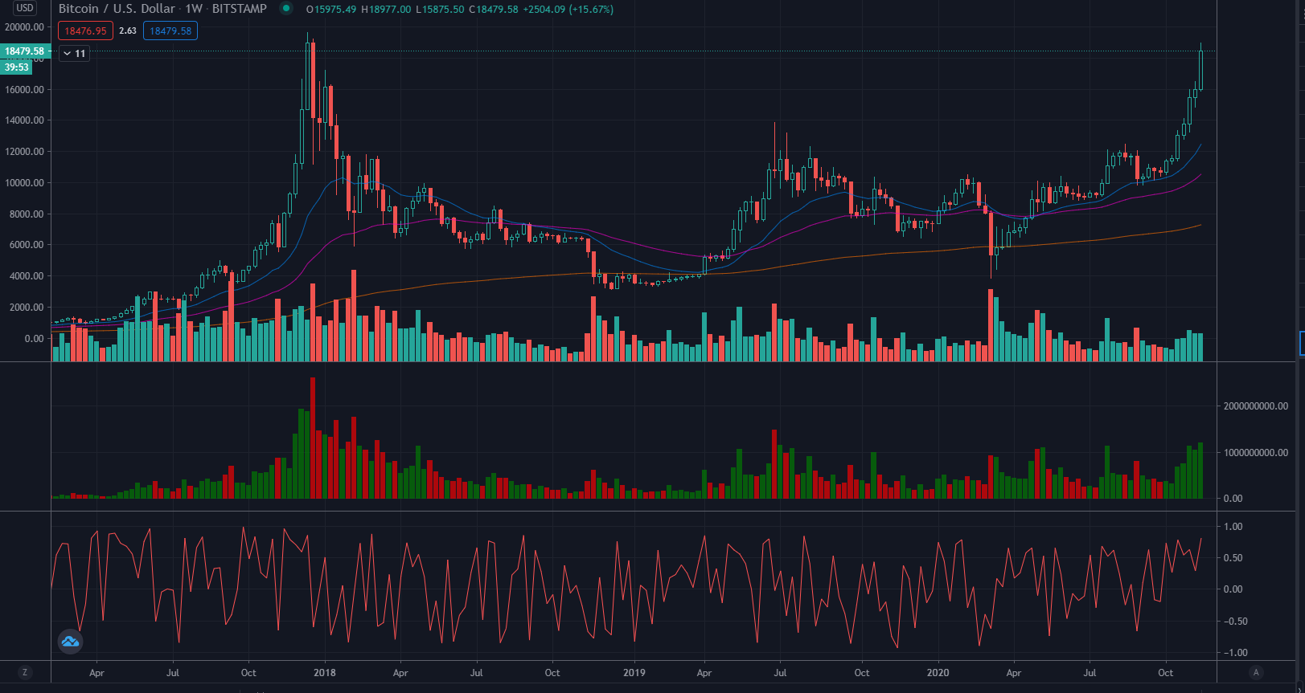
($btc/crypto related) new highs expect 20k soon, 100k price target by many fundamental analyzers, another example of risk on in the marketplace with no one knowing where to put their money, supporting a bull thesis for moves higher in the short-medium term; 20k is seen as an area of short term profit taking +/- 1 std dev

Slide 6
Individual tickers

Slide 7
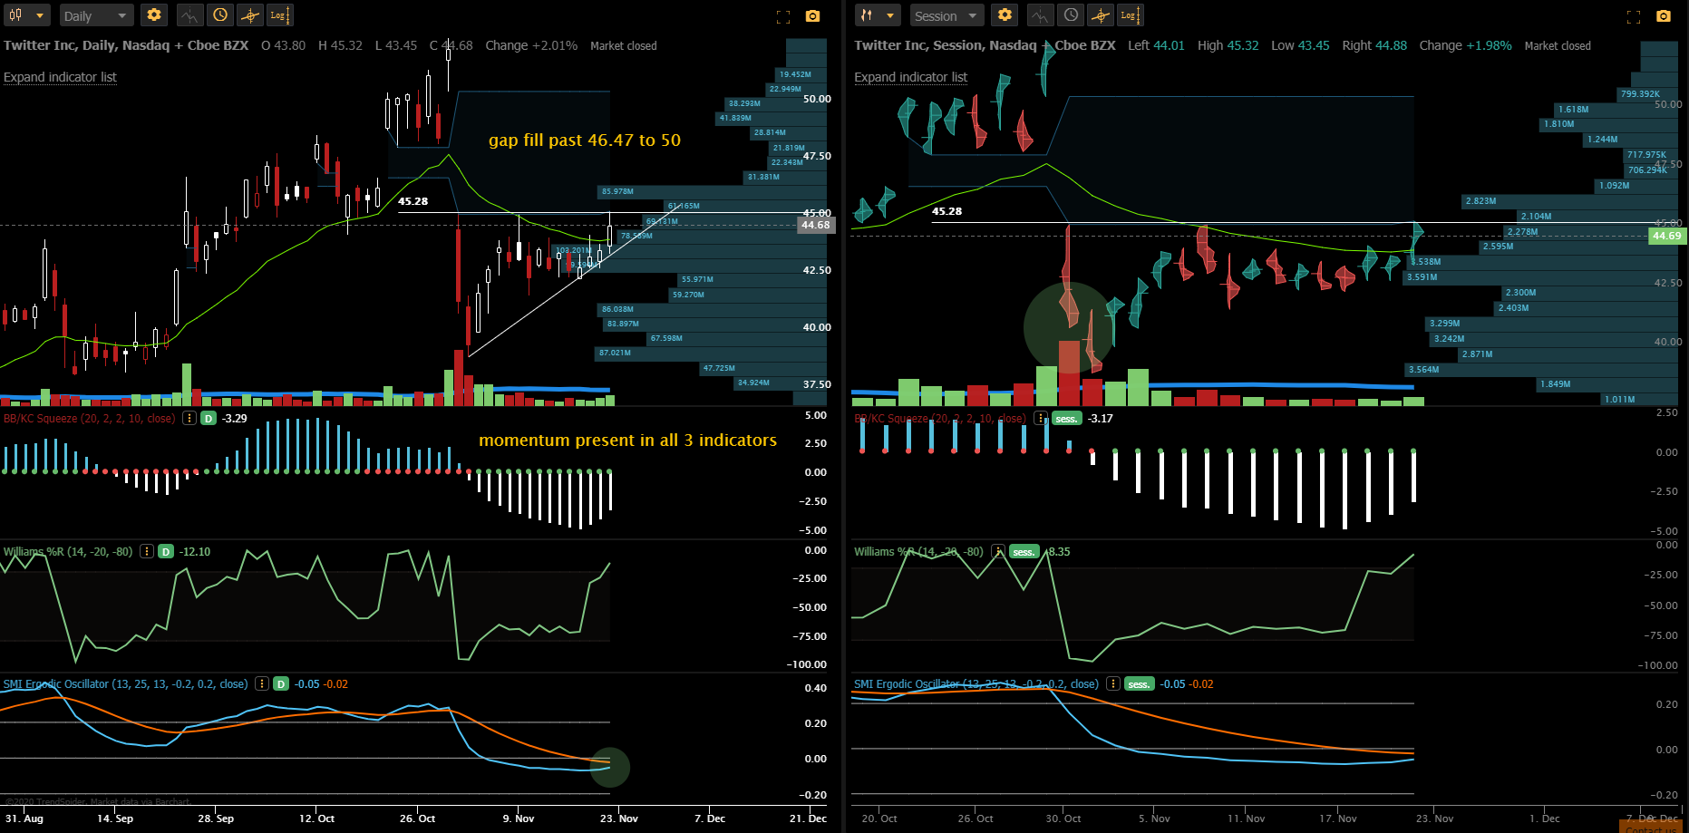
$TWTR: kc/squeeze + Williams% indicating momentum to the upside with the smi oscillator turning
Uptrend ascending triangle remains intact with volume increasing (still below average), 45.28 is the current resistance
Gap fill if we are able to push past 46.47 with strong volume (likely), 50 is the target +/- 1 std dev

Slide 8
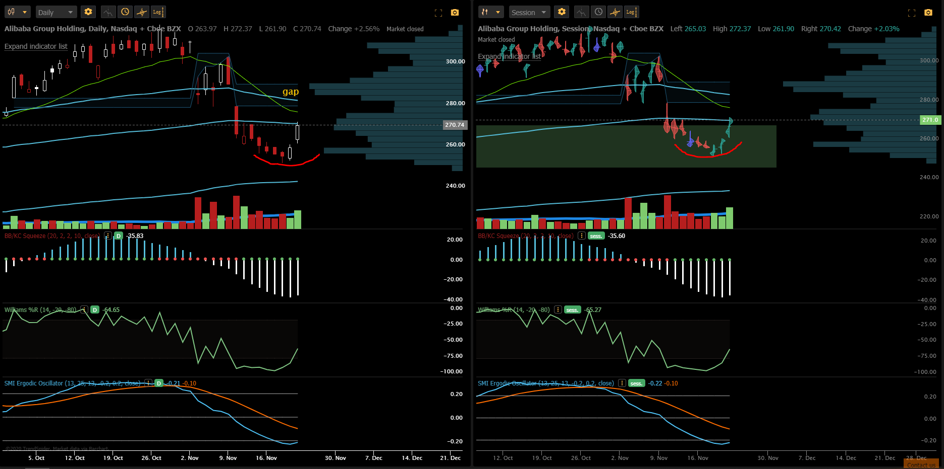
(BABA) rounded bottom on the daily, confirmation seen with larger than average volume on the last session, indicators pointing towards higher momentum; expecting volume to pick up as 300 is the target for most, notice we tagged the anchored vwap at 271 with the average volume profiled around 270-271 in the 2nd half of the session (price always moved back to 270-271); 280 is the next target if 271 is taken out with volume, 290 is a gap fill if 280 sees more interest from buyers after profit taking at 280 +/- 1 std dev

Slide 9
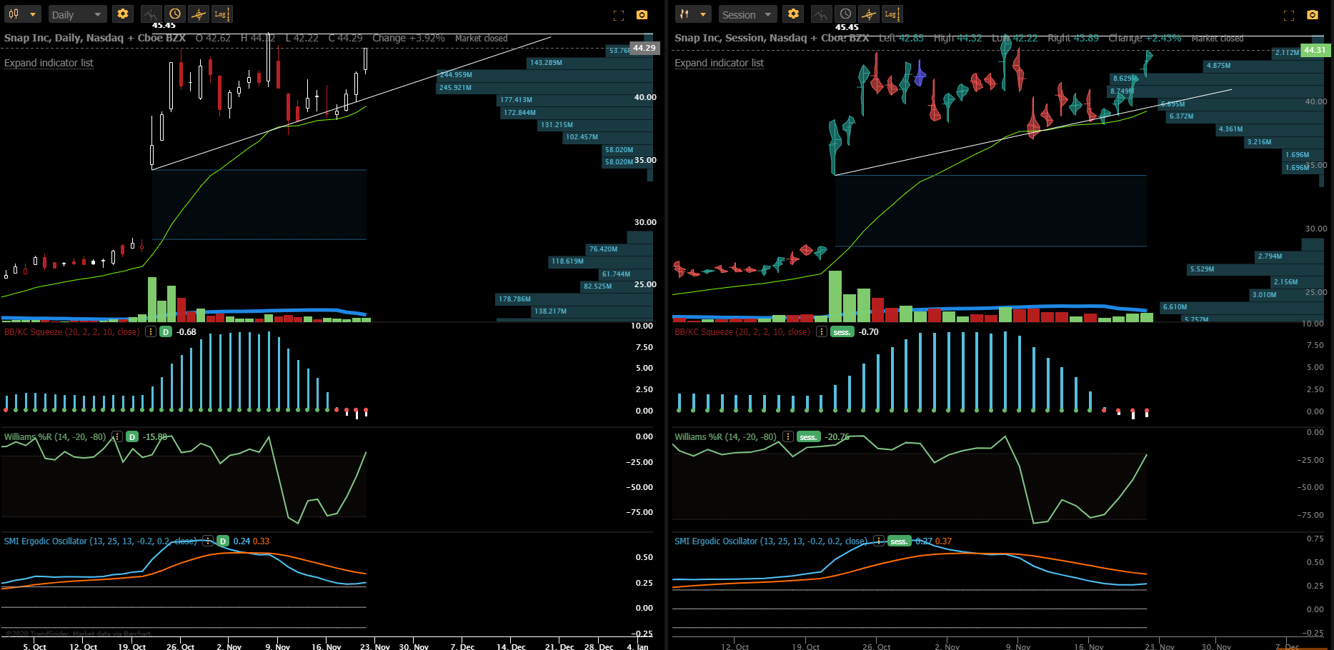
$SNAP: volume overall light, raindrop on the session indicative of strong buying in the past 4 trading sessions, KC/squeeze looking to squeeze higher, I expect a 45-retest going into next week with the likelihood of seeing 50 in the next 1-2 weeks now 44.29
Last trading session (raindrop) shows average volume profile aggregated above the volume shelf at 44, adding to thesis of likelihood of a strong move up next week

Slide 10
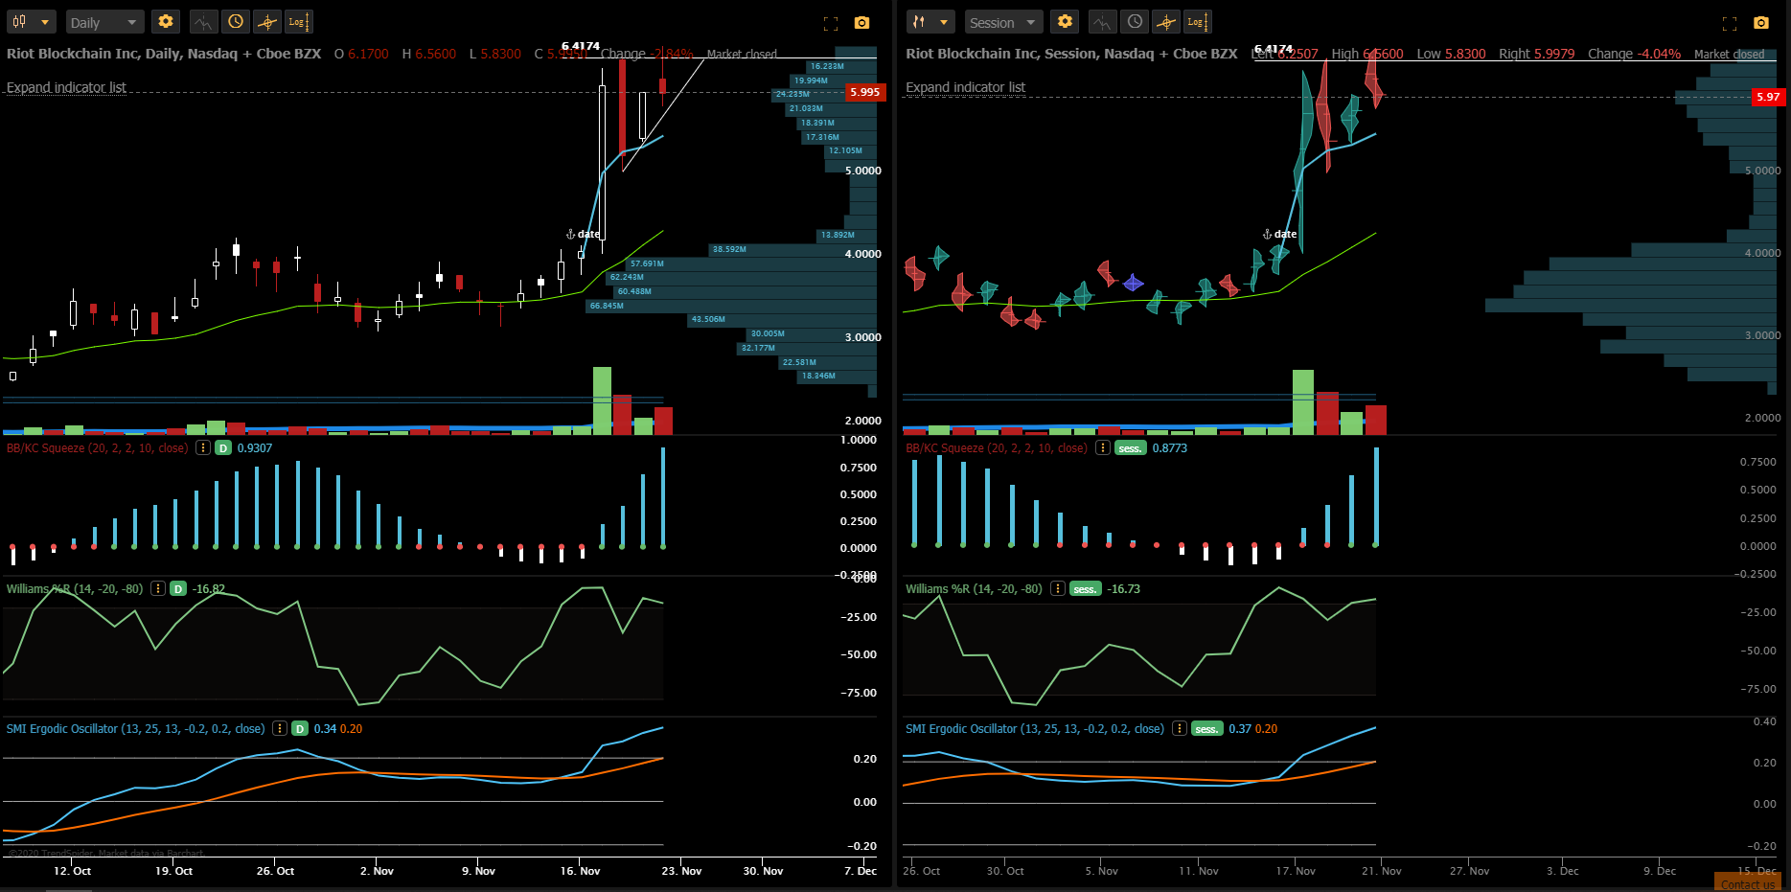
$RIOT: above average volume traded in the last session with more selling than buying pressure, 5.40 is the next area of interest for buyers if we fall below the upper trend support now 5.996; lots of eyes on this name with BTC rallying towards new highs and cash flowing into ETH and other alts as they lag behind BTC, I expect riot to do the same as they have highs of 46 when BTC ripped higher 3 years ago;
Shares and January 7c are my positions, this ticker serves as more of a medium-long term investment

Slide 11
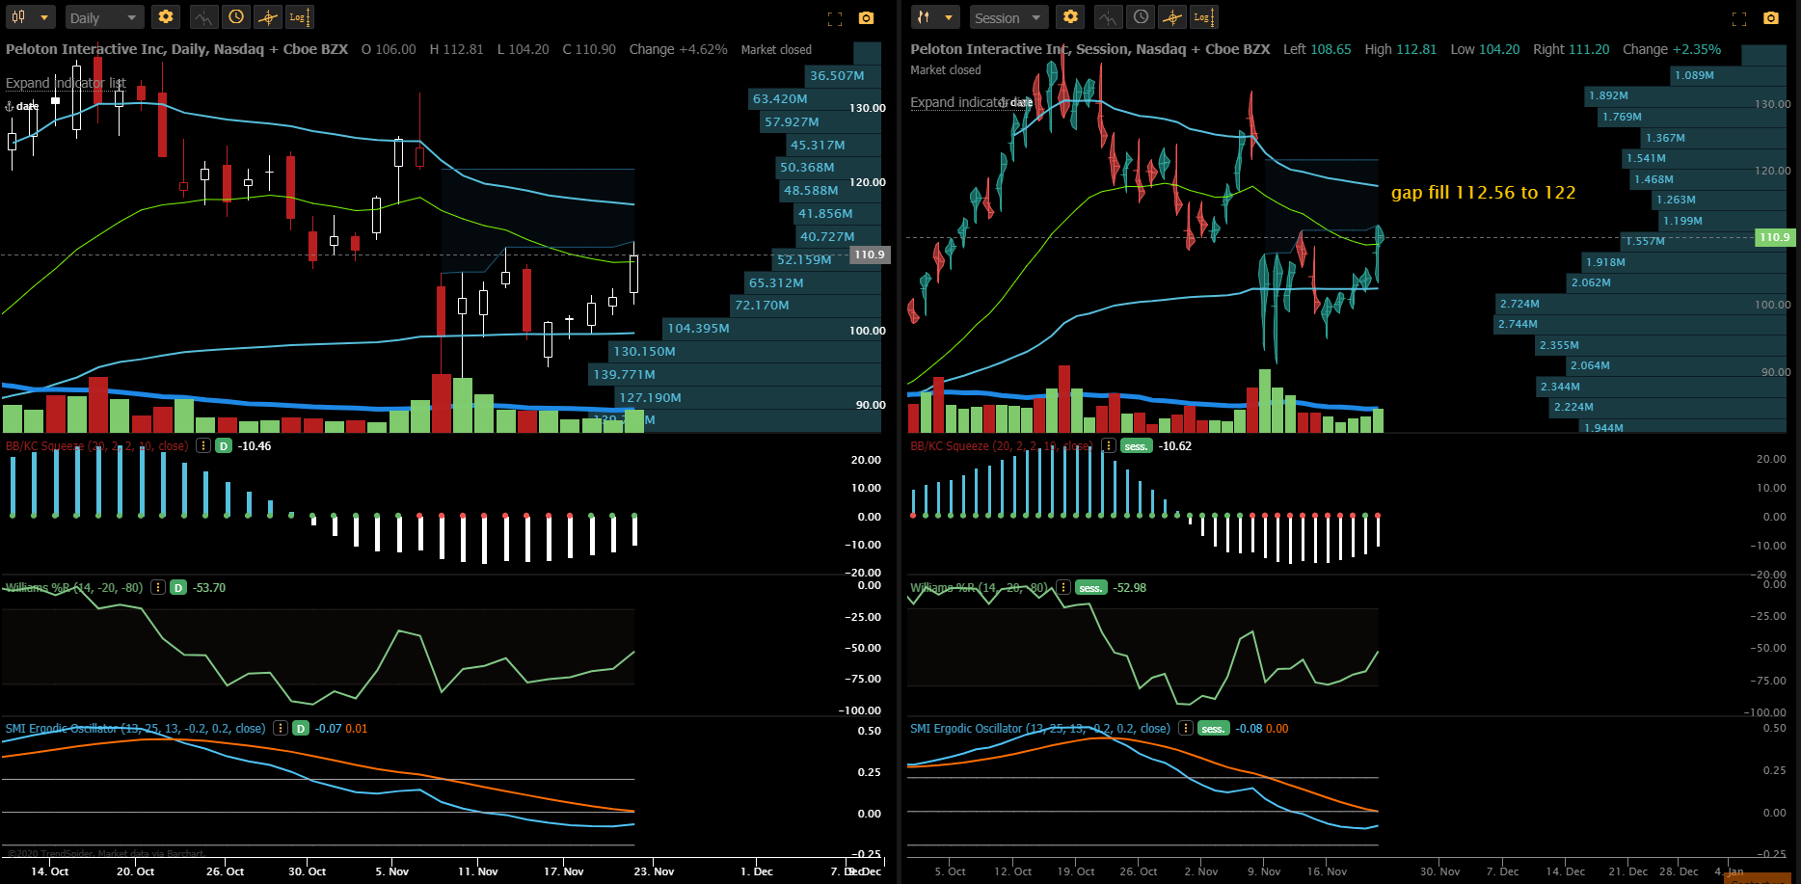
$PTON: big gap higher seen by the increase in volume with the second half of the volume traded between the 20ema and 113 (right below a gap fill to 122)
I expect this momentum to carry into next week with a gap fill to the 120 or 122 with profit taking seen at these areas with the price settling down to 118 or 120 as support for a leg higher to 125 and 127 (127 serves as a next major area of resistance)

Slide 12
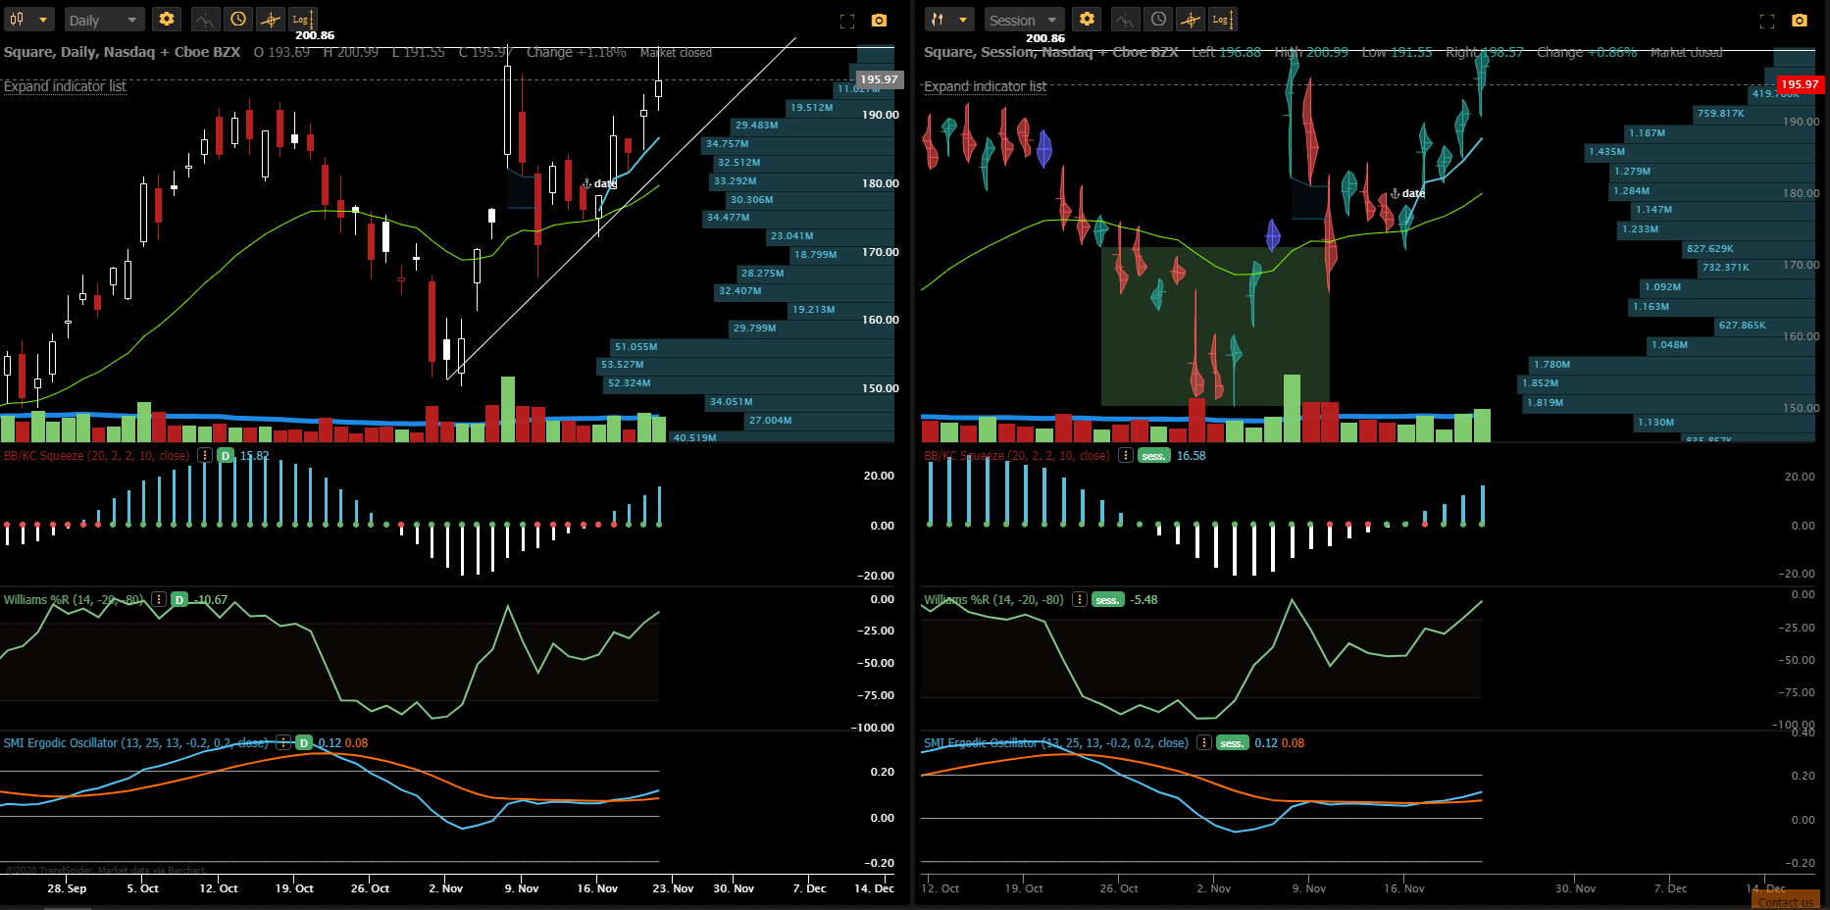
$SQ: Positive momentum continues on the William% with the SMI oscillator consolidating neutrally upwards (i.e gaining energy for big move); session from last Friday on the raindrop shows majority of volume aggregated along the 195-196 region; saw a brief break out of 200 but not enough buyers to support the price now 195.97, volume traded on the daily was also lower than previous day; upward trend remains in-tact, crypto hype behind SQ and PYPL should fuel the leg higher; pay attention to the volume for the break past 200

