Slide 1
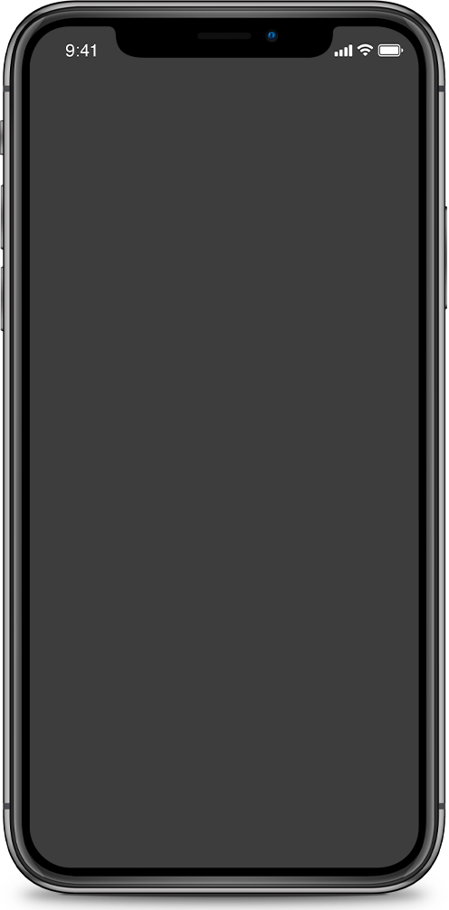
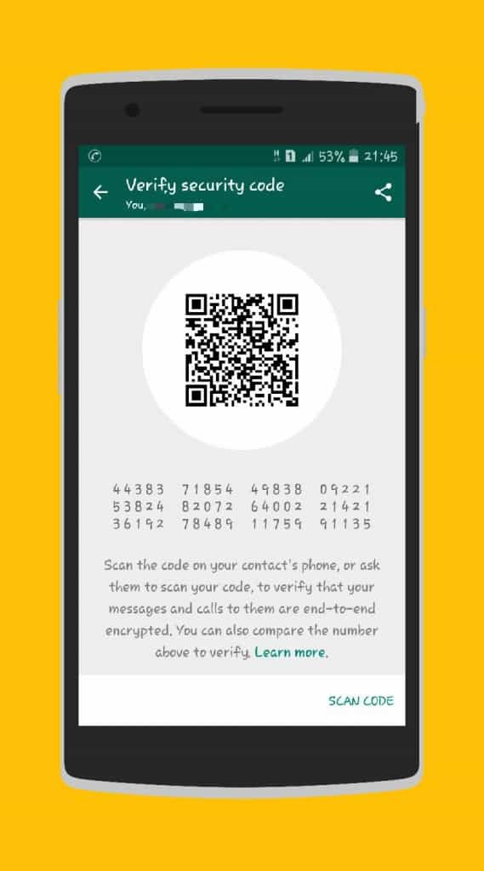
WhatsKey-Trasparency
La crittografia dietro l’app di messagistica più famosa al mondo
Salvatore Bianco, mat. 189353 , Crittografia Applicata 2024

Slide 2
Index
ARGUMENTS:
Overview
Infrastructure
Auditable
Demo

Slide 3
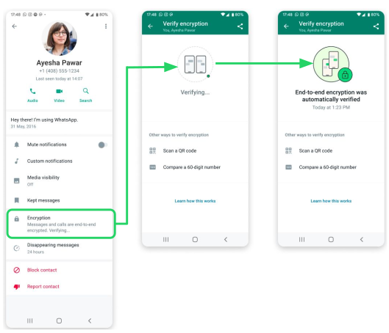
New cryptographic security feature

Slide 4
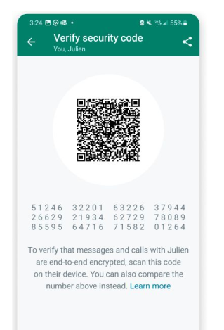
How did it work?
How does it work?
Physically verification
Automatic validation of public keys

Slide 5
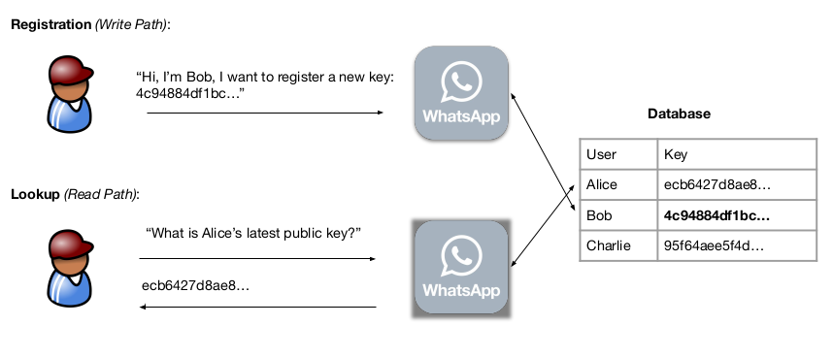
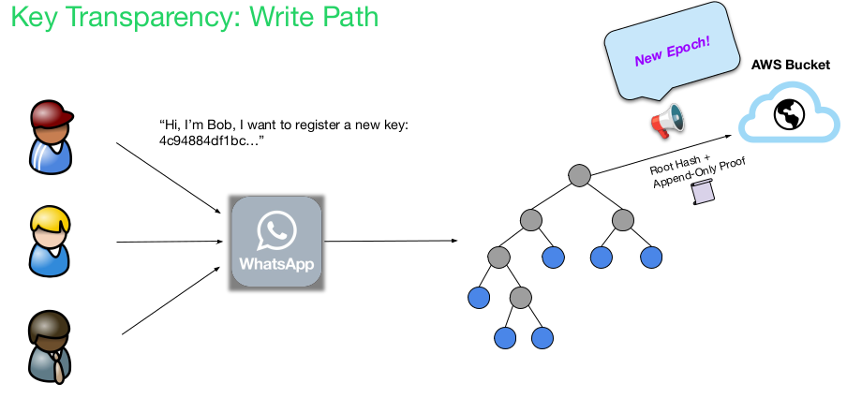
How did it work vs How does it work
vs

Slide 6
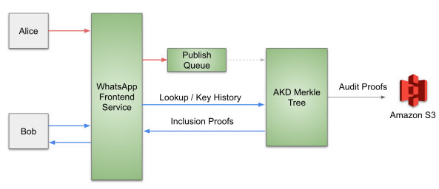
INFRASTRUCTURE
Registration
Pubkey-Curve25519
Lookup

Slide 7
More details
Client Registration
Merkle tree
Hash function Blake3
VRF
Epoch
Device Removal

Slide 8
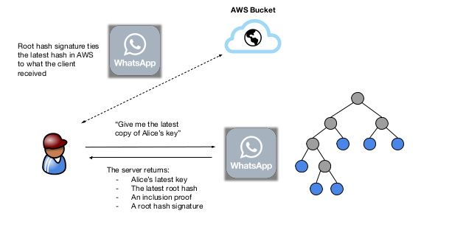

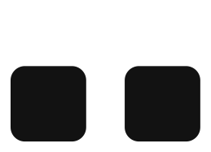
How does lookup work?
Lookup Requests
Client
Server

Slide 9


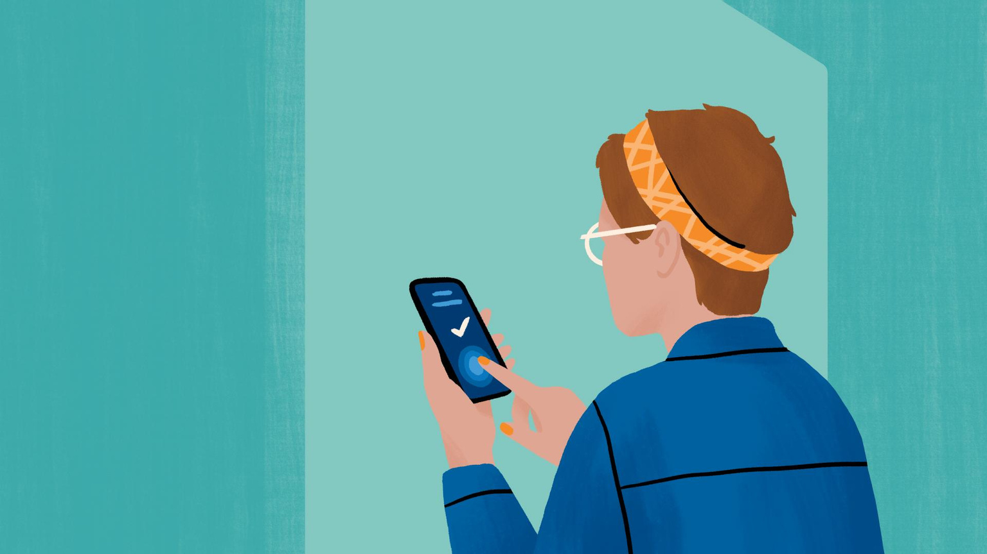
Auditing

Slide 10
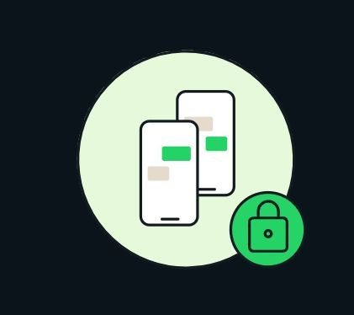
AUDIT AND FUTURE GOAL
01
Audit
Proof
AKD
02
Future goal
Consistent root hash distribution
Key history check

Slide 11
AKD
Auditable key directory
META AKD
PUBLISHING
Lookup proofs
History proofs
Append only proofs

Slide 12

DEMO TIME!
Language : Rust
Crate: Meta Akd
xerox0/ WhatsKey-Transparency

Slide 13
References
1.WhatsApp Encryption Overview - technical white paper
https://www.whatsapp.com/security/WhatsApp-Security-Whitepaper.pdf
2.About end-to-end encryption - Help center article
https://faq.whatsapp.com/820124435853543
3.About security-code change notifications - Help center article
https://faq.whatsapp.com/1524220618005378
4.Auditable key directory (AKD) implementation
https://github.com/facebook/akd

Slide 14
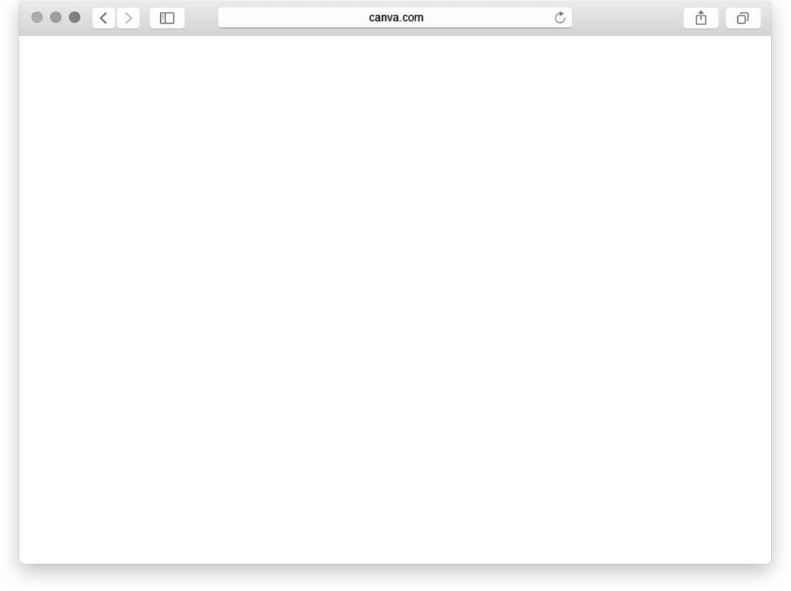
Questions?
Just ask! I hope you have learned something new..

