Slide 1

Singapore's Quest for Solar Panel Adoption and Sustainability

Slide 2

Singapore's Green Plan 2030 & Solar Energy Initiatives
Singapore is advancing towards net-zero emissions by 2050 as part of the Paris Agreement.
The Singapore Green Plan 2030 includes the installation of solar panels on HDB rooftops and floating photovoltaic farms.
Adoption of solar energy is vital to meet UNSDG Goals 4, 7, 11, and the nation's sustainable ambitions.

Slide 3

Barriers and Benefits to Solar Energy Adoption
Cost remains a significant barrier, with solar plans more expensive than regular electricity options.
Perceived individual benefits include reduced utility bills and increased property value with solar investments.
Shared ownership models like community solar in the US offer a flexible way to invest in off-site solar energy.

Slide 4
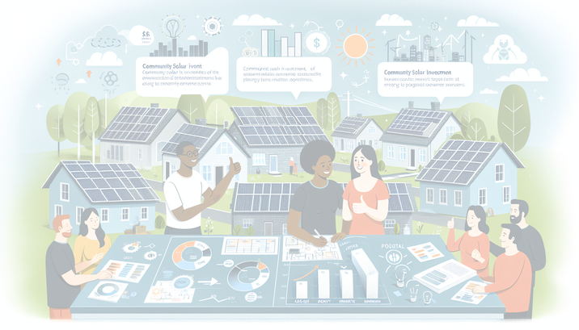
Proposed Solution: Community Solar Investment Scheme
A community solar model adapted for Singapore could drive widespread solar panel investment.
Potential to develop floating solar farms on reservoirs and at sea to utilize unused space.
Citizens can invest in solar panels with a ballot system, enjoying reduced electricity bills upon project completion.

Slide 5

Market Research Results: Strong Interest in Renewable Energy
Survey indicates 80% interest in renewable energy among Singaporeans.
Despite interest, 98% are unwilling to switch to a solar plan, mainly due to cost concerns.
93% showed interest in off-site solar projects, indicating a market demand for investment-driven solutions.

Slide 6

Impact on Sustainable Development Goals & Economy
Adopting community solar contributes to SDG Goals 7 (Affordable and Clean Energy) and 11 (Sustainable Cities).
Economic boost expected from increased solar investments and job creation in the solar energy sector.
Proposed solution tackles multiple SDGs, aiding Singapore's transition to a sustainable and low-carbon economy.

Slide 7

Challenges and Outlook for Solar Panel Investment
Limitations include scalability of solar energy deployments and sufficient benefits for individual investors.
Further development of solar technology and infrastructure is crucial to meet the growing demand.
Strategic initiatives and shared responsibility are key to achieving Singapore's sustainability goals by 2050.

