Slide 1
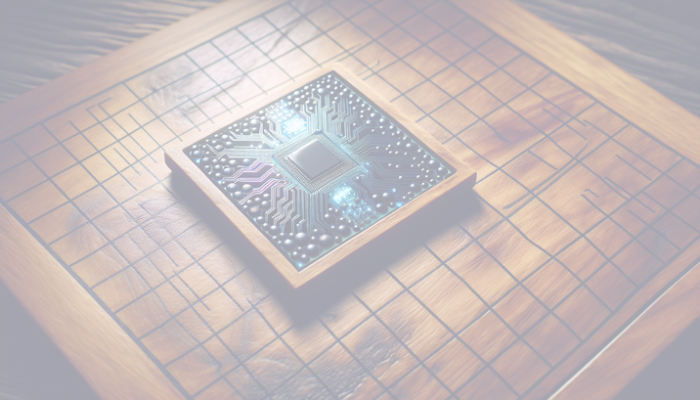
Unveiling AlphaGo: The AI Revolution in the Ancient Game of Go

Slide 2
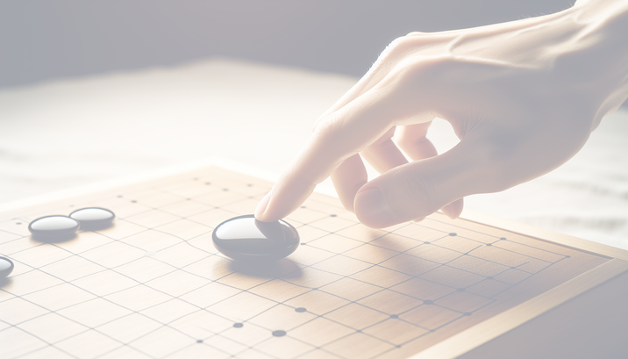
Understanding the Intricacies of Go
Go: A 2500-year-old board game of intense strategy and profound complexity.
Simple rules with deep tactical play make Go a grand challenge for AI.
An immense tree of possibilities: over 10^170 possible board configurations.

Slide 3
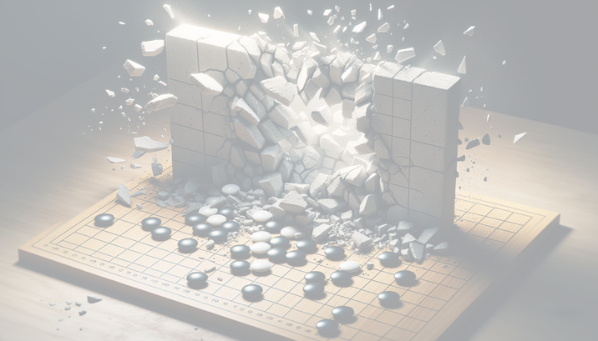
Breaking Barriers in Computer Go
Traditional AI approaches: ineffective against the subtlety of Go.
The shift from hard-coded heuristics to adaptive neural networks.
AlphaGo's leap: Machine learning replaces static rules.

Slide 4
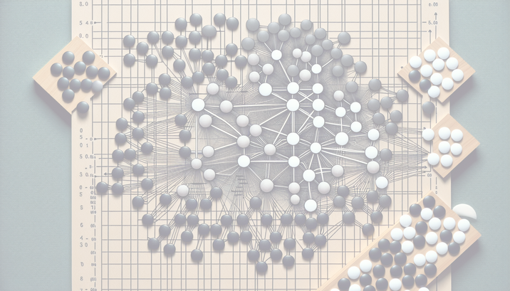
AlphaGo's Neural Network Mastery
Policy Network predicts moves by mimicking professional players.
Value Network assesses board positions to calculate winning odds.
Self-improvement through reinforcement learning and self-play.

Slide 5
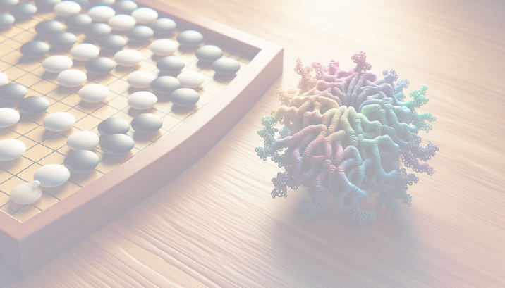
Advancing Beyond the Game
AlphaGo's victory: A symbol of AI's potential beyond gaming.
DeepMind's AlphaFold: Transforming medical science with AI protein folding.
AI's capacity for real-time, intelligent, and creative data analysis.

Slide 6
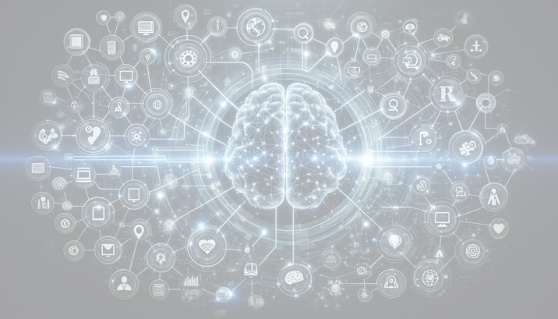
The Future of AI: Generalization and Real-world Application
General AI promises solutions to messy, complex real-world problems.
AlphaGo and AlphaFold: Pioneers in creative problem-solving with AI.
Embracing AI's potential for innovative approaches in various domains.

