Slide 1

HACKATHON 2K19
TECHNICAL PIRATES:
1.HIMANSHU SOMANI
2.HARSH AGRAWAL
3.VIVEK KUMAR JAIN
4.KAVISH GUPTA
5.DEVENDRA SHARMA

Slide 2
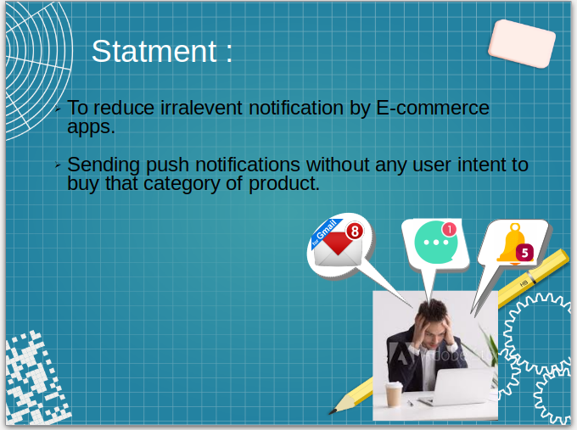
PROBLEM STATEMENT:

Slide 3

Basic Architecture To Represent The Approach
PUSH NOTIFICATIONS DOESN’T POP FOR USER
(SEND IN A PARTICULAR
TIME DURATION)
E-COMMERCE
CLUSTER
-VE RESPONSE
UPDATION IN
PARTICULAR APP
CLIENT
RESPONSE
+VE RESPONSE
PUSH NOTIFICATIONS POPS ON A REGULAR BASIS
NOTIFICATION POPS ACC. TO DATABASE
GENERATES A PUSH NOTIFICATION
DATABASE REGARDING TO
THE CLIENT ACTIVITIES

Slide 4
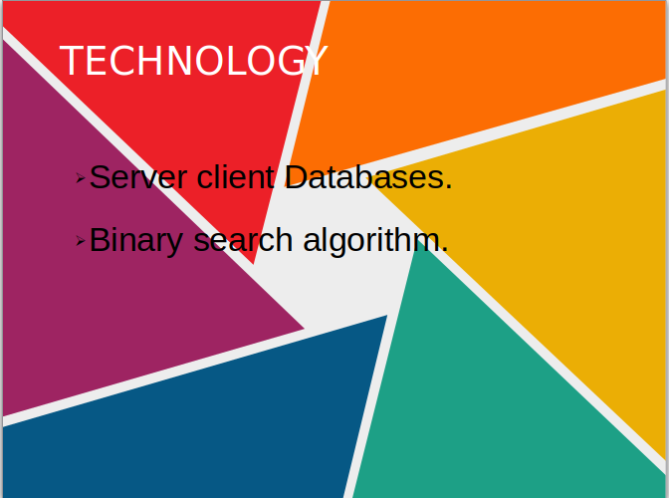

Slide 5

OTHERS
Analysing the database activities for a particular client who is been a frequent user.
categorising the notifications on the basis of user activities based upon an alternative option of creating button( i. e : duration).

