Slide 1


Aerodynamic Shell
CFD Analysis
Xerxes Chong

Slide 2
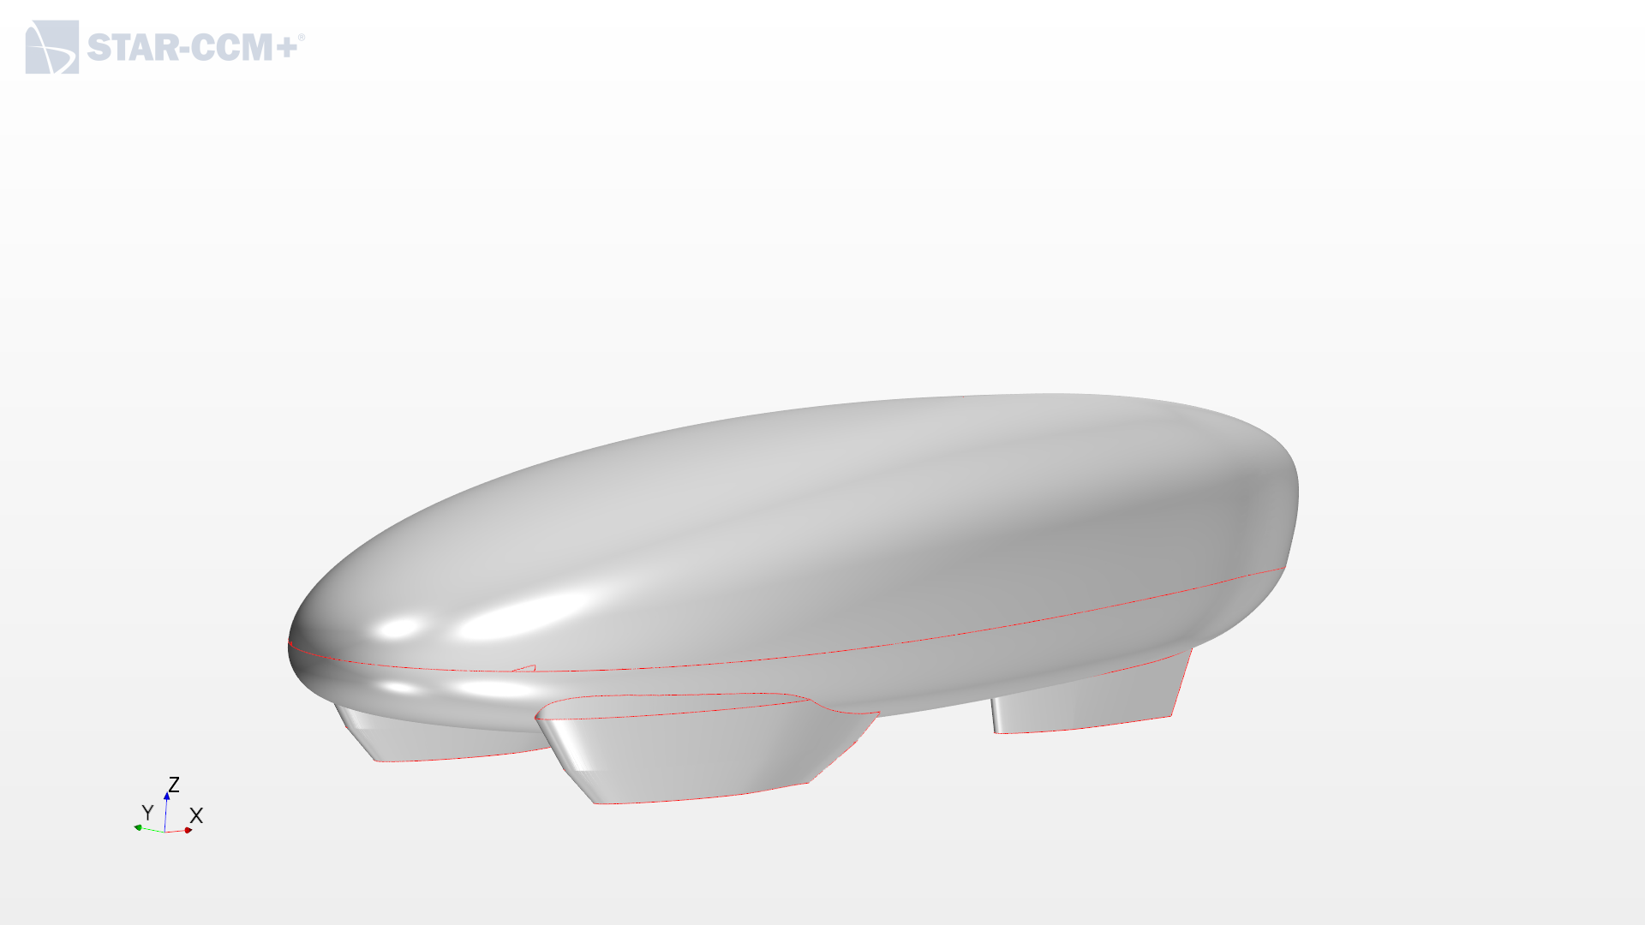
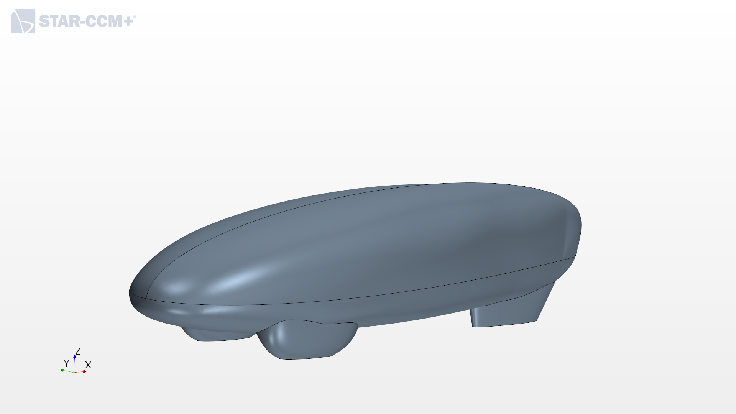
IRG 2021 Simulation : A Comparative Study
AERO20
IRG21

Slide 3
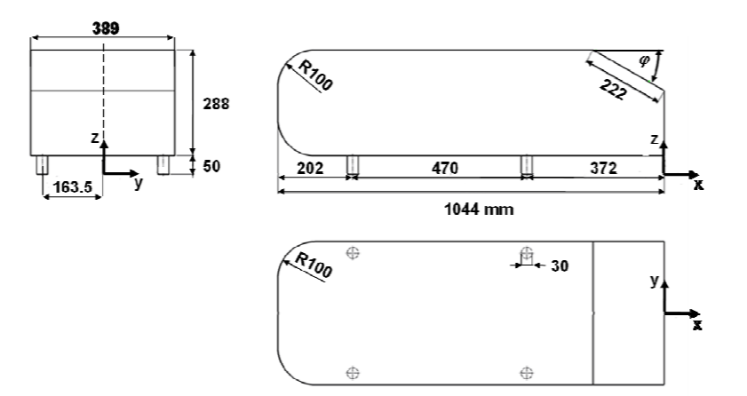
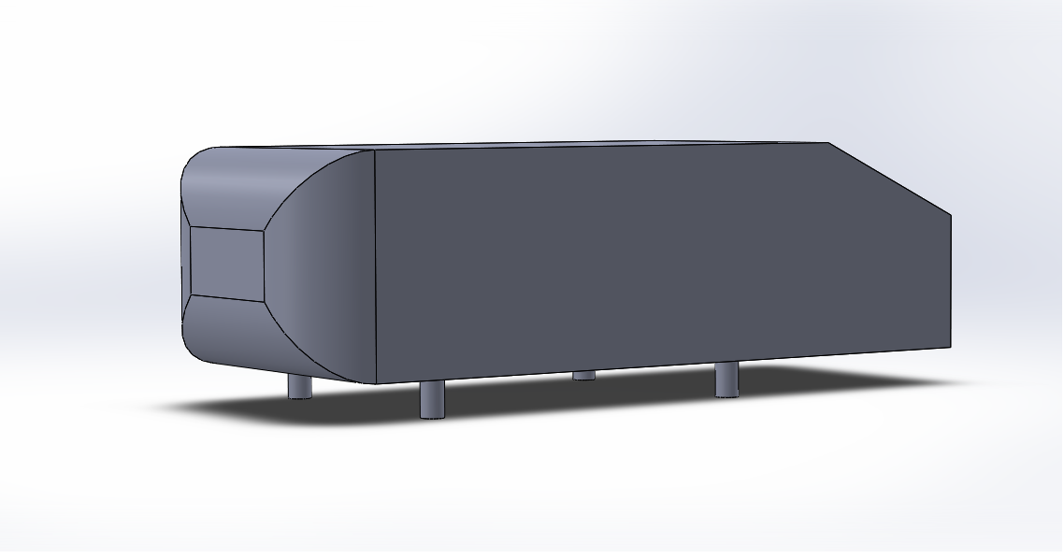
IRG 2021 Simulation : Validation of CFD settings using Ahmed Body
Ahmed Body
Need For Validation
CFD settings need to be validated to ensure simulation results are representative of real world aerodynamic characteristics
Ahmed Body is a well researched, industry standard geometry that captures the essential bluff body flow features i.e. the angled rear produces a wake and the inclusion of stilts creates an underbody flow
CFD results compared against literature

Slide 4
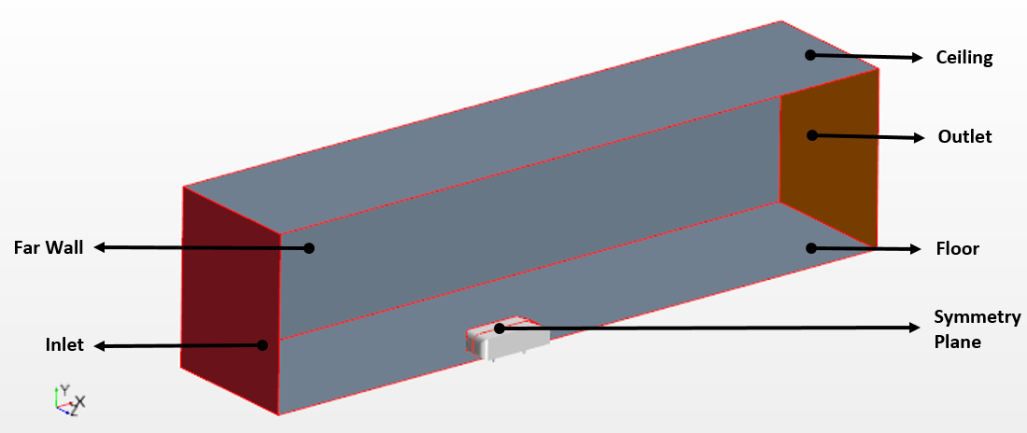
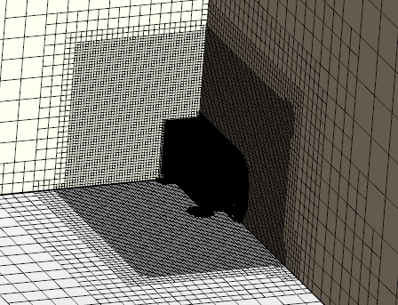
IRG 2021 Simulation : Validation of CFD settings using Ahmed Body
Computational Domain
Further Refinement

Slide 5
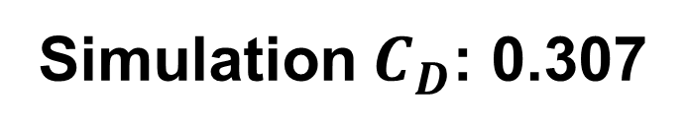

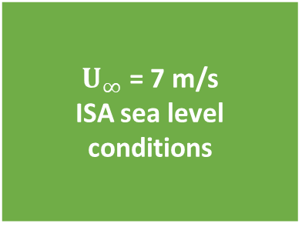
IRG 2021 Simulation : Validating Settings
Physics Settings
Governing Equation | Turbulence Model | Time | Solver | Wall Treatment | Reynolds No.
Constant Density RANS | K-Omega SST | Steady State | Segregated | All Y+ | 1.64 million
Flow Settings
$U_{∞}$ = 7 m/s ISA sea level conditions
Empirical $C_{D}$: 0.316
2.8% underprediction
Simulation $C_{D}$: 0.307

Slide 6
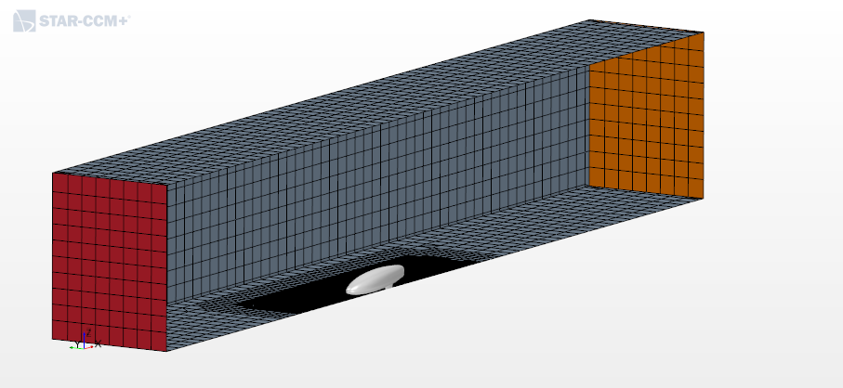
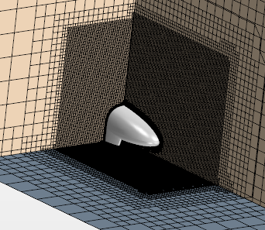
IRG 2021 Simulation : Setup
Similar set up methodology to Validation Case

Slide 7
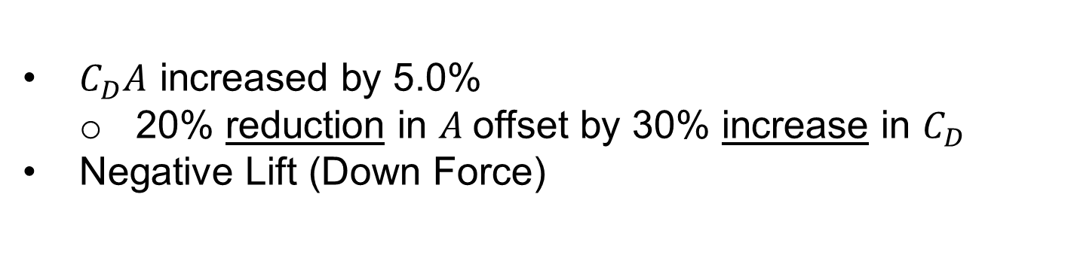
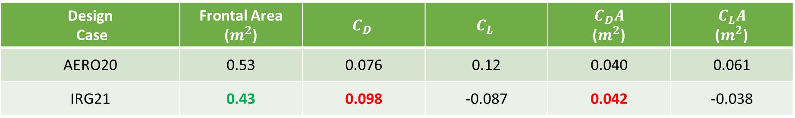
IRG 2021 Simulation : Results
Design Case | Frontal Area ($m^{2}$) | $$C_{D}$$ | $$C_{L}$$ | $$C_{D}A$$ ($m^{2}$) | $$C_{L}A$$ ($m^{2}$)
AERO20 | 0.53 | 0.076 | 0.12 | 0.040 | 0.061
IRG21 | 0.43 | 0.098 | -0.087 | 0.042 | -0.038
$C_{D}A$ increased by 5.0%
20% reduction in $A$offset by 30% increase in $C_{D}$
Negative Lift (Down Force)

Slide 8
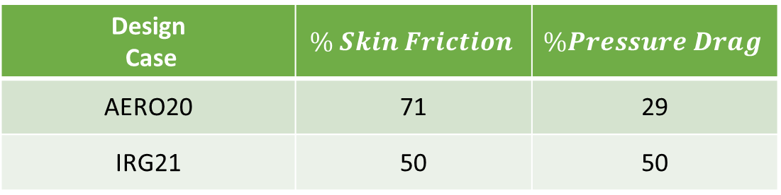
IRG 2021 Simulation : Investigating Drag
Design Case | $$\% Skin Friction$$ | $$\%Pressure Drag$$
AERO20 | 71 | 29
IRG21 | 50 | 50
Further inspecting the components of drag, the increase in drag for IRG21 arises from the higher contribution of pressure drag to the overall drag
The order of magnitude of skin friction is lower than that of pressure drag
Streamline objects eg. aero foils, the shapes of fishes, have negligible flow separation and hence only have skin friction (shear stresses) significantly impeding their motion
Bluff objects eg. cars, cubes, spheres, due to the sharper changes in geometry, are more likely to experience flow separation and form a wake
Low pressures (relative to the forward stagnation point) of the wake contributes to the increase in pressure drag

Slide 9
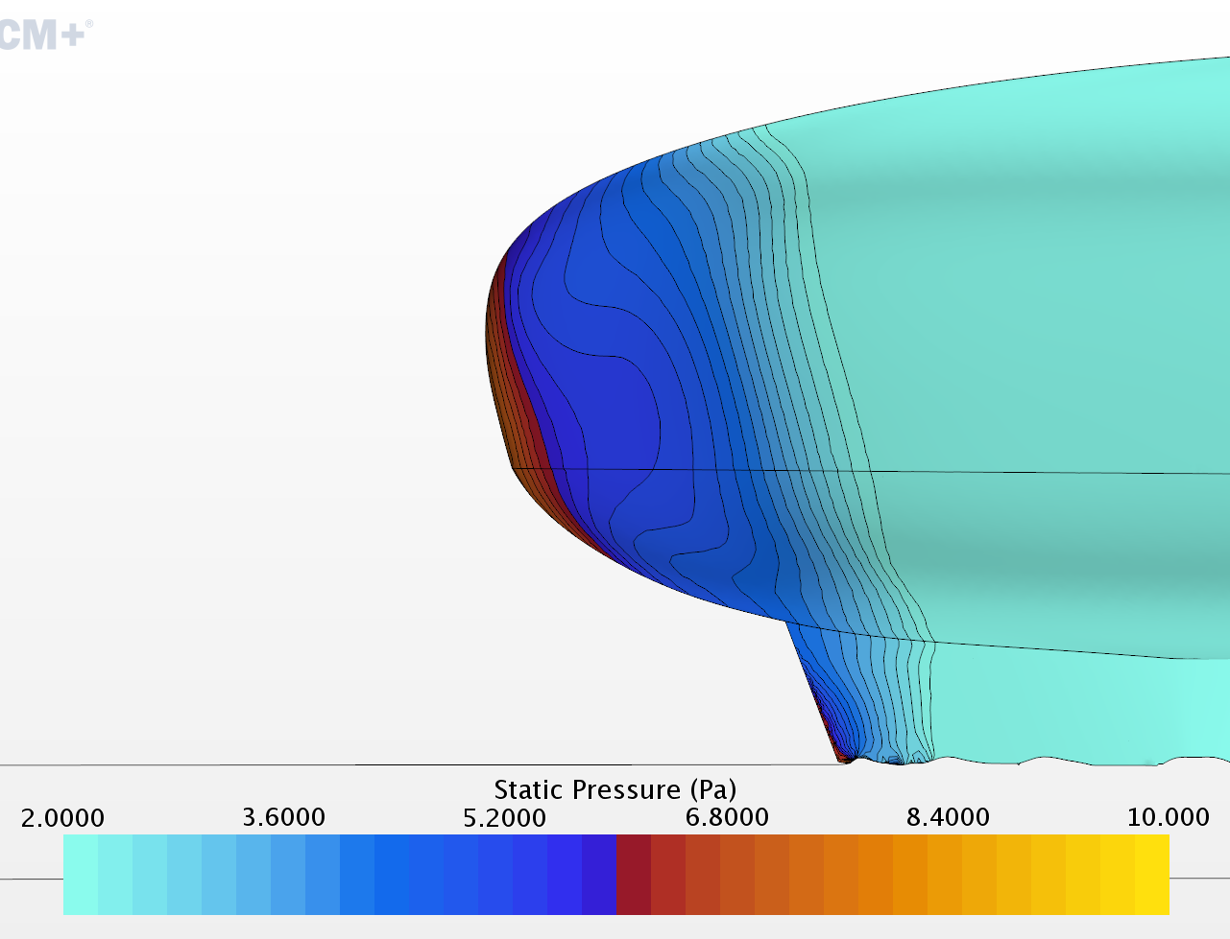
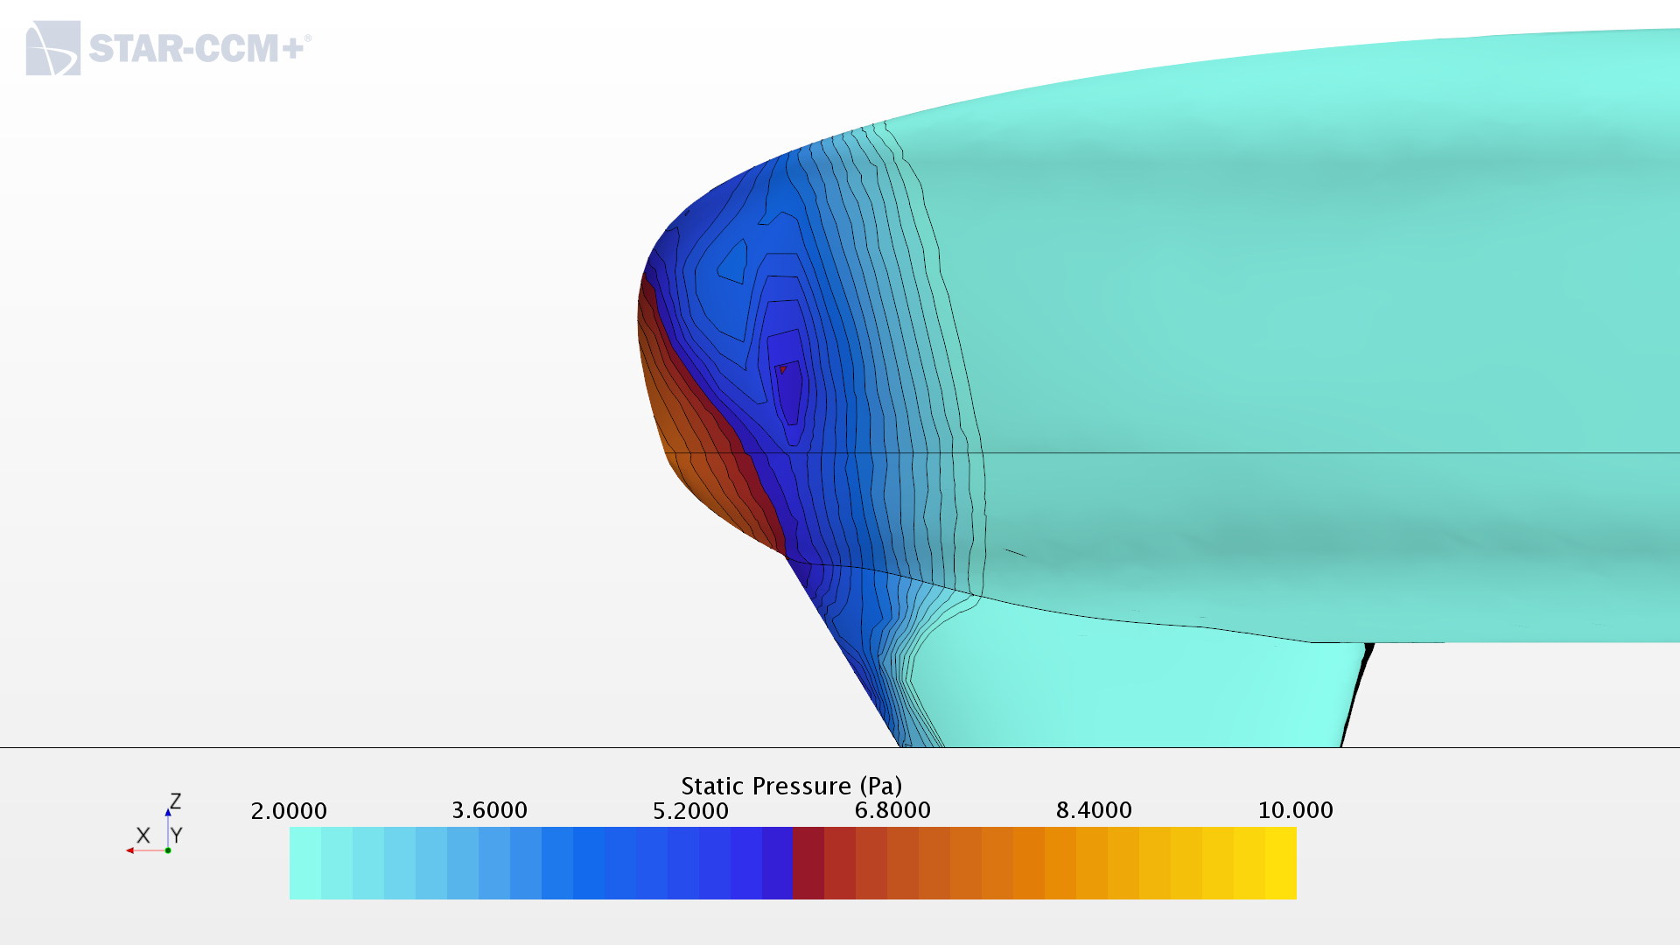
IRG 2021 Simulation : Investigating Drag
AERO20
IRG21

Slide 10
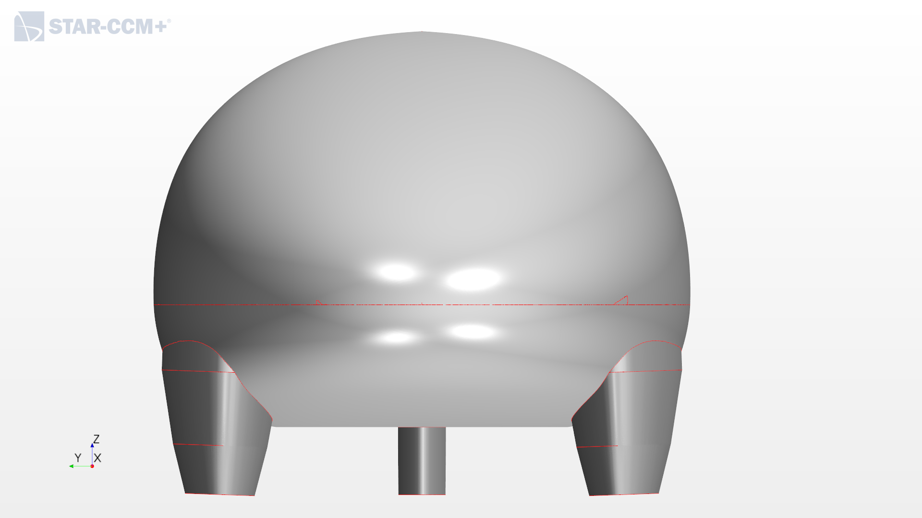
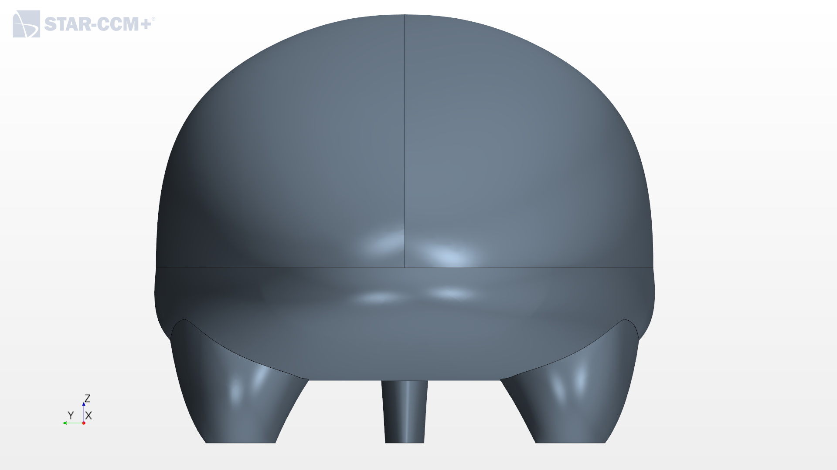
IRG 2021 Simulation : Investigating Lift
The change from positive lift to negative lift can be explained by the lower pressure beneath the vehicle between IRG21 and AERO20
The region of lower pressure coincides with the “tightest” point beneath the car.
The cross-sectional area seems to have decreased
By the conservation of mass, the flow velocity increases and results in a region of lower pressure beneath the car
This is illustrated by planar sections of the flow velocity magnitude and the distribution of static pressure on the bottom of the vehicles in the following slides
AERO20
IRG21

Slide 11
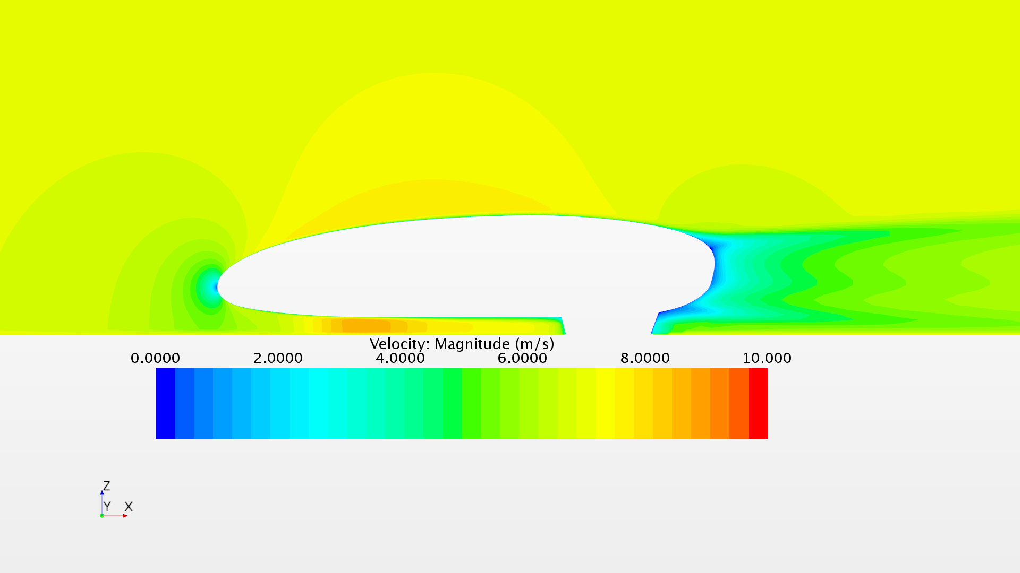
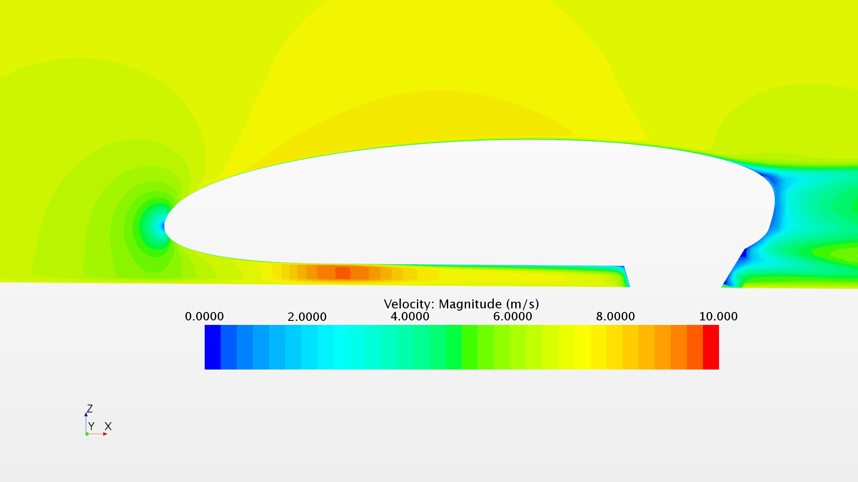
IRG 2021 Simulation : Investigating Lift
IRG21
AERO20

Slide 12
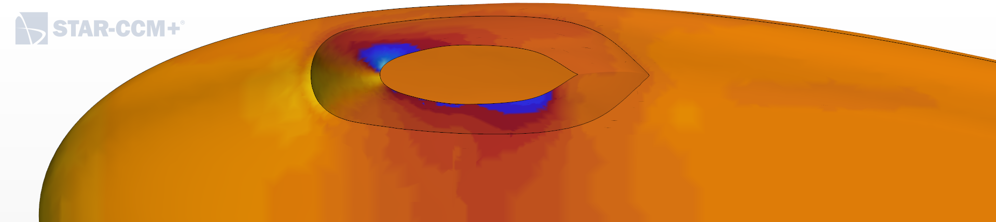
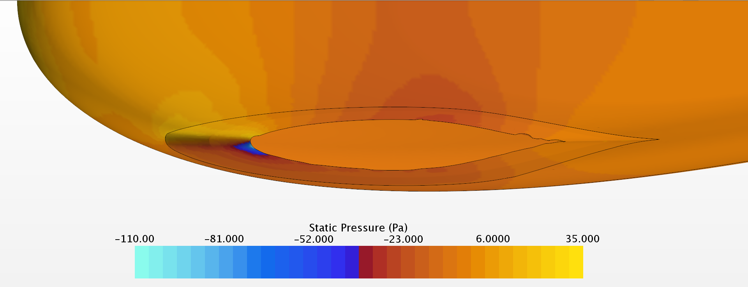
IRG 2021 Simulation : Investigating Lift
While not immediately obvious, there is a region of lower static pressure under IRG21 as compared to AERO20
An increase in down force will result in an increase in rolling resistance.
Location of low pressure also tilts the aero balance forwards, increasing the chances of oversteer
IRG21
AERO20

Slide 13
IRG 2021 Simulation: Suggested Improvements
Work on shaping vehicle rear and rear fairing
Consider decreasing angle of rear fairing relative to the flow
Reduce cross sectional area of fairings (as seen from the rear)
Maximize vehicle length to provide gentler change in rear geometry
Investigate the need for negative/positive lift
Consult the vehicle dynamics team
Recommended to maintain the slight negative lift for stability due to reduced track
Weigh importance of handling a few corners well vs an increase in rolling resistance

Slide 14
Thank you

