Slide 1

PROJECT REPORT ON :
Intel Products Sentiment Analysis from Online Reviews
BY :
Harshita Patnaik
Alok Gupta
Riya Kumari Tarwey
Saswat Brahma

Slide 2

The products refferred for extracting the reviews are :
1. Intel® Core ™ desktop processors (14th gen)
2. 12th Gen Intel® Core ™ desktop processors
The various tools under this project are :
● Web scraping - BeautifulSoup
- pandas, requests
● Sentiment analysis - seaborn, pandas, numpy, matplotlib, nltk
The following is the link to the code used for sentimental analysis :
https://colab.research.google.com/drive/1Qx9x1OyVeLSgfOaAHV4rLDy7BqDuxNxh?usp=sharing

Slide 3
GitHub Repository Link:
https://github.com/Hershy23/Sentiment_Analysis
APPROACH:
At first we had to get a dataset, for which we had to extract data from the websites using web scraping. Many websites did not allow web scraping. So we tried to scrap data from Amazon and Flipkart on proper interval of time.
After scraping the reviews, we had to clean the data and combine the data into one dataset.
After getting the cleaned dataset, we used the dataset to train a pre-exsisting model.
Then we got the final results.

Slide 4
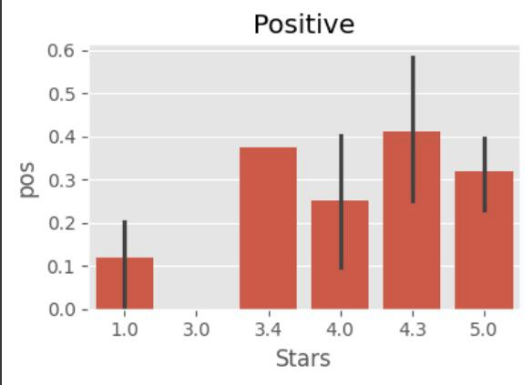
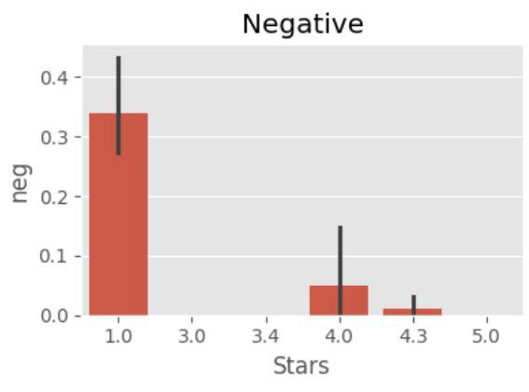
RESULTS :

Slide 5
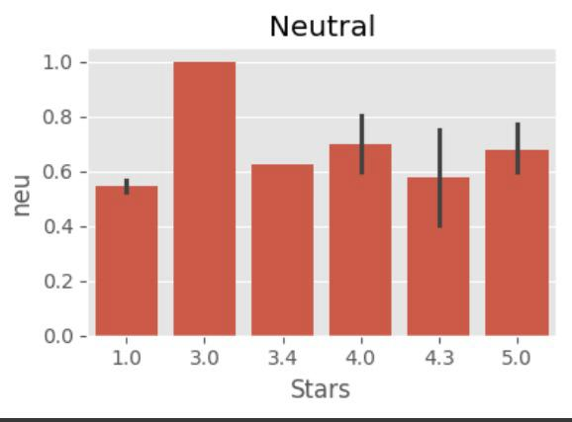
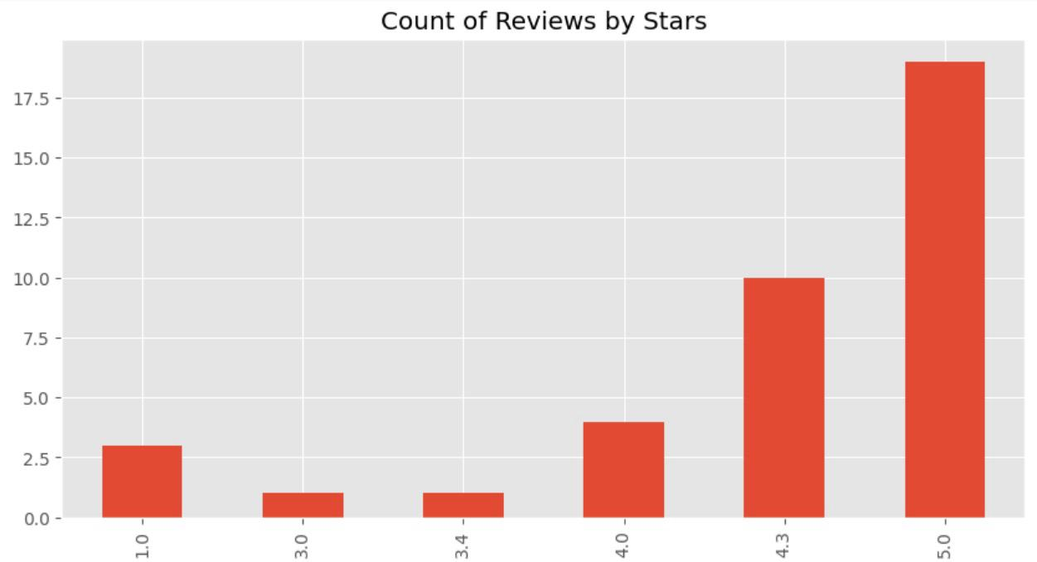

Slide 6
CONTRIBUTION:
HARSHITA PATNAIK:
web scraping, data cleaning
RIYA KUMARI:
web scraping
ALOK GUPTA:
sentiment analysis model training
SASWAT BHRAMA:
sentiment analysis model training

