Slide 1


Prompt Design and Answer Processing for Knowledge Base Construction from Pre-trained Language Models
Xiao Fang, Alex Kalinowski, Haoran Zhao, Ziao You, Yuhao Zhang, Yuan An
College of Computing and Informatics, Drexel University

Slide 2
Catalog
1. Introduction
2. Prompt Design
3. Answer Processing
4. Inspiration
Catalog

Slide 3
Introduction - How we solve the challenge
1. handle relation separately
2. Prompt Design: indirect design, multi-layer Q&A structure
3. Answer Processing: vocabulary filter, restrict answer space
BERT
Relation 1
Prompt 1
...
Relation 2
Prompt 2
...
Relation 3
Prompt 3
...
...
Abstract

Slide 4

Prompt Design - Indirect design
Direct design
Prompt: Is Nike a sport brand? [MASK].
What we want: [‘Yes’, ‘No’]
Indirect design
Prompt: Nike is a [MASK] brand.
What we want: P(sport)
Then use threshold to make classification
Prompt Design | 1

Slide 5
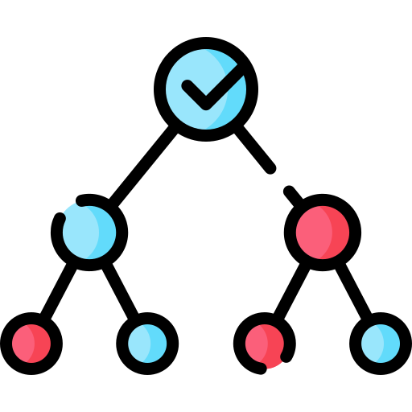
Prompt Design - Multi-layer Q&A structure
Single-layer Q&A structure
Q: X is dead in [MASK]. → What about [None]?
Multi-layer Q&A structure
Q1: Is X dead? [MASK].
Q1^ (indirect design): X is [MASK]. → F(P(dead), threshol)
if [dead]: Q2: X is dead in [MASK].
else: [None]
Prompt Design | 2

Slide 6

Answer Processing - Vocabulary filtering
Remove STOP words
Prompt: X is good at [MASK].
it, so, what, piano, music
Filter words that appear too frequently
Prompt: [A, B, C...X] is good at [MASK].
Count: {work: 10, music: 8, piano: 4, ...}
Result: {X: [piano, music...]} → {X: [piano...]}
Anwer Processing | 1

Slide 7
Answer Processing - Restrict answer space
Closed answer space
Using Glossary: C = {all the country names}
Prompt: X is born in [MASK]. → F(P(c)) | c ∈ C
Semi-closed answer space
Linguistic prefix/suffix filtering
S = {y[:4] for y in (all chemical element names)}
Prompt: Y has [MASK]. → F(P(s)) | s[:4] in S
More complex pattern filtering...
Anwer Processing | 2

Slide 8

Inspiration
Prior knowledge can effectively help answer engineering
Construct restricted answer space
Vocabulary, glossary, linguistic pattern filtering
Complex questions may require multi-prompt structures
One prompt only fits one relational question
But, one question may need multiple prompt to answer
Inspiration

Slide 9
Xiao Fang, Alex Kalinowski, Haoran Zhao, Ziao You, Yuhao Zhang, Yuan An
College of Computing and Informatics, Drexel University

