Slide 1
Ideas about Multimodal Report Mining
Mike Fang - Moberg Analytics - 22/11/28

Slide 2

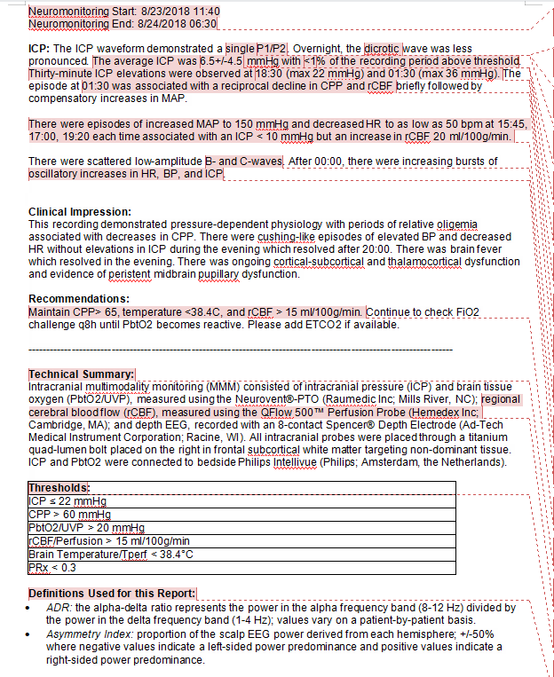
Unstructured
Although medical report documents have many important information, but neither read or write it is very time consuming. Plain text document is flat and unstructured, while using machine learning methods can help us automatically find structured data from it so that make it more straightforward.
Report document example

Slide 3

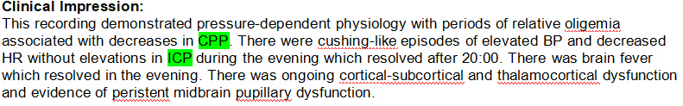
Structured
What could be the structure data?
For example, the creation timestamp, the importance level of each sentence, the corresponding medical entity for some words.
Creation timestamp
Key sentence in a paragraph
Some words with corresponding named medical entity

Slide 4
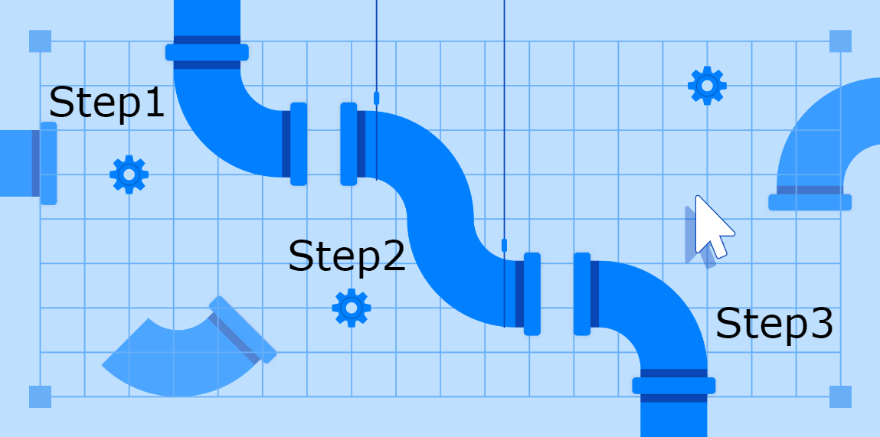
Our Goal
Our goal is to build NLP pipeline that can capture the ‘structure’ hidden in the report docs. This will help expert to write docs(auto gen timestamps, auto label words which refers to medical entity), and read docs(gen catalog, highlight key sentences and key words).
However, chasing the goal is a long project. We have to set the project into meaningful small steps.

Slide 5

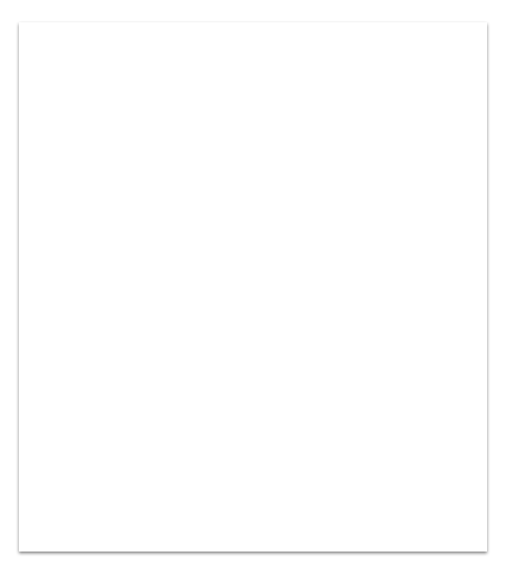
Each step should be achievable and testable. Also, is should be always able to find a way to integrate each step into our project, so that even we fail in some step, the previous steps can still create value for us.
Paragraph Labeling
Key Sentence Selection
Named Entity Recognition

Slide 6
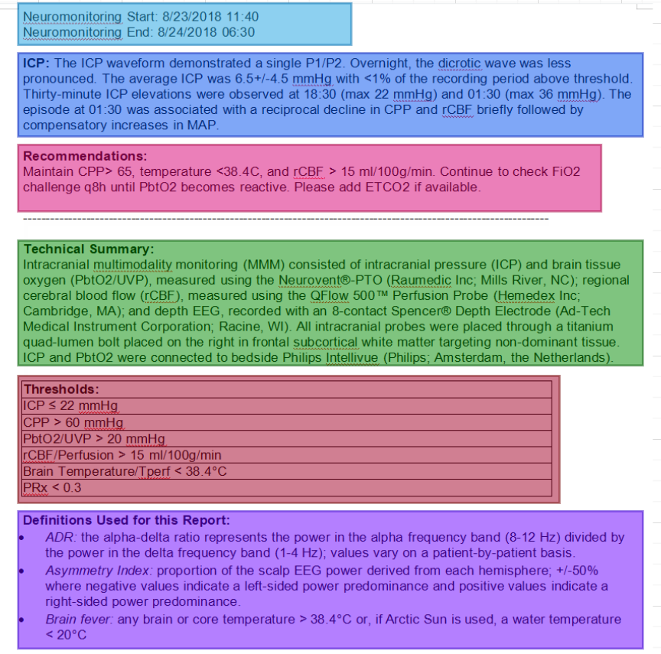
Paragraph Labeling
Given a report document with multiple paragraphs, label each paragraph according to its content and topic.
This could be used for generate document catalog. As we know the label of each paragraph, for some of the paragraph with certain label, we can do certain analysis: for “time” paragraph, we can extract the timestamp; for “recommendation” paragraph, we can collect the medication names appearing; for “modality” paragraph, we can do key sentence selection.

Slide 7
Timestamp
Modality
Recommendation
Tec Summary
Thresholds
Definition

Slide 8
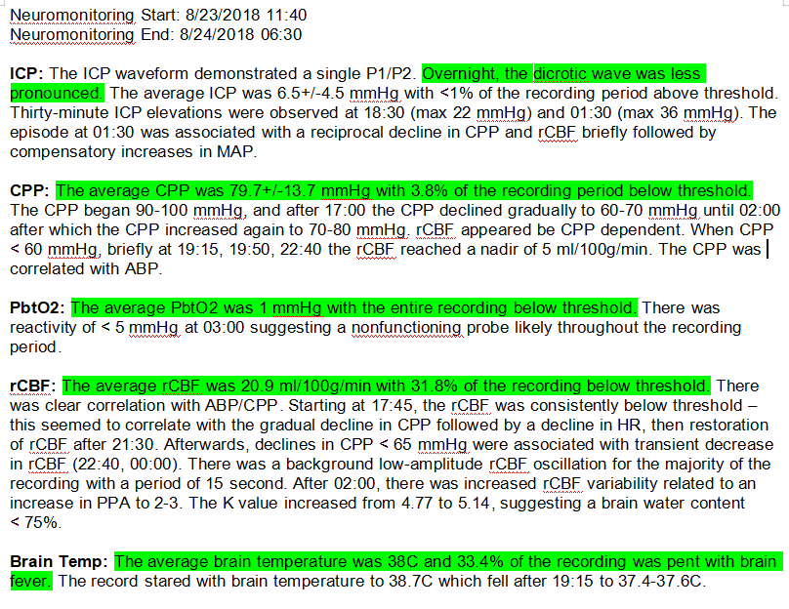
Key Sentence Selection
Given a paragraph with multiple sentences, select the most important or representative sentences according the context.
As we know the key sentences, we can highlight them when the user view the document in our application. Also, a sentence is key sentence or not can be one of the input to next step: Named Entity Recognition.

Slide 10
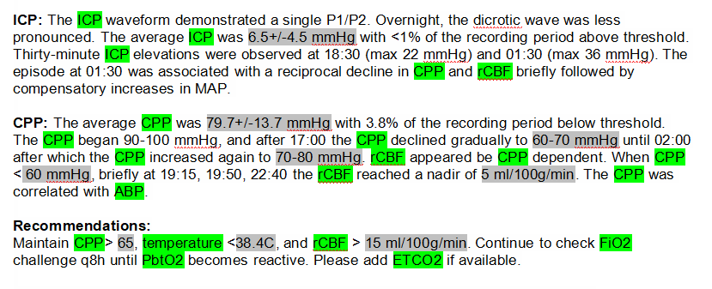
Named Entity Recognition
Given a series of labeled sentences (paragraph level label and sentence level label), extract the named entities (e.g. medication names, modality names).
By NER, we can do many things. The user can easily get what are the modalities or medications mentioned in some certain document. Also, as we know the modality set - medication set pairs, we can train model to do auto inferring from modalities to medications.

Slide 12
Question ?

