Slide 1
Discrete Choice Modeling
Part 01
Introduction

Slide 2
A simple example (1/4)
 | Journey to Work
 | Route 1 | Route 2
Travel Cost | 10 Yuan | 20 Yuan
Travel Time | 60 mins | 30 mins
My Choice |  | 
Generally, the satisfaction of Route 2 is higher than the satisfaction of Route 1
Specifically, 10-Yuan-saving cannot compensate for 30-mins-loss

Slide 3
A simple example (2/4)
Observation 1 | Journey to Work
 | Route 1 | Route 2
Travel Cost | 10 Yuan | 20 Yuan
Travel Time | 60 mins | 30 mins
My Choice |  | 
Observation 2 | Journey to Work
 | Route 1 | Route 2
Travel Cost | 15 Yuan | 25 Yuan
Travel Time | 45 mins | 30 mins
My Choice | 
Observation 1:
Rout 2 is 30 mins faster, 10 Yuan more expensive → choose Route 2
Value of (saving) time > 10 Yuan per 30 mins (i.e. 20 Yuan per hour)
Observation 2:
Rout 2 is 15 mins faster, 10 Yuan more expensive → choose Route 1
Value of (saving) time < 10 Yuan per 15 mins (i.e. 40 Yuan per hour)

Slide 4
A simple example (3/4)
 | Journey to Work
 | Route 1 | Route 2
Travel Cost | 10 Yuan | 20 Yuan
Travel Time | 60 mins | 30 mins
My Choice |  | 
Context
Alternatives → Choice Set
Attribute Level
Attributes
Preference

Slide 5
A simple example (4/4)
Individuals’ choices are observed (in real life or experiments)
Which travel mode to use for their commute
Whether to buy a new car, where to live and work, etc.
From these choices, preferences and trade-offs are inferred
Preference for car over train
Trade-off between travel time and cost
Based on preferences and trade-offs, future choices are predicted
Market share for a new travel mode
Effects of road pricing, higher transit fares
As well as the benefits of policies
How valuable is a reduction in total network travel time
Is the transit service / transport policy worth funding

Slide 6
First term: utility (1/6)
 | Journey to Work
 | Route 1 | Route 2
Travel Cost | 10 Yuan | 20 Yuan
Flight Time | 60 mins | 30 mins
My Choice |  | 
Utility is a measure of preferences over some set of goods that satisfies human needs
Utility represents satisfaction experienced by the consumer of a good
--- Wikipedia
Utility cannot be measured directly
For the above example, utility of Route 2 > utility of Route 1

Slide 7
First term: utility (2/6)
Cardinal utility:
Utility could be positive, negative or even zero
Utility = 0 does not mean “nothing”, it actually means something
Utility is relative, the absolute value means nothing
Summation and subtraction are suitable, while multiplication and division are not
e.g. Car A (utility = 100), Car B (utility = 50), Car C (utility = 0)
The utility of Car C is 0, that does not means Car C has no utility
Car A is better than Car B by exactly the same amount by which Car B is better than Car C
One cannot say Car A is twice better than Car B
Let utility of Car A = 50, utility of Car B = 0, utility of Car C = -50, their relationship does not change

Slide 8
Only Difference of Utility Matters!

Slide 9
First term: utility (4/6)
Researchers’ Point of View
Decision makers’ Point of View
Representative Utility + Error Term
Total Utility
Random Utility Maximization (RUM) Theory
Representative utility: everything that can be related to observed determinants
Error term: everything else not considered, assumed to follow a certain distribution
Alternative is chosen if its Total utility is highest
Researchers can only predict choices up to a probability

Slide 10
Total Utility = Representative Utility + Error Term

Slide 11
First term: utility (6/6)

Slide 12
Second term: preference (1/6)
Discrete choice of one alternative from a set of competing ones
Alternatives for journey to work | Commuter chooses
Bus
Bicycle
Drive own auto | 
Carpool
Walk
auto > bus, bicycle, carpool, walk

Slide 13
Second term: preference (2/6)
“Yes, I like this alternative” and “No, I don’t like this alternative”
Alternatives for journey to work | Commuter will consider
Bus | No
Bicycle | Yes
Drive own auto | Yes
Carpool | No
Walk | No
auto > bus, carpool, walk
bicycle > bus, carpool, walk

Slide 14
Second term: preference (3/6)
A complete ranking of alternatives from most to least preferred
Alternatives for journey to work | Ranking by likelihood use
Bus | 4
Bicycle | 2
Drive own auto | 1
Carpool | 3
Walk | 5
auto > bus, bicycle, carpool, walk
bicycle > bus, carpool, walk
carpool > bus, walk
bus > walk

Slide 15
Second term: preference (4/6)
A complete ranking of alternatives from most to least preferred
Based on decision makers’ strongly reliable and valid cognitive abilities
The middle part of a ranking is ambiguous and unreliable
“I like this alternative the best” and “I like that alternative the worst”
 | Travel Time | Travel Cost | Most Liked | Least Liked
Route 1 | 30 mins | 20 Yuan | 
Route 2 | 60 mins | 10 Yuan |  | 
Route 3 | 45 mins | 15 Yuan

Slide 16
Second term: preference (5/6)
Expressing degree of preference by rating alternatives on a scale
Alternatives for journey to work | rating by likelihood use (0 -10)
Bus | 6
Bicycle | 7
Drive own auto | 10
Carpool | 6
Walk | 4
auto > bus, bicycle, carpool, walk
bicycle > bus, carpool, walk
bus = carpool
bus > walk
carpool > walk

Slide 17
Second term: preference (6/6)
Expressing degree of preference by rating alternatives on a scale
Based on decision makers’ strongly reliable and valid cognitive abilities
Hard to interpret the meaning of a difference between a rating of “4” and a rating “7”
Respondents should be noticed with the best and the worst cases in advance

Slide 18
Third term: SP data (1/3)
Revealed preference (RP) data:
Describe individuals’ behavior or existing circumstances in the real world
- how many cars do you have?
- how did you come to school today?
- how far from your home to your company?
Stated preference (SP) data:
Describe individuals’ potential behavior in a hypothetical context
- if you are faced with two routes to
wok, the only difference are their
travel cost and time. Which one do
you prefer?
We are talking about SP data only!
Observation 1 | Journey to Work
 | Route 1 | Route 2
Travel Cost | 10 Yuan | 20 Yuan
Travel Time | 60 mins | 30 mins
My Choice |  | 

Slide 19
Third term: SP data (2/3)
Revealed preference (RP) data:
Depict the world as it is now
Process inherent relationship between attributes
Have only existing alternatives as observables
Have high reliability and face validity
Yield one observation per respondents at each observation point
RP data are to help us understand preferences within an existing market and technology structure

Slide 20
Third term: SP data (3/3)
Stated preference (RP) data:
Describe hypothetical or virtual decision contexts
Control relationships between attributes, which permits mapping of utility functions with technologies different from existing ones
Can include existing and/or proposed and/or generic (i.e., unlabeled) choice alternatives
Seem to be reliable when respondents understand, are committed to and can respond to tasks
Can yield multiple observations per respondents at each observation point
SP data provide insights into problems involving shifts in technological frontiers

Slide 21
Level of measurement (1/5)
Measuring:
Assigning numbers to empirical phenomena
Numbers are easier to deal with in analysis than text
Level of measurement:
How to interpret the numbers
Determines which analysis approaches are allowed
Nominal, Ordinal, Interval, and Ratio

Slide 22
Level of measurement (2/5)
Nominal:
1 ≠ 2 ≠ 3
- numbers just indicate the different categories
- thus no ordering
- numbers are fully interchangeable between categories
- colors, gender, means of transport
Example (mean of transport):
“1=car; 2=bike; 3=train” is equivalent to “2=car; 3=bike; 1=train”
Dichotomous:
- variable of nominal level with only 2 categories
- gender: 1=female, 2=male

Slide 23
Level of measurement (3/5)
Ordinal:
1 < 2 < 3 or 1 > 2 > 3
- there is an order between categories
- no equal differences between consecutive categories
- hierarchical levels, level of education, rank order
- when transforming, keep the order between categories the same
Example (education level):
- “1=bachelor degree; 2=master degree; 3=doctoral degree”
is equivalent to “2=bachelor degree; 3=master degree; 7=doctoral degree”

Slide 24
Level of measurement (4/5)
Interval:
2-1 = 4-3; but 2 ≠ 2 * 1
- order with equal differences between categories
- no absolute zero value
- preferences on rating scale, intelligence, ºF, ºC
- when transforming, keep equal differences
- any linear transformation wokrs (i.e., ºF = 32 + 9/5 x ºC)
Example (temperature in Celsius or Fahrenheit):
- right: difference 20ºC-10ºC = 2 x (15ºC-10ºC)
- wrong: if temperature decreases from 20ºC to 10ºC, it does not become twice as cold (rate in ºF: 68/50 = 1.36 ≠ 2)

Slide 25
Level of measurement (5/5)
Ratio:
2 = 2*1
- order & equal intervals & absolute zero value
- weight, distance, age, temperature in Kelvin
- when transforming, keep equal proportions
Example:
- 20 kilometers is twice as much as 10 kilometers
- weight 40 kilos is twice as heavy as 20 kilos

Slide 26
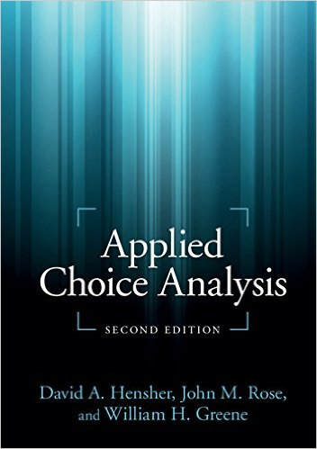
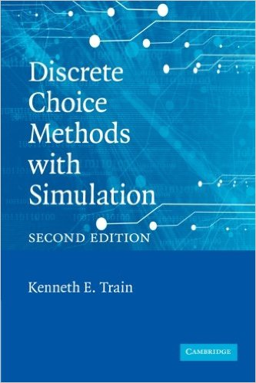
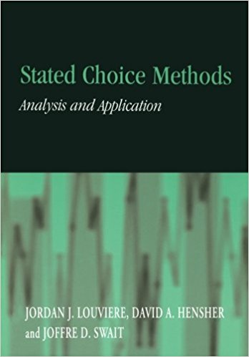
Reference (1/1)

Slide 27
Thanks!
Any questions?
You can find me at
- pan.x@outlook.com

