Slide 1
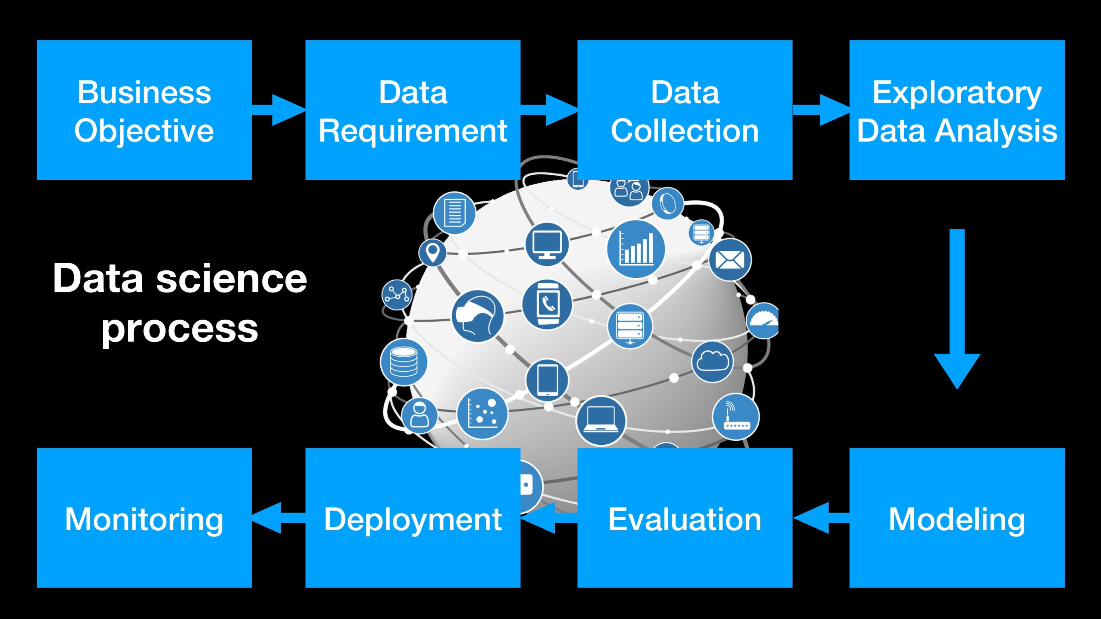

Slide 2
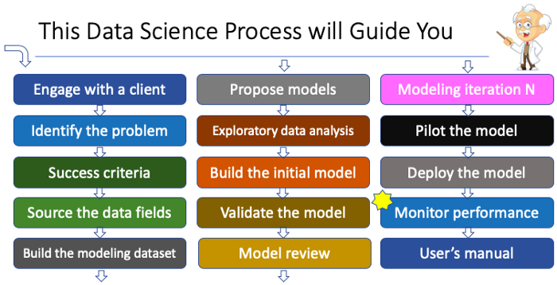

Slide 3
Modeling/Scoring General Guidance
How to create a modeling dataset (From raw dataset to a modeling dataset)?
What do you try to predict? Answer: It is the future anomalies of a specific agency/cardholder.
But the purchase amounts of the agencies vary widely by merchant category.
So the basic structure of your modeling data should be agency & merchant category
What are the average/min/max/median amounts per agency/merchant category? Get the statistics.
The merchant category can be the vendor. For example, an agency can always purchase from one vendor.
But what if an agency buy from multiple vendors for the same merchant category?
For example, features to detect anomalous spending:
- An agency spends more than the average amount for a particular merchant category.

Slide 4

Modeling and Scoring data preparation are very similar
Modeling
The raw data
Feature engineering
Modeling data
The modeling process
Supervised learning or unsupervised learning
Train/test split
Train the model
Variable importance
Validate the model
Raw Data
Agency / merchant category
Modeling
Data
Prediction
The raw data
Feature engineering
Scoring data
Raw Data
Agency / merchant category
Data to be scored
Prediction

