Slide 1
Deep Reinforcement Learning
Yue Wang

Slide 2
content
What is reinforcement learning
How to solve reinforcement learning
Why was reinforcement learning combined with deep learning

Slide 4
A simple example
Agent Environment
State Reward Action Observation Return
Exploration Exploitation

Slide 5
What is reinforcement learning
Machine learning
Supervised learning
Unsupervised learning
Reinforcement learning

Slide 6
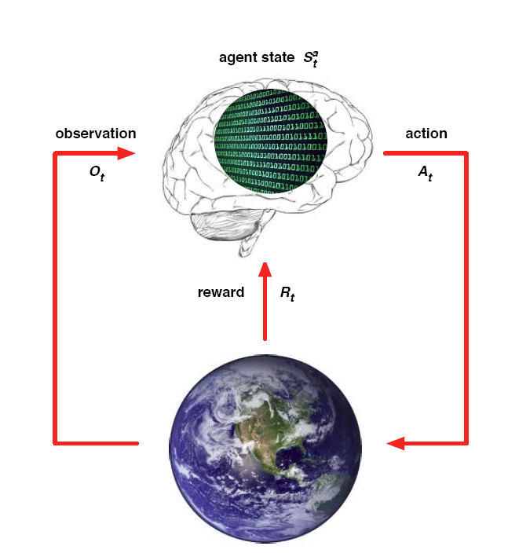


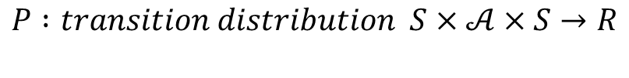

$$ℳ=(S,𝒜,R,P,γ)$$
$$S : state space is a (bounded) subset of the Euclidean space$$
$$𝒜: action space (finite\left|𝒜\right|<∞)$$
$$R :reward of a state−action pair S×𝒜×S→R$$
$$P :transition distribution S×𝒜×S→R$$
$$γ :discount factor γ∈[0,1]$$

