Slide 1
Deep Reinforcement Learning
Yue Wang

Slide 2
content
What is reinforcement learning
How to solve reinforcement learning
Why was reinforcement learning combined with deep learning

Slide 4
A simple example
Agent Environment
State Reward Action Observation Return
Exploration Exploitation

Slide 6
What is reinforcement learning
Machine learning
Supervised learning
Unsupervised learning
Reinforcement learning
y=f(x)
f(x)
y=f(x) z

Slide 7
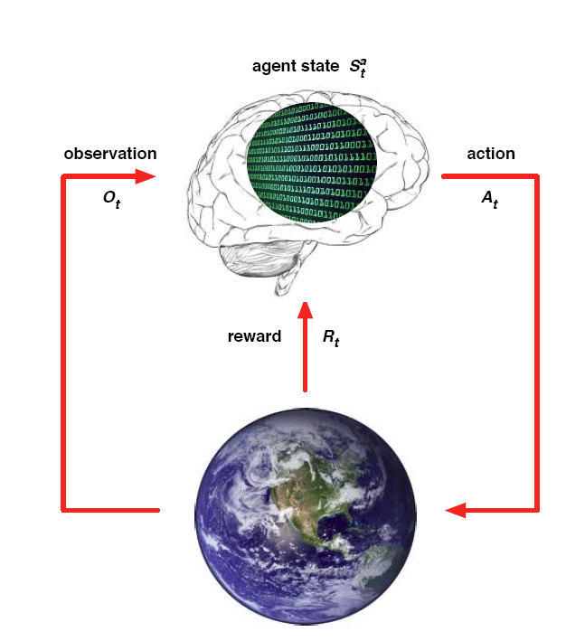
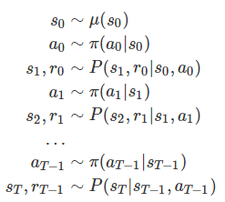
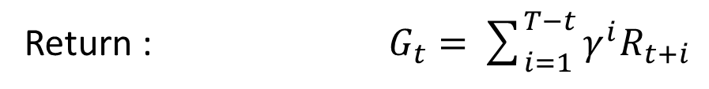

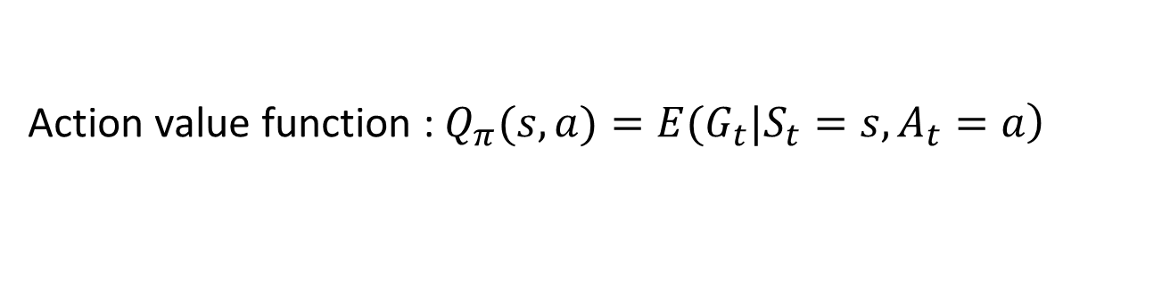

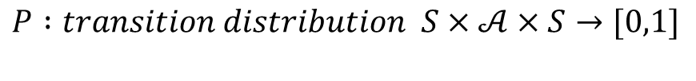
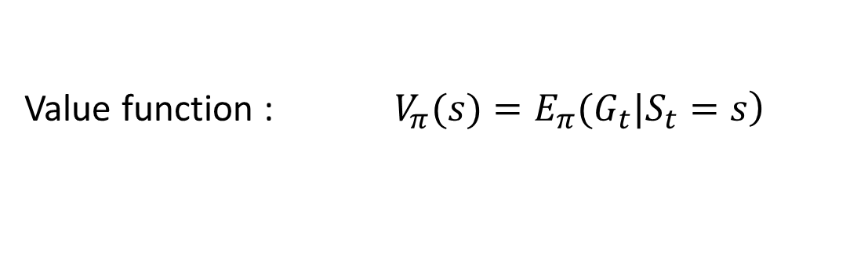
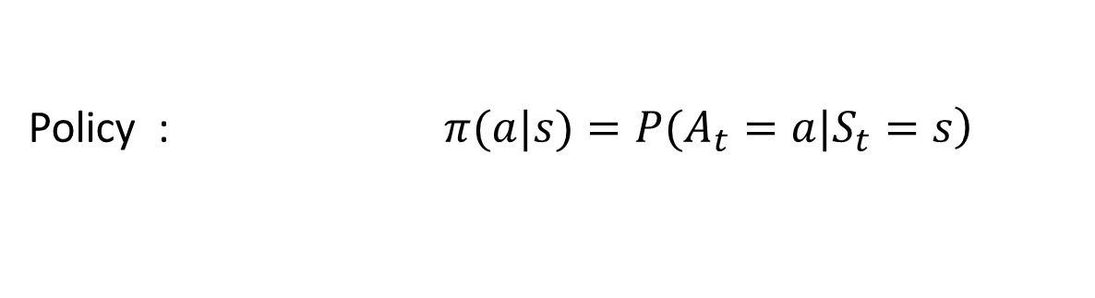

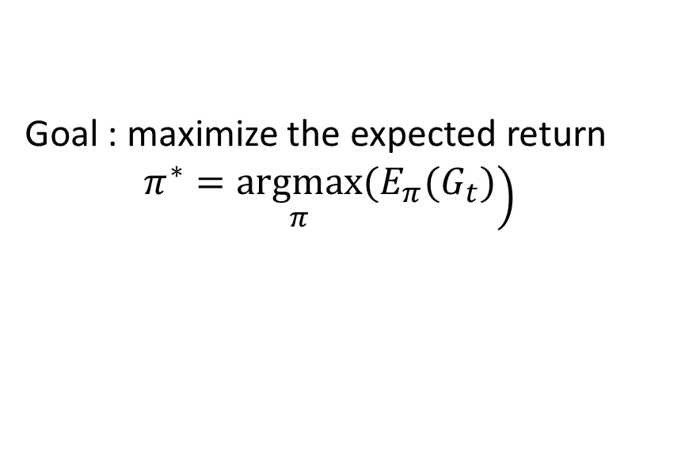
MDP
$$ℳ=(S,𝒜,R,P,γ)$$
$$S : state space is a (bounded) subset of the Euclidean space$$
$$𝒜: action space (finite\left|𝒜\right|<∞)$$
$$R :reward of a state−action pair S×𝒜×S→R$$
$$P :transition distribution S×𝒜×S→[0,1]$$
$$γ :discount factor γ∈[0,1]$$
Return : $G_{t}=\sum_{i=1}^{T−t}{γ^{i}R_{t+i}}$
Policy : $\left.π(a|s)=P(A_{t}=a|S_{t}=s\right)$
Value function : $\left.V_{π}(s)=E_{π}(G_{t}|S_{t}=s\right)$
Action value function : $\left.Q_{π}(s,a)=E(G_{t}|S_{t}=s,A_{t}=a\right)$
Goal : maximize the expected return
$\left.π^{∗}=\underset{π}{argmax}(E_{π}(G_{t})\right)$

Slide 8

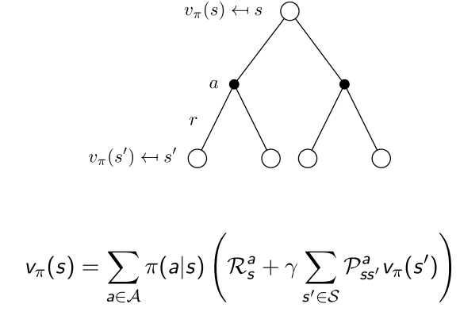
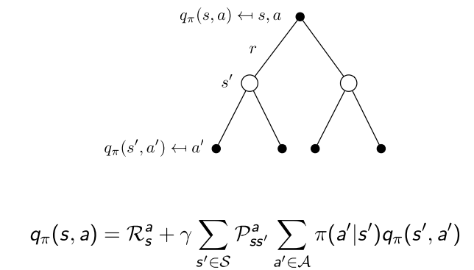
Value function

Slide 9
POMDP
Markov Models |  | Do we have control over the state transitions?
 |  | No | Yes
Are the states completely observable? | Yes | Markov Chain | MDP
 | No | HMM Hidden Markov Model | POMDP Partially Observable Markov Decision Process

Slide 10
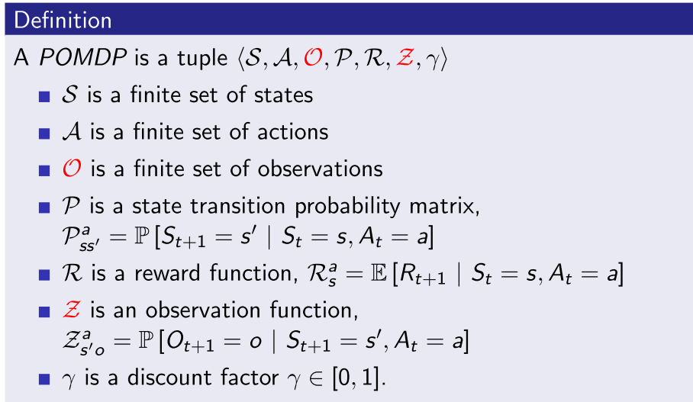
POMDP

Slide 13
Algorithms DP (Dynamic Programming)
Model dependent
Two method :
Policy iteration ( policy evaluation -> policy improvement )
Value iteration

Slide 14
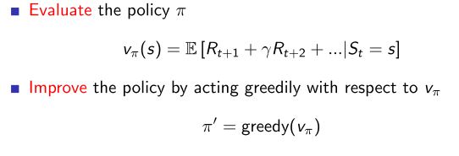
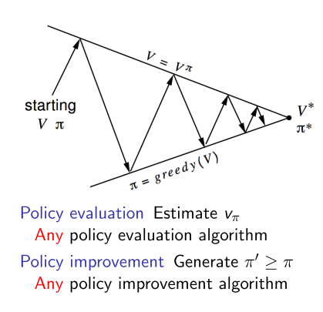
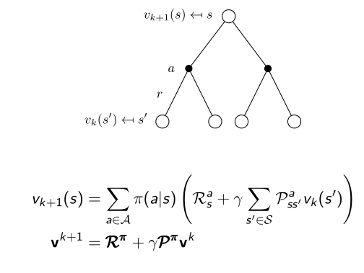
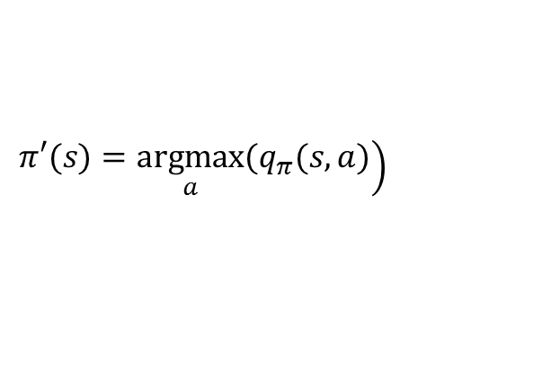
Policy iteration
$$\left.π′(s)=\underset{a}{argmax}(q_{π}(s,a)\right)$$

Slide 15
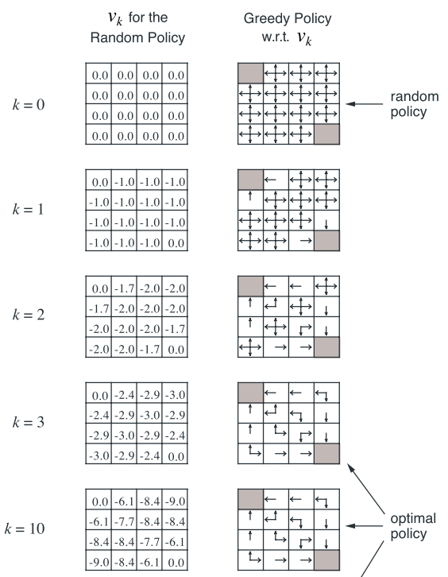
An example

Slide 16
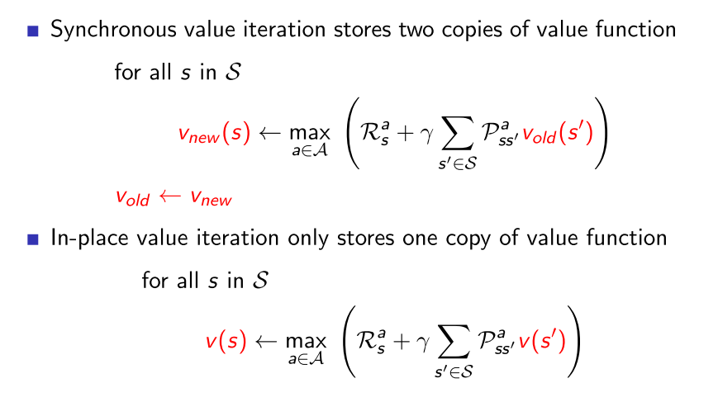
Value iteration

Slide 17
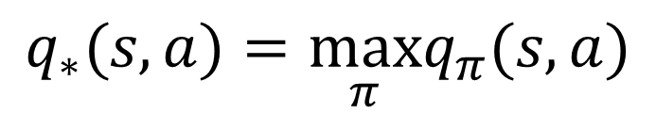
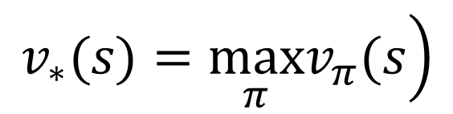
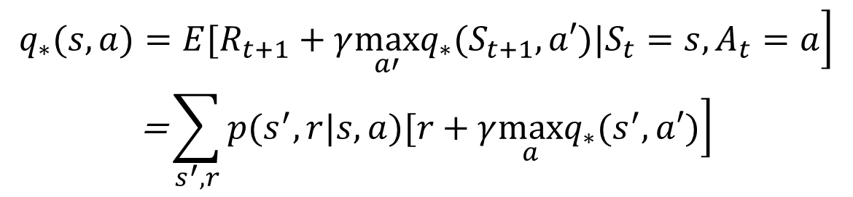
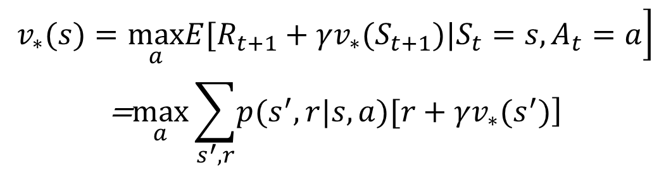
Optimal value function
$$\left.v_{∗}(s)=\max_{π}v_{π}(s\right)$$
$$q_{∗}(s,a)=\max_{π}q_{π}(s,a)$$
$$\left.q_{∗}(s,a)=E(R_{t+1}+γv_{∗}(S_{t+1})|S_{t}=s,A_{t}=a\right)$$
$$\begin{matrix}\left.v_{∗}(s)=\max_{a}E[R_{t+1}+γv_{∗}(S_{t+1})|S_{t}=s,A_{t}=a\right] \\ \text{=}\max_{a}\sum_{s^{′},r}{\left.p(s^{′},r|s,a)[r+γv_{∗}(s^{′})\right]}\end{matrix}$$
$$\begin{matrix}\left.q_{∗}(s,a)=E[R_{t+1}+γ\max_{a′}q_{∗}(S_{t+1},a′)|S_{t}=s,A_{t}=a\right] \\ \text{=}\sum_{s^{′},r}{\left.p(s^{′},r|s,a)[r+γ\max_{a}q_{∗}(s^{′},a′)\right]}\end{matrix}$$

Slide 18
Algorithms MC (Monte Carlo)

Slide 19
Algorithms TD (Temporal Difference)
Model dependent
Two method :
Policy iteration ( policy evaluation -> policy improvement )
Value iteration

