Slide 1
Deep Reinforcement Learning
Yue Wang

Slide 2
content
What is reinforcement learning
How to solve reinforcement learning
Deep reinforcement learning

Slide 4
A simple example
Agent Environment
State Reward Action Observation Return
Exploration Exploitation

Slide 6
What is reinforcement learning
Machine learning
Supervised learning
Unsupervised learning
Reinforcement learning
y=f(x)
f(x)
y=f(a) r

Slide 7
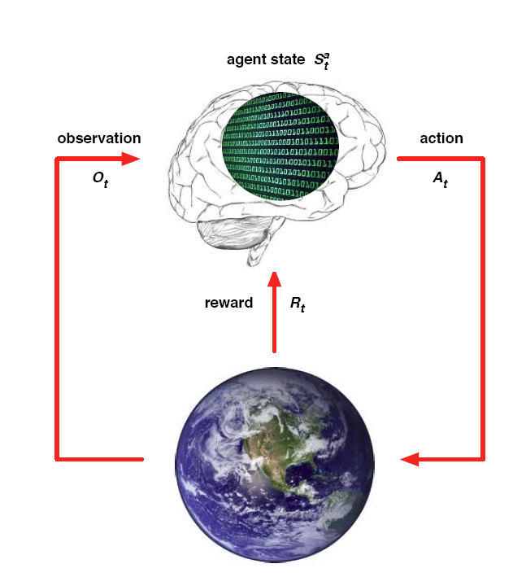
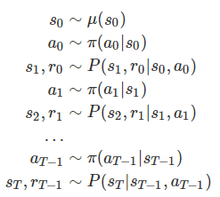


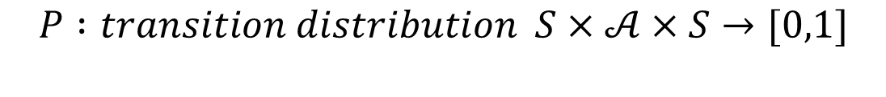

MDP
$$ℳ=(S,𝒜,R,P,γ)$$
$$S : state space is a (bounded) subset of the Euclidean space$$
$$𝒜: action space (finite\left|𝒜\right|<∞)$$
$$R :reward of a state−action pair S×𝒜×S→R$$
$$P :transition distribution S×𝒜×S→[0,1]$$
$$γ :discount factor γ∈[0,1]$$

Slide 8
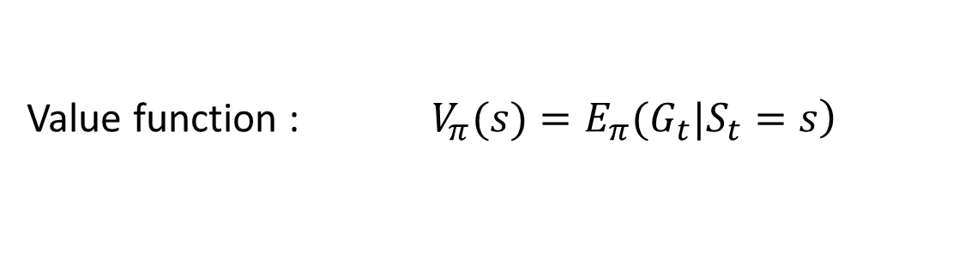
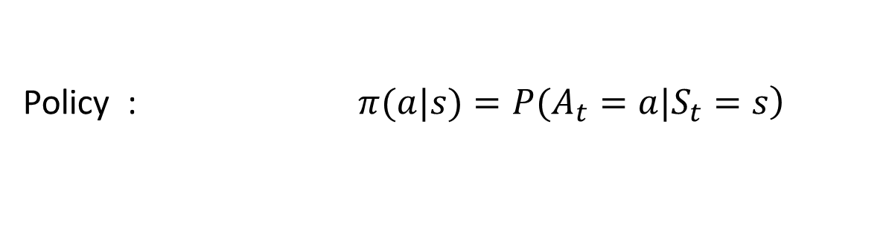
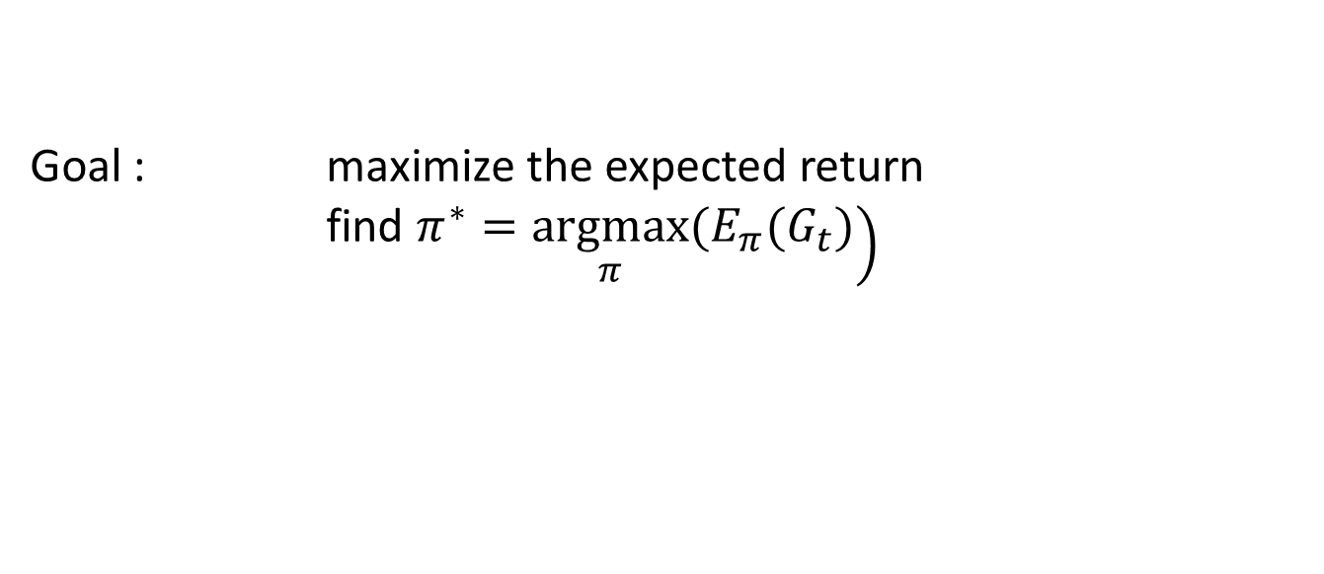
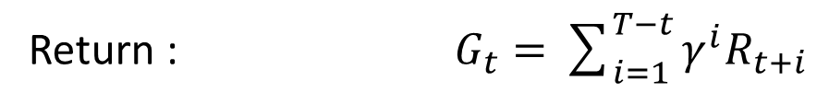
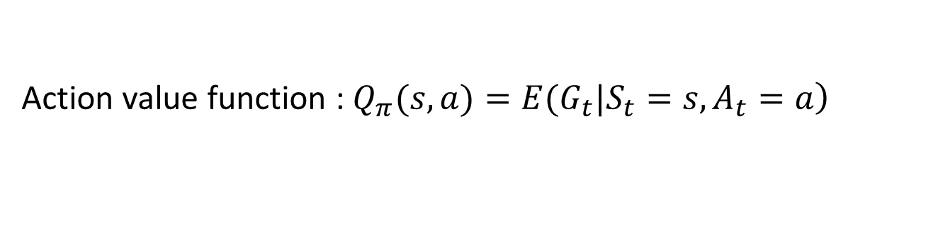
Reinforcement learning
Notation
Return : $G_{t}=\sum_{i=1}^{T−t}{γ^{i}R_{t+i}}$
Policy : $\left.π(a|s)=P(A_{t}=a|S_{t}=s\right)$
Value function : $\left.V_{π}(s)=E_{π}(G_{t}|S_{t}=s\right)$
Action value function : $\left.Q_{π}(s,a)=E(G_{t}|S_{t}=s,A_{t}=a\right)$
Goal : maximize the expected return
find $\left.π^{∗}=\underset{π}{argmax}(E_{π}(G_{t})\right)$

Slide 9

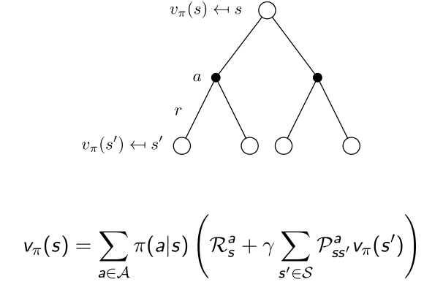
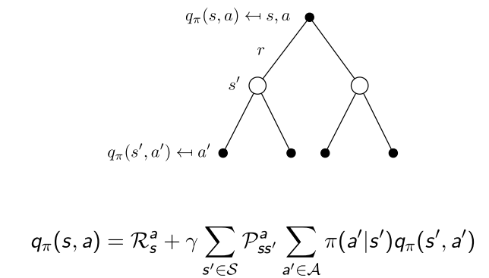
Value function

Slide 10
POMDP
Markov Models |  | Do we have control over the state transitions?
 |  | No | Yes
Are the states completely observable? | Yes | Markov Chain | MDP
 | No | HMM Hidden Markov Model | POMDP Partially Observable Markov Decision Process

Slide 11
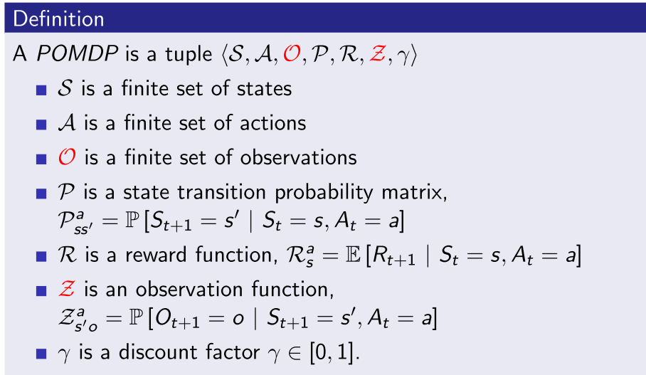
POMDP

Slide 13
Algorithms
Value function based
DP
Policy iteration
Value iteration
MC
On policy
Off policy
TD
Sarsa
Q-learning
Policy Gradient
Reinforce
Actor-Critic

Slide 14
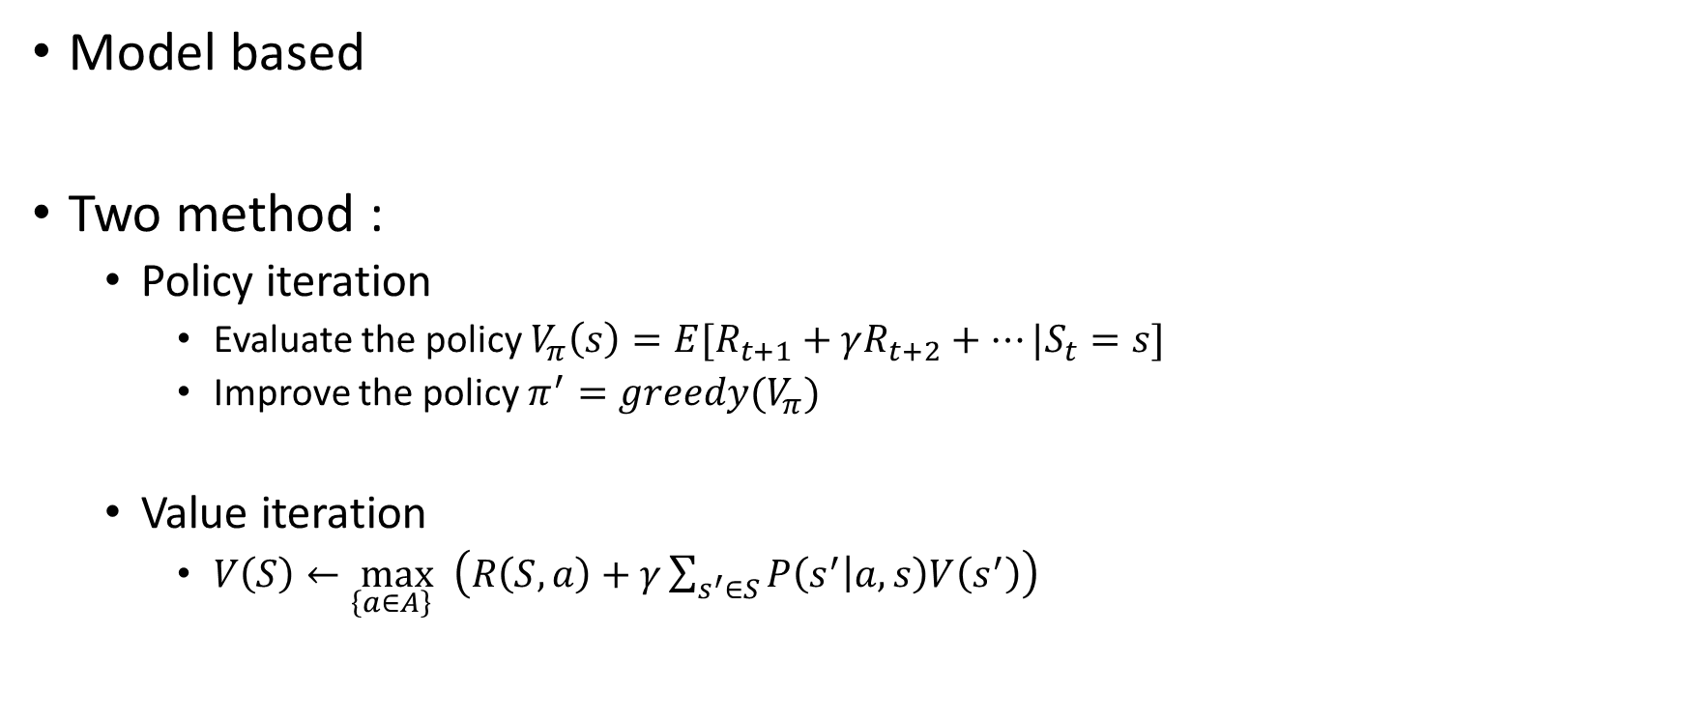
Algorithms DP (Dynamic Programming)
Model based
Two method :
Policy iteration
Evaluate the policy $V_{π}\left(s\right)=E[R_{t+1}+γR_{t+2}+…|S_{t}=s]$
Improve the policy $π^{′}=greedy(V_{π})$
Value iteration
$V\left(S\right)←\max_{\left\{a∈A\right\} }\left(R\left(S,a\right)+γ\sum_{s^{′}∈S}{P\left(s^{′} | a,s\right)V\left(s^{′}\right)}\right)$

Slide 15

An example
0 | 0 | 0 | 0
0 | 0 | 0 | 0
0 | 0 | 0 | 0
0 | 0 | 0 | 0
0 | -1 | -1 | -1
-1 | -1 | -1 | -1
-1 | -1 | -1 | -1
-1 | -1 | -1 | 0
0 | -1.7 | -2.0 | -2.0
-1.7 | -2.0 | -2.0 | -2.0
-2.0 | -2.0 | -2.0 | -1.7
-2.0 | -2.0 | -1.7 | 0
0 | -2.4 | -2.9 | -3.0
-2.4 | -2.9 | -3.0 | -2.9
-2.9 | -3.0 | -2.9 | -2.4
-3.0 | -2.9 | -2.4 | 0
0 | -6.1 | -8.4 | -9.0
-6.1 | -7.7 | -8.4 | -8.4
-8.4 | -8.4 | -7.7 | -6.1
-9.0 | -8.4 | -6.1 | 0
$$…$$
One step convergence !

Slide 16
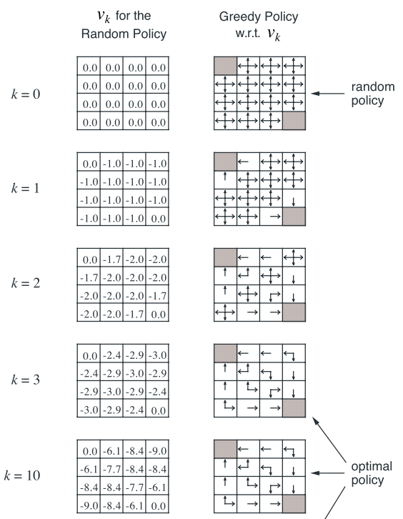
An example

Slide 17
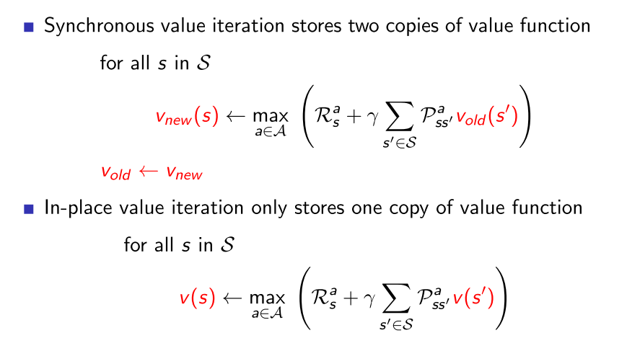
Value iteration

Slide 18
An example
0 | 0 | 0 | 0
0 | 0 | 0 | 0
0 | 0 | 0 | 0
0 | 0 | 0 | 100
0 | -1 | -1 | -1
-1 | -1 | -1 | -1
-1 | -1 | -1 | 99
-1 | -1 | 99 | 100
0 | -1 | -2 | -2
-1 | -2 | -2 | 98
-2 | -2 | 98 | 99
-2 | 98 | 99 | 100
0 | -1 | -2 | 97
-1 | -2 | 97 | 98
-2 | 97 | 98 | 99
97 | 98 | 99 | 100
0 | -1 | 96 | 97
-1 | 96 | 97 | 98
96 | 97 | 98 | 99
97 | 98 | 99 | 100
0 | 95 | 96 | 97
95 | 96 | 97 | 98
96 | 97 | 98 | 99
97 | 98 | 99 | 100
Convergence !

Slide 19
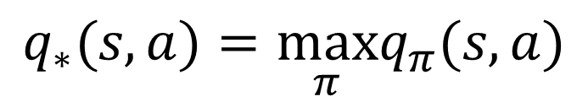
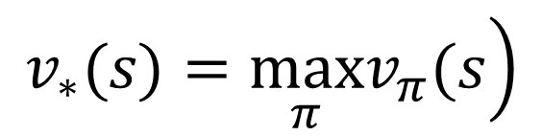
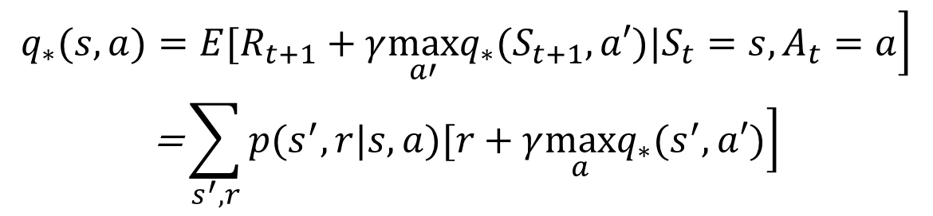
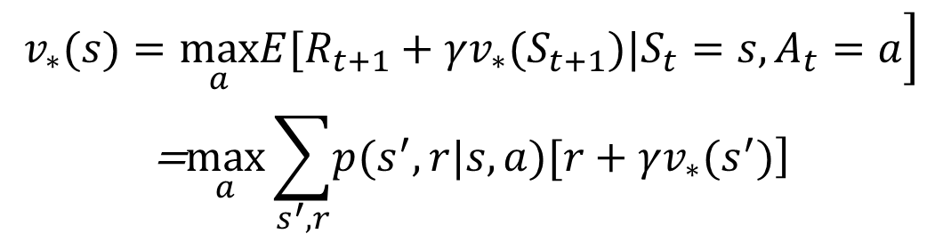
Optimal value function
$$\left.v_{∗}(s)=\max_{π}v_{π}(s\right)$$
$$q_{∗}(s,a)=\max_{π}q_{π}(s,a)$$
$$\left.q_{∗}(s,a)=E(R_{t+1}+γv_{∗}(S_{t+1})|S_{t}=s,A_{t}=a\right)$$
$$\begin{matrix}\left.v_{∗}(s)=\max_{a}E[R_{t+1}+γv_{∗}(S_{t+1})|S_{t}=s,A_{t}=a\right] \\ \text{=}\max_{a}\sum_{s^{′},r}{\left.p(s^{′},r|s,a)[r+γv_{∗}(s^{′})\right]}\end{matrix}$$
$$\begin{matrix}\left.q_{∗}(s,a)=E[R_{t+1}+γ\max_{a′}q_{∗}(S_{t+1},a′)|S_{t}=s,A_{t}=a\right] \\ \text{=}\sum_{s^{′},r}{\left.p(s^{′},r|s,a)[r+γ\max_{a}q_{∗}(s^{′},a′)\right]}\end{matrix}$$

Slide 20
Algorithms MC (Monte Carlo)
Model free
Episodic MDP
value = mean return
On policy and off policy !

Slide 21

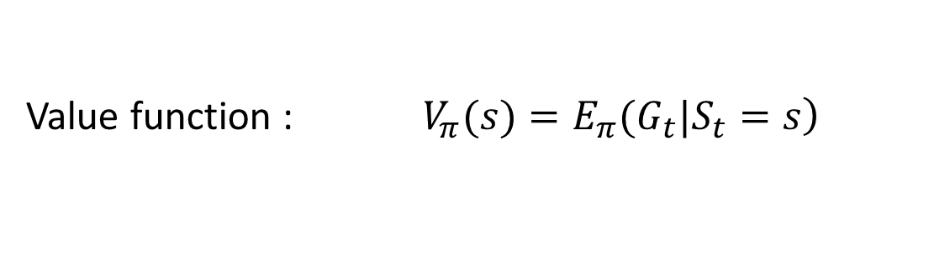

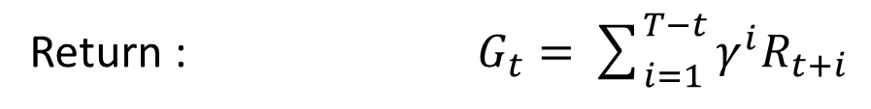
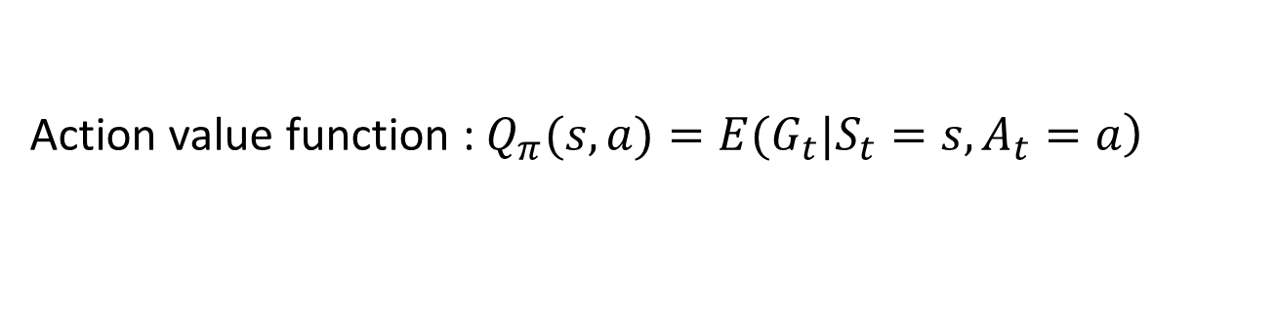
Initial MC algorithms
Return : $G_{t}=\sum_{i=1}^{T−t}{γ^{i}R_{t+i}}$
E for policy evaluation
I for policy improvement
Value function : $\left.V_{π}(s)=E_{π}(G_{t}|S_{t}=s\right)$
Action value function : $\left.Q_{π}(s,a)=E(G_{t}|S_{t}=s,A_{t}=a\right)$
$$\text{S}\text{1 ,}\text{A}\text{1,}\text{R}\text{1, }\text{S}\text{2,}\text{A}\text{2,}\text{R}\text{2,}…\text{,}\text{SK} \sim π$$
$$V_{π}\left(s\right)←V_{π}\left(s\right)+\frac{1}{n}{(G}_{t}−V_{π}(s))=\frac{n−1}{n} V_{π}\left(s\right)+\frac{1}{n}G_{t}$$
Is there any problem ? Recall the simple game before we start.
Trade off between exploration and exploitation

Slide 22
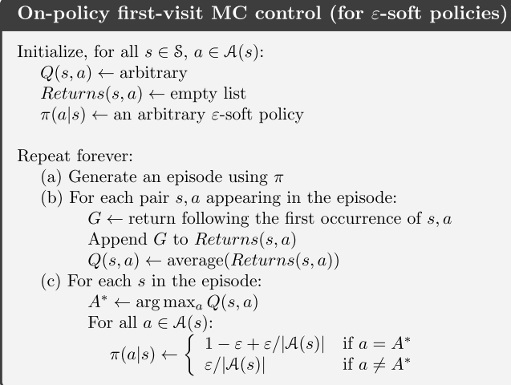

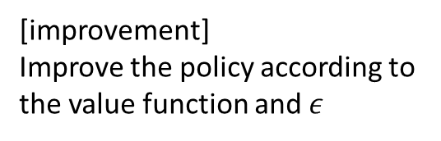
On policy and off policy
$$ε−greedy or ε−soft$$
[evaluation]
Compute the value function according to the expectation
[improvement]
Improve the policy according to the value function and $ε$

Slide 23

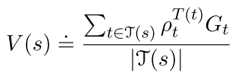
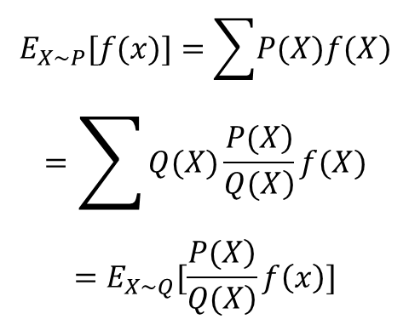
On policy and off policy
Behavior policy
Target policy
$$\begin{matrix}E_{X\sim P}[f(x)]=\sum{\left.P(X)f(X\right)} \\ =\sum{Q(X)\frac{\left.P(X\right)}{\left.Q(X\right)}f(X}) \\ =E_{X\sim Q}[\frac{\left.P(X\right)}{\left.Q(X\right)}f\left(x\right)]\end{matrix}$$

Slide 24
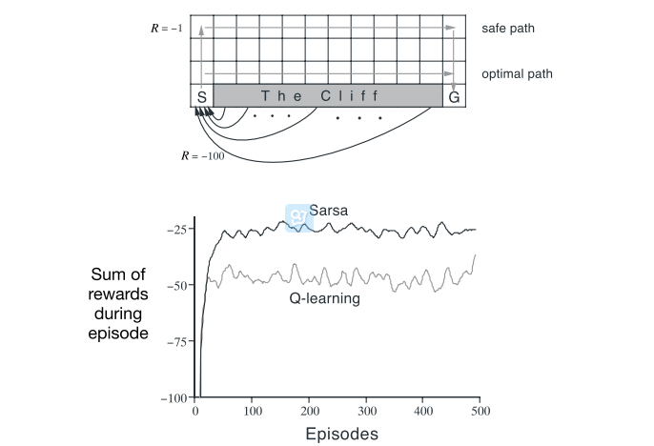
An example

Slide 25
Algorithms TD (Temporal Difference)
Model free
Three important methods :
TD(0)
Sarsa
Q-leaning

Slide 26
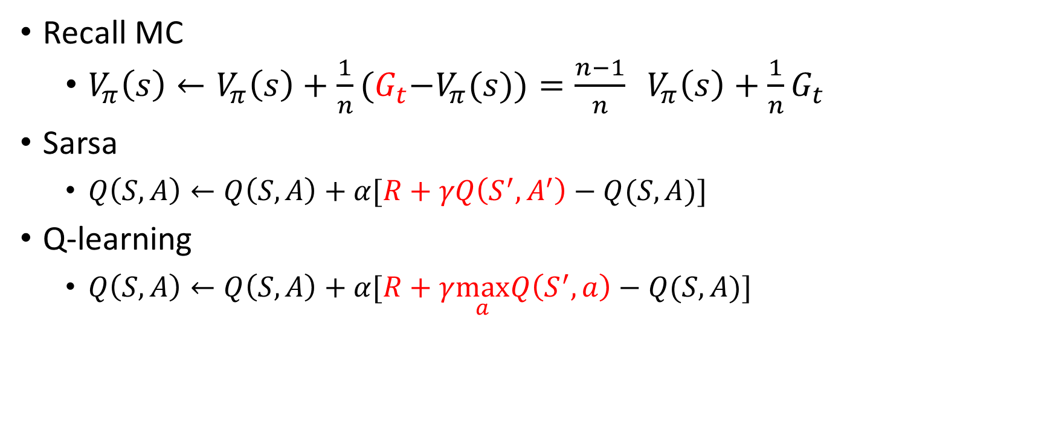
TD
Recall MC
$V_{π}\left(s\right)←V_{π}\left(s\right)+\frac{1}{n}{(G}_{t}−V_{π}(s))=\frac{n−1}{n} V_{π}\left(s\right)+\frac{1}{n}G_{t}$
Sarsa
$Q\left(S,A\right)←Q\left(S,A\right)+α[R+γQ\left(S^{′},A^{′}\right)−Q(S,A)]$
Q-learning
$Q\left(S,A\right)←Q\left(S,A\right)+α[R+γ\max_{a}Q\left(S^{′},a\right)−Q(S,A)]$

Slide 27
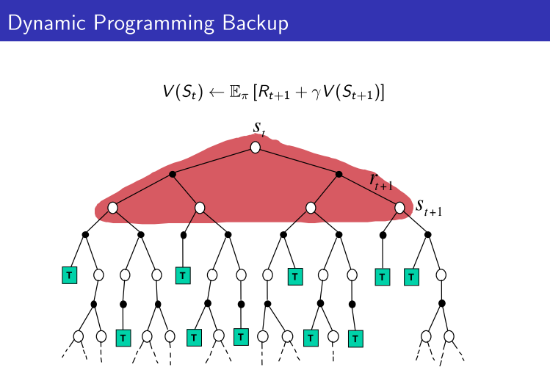
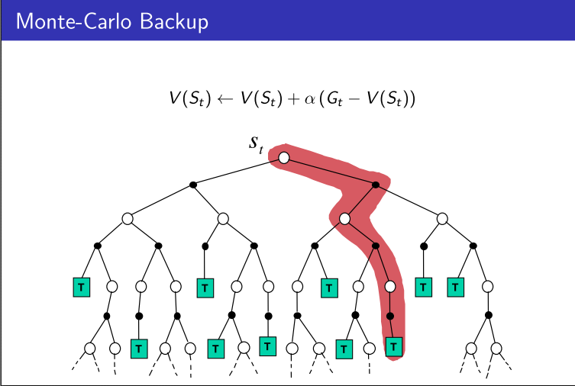
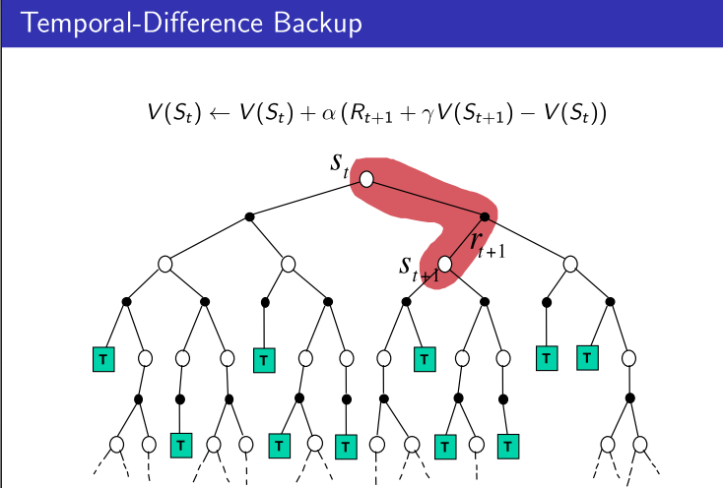
 | Markov Property | Bootstrapping | sampling
DP | Yes | Yes | No
MC | No | No | Yes
TD | Yes | Yes | Yes

Slide 28
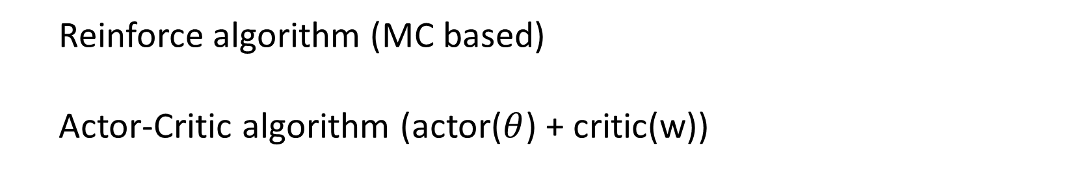

Policy Gradient
$policy :π_{θ}\left(s,a\right)=p\left[a | s;θ\right]$
$Goal :J\left(θ\right)=\sum_{s}{d^{π_{θ}}\left(s\right)\sum_{a}{π_{θ}\left(s,a\right)R_{s}^{a}}}$
Policy gradient theorem : $∇_{θ}J\left(θ\right)=E[∇_{θ}logπ_{θ}\left(s,a\right) Q^{π_{θ} }(s,a)]$
Reinforce algorithm (MC based)
Actor-Critic algorithm (actor($θ$) + critic(w))

Slide 30
Problems
Recall :
Value function is very complex mapping
Look up table
Function approximation
Policy improve need max operation
Continues control

Slide 31
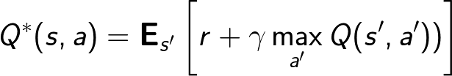

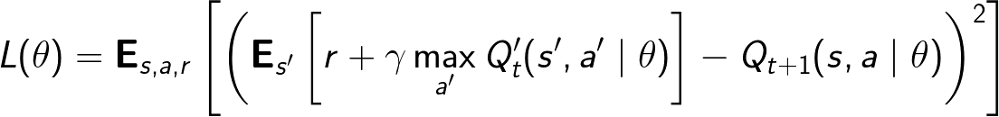
Function approximation
$$Q learning : Q\left(S,A\right)←Q\left(S,A\right)+α[R+γ\max_{a}Q\left(S^{′},a\right)−Q(S,A)]$$

Slide 32
Policy Gradient
$policy :π_{θ}\left(s,a\right)=p\left[a | s;θ\right]$
$Goal :J\left(θ\right)=\sum_{s}{d^{π_{θ}}\left(s\right)\sum_{a}{π_{θ}\left(s,a\right)R_{s}^{a}}}$
Policy gradient theorem : $∇_{θ}J\left(θ\right)=E[∇_{θ}logπ_{θ}\left(s,a\right) Q^{π_{θ} }(s,a)]$
Reinforce algorithm (MC based)
Actor-Critic algorithm (actor($θ$) + critic(w))

Slide 33
Deep reinforcement learning
Improvement of RL
Deep neural network to approximate functions in RL
Express abstract and complex function relation
End to end task
Continuous control task
Implementation of DRL
The definition of objection
Deep value function (DQN)
Deep policy approximation (DDPG)
Problems bring by deep learning
No convergence guarantee
Train slowly
Continuous control task (continuous action)

Slide 34
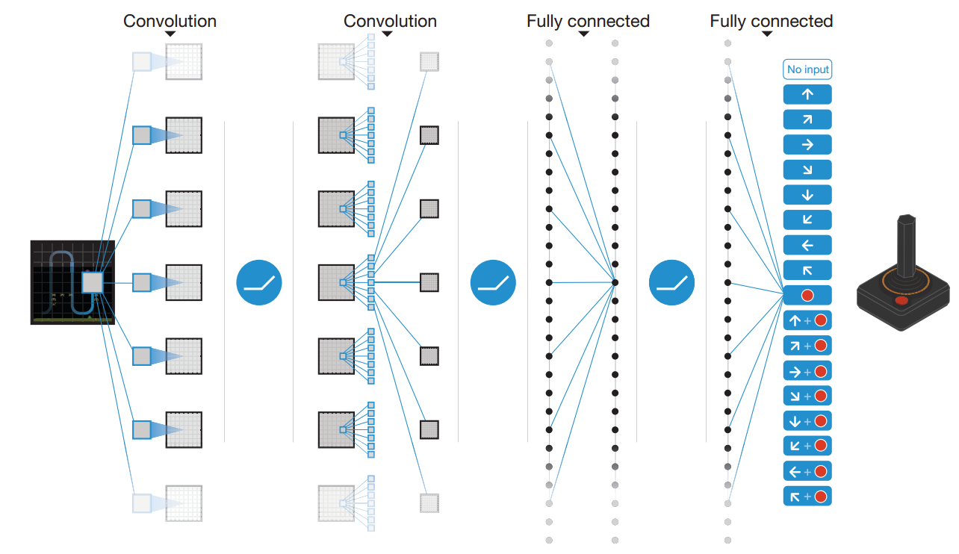

Slide 35
Formulation
1
2
3
Target
Variable

