Slide 1
Deep Reinforcement Learning
Yue Wang

Slide 2
content
RL and classic algorithms
Deep RL introduction
Some topic
My thinking

Slide 3
Recall of reinforcement learning
MDP and POMDP
Algorithms to solve RL

Slide 4
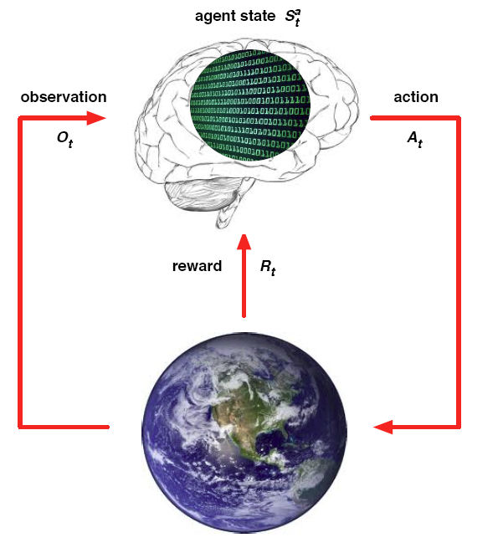
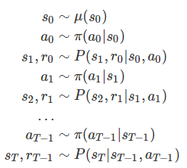


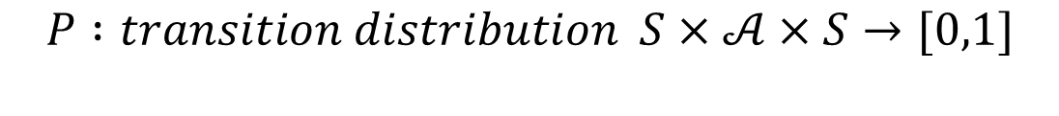

MDP
$$ℳ=(S,𝒜,R,P,γ)$$
$$S : state space is a (bounded) subset of the Euclidean space$$
$$𝒜: action space (finite\left|𝒜\right|<∞)$$
$$R :reward of a state−action pair S×𝒜×S→R$$
$$P :transition distribution S×𝒜×S→[0,1]$$
$$γ :discount factor γ∈[0,1]$$

Slide 5
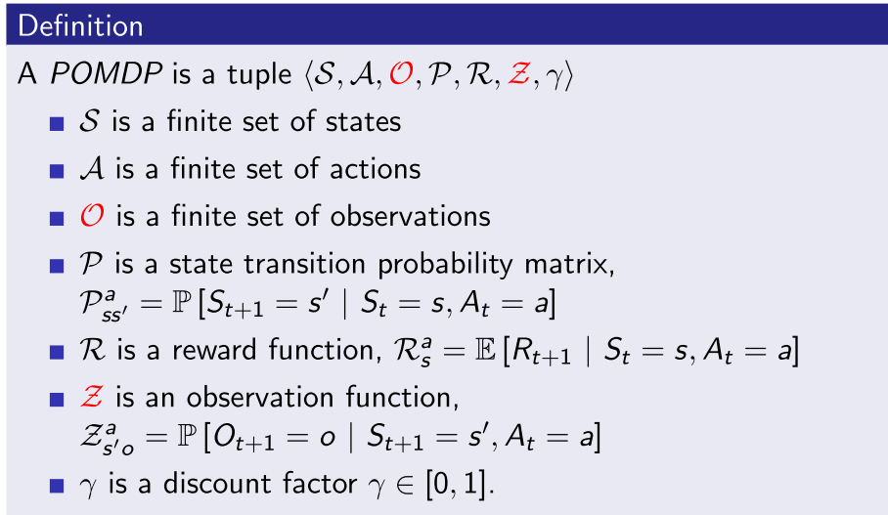
POMDP

Slide 6
Algorithms
Value function based
DP
Policy iteration
Value iteration
MC
On policy
Off policy
TD
Sarsa
Q-learning
Policy Gradient
Reinforce
Actor-Critic

Slide 7
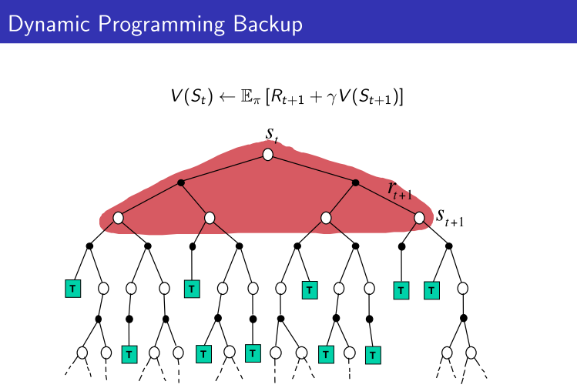
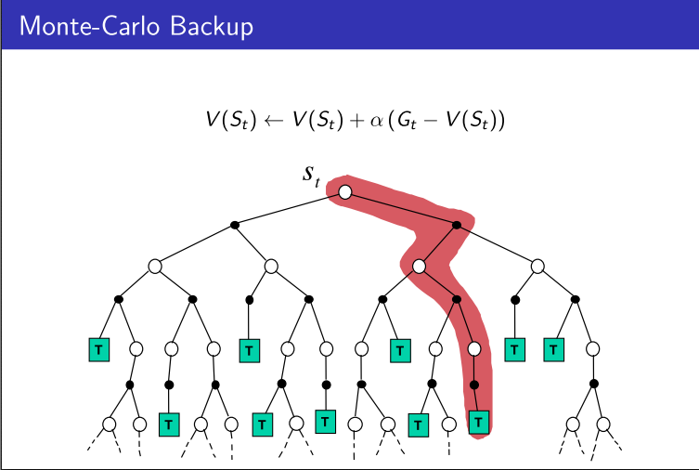
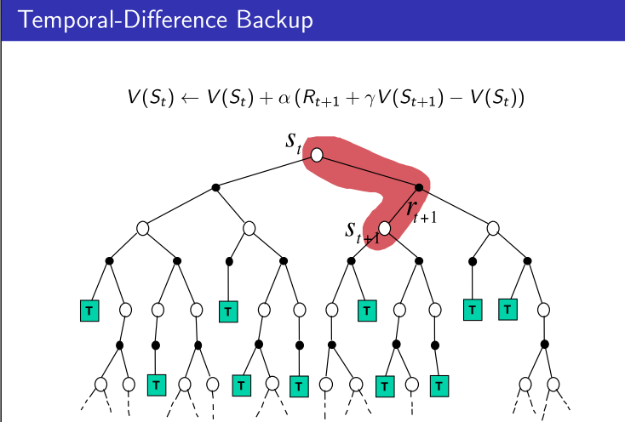
 | Markov Property | Bootstrapping | sampling
DP | Yes | Yes | No
MC | No | No | Yes
TD | Yes | Yes | Yes

Slide 8
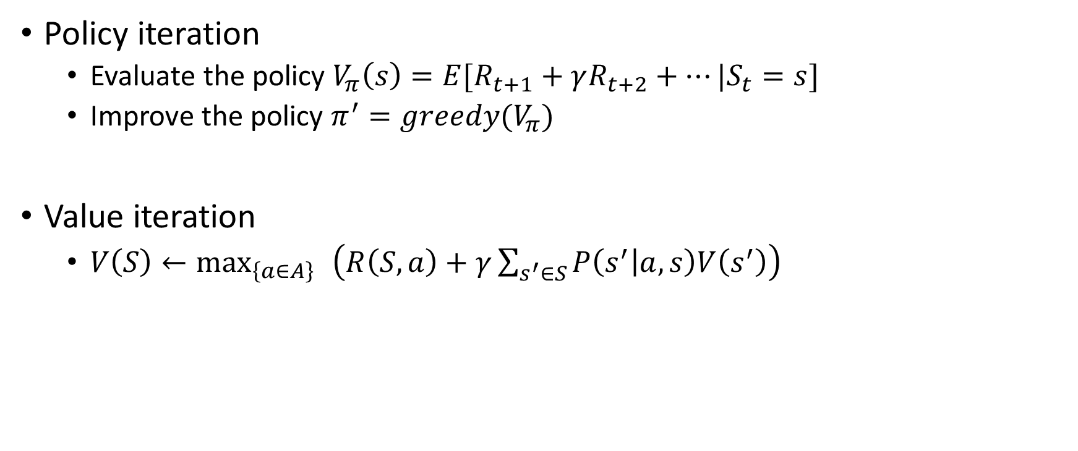
DP
Policy iteration
Evaluate the policy $V_{π}\left(s\right)=E[R_{t+1}+γR_{t+2}+…|S_{t}=s]$
Improve the policy $π^{′}=greedy(V_{π})$
Value iteration
$V\left(S\right)←\max_{\left\{a∈A\right\} }\left(R\left(S,a\right)+γ\sum_{s^{′}∈S}{P\left(s^{′} | a,s\right)V\left(s^{′}\right)}\right)$

Slide 9

MC
$\text{S}\text{1 }\text{,}\text{A}\text{1,}\text{R}\text{1, }\text{S}\text{2,}\text{A}\text{2,}\text{R}\text{2,}…\text{,}\text{SK} \sim π$
$G_{t}=R_{t+1}+γR_{t+2}+γ^{2}R_{t+3}+…$
$V_{π}\left(s\right)=E_{π}[G_{t}|S_{t}=s]$
$V_{π}\left(s\right)←V_{π}\left(s\right)+\frac{1}{n}{(G}_{t}−V_{π}(s))=\frac{n−1}{n} V_{π}\left(s\right)+\frac{1}{n}G_{t}$

Slide 10
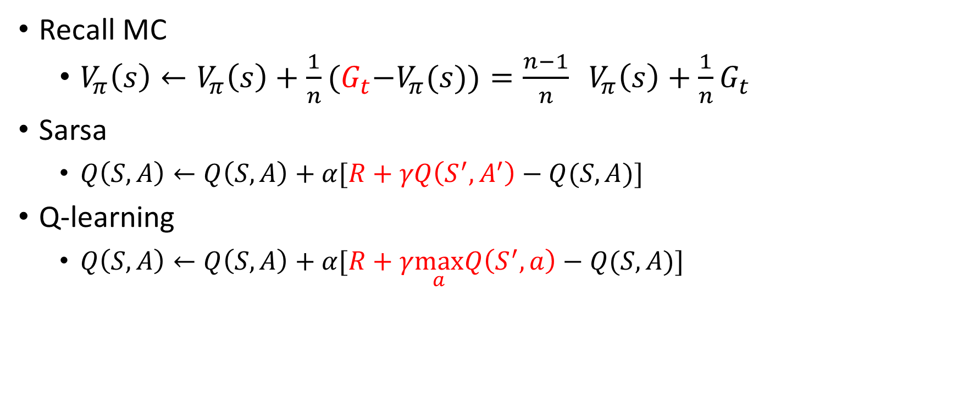
TD
Recall MC
$V_{π}\left(s\right)←V_{π}\left(s\right)+\frac{1}{n}{(G}_{t}−V_{π}(s))=\frac{n−1}{n} V_{π}\left(s\right)+\frac{1}{n}G_{t}$
Sarsa
$Q\left(S,A\right)←Q\left(S,A\right)+α[R+γQ\left(S^{′},A^{′}\right)−Q(S,A)]$
Q-learning
$Q\left(S,A\right)←Q\left(S,A\right)+α[R+γ\max_{a}Q\left(S^{′},a\right)−Q(S,A)]$

Slide 11
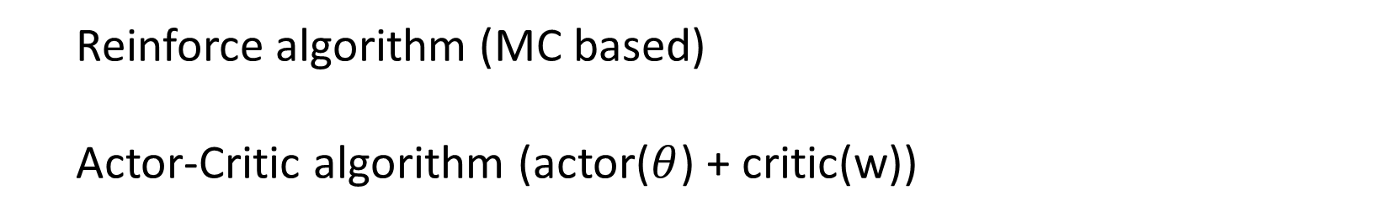

Policy Gradient
$policy :π_{θ}\left(s,a\right)=p\left[a | s;θ\right]$
$Goal :J\left(θ\right)=\sum_{s}{d^{π_{θ}}\left(s\right)\sum_{a}{π_{θ}\left(s,a\right)R_{s}^{a}}}$
Policy gradient theorem : $∇_{θ}J\left(θ\right)=E[∇_{θ}logπ_{θ}\left(s,a\right) Q^{π_{θ} }(s,a)]$
Reinforce algorithm (MC based)
Actor-Critic algorithm (actor($θ$) + critic(w))

Slide 12
Deep reinforcement learning
Improvement of RL
Deep neural network to approximate functions in RL
Express abstract and complex function relation
End to end task
Continuous control task
Implementation of DRL
The definition of objection
Deep value function (DQN)
Deep policy approximation (DDPG)
Problems bring by deep learning
No convergence guarantee
Train slowly
Continuous control task (continuous action)

Slide 13
Convergence speed
Some trick
Asynchronous
Variance reduce
others

Slide 14
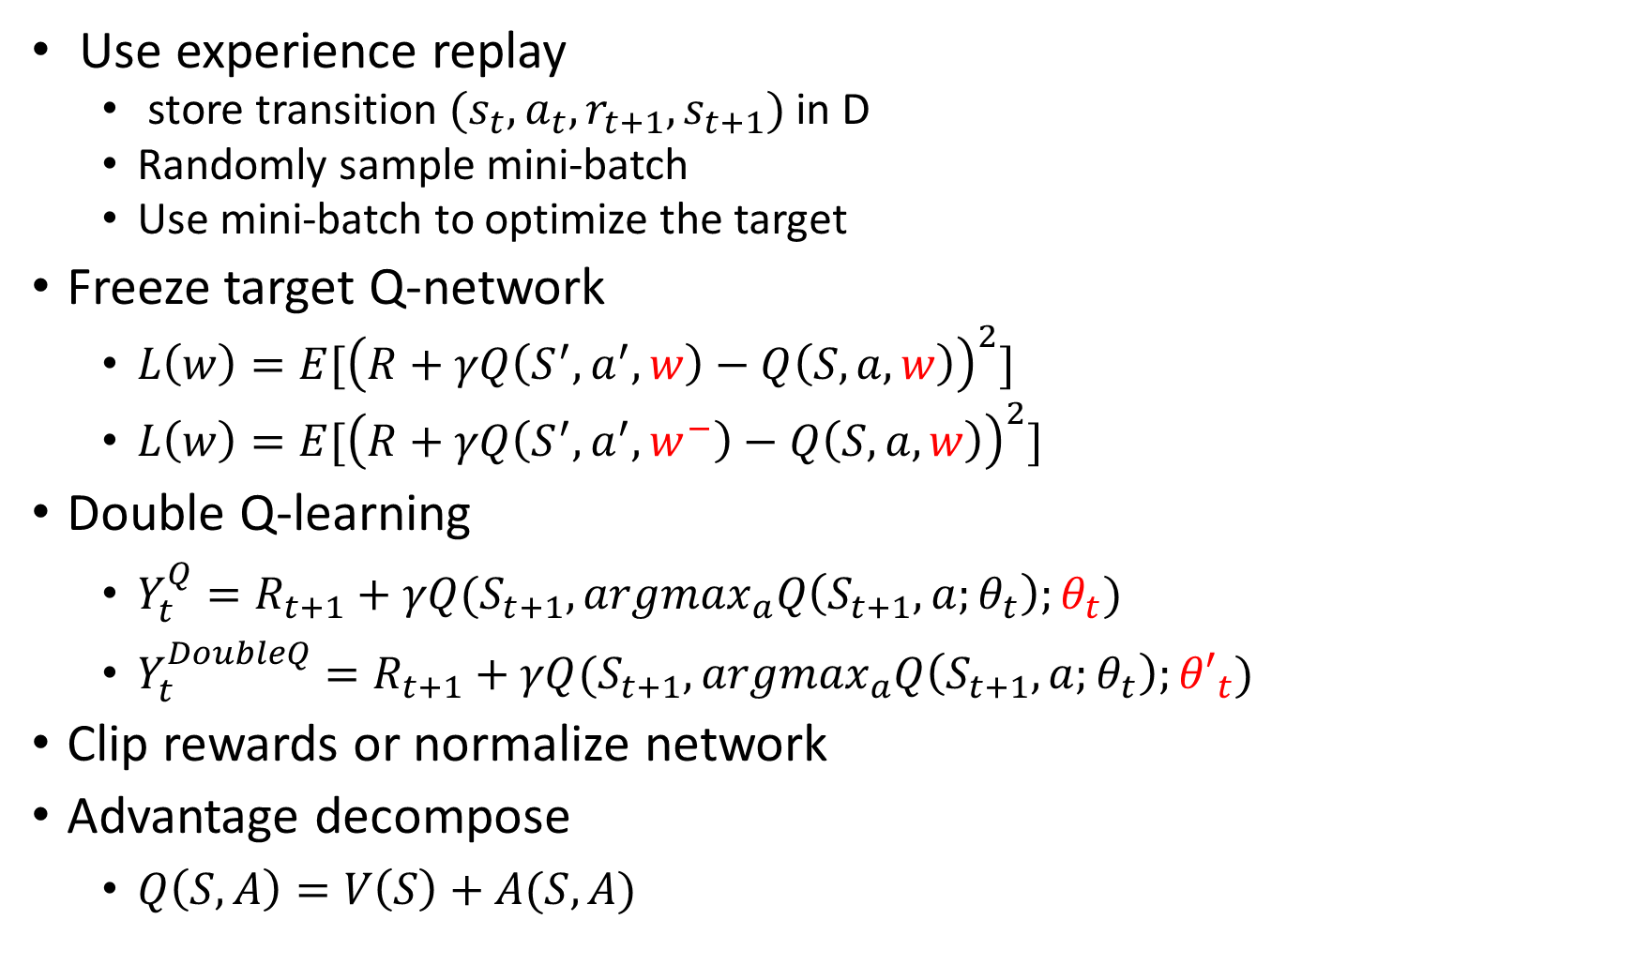
Some trick
Use experience replay
store transition ${(s}_{t},a_{t},r_{t+1},s_{t+1})$ in D
Randomly sample mini-batch
Use mini-batch to optimize the target
Freeze target Q-network
$L\left(w\right)=E[{\left(R+γQ\left(S^{′},a^{′},w\right)−Q\left(S,a,w\right)\right)}^{2}]$
$L\left(w\right)=E[{\left(R+γQ\left(S^{′},a^{′},w^{−}\right)−Q\left(S,a,w\right)\right)}^{2}]$
Double Q-learning
$Y_{t}^{Q}=R_{t+1}+γQ(S_{t+1},argmax_{a}Q\left(S_{t+1},a;θ_{t}\right);θ_{t})$
$Y_{t}^{DoubleQ}=R_{t+1}+γQ(S_{t+1},argmax_{a}Q\left(S_{t+1},a;θ_{t}\right);{θ′}_{t})$
Clip rewards or normalize network
Advantage decompose
$Q\left(S,A\right)=V\left(S\right)+A(S,A)$

Slide 15
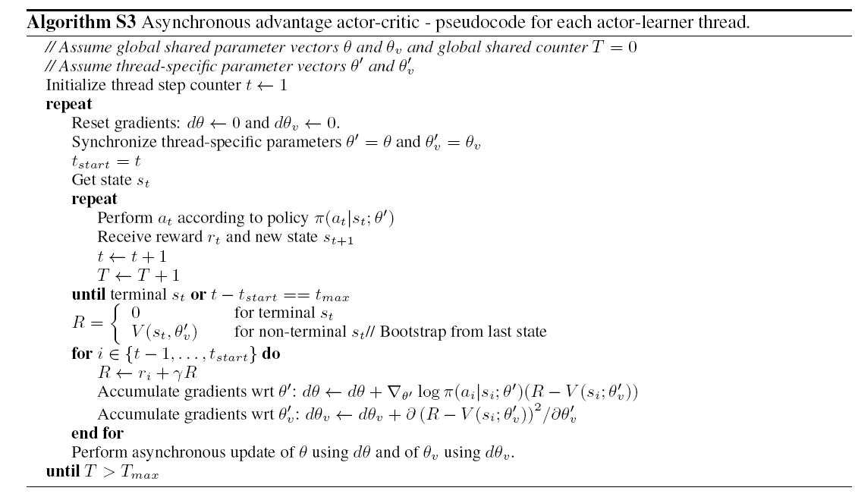
Asynchronous
Mnih, Volodymyr, et al. "Asynchronous methods for deep reinforcement learning." arXiv preprint arXiv:1602.01783 (2016).

Slide 16
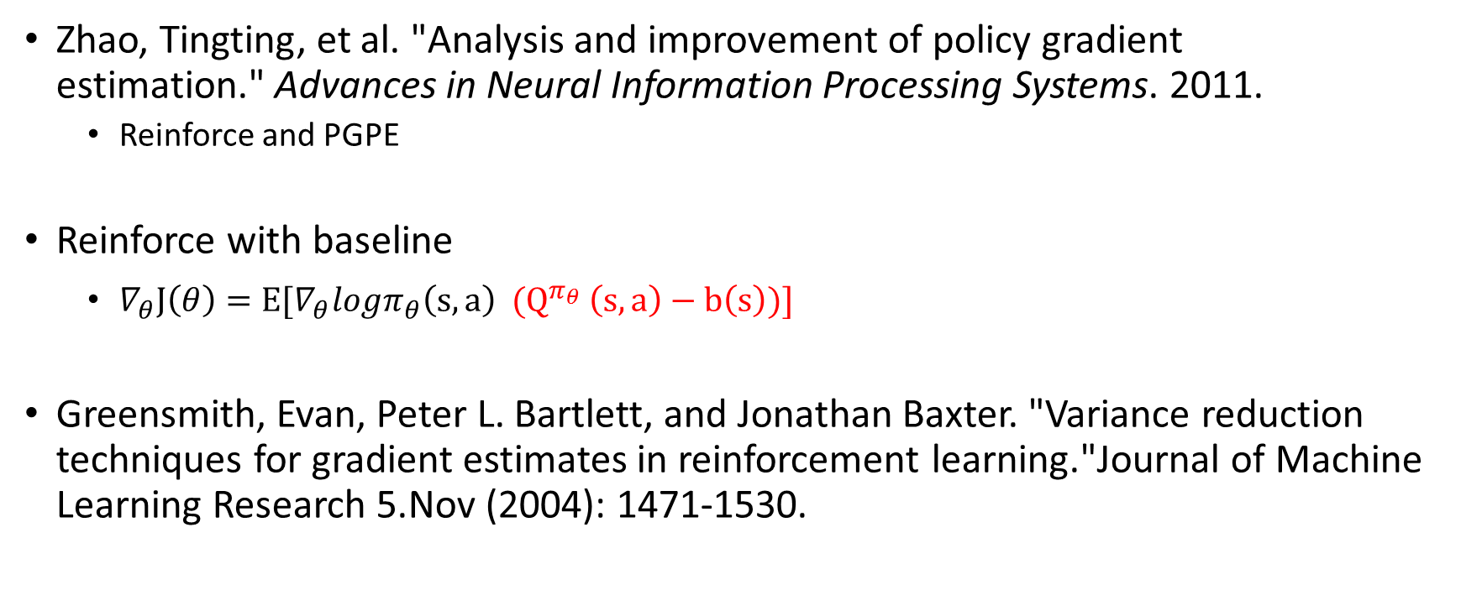
Variance reduce
Zhao, Tingting, et al. "Analysis and improvement of policy gradient estimation." Advances in Neural Information Processing Systems. 2011.
Reinforce and PGPE
Reinforce with baseline
$∇_{θ}J\left(θ\right)=E[∇_{θ}logπ_{θ}\left(s,a\right) {(Q}^{π_{θ} }\left(s,a\right)−b\left(s\right))]$
Greensmith, Evan, Peter L. Bartlett, and Jonathan Baxter. "Variance reduction techniques for gradient estimates in reinforcement learning."Journal of Machine Learning Research 5.Nov (2004): 1471-1530.

Slide 17
Continuous control
Policy gradient based
DPG
DDPG
Value gradient(SVG)
Q-learning based
NAF

Slide 18
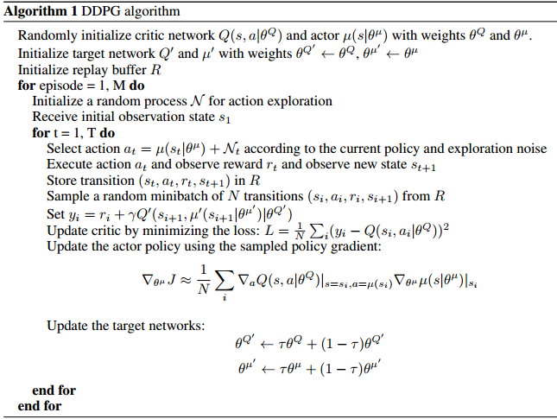
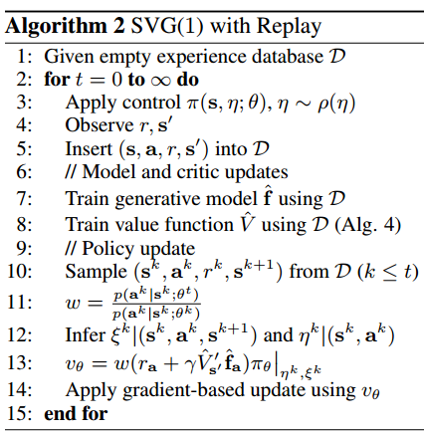

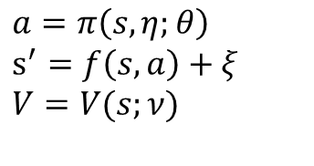
Continuous control
$$∇_{θ}J\left(θ\right)=E[∇_{θ}logπ_{θ}\left(s,a\right) Q^{π_{θ} }(s,a)]$$
$$a=π\left(s,η;θ\right)$$
$$s^{′}=f\left(s,a\right)+ξ$$
$$V=V(s;ν)$$

Slide 19
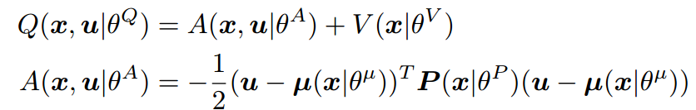
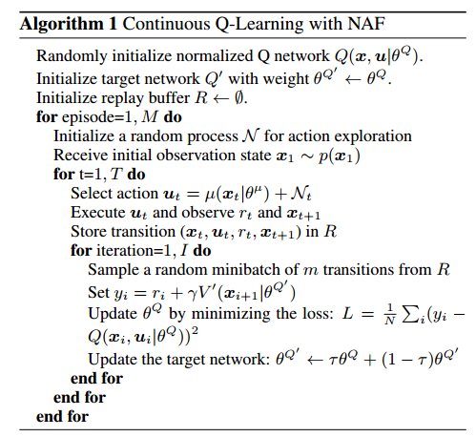
Continuous control
Continuous Q-Learning with Normalized Advantage Functions
$$Q\left(S,A\right)←Q\left(S,A\right)+α[R+γ\max_{a}Q\left(S^{′},a\right)−Q(S,A)]$$

Slide 20
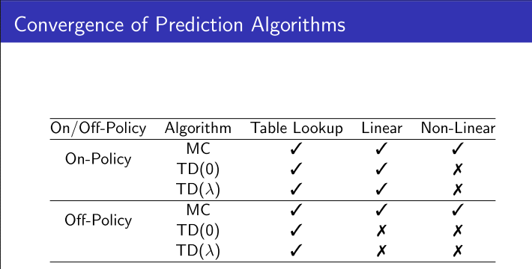
My thinking
Is there any theoretical analysis of the convergence about RL algorithms and functional approximation

Slide 21
My thinking
Many tricks and improvements make algorithms work for real task.
It seems most of them only have intuitive explanation.
Such as advantage decomposition.
Can we give some theoretical explanation about these tricks and improvements.

Slide 22
My thinking
Analysis
Understand
Improve

Slide 23
Thanks

Slide 24
Other issue
POMDP
Exploration and exploitation

Slide 25
Deep reinforcement learning
Implementation of DRL
DQN(Playing Atari with Deep Reinforcement Learning )

