Slide 1
Markov Decision Processes
Infinite Horizon Problems
Alan Fern *
* Based in part on slides by Craig Boutilier and Daniel Weld

Slide 2
What is a solution to an MDP?
MDP Planning Problem:
Input: an MDP (S,A,R,T)
Output: a policy that achieves an “optimal value”
This depends on how we define the value of a policy
There are several choices and the solution algorithms depend on the choice
We will consider two common choices
  Finite-Horizon Value
  Infinite Horizon Discounted Value

Slide 3
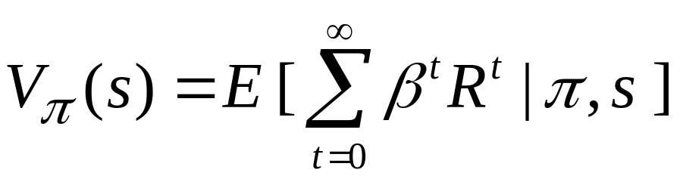
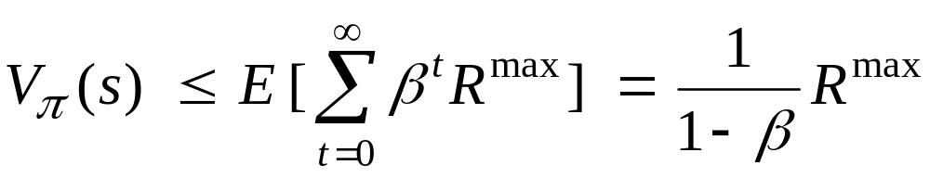
Discounted Infinite Horizon MDPs
Defining value as total reward is problematic with infinite horizons
  many or all policies have infinite expected reward
  some MDPs are ok (e.g., zero-cost absorbing states)
“Trick”: introduce discount factor 0 ≤ β < 1
  future rewards discounted by β per time step
Note:
Motivation: economic? prob of death? convenience?
Bounded Value

Slide 4
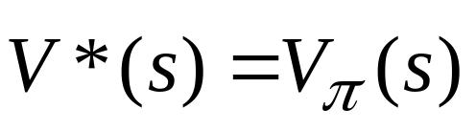
Notes: Discounted Infinite Horizon
Optimal policies guaranteed to exist (Howard, 1960)
  I.e. there is a policy that maximizes value at each state
Furthermore there is always an optimal stationary policy
  Intuition: why would we change action at s at a new time when there is always forever ahead
  We define for some optimal stationary π

Slide 5
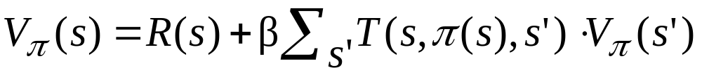
Policy Evaluation
Value equation for fixed policy
  Immediate reward + Expected discounted future reward
How can we compute the value function for a policy?
  we are given R and T
  linear system with n variables and n constraints
    Variables are values of states: V(s1),…,V(sn)
    Constraints: one value equation (above) per state
  Use linear algebra to solve for V (e.g. matrix inverse)
derive this from original definition

Slide 6
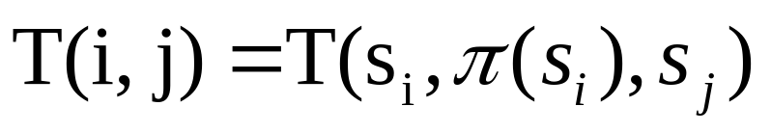
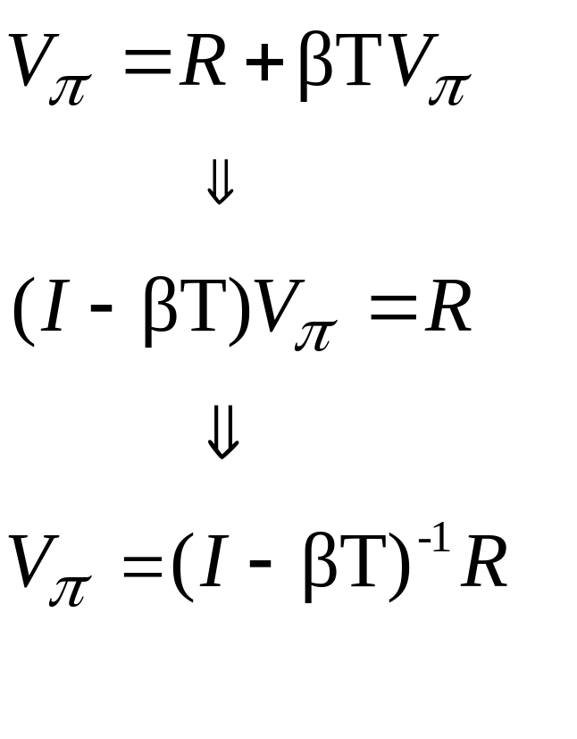
Policy Evaluation via Matrix Inverse
V_{π} and R are n-dimensional column vector (one element for each state)
T is an nxn matrix s.t.

Slide 7
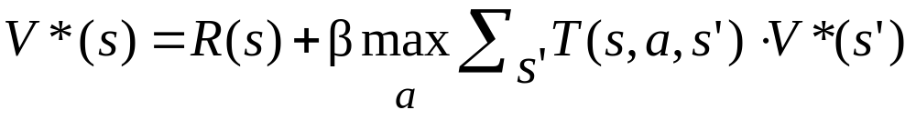
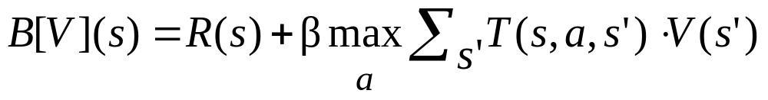
Computing an Optimal Value Function
Bellman equation for optimal value function
  Bellman proved this is always true for an optimal value function
How can we compute the optimal value function?
  The MAX operator makes the system non-linear, so the problem is more difficult than policy evaluation
Notice that the optimal value function is a fixed-point of the Bellman Backup operator B (i.e. B[V*]=V*)
  B takes a value function as input and returns a new value function

Slide 8
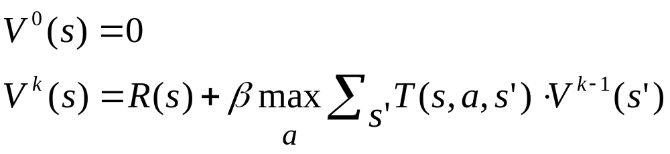
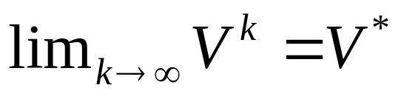
Value Iteration
Can compute optimal policy using value iteration based on Bellman backups, just like finite-horizon problems (but include discount term)
Will it converge to optimal value function as k gets large?
  Yes.
When should we stop in practice?

Slide 9
Convergence: Contraction Property
B[V] is a contraction operator on value functions
That is, operator B satisfies:
For any V and V’, || B[V] – B[V’] || ≤ β || V – V’ ||
Here ||V|| is the max-norm, which returns the maximum element of the vector.
  E.g. ||(0.1 100 5 6)|| = 100
So applying a Bellman backup to any two value functions causes them to get closer together in the max-norm sense!

Slide 10
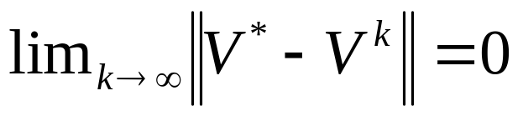
Convergence
Using the contraction property we can prove convergence of value iteration.
Proof:
  For any V: || V* - B[V] || = || B[V*] – B[V] || ≤ β|| V* - V||
  So applying Bellman backup to any value function V brings us closer to V* by a constant factor β in max-norm sense
  This means that ||V^{k} – V*|| ≤ β^{k} || V* - V⁰ ||
  Thus

Slide 11
Stopping Condition
Want to stop when we can guarantee the value function is near optimal.
Key property:
If ||V^{k} - V^{k-1}||≤ ε then ||V^{k} – V*|| ≤ εβ /(1-β)
You’ll show this in your homework
Continue iteration until ||V^{k} - V^{k-1}||≤ ε
  Select small enough ε for desired error guarantee

Slide 12
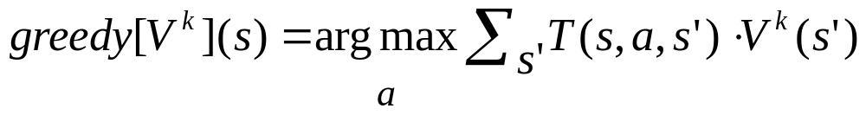
How to Act
Given a V^{k} from value iteration that closely approximates V*, what should we use as our policy?
Use greedy policy: (one step lookahead)
Note that the value of greedy policy may not be equal to V^{k}
Let V^{G} be the value of the greedy policy? How close is V^{G} to V*?
  I.e. how close is our greedy policy to optimal after k iterations

Slide 13
How to Act
Given a V^{k} that closely approximates V*, what should we use as our policy?
Use greedy policy: (one step lookahead)
This selects the action that looks best if we assume that we get value V^{k} in one step
How good is this policy?

Slide 14
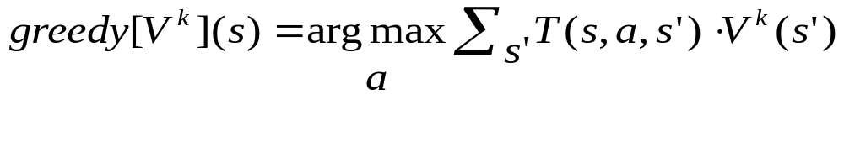
Value of Greedy Policy
Define V_{g} to be the value of this greedy policy
  This is likely not the same as V^{k} (convince yourself of this)
Property: If ||V^{k} – V*|| ≤ λ then ||V_{g} - V*|| ≤ 2λβ /(1-β)
  Thus, V_{g} is not too far from optimal if V^{k} is close to optimal
Set stopping condition so that V_{g} has desired accuracy
Furthermore, there is a finite ε s.t. greedy policy is optimal
  That is, even if value estimate is off, greedy policy is optimal once it is close enough. Why?

Slide 15
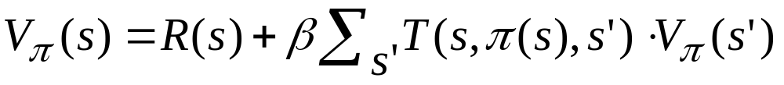
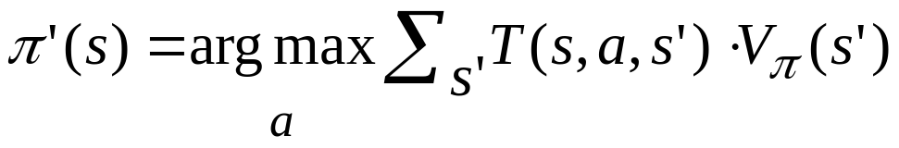
Optimization via Policy Iteration
Recall, given policy, can compute its value exactly:
Policy iteration exploits this: iterates steps of policy evaluation and policy improvement
1. Choose a random policy π
2. Loop:
(a) Evaluate V_{π}
(b) For each s in S, set
(c) Replace π with π’
Until no improving action possible at any state
Policy improvement

Slide 16
Policy Iteration: Convergence
Policy improvement guarantees that π’ is no worse than π. Further if π is not optimal then π’ is strictly better in at least one state.
  Local improvements lead to global improvement!
  For proof sketch see http://webdocs.cs.ualberta.ca/~sutton/book/ebook/node42.html
  I’ll walk you through a proof in a HW problem
Convergence assured
  No local maxima in value space (i.e. an optimal policy exists)
  Since finite number of policies and each step improves value, then must converge to optimal
Gives exact value of optimal policy

Slide 17
Policy Iteration Complexity
Each iteration runs in polynomial time in the number of states and actions
There are at most |A|^{n} policies and PI never repeats a policy
  So at most an exponential number of iteations
  Not a very good complexity bound
Empirically O(n) iterations are required
  Challenge: try to generate an MDP that requires more than that n iterations
Still no polynomial bound on the number of PI iterations (open problem)!
  But maybe not anymore …..

Slide 18
Value Iteration vs. Policy Iteration
Which is faster? VI or PI
  It depends on the problem
VI takes more iterations than PI, but PI requires more time on each iteration
  PI must perform policy evaluation on each iteration which involves solving a linear system
VI is easier to implement since it does not require the policy evaluation step
We will see that both algorithms will serve as inspiration for more advanced algorithms

Slide 19
Recap: things you should know
What is an MDP?
What is a policy?
  Stationary and non-stationary
What is a value function?
  Finite-horizon and infinite horizon
How to evaluate policies?
  Finite-horizon and infinite horizon
  Time/space complexity?
How to optimize policies?
  Finite-horizon and infinite horizon
  Time/space complexity?
  Why they are correct?

