Slide 1
Deep Reinforcement Learning
Yue Wang

Slide 2
content
What is reinforcement learning
How to solve reinforcement learning
Why was reinforcement learning combined with deep learning

Slide 4
A simple example
Agent Environment
State Reward Action Observation Return
Exploration Exploitation

Slide 6
What is reinforcement learning
Machine learning
Supervised learning
Unsupervised learning
Reinforcement learning
y=f(x)
f(x)
y=f(x) z

Slide 7
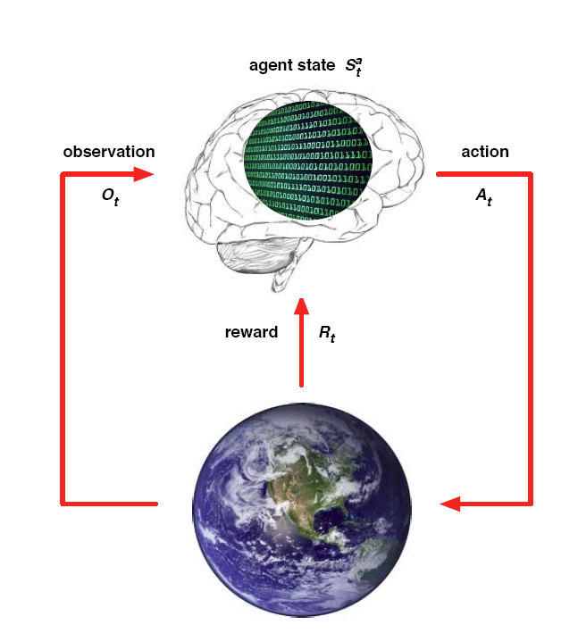
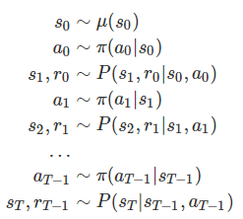


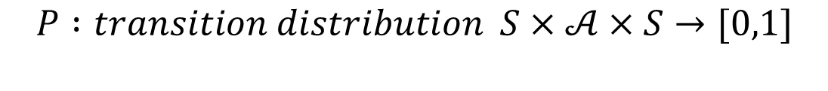

MDP
$$ℳ=(S,𝒜,R,P,γ)$$
$$S : state space is a (bounded) subset of the Euclidean space$$
$$𝒜: action space (finite\left|𝒜\right|<∞)$$
$$R :reward of a state−action pair S×𝒜×S→R$$
$$P :transition distribution S×𝒜×S→[0,1]$$
$$γ :discount factor γ∈[0,1]$$

Slide 8
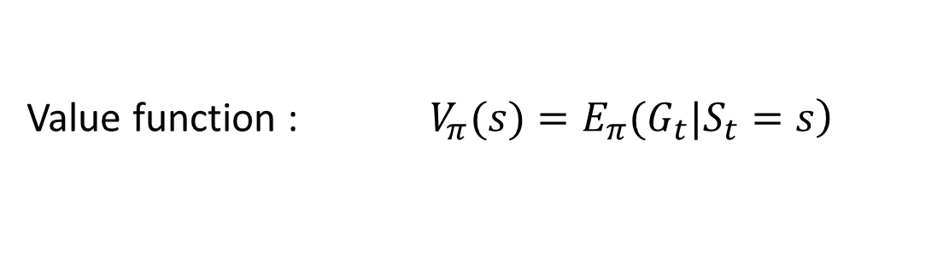
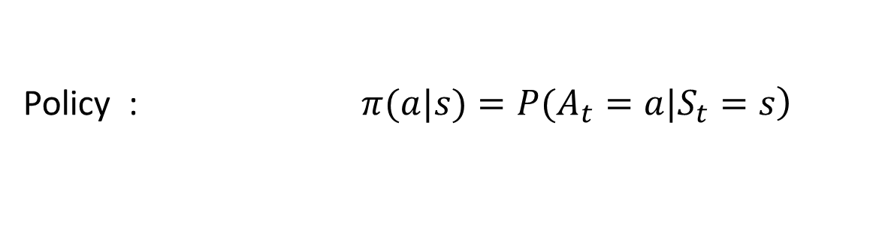
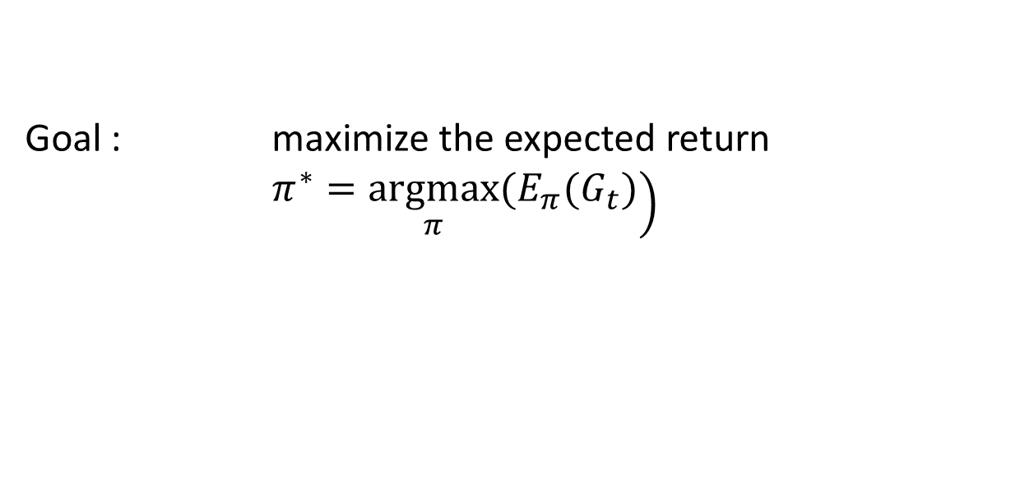
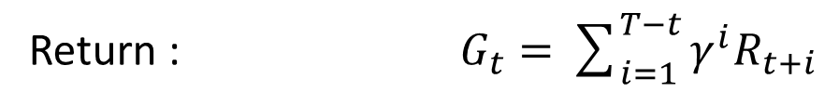
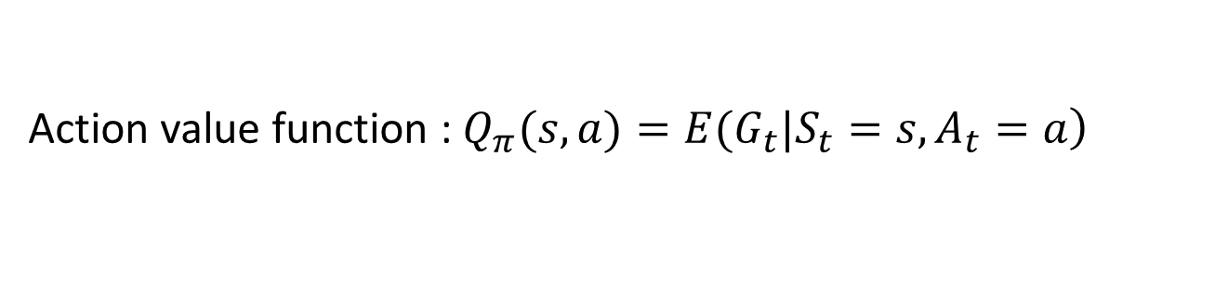
Reinforcement learning
Notation
Return : $G_{t}=\sum_{i=1}^{T−t}{γ^{i}R_{t+i}}$
Policy : $\left.π(a|s)=P(A_{t}=a|S_{t}=s\right)$
Value function : $\left.V_{π}(s)=E_{π}(G_{t}|S_{t}=s\right)$
Action value function : $\left.Q_{π}(s,a)=E(G_{t}|S_{t}=s,A_{t}=a\right)$
Goal : maximize the expected return
$\left.π^{∗}=\underset{π}{argmax}(E_{π}(G_{t})\right)$

Slide 9

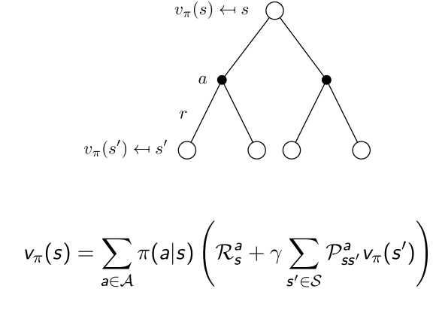
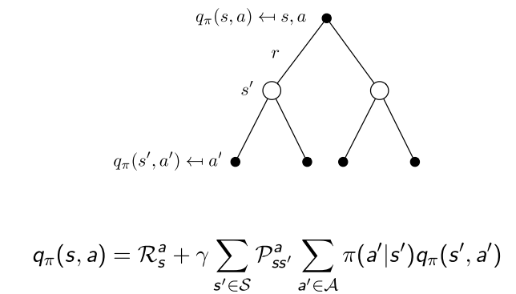
Value function

Slide 10
POMDP
Markov Models |  | Do we have control over the state transitions?
 |  | No | Yes
Are the states completely observable? | Yes | Markov Chain | MDP
 | No | HMM Hidden Markov Model | POMDP Partially Observable Markov Decision Process

Slide 11
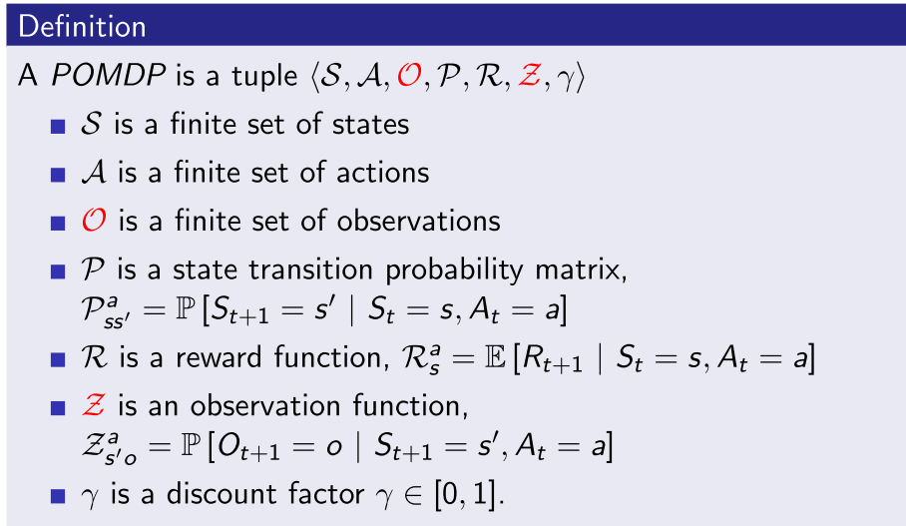
POMDP

Slide 14
Algorithms
Value function
DP
MC
TD
Policy
Reinforce
Actor-Critic
Aim
The relationship and the difference
What problem do they solve

Slide 15
Algorithms DP (Dynamic Programming)
Model based
Two method :
Policy iteration ( policy evaluation -> policy improvement )
Value iteration

Slide 16
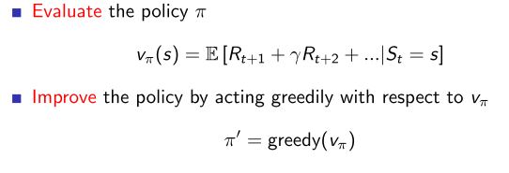
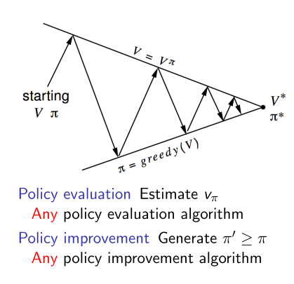
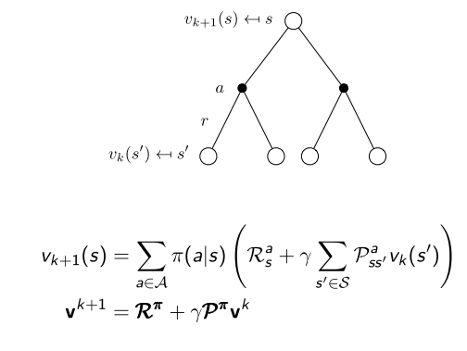
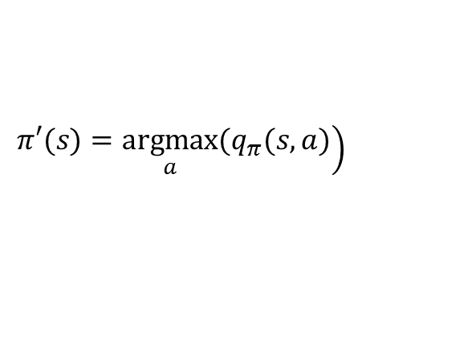
Policy iteration
$$\left.π′(s)=\underset{a}{argmax}(q_{π}(s,a)\right)$$

Slide 17
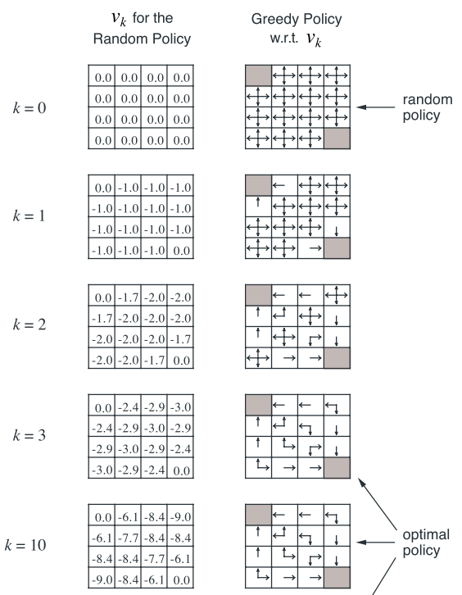
An example

Slide 18
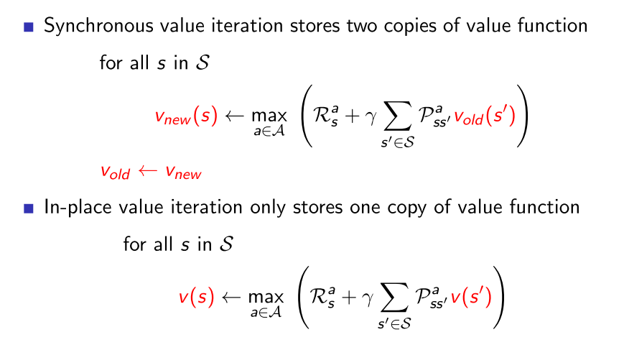
Value iteration

Slide 19
An example
0 | 0 | 0 | 0
0 | 0 | 0 | 0
0 | 0 | 0 | 0
0 | 0 | 0 | 100
0 | -1 | -1 | -1
-1 | -1 | -1 | -1
-1 | -1 | -1 | 99
-1 | -1 | 99 | 100
0 | -1 | -2 | -2
-1 | -2 | -2 | 98
-2 | -2 | 98 | 99
-2 | 98 | 99 | 100
0 | -1 | -2 | 97
-1 | -2 | 97 | 98
-2 | 97 | 98 | 99
97 | 98 | 99 | 100
0 | -1 | 96 | 97
-1 | 96 | 97 | 98
96 | 97 | 98 | 99
97 | 98 | 99 | 100
0 | 95 | 96 | 97
95 | 96 | 97 | 98
96 | 97 | 98 | 99
97 | 98 | 99 | 100
Convergence !

Slide 20
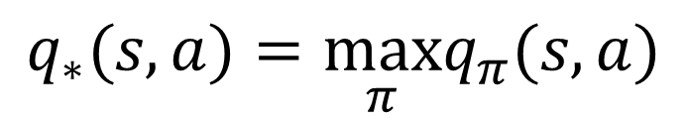
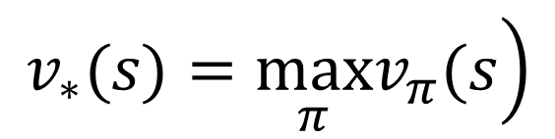
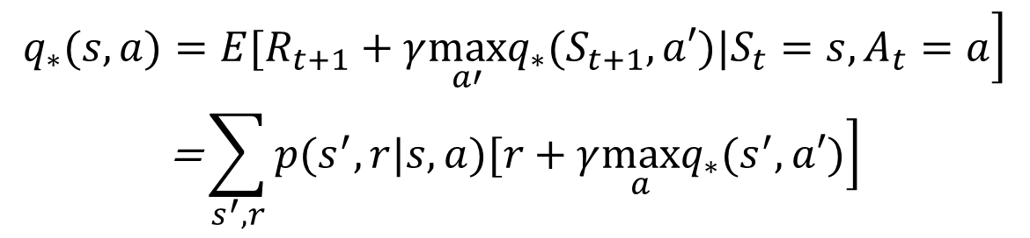
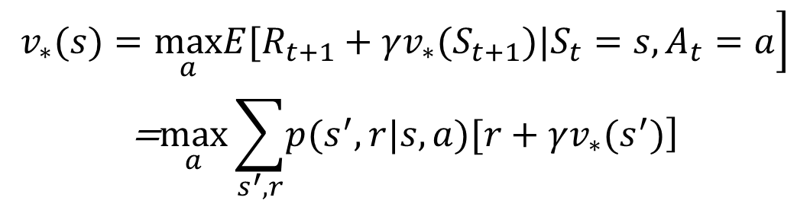
Optimal value function
$$\left.v_{∗}(s)=\max_{π}v_{π}(s\right)$$
$$q_{∗}(s,a)=\max_{π}q_{π}(s,a)$$
$$\left.q_{∗}(s,a)=E(R_{t+1}+γv_{∗}(S_{t+1})|S_{t}=s,A_{t}=a\right)$$
$$\begin{matrix}\left.v_{∗}(s)=\max_{a}E[R_{t+1}+γv_{∗}(S_{t+1})|S_{t}=s,A_{t}=a\right] \\ \text{=}\max_{a}\sum_{s^{′},r}{\left.p(s^{′},r|s,a)[r+γv_{∗}(s^{′})\right]}\end{matrix}$$
$$\begin{matrix}\left.q_{∗}(s,a)=E[R_{t+1}+γ\max_{a′}q_{∗}(S_{t+1},a′)|S_{t}=s,A_{t}=a\right] \\ \text{=}\sum_{s^{′},r}{\left.p(s^{′},r|s,a)[r+γ\max_{a}q_{∗}(s^{′},a′)\right]}\end{matrix}$$

Slide 21
Algorithms MC (Monte Carlo)
Model free
Episodic MDP
value = mean return
On policy and off policy !

Slide 22

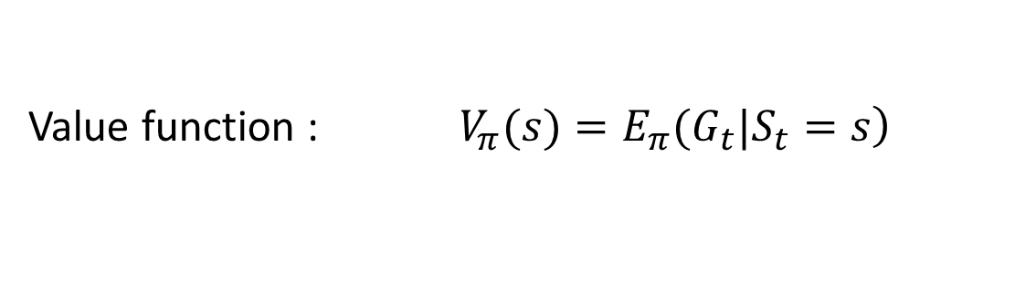
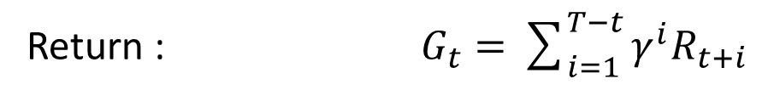
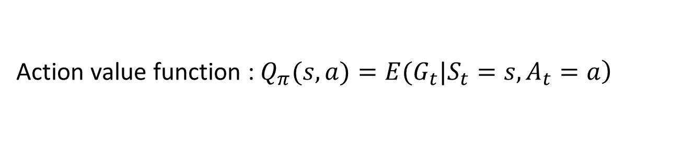
Initial MC algorithms
Return : $G_{t}=\sum_{i=1}^{T−t}{γ^{i}R_{t+i}}$
E for policy evaluation
I for policy improvement
Value function : $\left.V_{π}(s)=E_{π}(G_{t}|S_{t}=s\right)$
Action value function : $\left.Q_{π}(s,a)=E(G_{t}|S_{t}=s,A_{t}=a\right)$
Is there any problem ? Recall the simple game before we start.
Trade off between exploration and exploitation

Slide 23
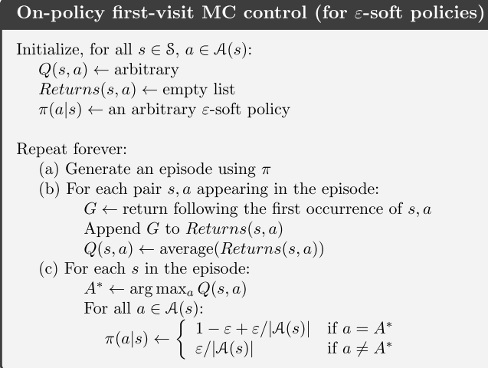

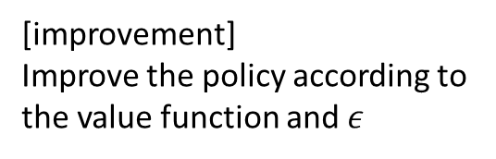
On policy and off policy
$$ε−greedy or ε−soft$$
[evaluation]
Compute the value function according to the expectation
[improvement]
Improve the policy according to the value function and $ε$

Slide 24

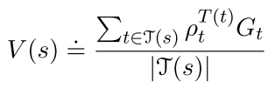
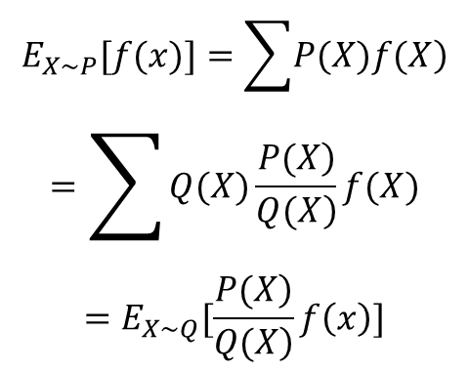
On policy and off policy
Behavior policy
Target policy
$$\begin{matrix}E_{X\sim P}[f(x)]=\sum{\left.P(X)f(X\right)} \\ =\sum{Q(X)\frac{\left.P(X\right)}{\left.Q(X\right)}f(X}) \\ =E_{X\sim Q}[\frac{\left.P(X\right)}{\left.Q(X\right)}f\left(x\right)]\end{matrix}$$

Slide 25
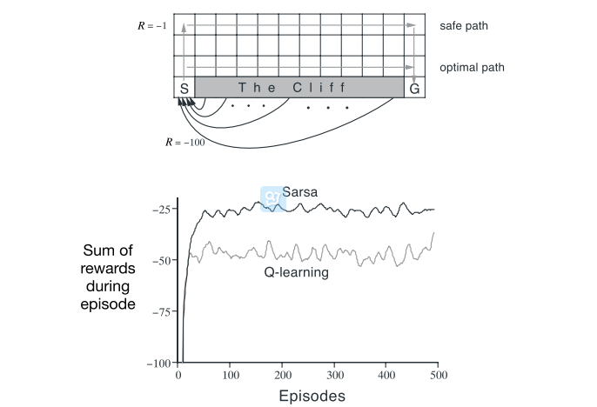
An example

Slide 26
Algorithms TD (Temporal Difference)
Model free
Three important methods :
TD(0)
Sarsa
Q-leaning

Slide 27
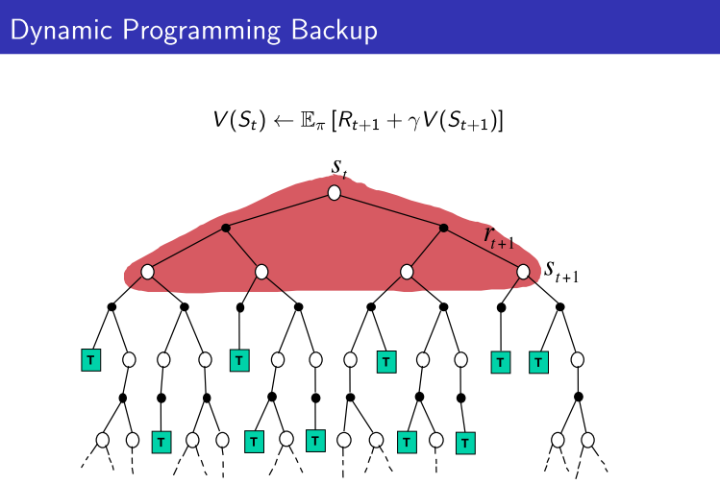
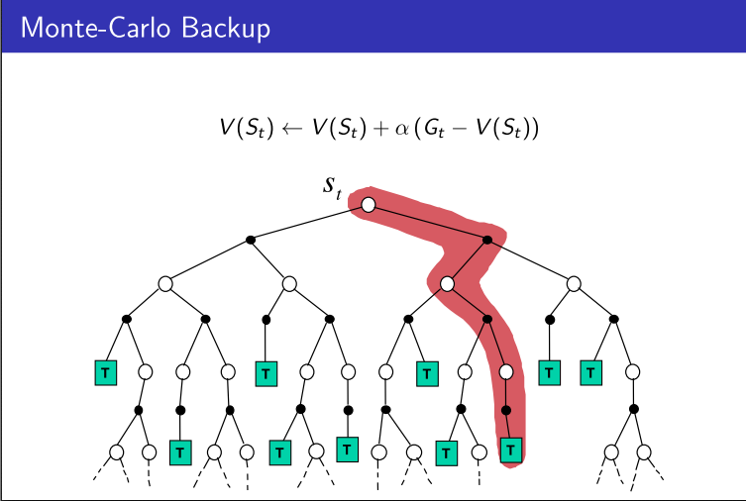
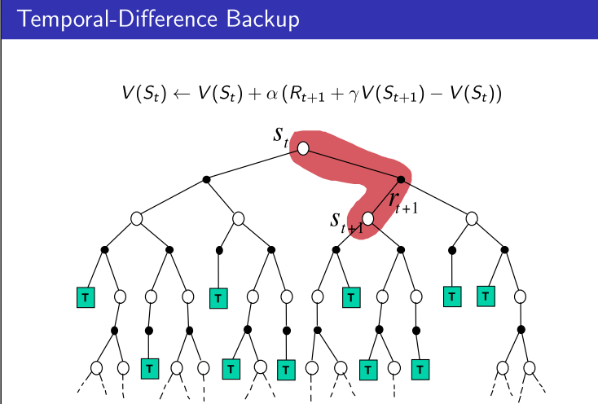
 | Markov Property | Bootstrapping | sampling
DP | Yes | Yes | No
MC | No | No | Yes
TD | Yes | Yes | Yes

