Slide 1
Deep Reinforcement Learning
Yue Wang

Slide 2
content
RL and classic algorithms
Deep RL introduction
Some topic

Slide 3
Recall of reinforcement learning
MDP and POMDP
Algorithms to solve RL

Slide 4
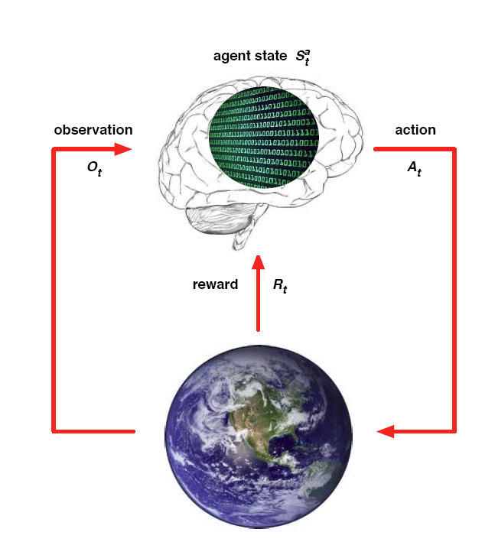
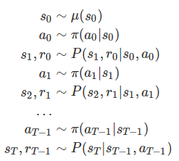


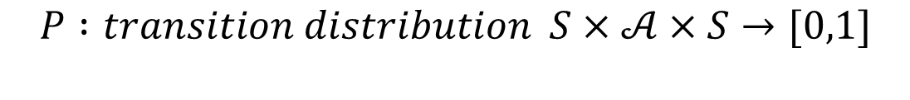

MDP
$$ℳ=(S,𝒜,R,P,γ)$$
$$S : state space is a (bounded) subset of the Euclidean space$$
$$𝒜: action space (finite\left|𝒜\right|<∞)$$
$$R :reward of a state−action pair S×𝒜×S→R$$
$$P :transition distribution S×𝒜×S→[0,1]$$
$$γ :discount factor γ∈[0,1]$$

Slide 5
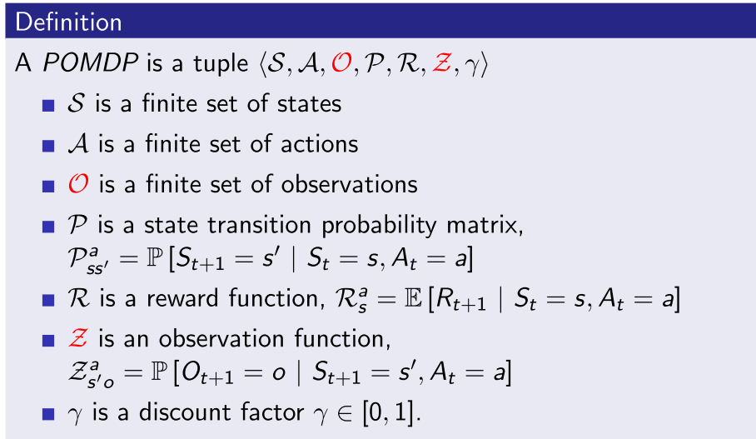
POMDP

Slide 6
Algorithms
Value function based
DP
Policy iteration
Value iteration
MC
On policy
Off policy
TD
Sarsa
Q-learning
Policy Gradient
Reinforce
Actor-Critic

Slide 7
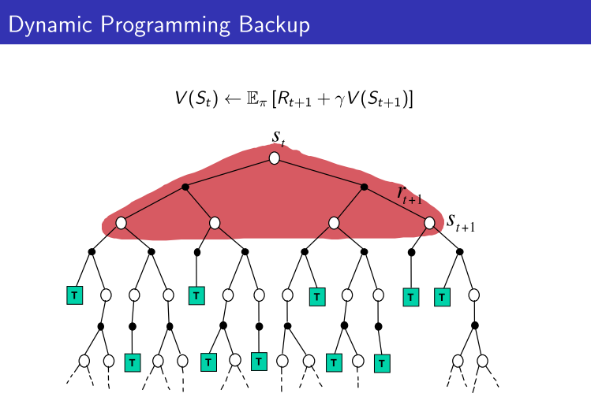
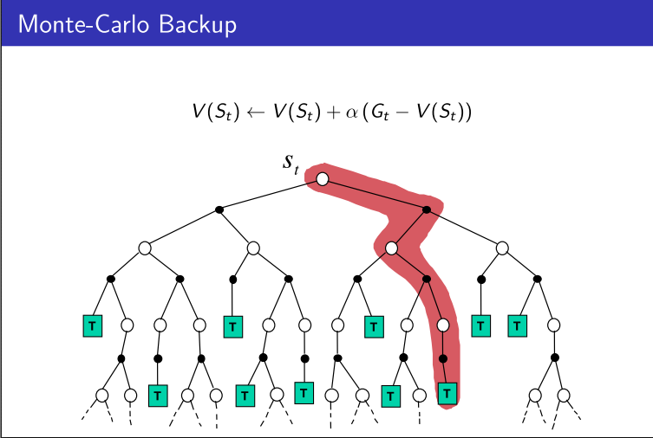
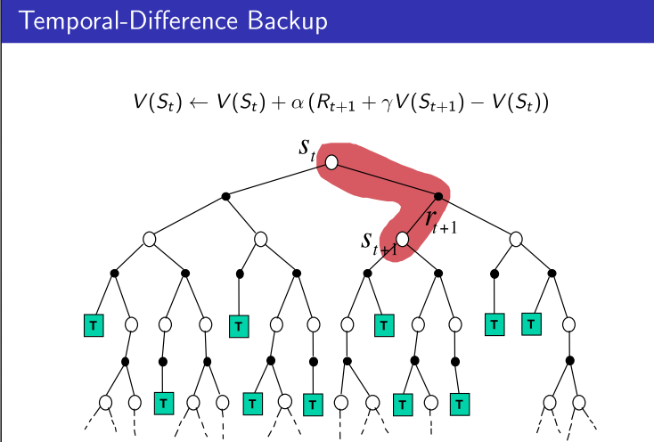
 | Markov Property | Bootstrapping | sampling
DP | Yes | Yes | No
MC | No | No | Yes
TD | Yes | Yes | Yes

Slide 8
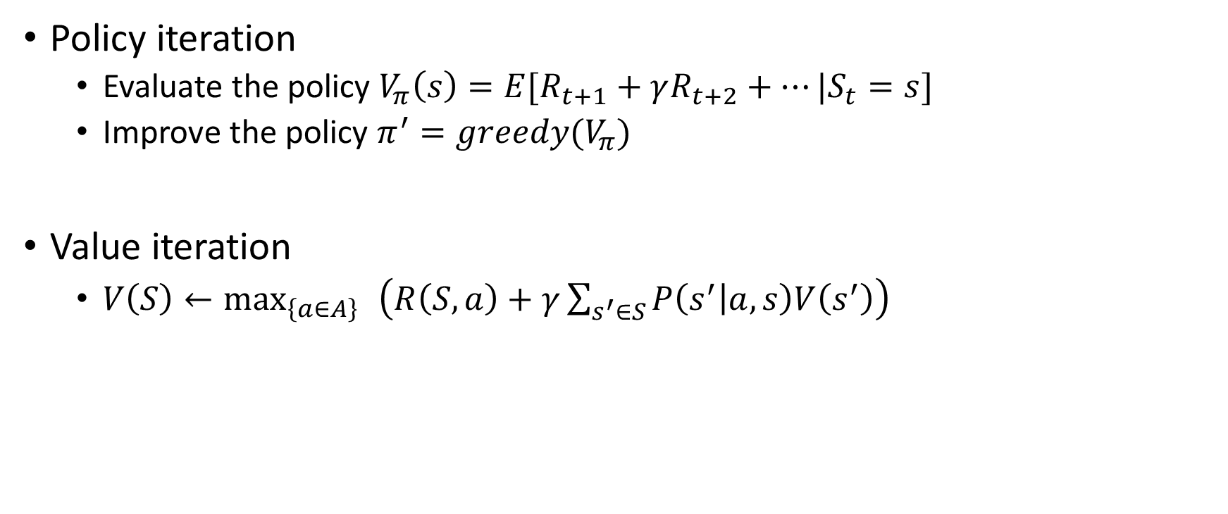
DP
Policy iteration
Evaluate the policy $V_{π}\left(s\right)=E[R_{t+1}+γR_{t+2}+…|S_{t}=s]$
Improve the policy $π^{′}=greedy(V_{π})$
Value iteration
$V\left(S\right)←\max_{\left\{a∈A\right\} }\left(R\left(S,a\right)+γ\sum_{s^{′}∈S}{P\left(s^{′} | a,s\right)V\left(s^{′}\right)}\right)$

Slide 9

MC
$\text{S}\text{1 }\text{,}\text{A}\text{1,}\text{R}\text{1, }\text{S}\text{2,}\text{A}\text{2,}\text{R}\text{2,}…\text{,}\text{SK} \sim π$
$G_{t}=R_{t+1}+γR_{t+2}+γ^{2}R_{t+3}+…$
$V_{π}\left(s\right)=E_{π}[G_{t}|S_{t}=s]$
$V_{π}\left(s\right)←V_{π}\left(s\right)+\frac{1}{n}{(G}_{t}−V_{π}(s))=\frac{n−1}{n} V_{π}\left(s\right)+\frac{1}{n}G_{t}$

Slide 10
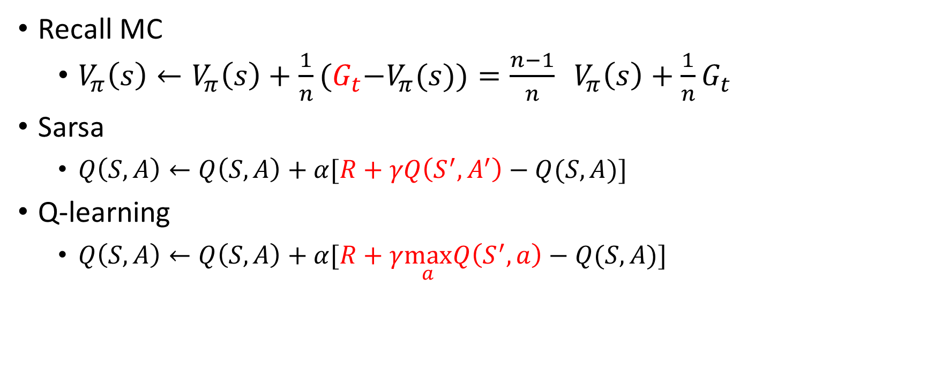
TD
Recall MC
$V_{π}\left(s\right)←V_{π}\left(s\right)+\frac{1}{n}{(G}_{t}−V_{π}(s))=\frac{n−1}{n} V_{π}\left(s\right)+\frac{1}{n}G_{t}$
Sarsa
$Q\left(S,A\right)←Q\left(S,A\right)+α[R+γQ\left(S^{′},A^{′}\right)−Q(S,A)]$
Q-learning
$Q\left(S,A\right)←Q\left(S,A\right)+α[R+γ\max_{a}Q\left(S^{′},a\right)−Q(S,A)]$

Slide 11
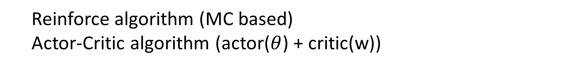

Policy Gradient
$policy :π_{θ}\left(s,a\right)=p\left[a | s,θ\right]$
$Goal :J\left(θ\right)=\sum_{s}{d^{π_{θ}}\left(s\right)\sum_{a}{π_{θ}\left(s,a\right)R_{s}^{a}}}$
Policy gradient theorem : $∇_{θ}J\left(θ\right)=E[∇_{θ}logπ_{θ}\left(s,a\right) Q^{π_{θ} }(s,a)]$
Reinforce algorithm (MC based)
Actor-Critic algorithm (actor($θ$) + critic(w))

Slide 12
Deep reinforcement learning
Improvement of RL
Deep neural network to approximate functions in RL
End to end task
Continuous control task
Implementation of DRL
Deep value function
Deep policy approximation
Problems bring by deep learning
No convergence guarantee
Exploration

Slide 13
Deep reinforcement learning
Implementation of DRL
DQN(Playing Atari with Deep Reinforcement Learning )

Slide 15
Continuous control
Policy gradient based
DPG
DDPG
Value gradient
Q-learning based
NAF

Slide 16
Convergence speed
Some trick
Asynchronous
Variance reduce
others

Slide 17
Other issue
POMDP
Exploration

