Slide 1
Torch Introduction
Xiang Li
2016/07/25

Slide 2
Outline
Overview of Torch & Basic Usage
Download and Setup
Resources

Slide 3
Outline
Overview of Torch & Basic Usage
Download and Setup
Resources

Slide 4

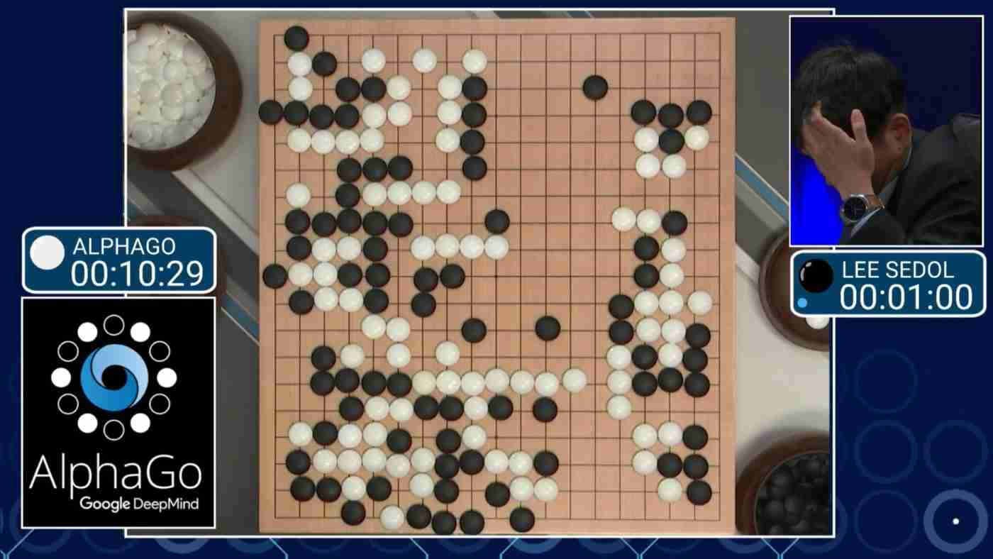
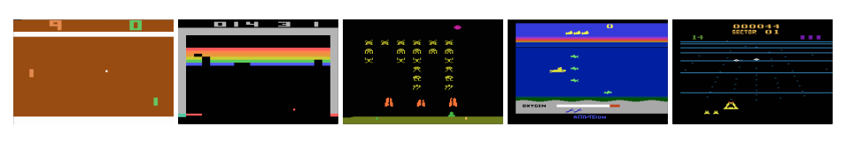
Google Deepmind / Facebook AI
https://github.com/facebookresearch/darkforestGo
Lua →
Torch7
Notes:
Google’s DeepMind artificial intelligence (AI) research group today announced that for all future research it will use TensorFlow, a machine learning library that Google open-sourced last year, instead of Torch, an older framework.
APRIL 29, 2016

Slide 5
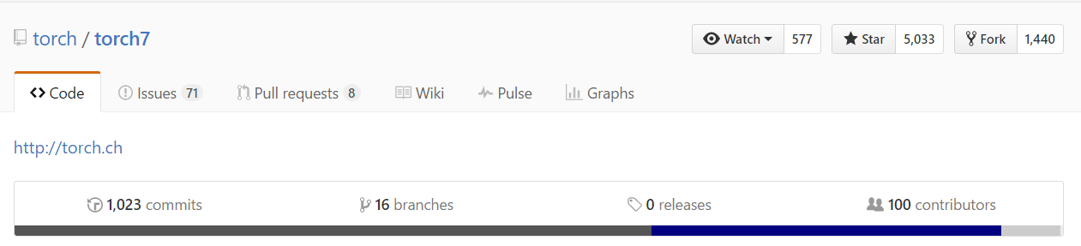
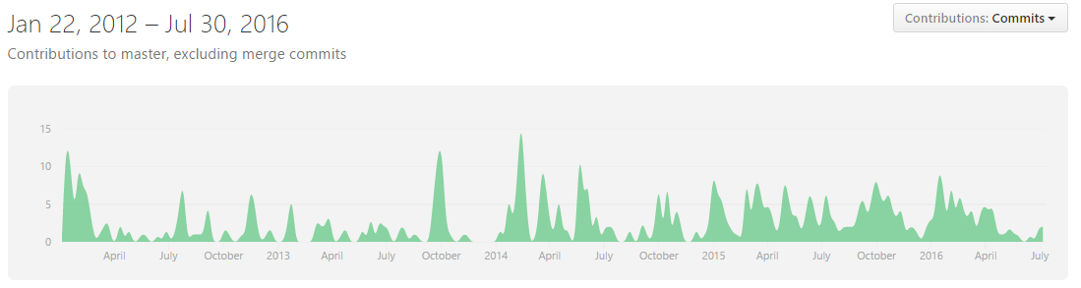
Popularity
Notes:
Google’s DeepMind artificial intelligence (AI) research group today announced that for all future research it will use TensorFlow, a machine learning library that Google open-sourced last year, instead of Torch, an older framework.
APRIL 29, 2016

Slide 6
Overview of Torch
torch package
nn package
cunn package
Lua (table) →
Torch7 (scientific computing framework)
cutorch package
image package
……

Slide 7
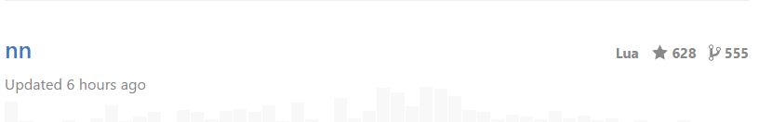


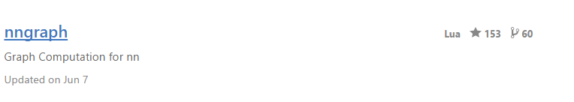
Overview of Torch
Torch is the main package in Torch7
Tensor Library / File I/O Interface Library / Useful Utilities
For Neural Network: Neural Network Package

Slide 8
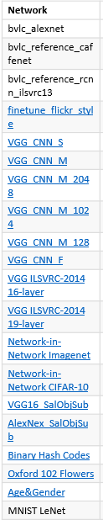
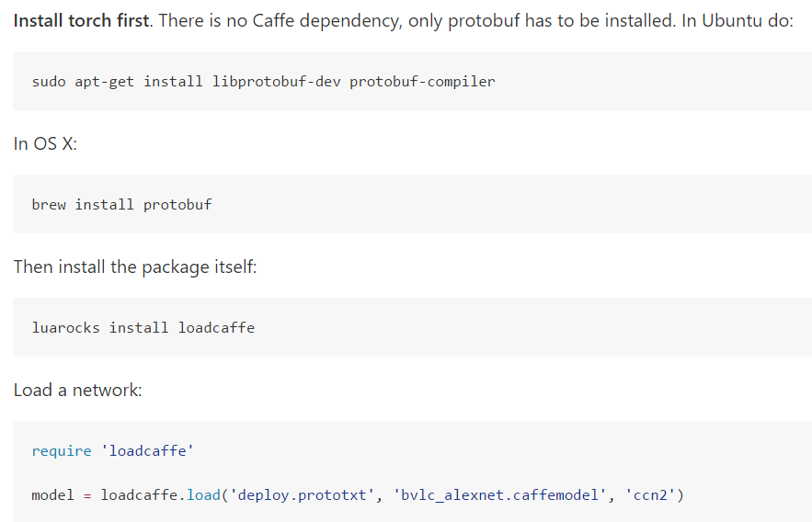
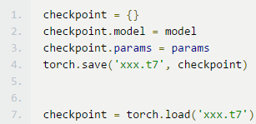
Existing models (load from caffe)
Model save/load:
https://github.com/BVLC/caffe/wiki/Model-Zoo

Slide 9
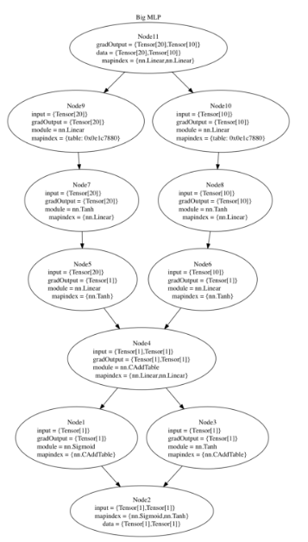
Key features
Graph represent (nngraph)
Support CPU, GPU (nn, cunn+cutorch)
Official synchronous mode
With multiverso, easy to data parallel asynchronous

Slide 10
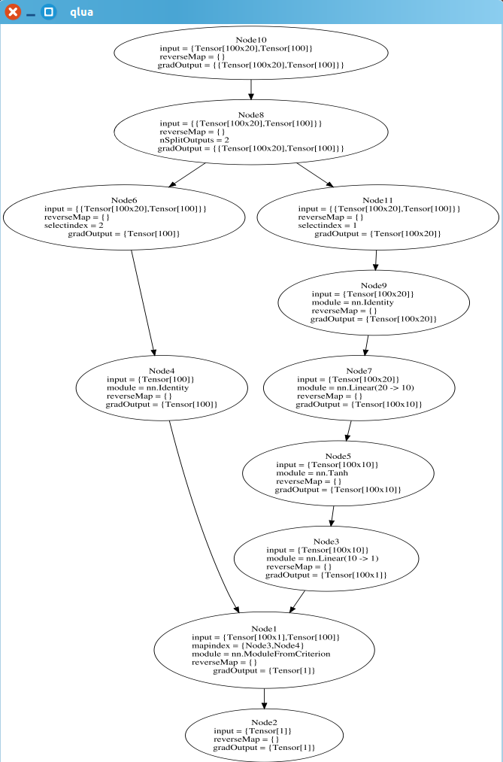
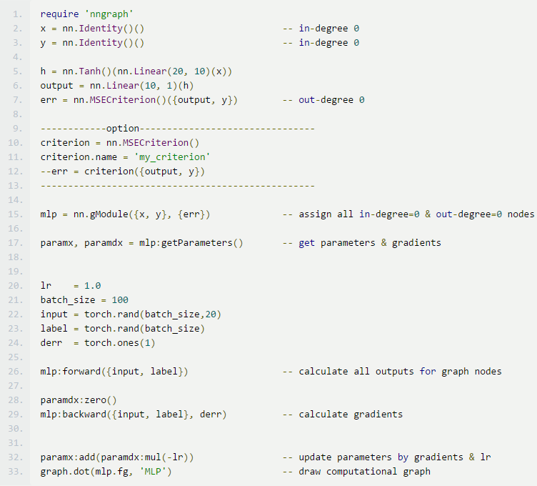
Computational Graph
dst = nn.Module(H Params) (src)
Data Preparation
Forward; Backward
Gradient Desent
https://github.com/torch/qtlua/issues/16
Notes:
http://blog.csdn.net/hungryof/article/details/51498733 setmetatable！！！

Slide 11
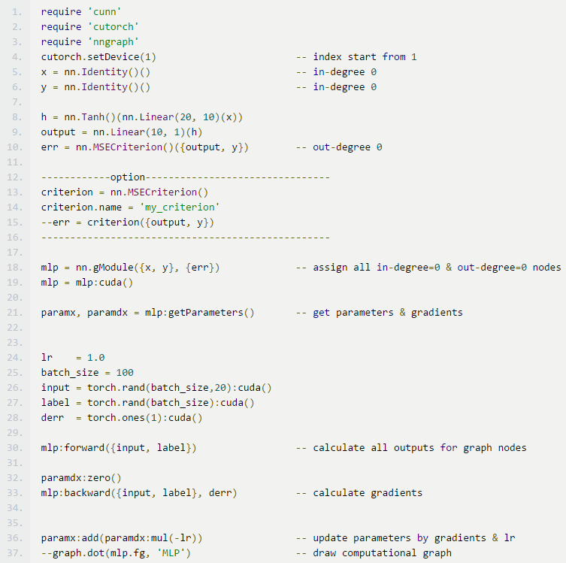
Transfer into GPU
More requires for supporting GPU
Set which gpu to use
Transfer model’s parameters into GPU
Transfer data into GPU

Slide 12
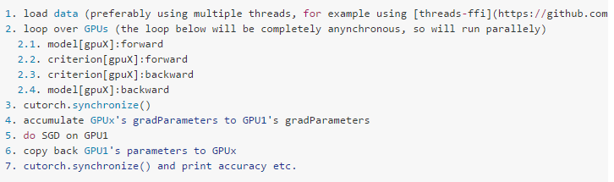
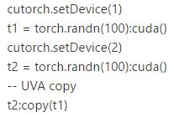
Multi-GPU official framework
https://github.com/torch/cutorch/issues/42
All cuda calls are asynchronous, and can be synchronized with cutorch.synchronize()

Slide 13
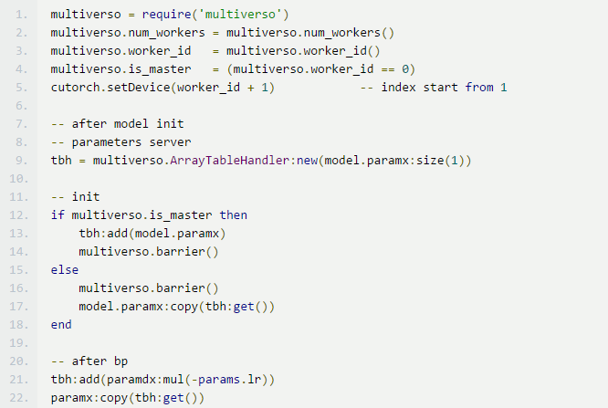
Multi-GPU multiverso framework in Torch
https://github.com/Microsoft/multiverso
https://github.com/Microsoft/multiverso/tree/master/binding/lua
Basic variants for multiverso
Parameter Server
Basic form of a thing which is only conducted by master
Communication with parameter server

Slide 14
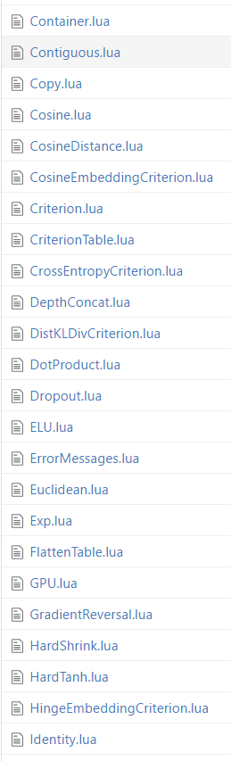
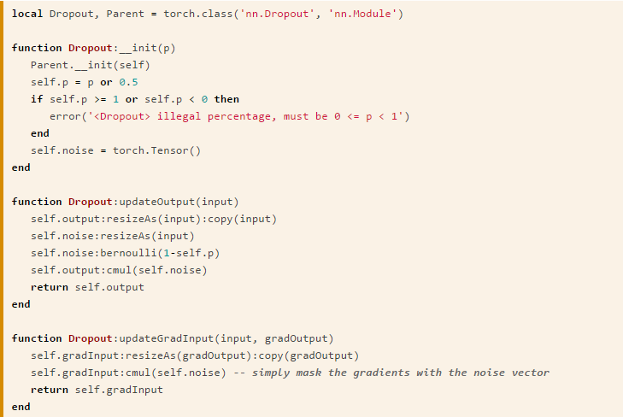
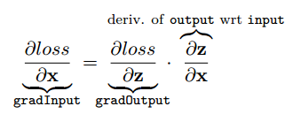

Gradients Computing (Automatic?)
https://github.com/torch/nn
Reference more to write
$$z=f(x)$$

Slide 15

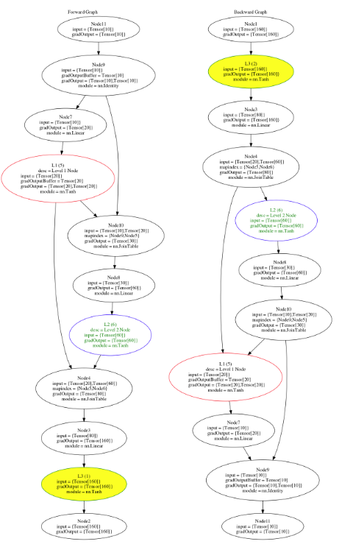
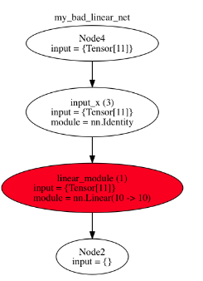
Tools
https://github.com/torch/nngraph/blob/master/README.md

Slide 16
Coding References
https://github.com/torch/nn/tree/master/doc
https://github.com/torch/torch7/blob/master/doc/maths.md
https://github.com/torch/nn
New Layers

Slide 17
Outline
Overview of Torch & Basic Usage
Download and Setup
Resources

Slide 18

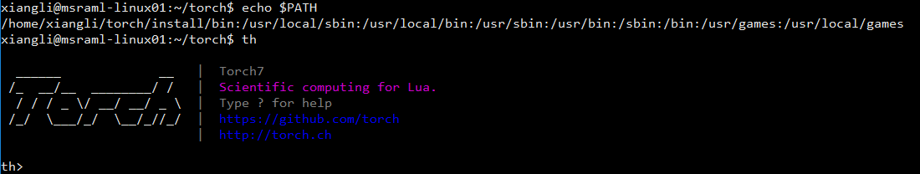
Download and Setup
http://torch.ch/docs/getting-started.html#_
Install:
Remove:
Check:

Slide 19



Download and Setup
Torch7 officially no support for Windows
Linux/Mac OS
Set up Packages
OR

Slide 20
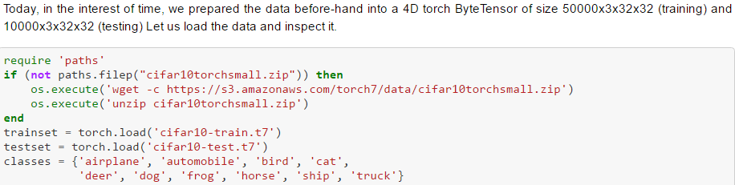
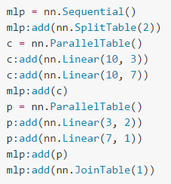
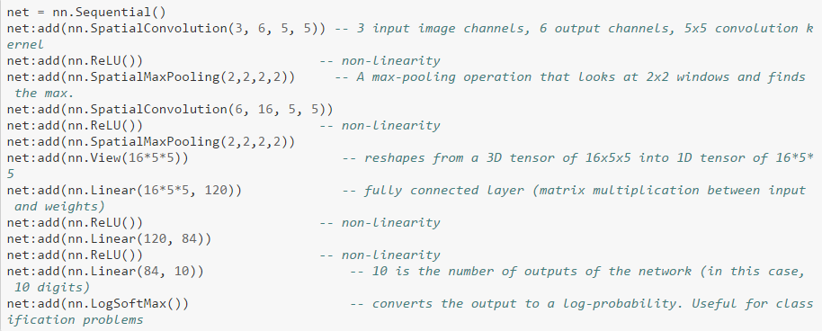
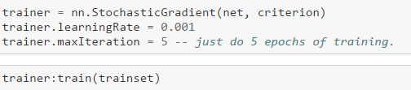
Another way to construct network
https://github.com/soumith/cvpr2015/blob/master/Deep%20Learning%20with%20Torch.ipynb
Not so recommend !
Loss and Train

Slide 21
Outline
Overview of Torch && Basic Usage
Download and Setup
Resources

Slide 22
Resources
Official documental site: http://torch.ch/docs/getting-started.html
Official github site: https://github.com/torch
Tutorials list:
Learn Lua in 15 Minutes
Applied Deep Learning for Computer Vision with Torch CVPR15 Tutorial [Slides]
Deep Learning with Torch - A 60-minute blitz
NNGraph - graph style neural networks
Character-level Recurrent networks. An introduction to real-world nngraph RNN training
Deep-Q Reinforcement learning to play Atari games
Implementing LSTMs with nngraph
Machine Learning with Torch for IPAM Summer School on Deep Learning. [Code]
An introduction to Torch. Implementing Convolution Neural Networks and Recurrent Neural Networks by Nicholas Leonard

Slide 23
Thanks!

