Slide 1
Topic 1: Vulnerable Power Management
Power
Power Limit 4 (PL4)
Region-4
Power Capping
Power Attack
- EPP [ISCA’16]
- PG [ICCD’18]
- DOPE [ICPP’19]
Power Limit 3 (PL3)
Region-3
Battery Support
Power Limit 2 (PL2)
Energy Opti.
Energy Attack
- Prior work
Region-2
Power Limit 1 (PL1)
Low Utilization
Region-1
Time
ODC Power Trace Example
Notes:
The first research topic is about power-related attacks and their defense approaches.
This picture shows the four main power management regions in ODC.
Based on different power thresholds, there are four regions including , power capping region, battery support region, energy optimization region, low utilization region.
Prior works have shown energy attack which tries to improve the electricity cost by wasting energy resources.
My works aims to show more powerful power-related attacks which can incur more severe damage like power outage or system failure.

Slide 2
Topic 1: Vulnerable Power Management
Power
Power Limit 4 (PL4)
Region-4
Power Capping
Power Attack
- EPP [ISCA’16]
- PG [ICCD’18]
- DOPE [ICPP’19]
Power Limit 3 (PL3)
Battery Support
Region-3
Power Limit 2 (PL2)
Energy Opti.
Energy Attack
- Prior work
Region-2
Power Limit 1 (PL1)
Low Utilization
Region-1
Time
ODC Power Trace Example
Notes:
The first research topic is about power-related attacks and their defense approaches.
This picture shows the four main power management regions in ODC.
Based on different power thresholds, there are four regions including , power capping region, battery support region, energy optimization region, low utilization region.
Prior works have shown energy attack which tries to improve the electricity cost by wasting energy resources.
My works aims to show more powerful power-related attacks which can incur more severe damage like power outage or system failure.

Slide 3

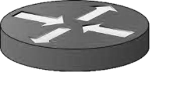
Figure 3- Background
Attacker
Attacker
PDU
Masters
Masters
UPS
Slaves
Servers
PDU
VMs
Guest OS
Hypervisor
UPS
Host HW
Servers
Servers

Slide 4
Figure 3- Background
Attacker
Attacker
PDU
Masters
Masters
UPS
Slaves
Servers
PDU
VMs
Guest OS
Hypervisor
UPS
Host HW
Servers
Servers

Slide 5



Container
…
Container
Agile Power Budgeting
$μ$Service 1
$μ$Service $n$
Differentiated Power Allocation
Container Orchestrator
Decider
Allocator
Deployment
Master
…
APB
Fast Model Generation
Transparent Tagging
Constructor
Calibrator
.s-tag: $\{{ms}_{id}$,$prio, ∇power\}$
.h-tag: NPS-MSR
Native Performance Scaling
Kernel
Device drivers
…
NPS
Microservice Processes
Tags
Hardware
Off-Chip VR
…
User Level
Kernel
VR
VR
VR
…
Native Daemon
Core
Core
Core
VR
VR
VR
On-chip Voltage Regulators
Core
Core
Core

Slide 6
































二分图：
Request
API
Application Service
Infrastructure
Service
Vertex
Indegree
Dynamic Weight
Criticality
n
$$e_{1}^{n}$$
$${ne}_{1}^{n}$$
$${In}_{1}$$
x
$$<w_{1}, β_{1}>$$
$$c_{1}$$
x
>threshold
Critical MS
$$e_{4}^{n}$$
$${ne}_{2}^{n}$$
$${In}_{2}$$
$$<w_{2}, β_{2}>$$
$$c_{2}$$
…
$$e_{2}^{n}$$
m
$$e_{3}^{m}$$
$$me_{3}^{m}$$
$${In}_{3}$$
x
$$<w_{3}, β_{3}>$$
$$c_{3}$$
$$e_{4}^{l}$$
$${me}_{4}^{m}+ne_{4}^{n}$$
x
$$<w_{4}, β_{4}>$$
$$c_{4}$$
…
$$e_{6}^{m}$$
$${In}_{4}$$
<threshold
Non-critical MS
l
$$e_{5}^{l}$$
$${le}_{5}^{l}$$
$${In}_{5}$$
x
$$<w_{5}, β_{5}>$$
$$c_{5}$$
$$e_{6}^{l}$$
$$me_{6}^{m}+le_{6}^{l}$$
$${In}_{6}$$
x
$$<w_{6}, β_{6}>$$
$$c_{6}$$

Slide 7
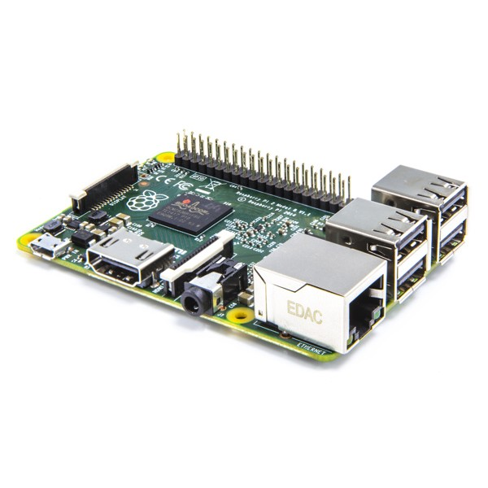
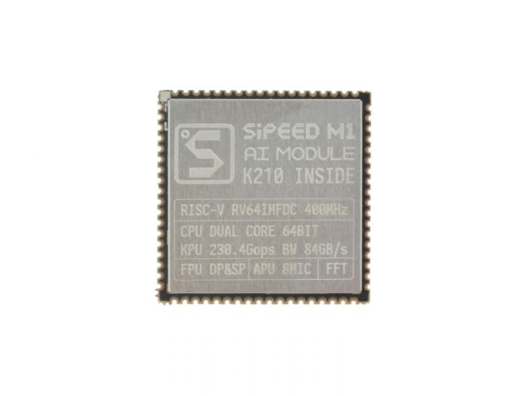
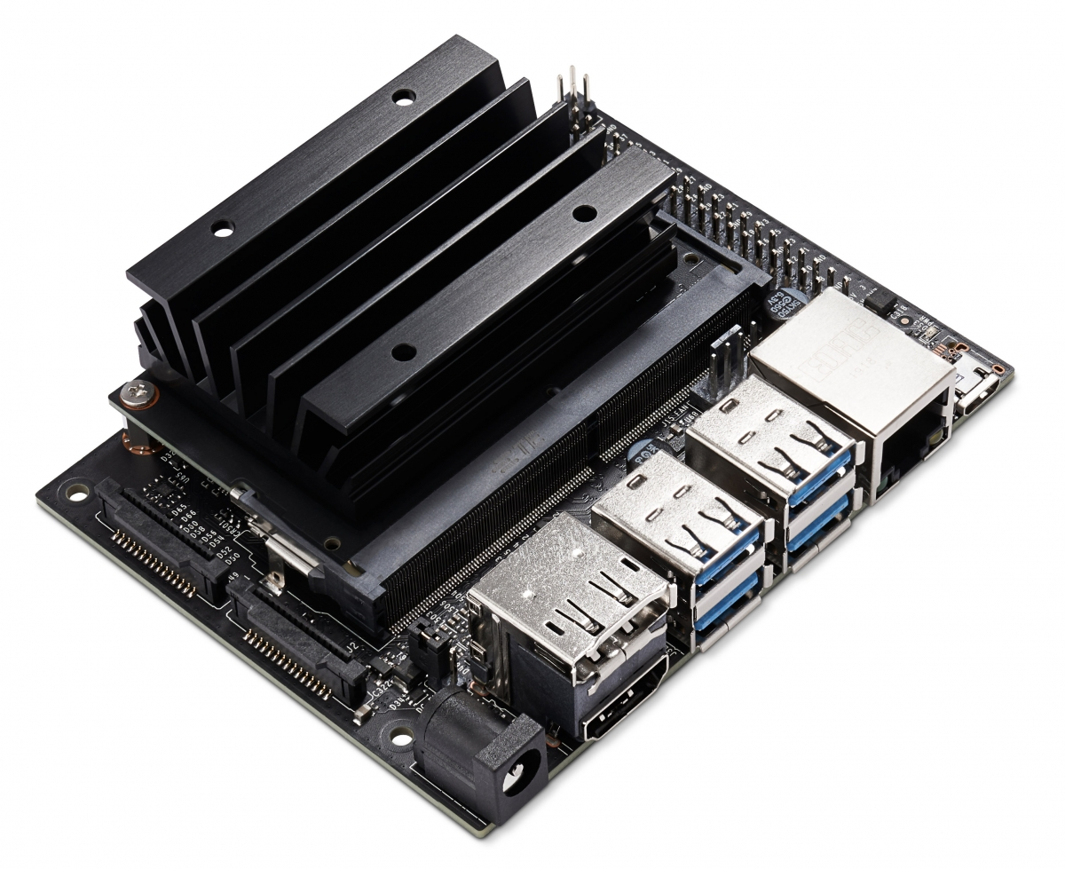

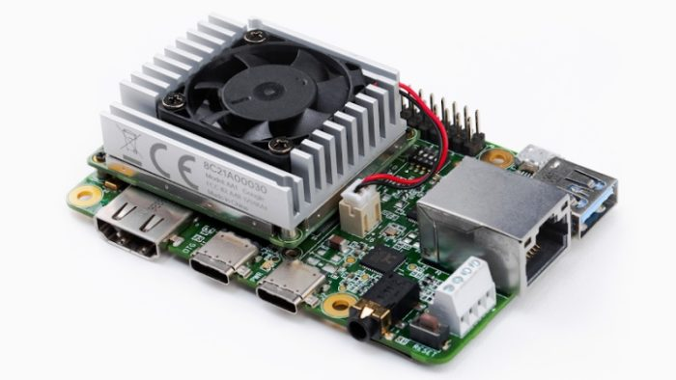
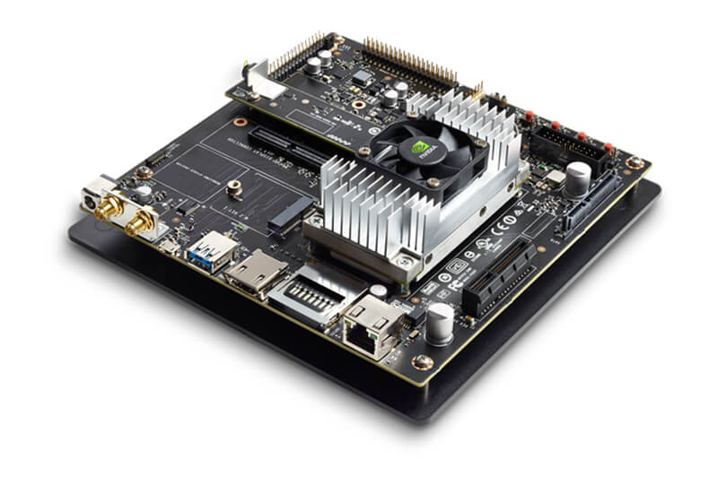
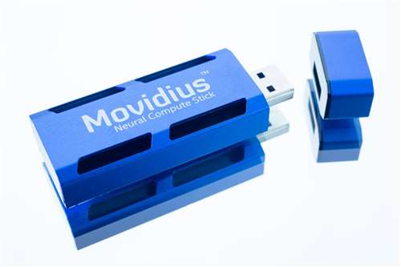
IOT/Edge Devices
Raspberry pi 3
KPU-Accelerated IoT Devices
Jason Nano
Kendryte K210
Hardware Platforms
Jason NTX
Movidius
NCS
EdgeTPU
GPU-Accelerated IoT Devices
ASIC-Accelerated IoT Devices

Slide 8
IOT/Edge Devices
Raspberry pi 3
KPU-Accelerated IoT Devices
Jason Nano
Kendryte K210
Hardware Platforms
Jason NTX
Movidius
NCS
EdgeTPU
GPU-Accelerated IoT Devices
ASIC-Accelerated IoT Devices

