Slide 1
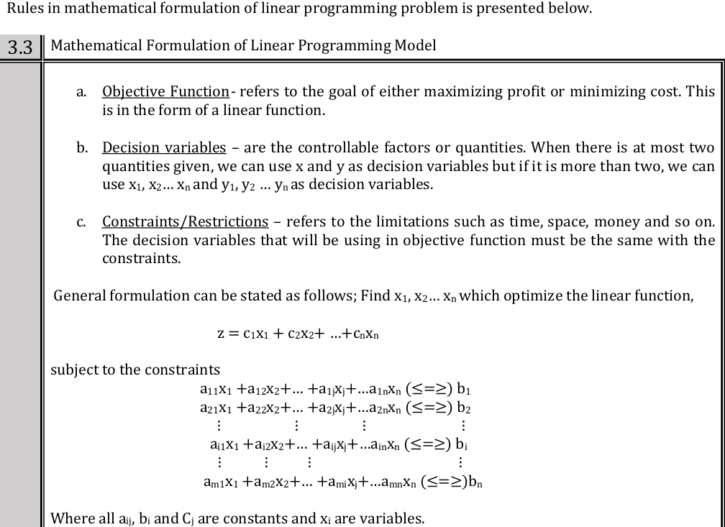

Slide 2
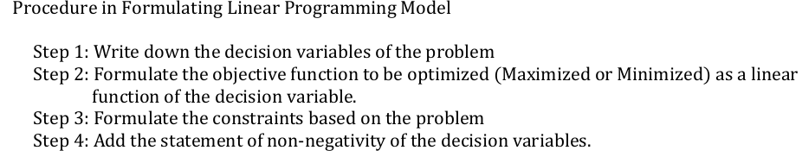

Slide 3
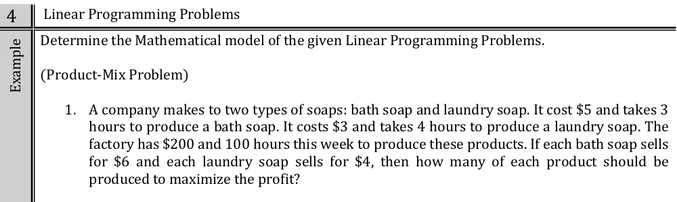

Slide 4
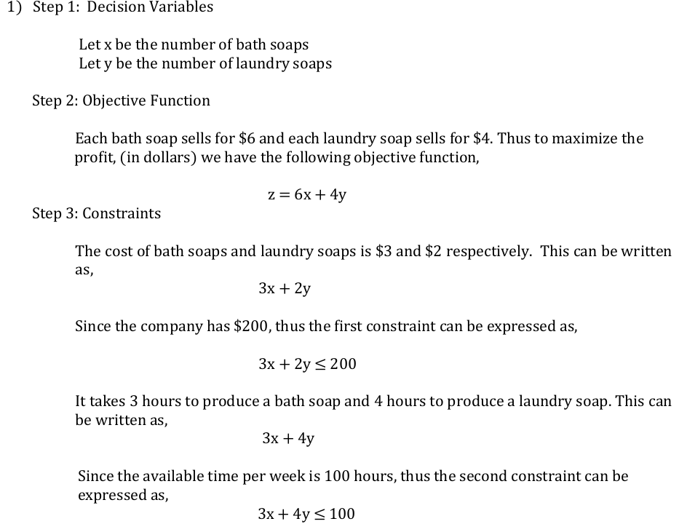
$5
$3
5x + 3y
5x + 3y

Slide 5
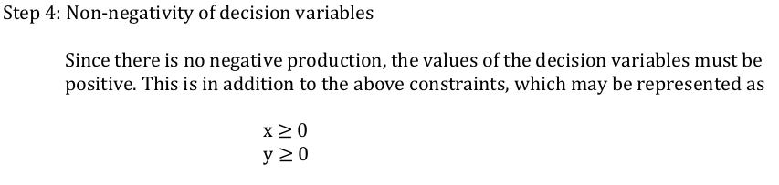
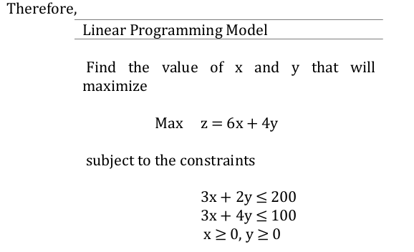
5x + 3y

Slide 6
1. Bob builds two types of sheds. He uses 10 sheets of dry wall and 15 studs for small shed, and 15 sheets of dry wall and 45 studs for large shed. He has available 60sheds of dry wall and 135 studs . If Bob makes $390 profit on a small shed and $520 on large shed, how many of each type of building should bob build to maximize his profit?
Formulate mathematically the following LP problem

Slide 7
2. a steel producer makes two type of steel. Regular and special steel, a ton of regular steel requires 2 hours in the open heat furnace and 5 hours of in the soaking pit, a ton of special steel requires 2 hours in the open heat furnace and 3 hours in the soaking pit. The open heat furnace is available 8 hours/day and the soaking pit is available 15 hours/day. The profit of a ton of regular steel is $120 and $100 profit of a ton of special steel. Determine how many tons o regular and special steel should be made to maximize the profit.

Slide 8
3. At burger heaven a double burger contains 2 meat patties, and 6 pickles, while a triple burger contains 3 meat patties and 3 pickles. Near closing time one day only 24 meat patties and 48 pickles are available. If a double burger sells at $1.5 and the triple burger sells $1.2 then how many of each should be made to maximize the total revenue?

Slide 9
4. A company manufacturers sells two models of lamps bright and dim ligth. To manufacture each lamp, bright lamp requires manual work for 20 minutes and mechanical work for 20 minutes, while the dim light requires manual work for 30 minutes and 10 minutes for mechanical work. The manual work available per month is 100 hours and machine is limited to only 80 hours per month. Knowing the profit per unit is $15 and 10$ respectively, determine the quantities of each lamp that should be manufactured to obtain the maximum profit.

Slide 10
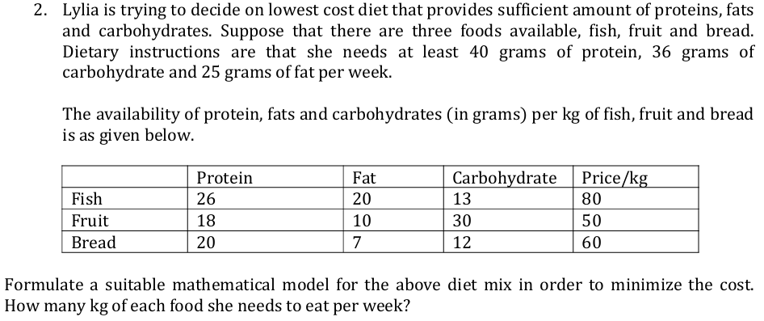

Slide 11
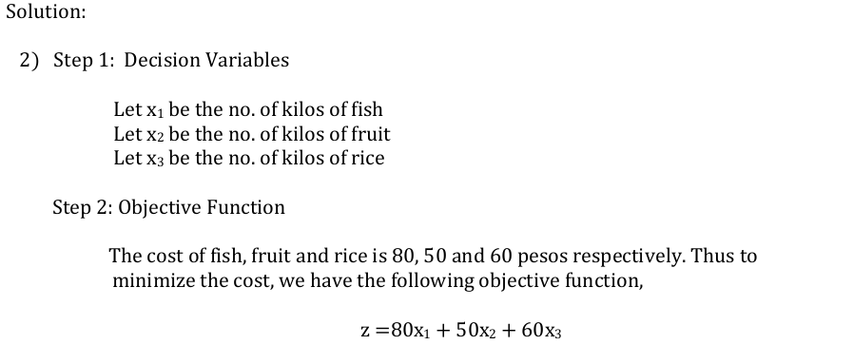

Slide 12
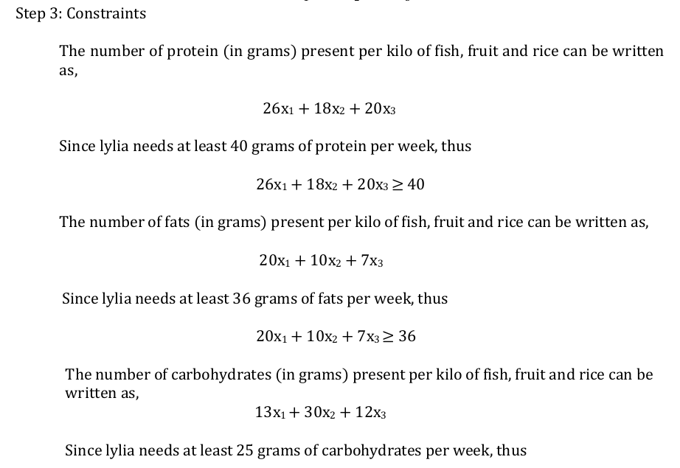

Slide 13
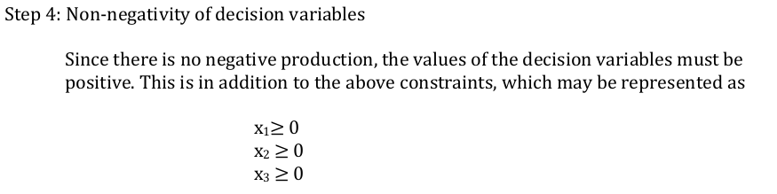
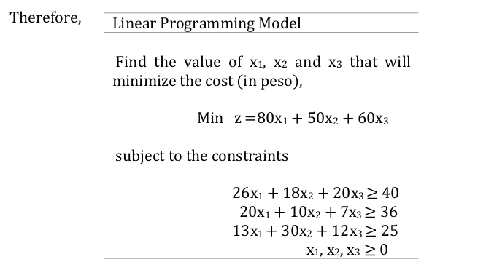

Slide 14
One cup of doggie dinner contains 20 grams of protein and 40 grams of carbo hydrate. One cup of puppy power contains 30 grams of protein and 20 grams of carbohydrates, Susan wants her dog to get at least 200 grams of protein and 180 grams of carbohydrate. If the doggie dinner costs16 cents/cup and the puppy power cost 20cents/cup, then how many cups of each would satisfy the constraints and minimize the cost?

Slide 15
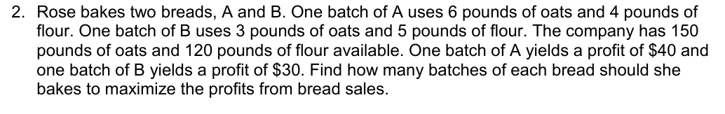

Slide 16
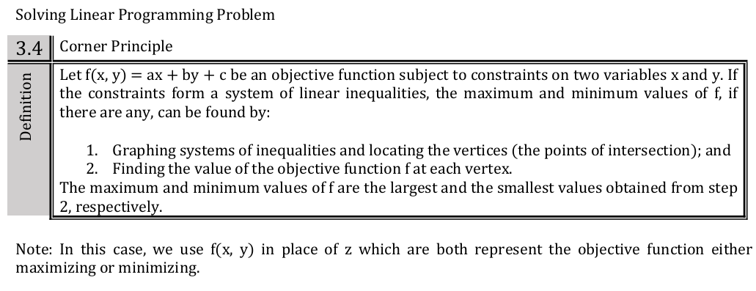

Slide 17
FEASIBLE REGION – Refers to the area that satisfies all the constraints of a linear programming problem. It’s the region where all the constraints overlap.
BOUNDED BY CONTRAINTS – The feasible region is defined by the lines or curves representing the constraints
SATISFIES ALL CONSTRAINTS – Every point within the feasible region meets all the constraints.
OPTIMAL SOLUTION – The optimal solution to the linear programming problem lies within the feasible region, often at vertex or corner point.

Slide 18
At burger heaven a double burger contains 2 meat patties, and 6 pickles, while a triple burger contains 3 meat patties and 3 pickles. Near closing time one day only 24 meat patties and 48 pickles are available. If a double burger sells at $1.5 and the triple burger sells $1.2 then how many of each should be made to maximize the total revenue?

Slide 19
A steel producer makes two type of steel. Regular and special steel, a ton of regular steel requires 2 hours in the open heat furnace and 5 hours of in the soaking pit, a ton of special steel requires 2 hours in the open heat furnace and 3 hours in the soaking pit. The open heat furnace is available 8 hours/day and the soaking pit is available 15 hours/day. The profit of a ton of regular steel is $120 and $100 profit of a ton of special steel. Determine how many tons o regular and special steel should be made to maximize the profit.

Slide 20
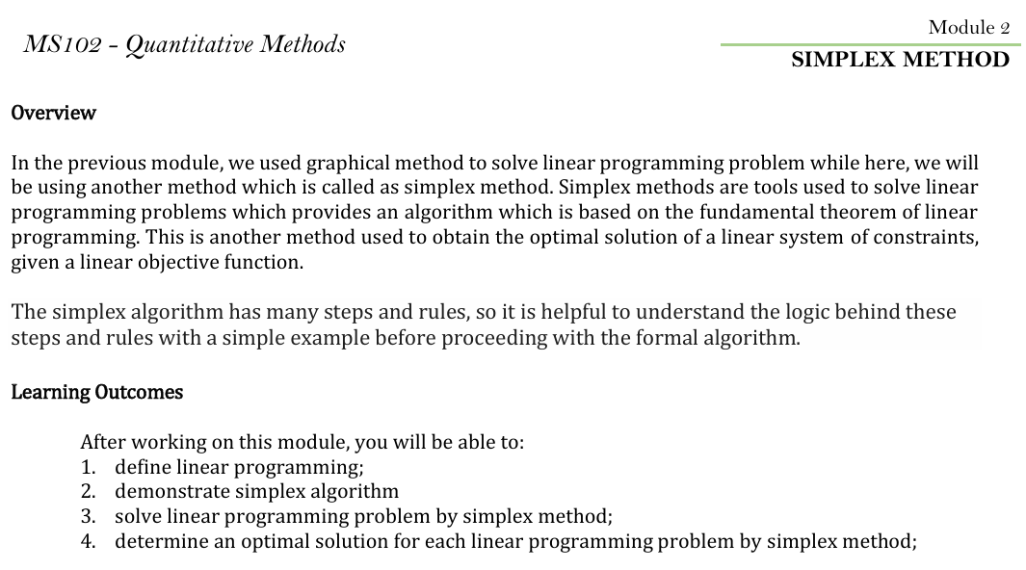

Slide 21
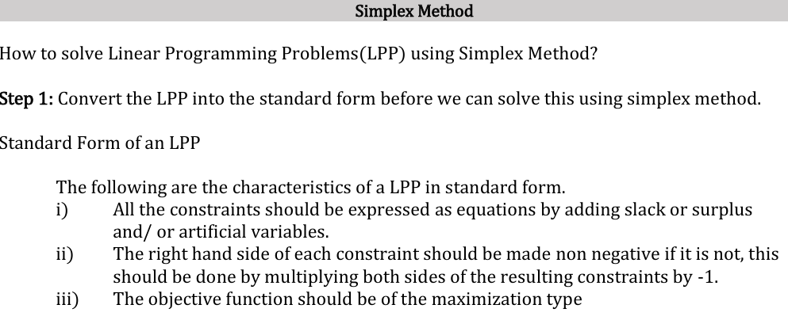

Slide 22
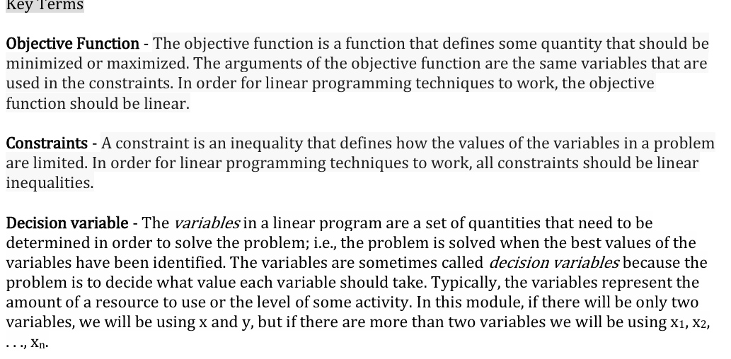

Slide 23
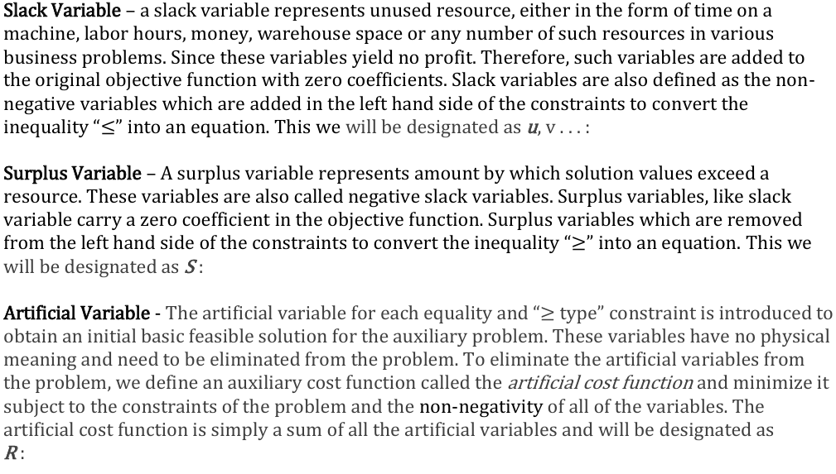

Slide 24
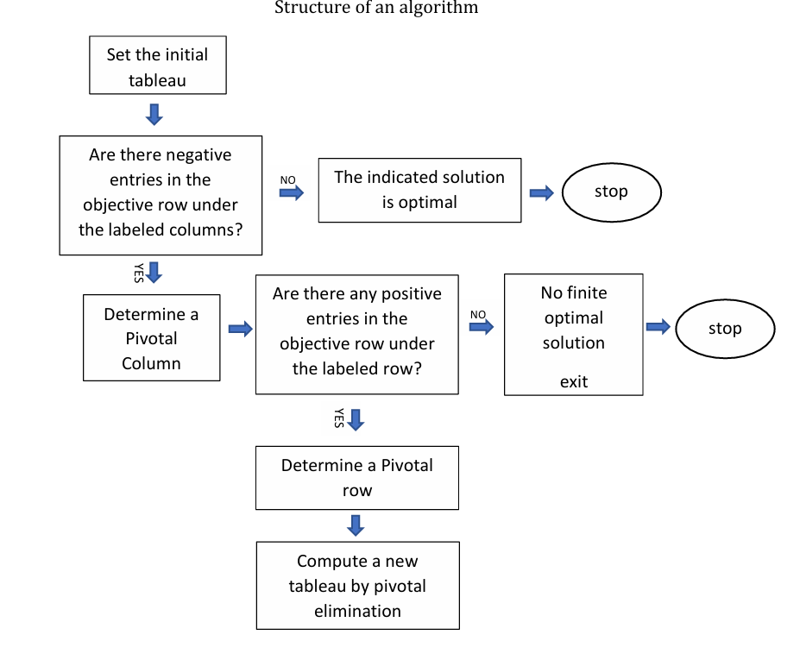

Slide 25
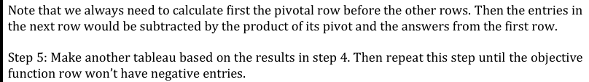
Pivot column – most negative entries in Z row
Pivot row – positive smallest ratio in pivot column and RHS
Pivot – intersection between pivot column and pivot row
Pivotal elimination – multiply 1/k ( where k is pivot) to the entries in pivot row

Slide 26
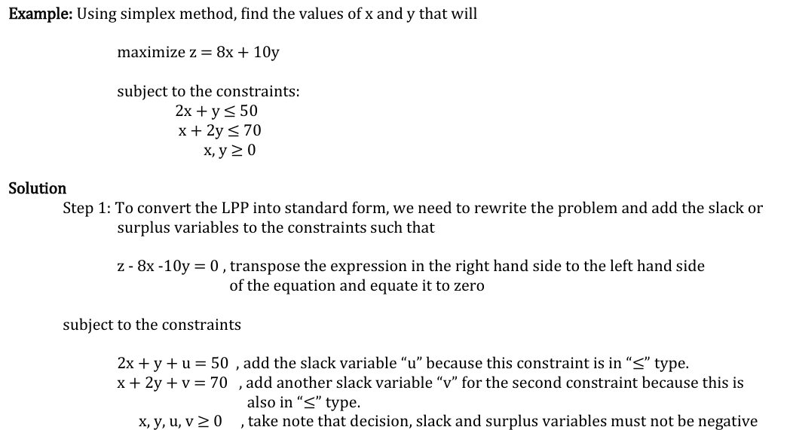

Slide 27
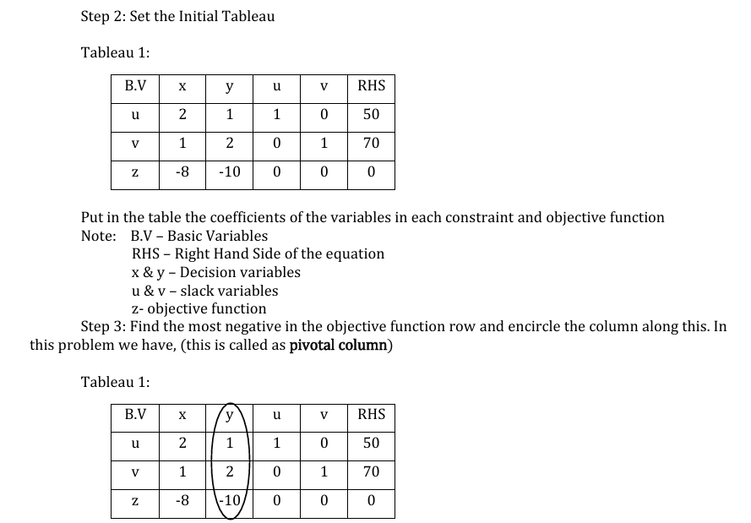

Slide 28
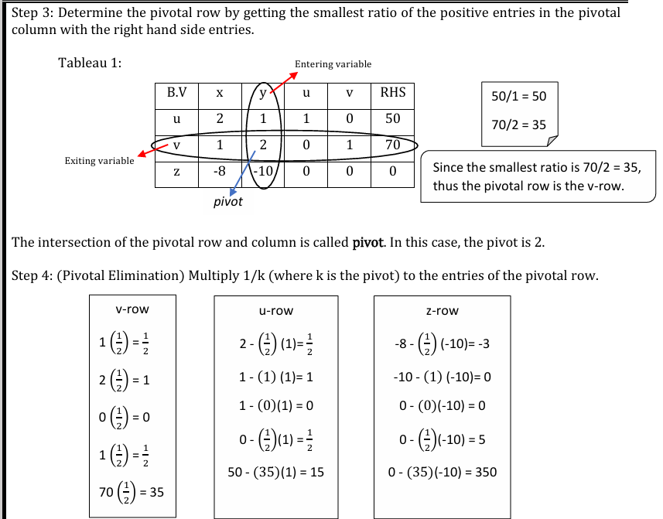

Slide 29
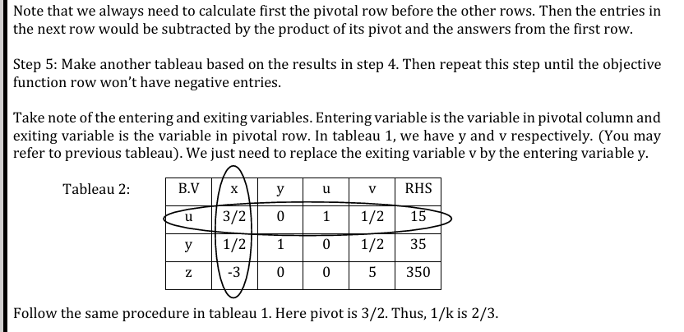

Slide 30
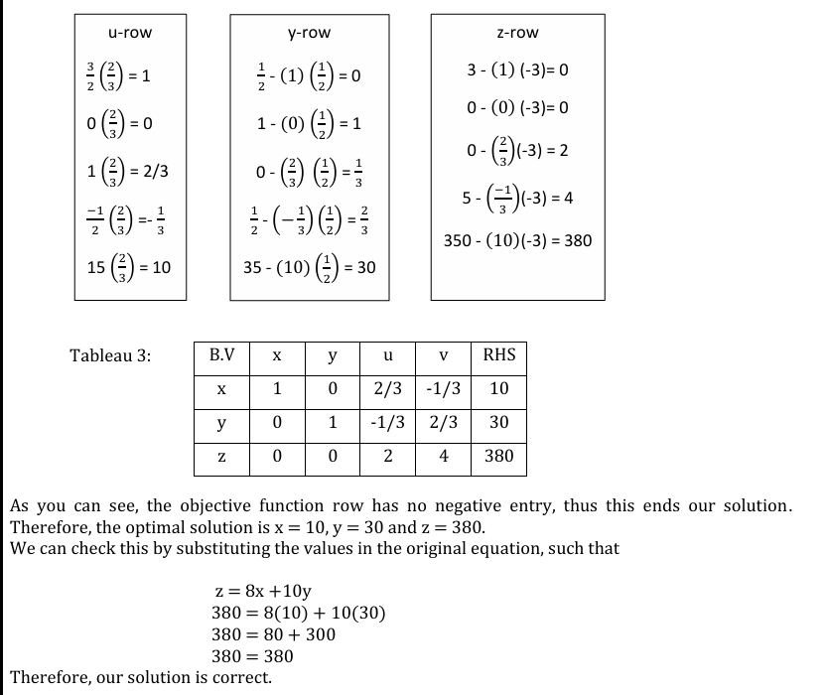

Slide 31
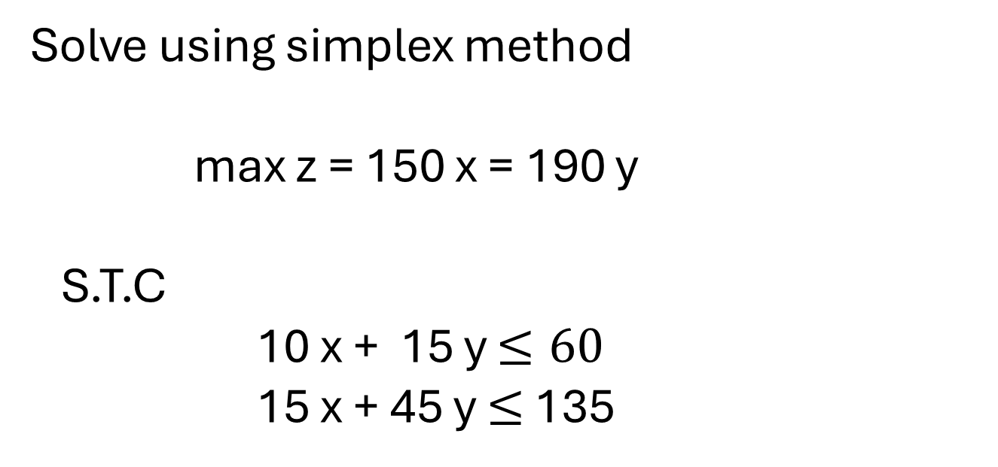
Solve using simplex method
max z = 150 x = 190 y
S.T.C
10 x + 15 y $≤60$
15 x + 45 y $≤$ 135

