Slide 1

Keystroke biometrics multifactor authentication
Chua Chiang Sheng, Andy
1902138
Notes:
Good morning professors, my name is Andy and I will be presenting on Keystroke Biometrics Multifactor Authentication

Slide 2
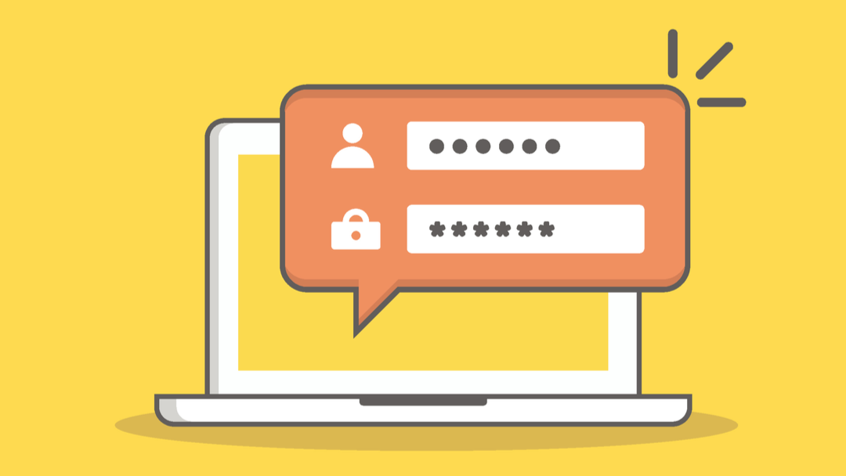
Problem statement
Notes:
Humans are ever more connected through different platforms as the digital age expands. These platforms offer services or applications in the virtual world, and users would often have to log in by authenticating themselves. The login process would consist of a username or email, followed by a password for verification.

Slide 3


Problem statement
Physical Exploit (E.g., Shoulder Surfing)
Cyber Exploit (E.g., Brute Force)
S.M Matyas, J Stapleton. A Biometric Standard for Information Management and Security. Computers & Security Vol.19 Issue: 2. 2000.pp.428-441. Available: https://www.academia.edu/528259/A_biometric_standard_for_information_management_and_security
Notes:
This process is vulnerable to exploitation in the physical and cyber world.
An example of physical exploit would be shoulder surfing or cyber exploit such as brute force attack. Thus there is a need for better security methods to prevent attackers from retrieving user’s password

Slide 4




Problem statement
Multi-Factor Authentication (MFA)
=
/
/
Something
you KNOW
(E.g., Password)
Something
You ARE
(E.g., Fingerprint)
Something
You HAVE (E.g., Key Card)
Notes:
Multifactor authentication (MFA) is an ubiquitous security method that is known to be applied to protect the login authentication process. It consist of either using something-you-know, something-you-are, or something-you-have.

Slide 5
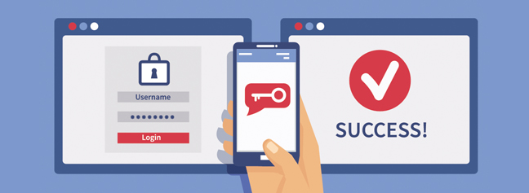
Problem statement
I. V. McLoughlin and M. s/o Naransamy, “Keypress biometrics for user validation in mobile consumer devices,” 2009 IEEE 13th International Symposium on Consumer Electronics. IEEE, 2009. doi: 10.1109/isce.2009.5156933
Notes:
However, there have been numerous cases where attackers are able to obtain the required secondary code from something-you-have by stealing the device or performing scam calls or texts. In addition, the something-you-have authentication method is often clunky as the users have to whip out their phones or log in to their email or authenticator app to retrieve the secondary authentication credentials. These raised a few issues with MFA and can be further improved to provide better security and user experience.

Slide 6
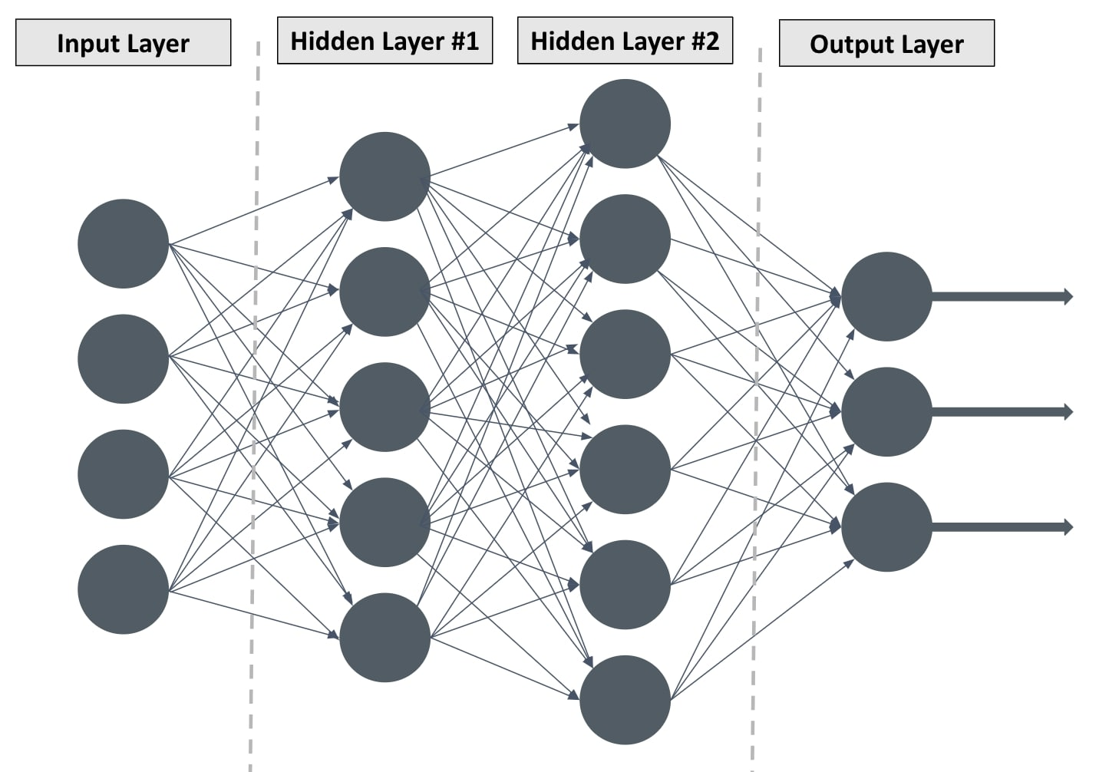
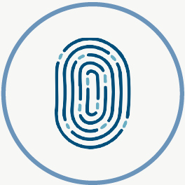
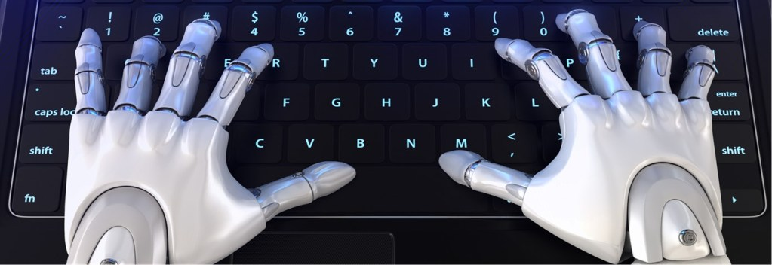
CAPSTONE PROJECT
+
Deep Learning
Something
You ARE
(E.g., Fingerprint)
Keystroke Biometrics
Notes:
The capstone project proposed to use behavioural biometrics that consists of a unique attribute to every individual for MFA. These will prevent attackers from leveraging existing loopholes in MFA to attempt to phish for secondary credentials due to the inherent nature of something-you-are authentication. There are various methods to authenticate in the field of behavioural biometrics, such as iris recognition or keystroke biometrics. As keystroke biometrics utilise only the keyboard and does not require other apparatus, these would make it hassle-free and inexpensive as the user does not need to take another step to retrieve the secondary credential.

Slide 7
CAPSTONE PROJECT
+
Something
You ARE
(E.g., Fingerprint)
Keystroke Biometrics
Deep Learning
Keystroke Biometrics as an Multifactor Authentication
Notes:
Hence, the project proposes to research on the ability to incorporate deep learning with keystroke biometrics as an MFA and its practicality and usability in a real-world setting.

Slide 8

PRELUDE: PROJECT LANGUAGE AND LIBRARIES
Library Name | Purpose
pynput | Capture Keypress Timing
pyinstaller | Export Python Application into .exe
tensorflow | Provide a collection of workflows to develop and train models
keras | Provide an API to reduce cognitive load
sklearn | Contains efficient tools for deep learning
jupyterlab | Web-based IDE for deep learning
pandas | Manage data structure for deep learning
numpy | Manage data in an array object
matplotlib | Create static visualisation
seaborn | Provide informative statistical graphic
Notes:
As the project involves deep learning, Python will be the default language for the project. To generate the dataset, participants will type on a physical keyboard. A table consisting of all the libraries used are shown above.

Slide 9
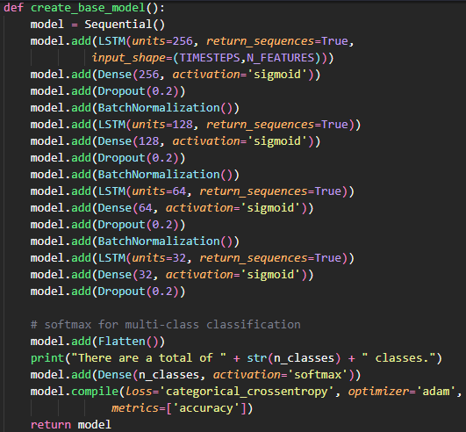
PRELUDE: MODEL
Notes:
The model utilises unidirectional Long Short-Term Memory layer that helps to remember key information between sequence data and hence is the most suitable layer for our deep learning project.

Slide 10
PRELUDE: MODEL
Notes:
The use of Sigmoid as an activation function will help with the interpretation of the probability of our multiclassification problem.

Slide 11
PRELUDE: MODEL
Notes:
The Dropout layer aims to prevent overfitting which reduces a model’s ability to perform against unseen data.

Slide 12
PRELUDE: MODEL
Notes:
Meanwhile, Batch Normalization layer aims to normalise the data before it is input to the next layer to reduce biasness from seeping into the data.

Slide 13
PRELUDE: MODEL
Notes:
Lastly, SoftMax layer helps to allow the model to predict multinomial probability distribution that attempts to identify how likely some data belong or matches the known class which solves our multi-class classification problem. Various numbers and layers have been experimented, with the current one deemed the most stable version.

Slide 14
PRELUDE: DATASET TYPE
Dataset
Fixed-Text Dataset
Free-Text Dataset
WORD: HELLO
HELLO
HELLO
HELLO
Controlled Free-Text Dataset
Non-Controlled Free-Text Dataset
SCOPE: ANIMAL
CROW
LEOPARD
ELEPHANT
NO SCOPE
BUTTERFLY
BASKETBALL
SUSHI
DATA to achieve high accuracy
DATA to achieve high accuracy
B. Ayotte, M. Banavar, D. Hou, and S. Schuckers, “Fast Free-Text Authentication via Instance-Based Keystroke Dynamics,” IEEE Transactions on Biometrics, Behavior, and Identity Science, vol. 2, no. 4. Institute of Electrical and Electronics Engineers (IEEE), pp. 377–387, Oct. 2020. doi: 10.1109/tbiom.2020.3003988.
Notes:
In keystroke dynamics, a model performs deep learning with a fixed-text or a free-text dataset.

Slide 15
PRELUDE: DATASET TYPE
Dataset
Fixed-Text Dataset
Free-Text Dataset
WORD: HELLO
HELLO
HELLO
HELLO
Controlled Free-Text Dataset
Non-Controlled Free-Text Dataset
SCOPE: ANIMAL
CROW
LEOPARD
ELEPHANT
NO SCOPE
BUTTERFLY
BASKETBALL
SUSHI
DATA to achieve high accuracy
DATA to achieve high accuracy
B. Ayotte, M. Banavar, D. Hou, and S. Schuckers, “Fast Free-Text Authentication via Instance-Based Keystroke Dynamics,” IEEE Transactions on Biometrics, Behavior, and Identity Science, vol. 2, no. 4. Institute of Electrical and Electronics Engineers (IEEE), pp. 377–387, Oct. 2020. doi: 10.1109/tbiom.2020.3003988.
Notes:
A fixed text dataset consists of the keystroke sequence of the same characters typed by participants.

Slide 16
PRELUDE: DATASET TYPE
Dataset
Fixed-Text Dataset
Free-Text Dataset
WORD: HELLO
HELLO
HELLO
HELLO
Controlled Free-Text Dataset
Non-Controlled Free-Text Dataset
SCOPE: ANIMAL
CROW
LEOPARD
ELEPHANT
NO SCOPE
BUTTERFLY
BASKETBALL
SUSHI
DATA to achieve high accuracy
DATA to achieve high accuracy
B. Ayotte, M. Banavar, D. Hou, and S. Schuckers, “Fast Free-Text Authentication via Instance-Based Keystroke Dynamics,” IEEE Transactions on Biometrics, Behavior, and Identity Science, vol. 2, no. 4. Institute of Electrical and Electronics Engineers (IEEE), pp. 377–387, Oct. 2020. doi: 10.1109/tbiom.2020.3003988.
Notes:
Yet if the participants type without any condition, it is known as a non-controlled free-text dataset.

Slide 17
PRELUDE: DATASET TYPE
Dataset
Fixed-Text Dataset
Free-Text Dataset
WORD: HELLO
HELLO
HELLO
HELLO
Controlled Free-Text Dataset
Non-Controlled Free-Text Dataset
SCOPE: ANIMAL
CROW
LEOPARD
ELEPHANT
NO SCOPE
BUTTERFLY
BASKETBALL
SUSHI
DATA to achieve high accuracy
DATA to achieve high accuracy
B. Ayotte, M. Banavar, D. Hou, and S. Schuckers, “Fast Free-Text Authentication via Instance-Based Keystroke Dynamics,” IEEE Transactions on Biometrics, Behavior, and Identity Science, vol. 2, no. 4. Institute of Electrical and Electronics Engineers (IEEE), pp. 377–387, Oct. 2020. doi: 10.1109/tbiom.2020.3003988.
Notes:
However, if the participants can only type under a specific topic or scope, the generated dataset would fall under a controlled free-text dataset

Slide 18
PRELUDE: DATASET TYPE
Dataset
Fixed-Text Dataset
Free-Text Dataset
WORD: HELLO
HELLO
HELLO
HELLO
Controlled Free-Text Dataset
Non-Controlled Free-Text Dataset
SCOPE: ANIMAL
CROW
LEOPARD
ELEPHANT
NO SCOPE
BUTTERFLY
BASKETBALL
SUSHI
DATA to achieve high accuracy
DATA to achieve high accuracy
B. Ayotte, M. Banavar, D. Hou, and S. Schuckers, “Fast Free-Text Authentication via Instance-Based Keystroke Dynamics,” IEEE Transactions on Biometrics, Behavior, and Identity Science, vol. 2, no. 4. Institute of Electrical and Electronics Engineers (IEEE), pp. 377–387, Oct. 2020. doi: 10.1109/tbiom.2020.3003988.
Notes:
In addition, fixed-text dataset tends to obtain high accuracy with lesser rows of data in keystroke biometrics.

Slide 19
PRELUDE: DATASET TYPE
Dataset
Fixed-Text Dataset
Free-Text Dataset
WORD: HELLO
HELLO
HELLO
HELLO
Controlled Free-Text Dataset
Non-Controlled Free-Text Dataset
SCOPE: ANIMAL
CROW
LEOPARD
ELEPHANT
NO SCOPE
BUTTERFLY
BASKETBALL
SUSHI
DATA to achieve high accuracy
DATA to achieve high accuracy
B. Ayotte, M. Banavar, D. Hou, and S. Schuckers, “Fast Free-Text Authentication via Instance-Based Keystroke Dynamics,” IEEE Transactions on Biometrics, Behavior, and Identity Science, vol. 2, no. 4. Institute of Electrical and Electronics Engineers (IEEE), pp. 377–387, Oct. 2020. doi: 10.1109/tbiom.2020.3003988.
Notes:
Meanwhile, a free-text dataset which contains more variability due to its unpredictable nature will require more keystroke data to achieve higher accuracy.

Slide 20
PRELUDE: Keystroke dynamics variation
Keystroke Dynamics
Static Keystroke Dynamics
Continuous Keystroke Dataset
Static Text
Password
Verifies throughout a session
Note:
IR = Identical-Random DR = Different-Random
S. Krishnamoorthy, L. Rueda, S. Saad, and H. Elmiligi, “Identification of User Behavioral Biometrics for Authentication Using Keystroke Dynamics and Machine Learning,” Proceedings of the 2018 2nd International Conference on Biometric Engineering and Applications - ICBEA ’18. ACM Press, 2018. doi: 10.1145/3230820.3230829
Notes:
In keystroke dynamics, there are two variations which are static keystroke dynamics or continuous keystroke dynamics. Static keystroke dynamics verifies user based on a static text or password whereas continuous keystroke dynamics verifies throughout a session.

Slide 21
PRELUDE: Keystroke dynamics variation
Keystroke Dynamics
Static Keystroke Dynamics
Continuous Keystroke Dataset
Static Text
Password
Verifies throughout a session
Note:
IR = Identical-Random DR = Different-Random
S. Krishnamoorthy, L. Rueda, S. Saad, and H. Elmiligi, “Identification of User Behavioral Biometrics for Authentication Using Keystroke Dynamics and Machine Learning,” Proceedings of the 2018 2nd International Conference on Biometric Engineering and Applications - ICBEA ’18. ACM Press, 2018. doi: 10.1145/3230820.3230829
Notes:
This report will focus on static keystroke dynamics with fixed-text dataset due to the lesser need for high amount of data.

Slide 22
PRELUDE: Keystroke dynamics variation
Keystroke Dynamics
Static Keystroke Dynamics
Continuous Keystroke Dataset
Static Text
Password
Verifies throughout a session
Note:
IR = Identical-Random DR = Different-Random
S. Krishnamoorthy, L. Rueda, S. Saad, and H. Elmiligi, “Identification of User Behavioral Biometrics for Authentication Using Keystroke Dynamics and Machine Learning,” Proceedings of the 2018 2nd International Conference on Biometric Engineering and Applications - ICBEA ’18. ACM Press, 2018. doi: 10.1145/3230820.3230829
Notes:
Lastly, participants will generate different datasets based on the experiment. It may be identical random (IR) or different random (DR) phrases between each participant.

Slide 23
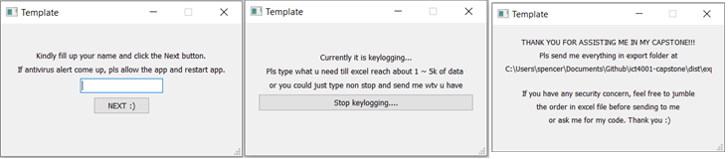
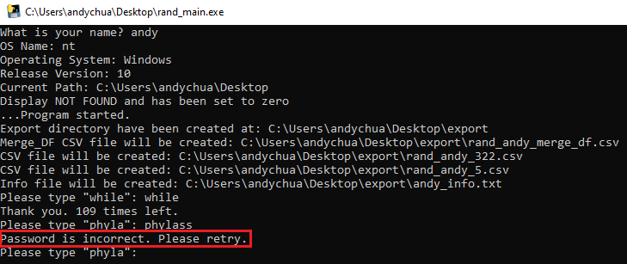
PRELUDE: DATASET COLLECTION – USER INTERFACE
M. miguelhp89, “Miguelhp89/Keystroke_Dynamics_Gen: Generator of Keystroke Dynamics Dataset,” GitHub. [Online]. Available: https://github.com/miguelhp89/Keystroke_Dynamics_Gen.
Notes:
To collect keystroke dataset, it was necessary to package the code into a GUI to be distributable to anyone without installation. As it is a prototype GUI, only the bare bones and necessary information are added to facilitate the collection of the keystroke dataset.
As there were a need for a more interactive environment for other experiments, a CLI application is created to receive feedback when the entry was not appropriate or was keyed incorrectly. This will help to reduce the amounts of mistakes and incorrect values that would be added into the dataset.

Slide 24
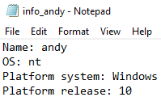
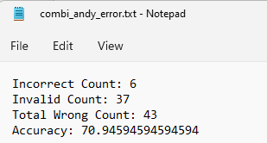
PRELUDE: DATASET COLLECTION EXTRACTION – Miscellaneous INFO
Check for incompatibility
Quality check on dataset
Notes:
Besides recording the keystroke data, the compiled application also aims to retrieve additional information such as the device information and accuracy of the keystrokes.

Slide 25
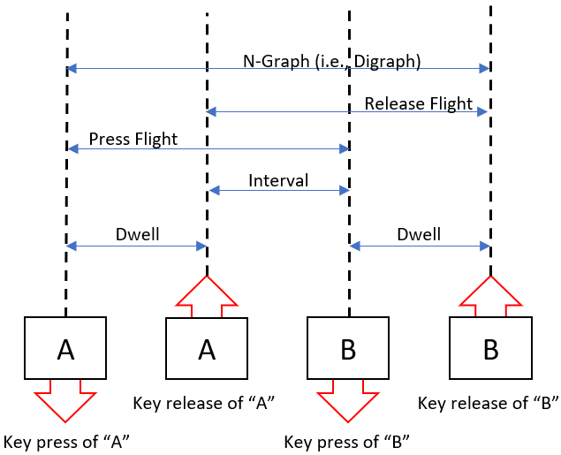
PRELUDE: DATASET COLLECTION EXTRACTION – Features
R. Conijn, J. Roeser, and M. van Zaanen, “Understanding the keystroke log: the effect of writing task on keystroke features,” Reading and Writing, vol. 32, no. 9. Springer Science and Business Media LLC, pp. 2353–2374, May 15, 2019. doi: 10.1007/s11145-019-09953-8.
Notes:
In a pair of two characters for primary features, the targeted features to extract are dwell timing, interval timing, press flight timing, release flight timing and n-graph timing

Slide 26
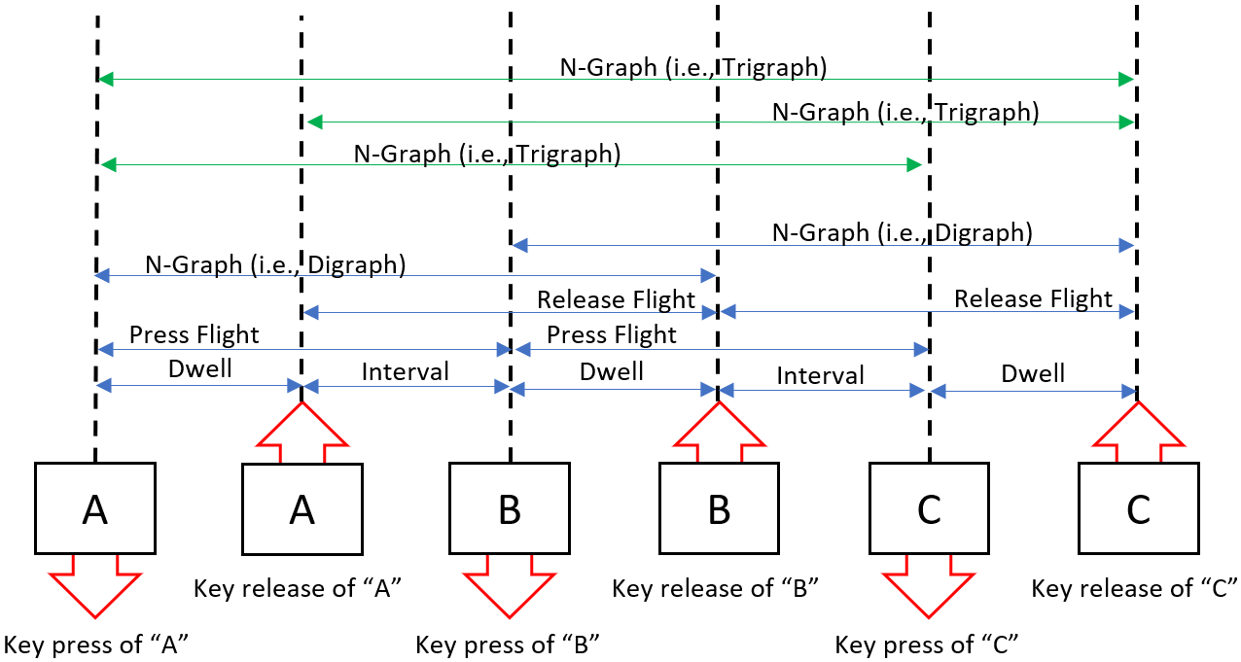
PRELUDE: DATASET COLLECTION EXTRACTION – Features
Notes:
If there are more than two characters in a sequence, there are multiple n-graph features to be extracted. This will continue depending on the number of characters that exist in the sequence.

Slide 27
PRELUDE: DATASET COLLECTION EXTRACTION – Statistical Features
Sum
Mean
Variance
Standard Deviation
Notes:
There are also attempts to extract statistical features such as the sum, mean, variance and standard deviation of the keystroke timing.

Slide 28
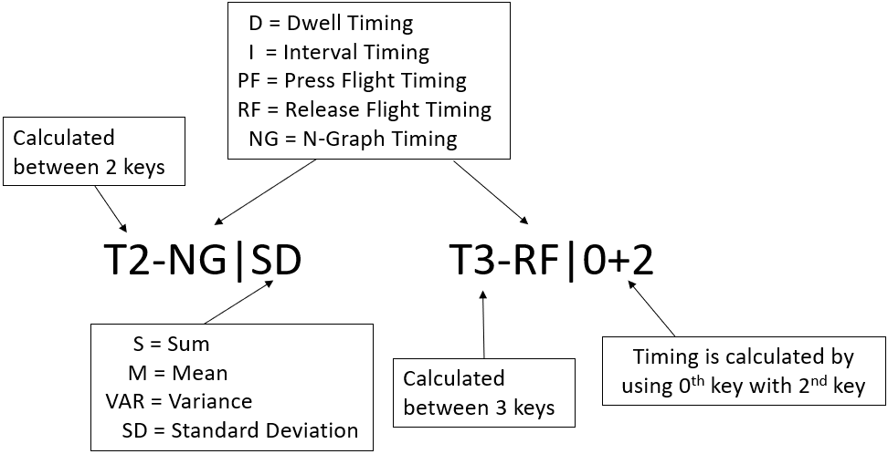

PRELUDE: DATASET COLLECTION EXTRACTION – CSV
Notes:
All these extracted features will be saved into csv file that would be read by the program and into the model and will be represented as follows.

Slide 29

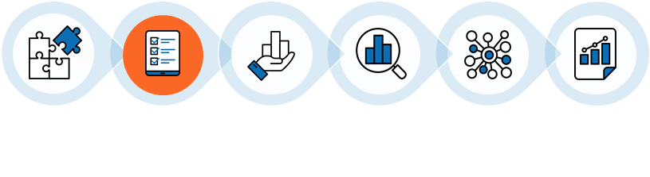

EXPERIMENTS
Collection Phase
Validation Phase
Live Testing Phase
Collect Data
KFold Validation
Test of the new model
Notes:
In this section, we aim to explore different experiments to determine possibilities of usage and accuracy of keystroke biometrics as a multi-factor authentication method.
The experiment will go through three different phases. It will go through collection phase to collect dataset based on the premise of the experiment. The next phase is to perform validation to estimate the skill of the model on unseen data that helps to determine if the parameters (e.g., epoch, batch size) were appropriate. As it is not practical or feasible to request for a participant to key in humongous amount of data, kfold validation is performed instead of hold-out validation. Lastly, an actual live test will be performed to make sure that the model is suitable for real life cases.

Slide 30
EXPERIMENTS
Collection Phase
Provide relevant words for user to key in
Collect data to form dataset
Validation Phase
Evaluate model parameters were appropriate through KFold validation
Dataset goes through model
User Authentication with Password
Input data* through model
Successfully Authenticate
Live Testing Phase
*Data type will change based on the premise of the experiments
Notes:
In this section, we aim to perform different experiments to determine possibilities of usage and accuracy of keyboard as a MFA.
The experiment will go through three different phases. It will go through collection phase to collect dataset based on the premise of the experiment. The next phase is to perform validation to estimate the skill of the model on unseen data that helps to determine if the parameters were appropriate. As it is not feasible to request for a participant to key in humongous amount of data, kfold validation is performed instead of hold-out validation. Lastly, an actual live test will be performed to make sure that the model is suitable for real life cases.

Slide 31
EXPERIMENTS
Exp | Experiment 1 |  | Experiment 2
Use-Case | CAPTCHA |  | CAPTCHA
Dataset Type | Original | Pairing | Original | Original | Pairing | Pairing
Train Dataset | DR | DR | IR | IR | IR | IR
Test Dataset | DR | DR | IR | DR | IR | DR
Results
Note:
IR = Identical-Random DR = Different-Random
Notes:
Overall there are 4 experiments, experiment 1 and 2 will focus on the use-case for CAPTCHA

Slide 32
EXPERIMENTS
Exp | Experiment 3 |  | Experiment 2
Use-Case | Password |  | CAPTCHA
Dataset Type | Original | Pairing | Original | Original | Pairing | Pairing
Train Dataset | DR | DR | IR | IR | IR | IR
Test Dataset | DR | DR | IR | DR | IR | DR
Results
Note:
IR = Identical-Random DR = Different-Random
Exp | Experiment 4
Use-Case | Password
Dataset Type | Original |  |  |  | Pairing
Train Dataset | Same | Own | Combine | Combine | Same | Own | Combine | Combine
Test Dataset | Same | Own | Legit | Fake | Same | Own | Legit | Fake
Results
Notes:
Whereas Experiment 3 and 4 will focus more on the use case of password. Experiment 3 will follow the same format of performing experiment as experiment 1 and 2, While Experiment 4 will perform experiment in a different format.

Slide 33
Experiment 1: RANDOM TEN-CHARACTERS CAPTCHA DATASET (ORIGINAL)
Existing Authentication Method
User Authentication with Password
Complete
CAPTCHA
Input MFA code through phone/email
Successfully Authenticate
Suggested Authentication Method
User Authentication with Password
MFA with keystroke biometrics obtained from CAPTCHA through the model
Successfully Authenticate
Notes:
For the first experiment, it aims to utilise keyboard as MFA to identify legitimate users based on their keystroke when keying in CAPTCHA. This would kill two birds with one stone as it also verifies that the user is a human instead of a bot.

Slide 34
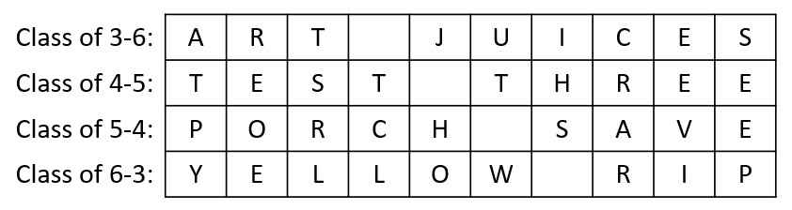
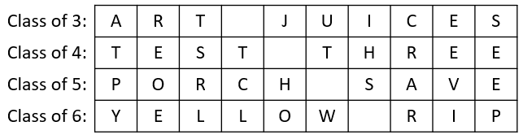
Experiment 1: RANDOM TEN-CHARACTERS CAPTCHA DATASET (ORIGINAL)
Words from the dictionary are used to retain keystroke speed
10 characters
Notes:
The dataset is made up of CAPTCHA words from the dictionary. This is to allow the participants to maintain their keystroke speed and timing by typing words that they are familiar with. As the model requires a fixed shape input or phrases of the same length, words of different length are joined together to achieve wider variety of phrases. In total, each CAPTCHA phrase will be made up from ten characters and be sorted into four classes of CAPTCHA phrases based on the number of letters that the first word is made up of.

Slide 35

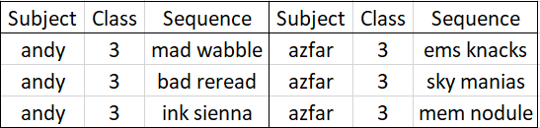
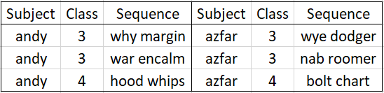
Experiment 1: RANDOM TEN-CHARACTERS CAPTCHA DATASET (ORIGINAL)
10
37
Train
920 DR rows
Participants
Features for Original dataset
Test
80 DR rows
Different Random
Controlled Free-Text Training Dataset
Different Random
Controlled Free-Text Dataset
Different Random
Controlled Free-Text Testing Dataset
Notes:
The dataset that will be used for the experiment will be random controlled free-text dataset between each participant to determine if the model is able to verify users based on unseen data to reduce security concerns from predictable words.

Slide 36

Experiment 1: RANDOM TEN-CHARACTERS CAPTCHA DATASET (ORIGINAL)
Exp | Experiment 1 |  | Experiment 2
Use-Case | CAPTCHA |  | CAPTCHA
Dataset Type | Original | Pairing | Original | Original | Pairing | Pairing
Train Dataset | DR | Random | IR | IR | IR | IR
Test Dataset | DR | Random | IR | DR | IR | DR
Results | 33/80 (41.3%)
Notes:
The results shows that the model performs badly as it was only capable of identifying with a total of 41.3% success rate.
In order to better identify what potential flaws there are in the dataset or ways to increase accuracy, more experiments were held.

Slide 37
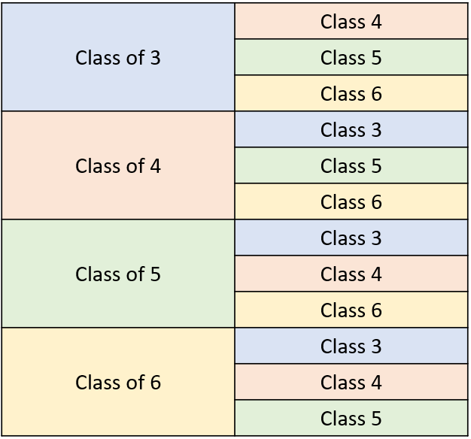
Experiment 1: RANDOM TEN-CHARACTERS CAPTCHA DATASET (PAIRING)
1
2
Statistical Features
N-Graphs (e.g., digraphs, trigraphs)
Notes:
In order to increase the accuracy, two proposals were made. One was to increase the number of extracted features such as including statistics features and n-graphs (e.g., digraphs and trigraphs). The second proposal was to increase the quantity of the dataset by having each row of data paired up based on classes to increase the dataset. This would align with the practical usage of CAPTCHA where users have to key in two CAPTCHAs in a row when submitting their response.
Using the same type of CAPTCHA phrases, the rows will be paired to each other based off their classes so that no pairing will be from the same classes. In total there are 12 classes.

Slide 38
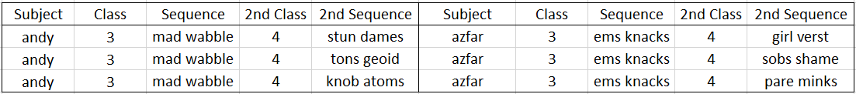
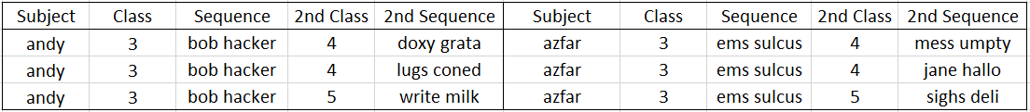
Experiment 1: RANDOM TEN-CHARACTERS CAPTCHA DATASET (PAIRING)
10
644
Train
63480 DR rows
Participants
Features for Pairing dataset
Test
480 DR rows
Different Random
Controlled Free-Text Training Dataset
Different Random
Controlled Free-Text Dataset
Different Random
Controlled Free-Text Testing Dataset
Notes:
For pairing dataset in Experiment 1, this is how it will look.

Slide 39
Experiment 1: RANDOM TEN-CHARACTERS CAPTCHA DATASET (PAIRING)
Exp | Experiment 1 |  | Experiment 2
Use-Case | CAPTCHA |  | CAPTCHA
Dataset Type | Original | Pairing | Original | Original | Pairing | Pairing
Train Dataset | DR | DR | IR | IR | IR | IR
Test Dataset | DR | DR | IR | DR | IR | DR
Results | 33/80 (41.3%) | 271/480 (56.5%)
Notes:
The pairing results shows that the model performs badly as it was only capable of identifying with a total of 56.5% success rate.
Thus, we can conclude that pairing dataset together will increase overall accuracy and will be utilised for future experiments.

Slide 40
Experiment 2: IDENTICAL TEN-CHARACTERS CAPTCHA DATASET (ORIGINAL)
PREVIOUSLY
CURRENTLY
Identical Controlled Free-Text Dataset
Different Random
Controlled Free-Text Dataset
Identical Random Controlled Free-Text Training Dataset
Controlled Free-Text Testing Dataset
Identical Random (IR)
Controlled Free-Text Testing Dataset
Different Random (DR) Controlled Free-Text Testing Dataset
Different Random
Controlled Free-Text Training Dataset
Different Random
Controlled Free-Text Testing Dataset
Notes:
As the previous experiment was conducted with each participant having different random controlled free-text dataset, the results have shown that we are not able to obtain a model with high accuracy.
This experiment will aim to continue with the same goal and format of the previous experiment, except each participant will generate identical random controlled free-text training dataset. In addition, there will be two test datasets for each of the experiment that comprises of identical random (IR) and different random (DR) controlled free-text dataset to determine if there are any factor or relevance to obtain a higher accuracy model.

Slide 41
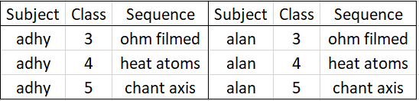
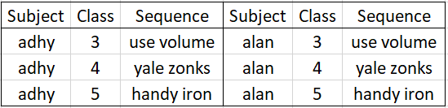
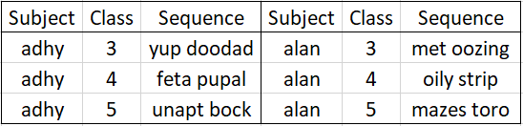
Experiment 2: IDENTICAL TEN-CHARACTERS CAPTCHA DATASET (ORIGINAL)
10
320
Train
63480 IR rows
Participants
Features for Original dataset
Test
480 IR and 480 DR rows
Identical Random Controlled Free-Text Training Dataset
Identical Controlled Free-Text Dataset
Identical Random (IR)
Controlled Free-Text Testing Dataset
Controlled Free-Text Testing Dataset
Different Random (DR) Controlled Free-Text Testing Dataset
Notes:
This is how the original dataset will look like for Experiment 2 where it uses two different testing dataset

Slide 42
Experiment 2: IDENTICAL TEN-CHARACTERS CAPTCHA DATASET (ORIGINAL)
Exp | Experiment 1 |  | Experiment 2
Use-Case | CAPTCHA |  | CAPTCHA
Dataset Type | Original | Pairing | Original | Original | Pairing | Pairing
Train Dataset | DR | DR | IR | IR | IR | IR
Test Dataset | DR | DR | IR | DR | IR | DR
Results | 33/80 (41.3%) | 271/480 (56.5%) | 40/80 (50%) | 38/80 (47.5%)
Notes:
Testing against the IR dataset, the model performs badly as it only identifies with a total of 50%. Meanwhile, testing against the DR dataset, the model performs worse as it only identifies with a total of 47.5%.
With a marginal difference for this experiment, we can conclude that IR training and IR testing dataset will perform better than IR training and DR testing dataset. As the accuracy of the results were significantly low, pairing datasets would be attempted to determine if there will be any significant results in terms of accuracy.

Slide 43
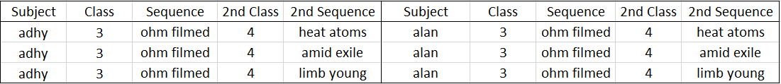
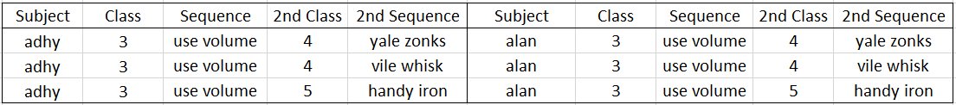
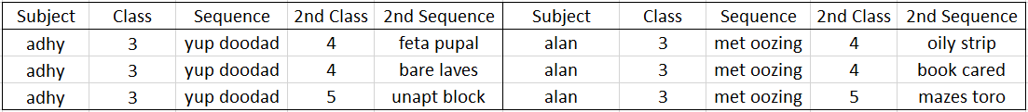
Experiment 2: IDENTICAL TEN-CHARACTERS CAPTCHA DATASET (PAIRING)
10
644
Train
920 IR rows
Participants
Features for Pairing dataset
Test
80 IR and 80 DR rows
Identical Random Controlled Free-Text Training Dataset
Identical Controlled Free-Text Dataset
Identical Random (IR)
Controlled Free-Text Testing Dataset
Controlled Free-Text Testing Dataset
Different Random (DR) Controlled Free-Text Testing Dataset
Notes:
Performing the same experiment but with the pairing dataset, this is how the data will look like.

Slide 44
Experiment 2: IDENTICAL TEN-CHARACTERS CAPTCHA DATASET (PAIRING)
Exp | Experiment 1 |  | Experiment 2
Use-Case | CAPTCHA |  | CAPTCHA
Dataset Type | Original | Pairing | Original | Original | Pairing | Pairing
Train Dataset | DR | DR | IR | IR | IR | IR
Test Dataset | DR | DR | IR | DR | IR | DR
Results | 33/80 (41.3%) | 271/480 (56.5%) | 40/80 (50%) | 38/80 (47.5%) | 294/480 (61.3%) | 245/480 (51.0%)
Notes:
Testing against the IR pairing dataset, the model performs badly as it identifies a total of 61.3% accurately. Meanwhile, testing against the DR pairing dataset, the model performs worse as it only identifies a total of 51.0% in the dataset. With such significant difference between Experiment 2 Original Dataset (IRDR) and Experiment 2 Pairing Dataset (IRDR), pairing dataset do help to improve the model accuracy.
In both original and especially pairing experiments, there is a significant difference where IR training and IR testing dataset performs better than IR training and DR testing dataset in terms of accuracy. One plausible conclusion based on our initial research could be that a more restrictive dataset would help the model to predict better.

Slide 45
Experiment 3: FIVE-LETTERS PASSWORD DATASET
Existing Authentication Method
User Authentication with Password
Successfully Authenticate
Input MFA code through phone/email
Suggested Authentication Method
User Authentication with Password
MFA with keystroke biometrics obtained from Password through the model
Successfully Authenticate
Notes:
A more restrictive dataset would also mean that there will be a higher predictability in the generated CAPTCHA words. This goes against security as CAPTCHA is supposed to be made up of random characters. Hence, the use case for next two experiment on keystroke biometrics multifactor authentication will be testing on the possibility of integrating it with the master password.

Slide 46
Experiment 3: FIVE-LETTERS PASSWORD DATASET
Exp | Experiment 1 |  | Experiment 2
Use-Case | CAPTCHA |  | CAPTCHA
Dataset Type | Original | Pairing | Original | Original | Pairing | Pairing
Train Dataset | DR | DR | IR | IR | IR | DR
Test Dataset | DR | DR | IR | DR | IR | DR
Exp | Experiment 3 |  | Experiment 3
Use-Case | Password |  | CAPTCHA
Dataset Type | Original | Pairing | Original | Original | Pairing | Pairing
Train Dataset | DR | DR | IR | IR | IR | DR
Test Dataset | DR | DR | IR | DR | IR | DR
Notes:
Before the dataset becomes more restrictive for Experiment 4, this experiment will be performed to check if there are distinctive changes when performing on a five-letters password dataset as compared to a ten-characters CAPTCHA dataset. Hence, Experiment 3 will also perform on the same type of train and test dataset as seen in Experiment 1 and 2.

Slide 47
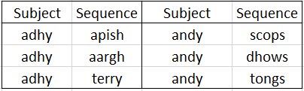
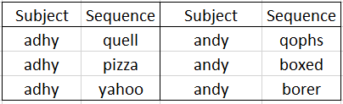
Experiment 3: FIVE-LETTERS PASSWORD DATASET (RANDOM)
8
97
Train
800 DR rows
Participants
Features for Original dataset
Test
80 DR rows
Different Random
Controlled Free-Text Training Dataset
Different Random
Controlled Free-Text Dataset
Different Random
Controlled Free-Text Testing Dataset
Notes:
To reduce repetition of the explanation from Experiment 1 and Experiment 2, a sample of the word list will be shown for both random and identical dataset for experiment 3. The word list is made up of entirely five-letter words from the dictionary to allow the participants to maintain their keystroke speed and timing by typing words that they are familiar with. This is the random five-letters password dataset

Slide 48
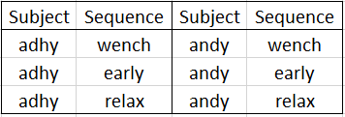
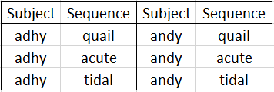
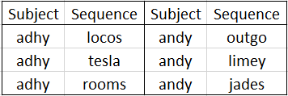
Experiment 3: FIVE-LETTERS PASSWORD DATASET (IDENTICAL)
8
194
Train
800 IR rows
Participants
Features for Pairing dataset
Test
80 IR and 80 DR rows
Identical Random Controlled Free-Text Training Dataset
Identical Controlled Free-Text Dataset
Identical Random (IR)
Controlled Free-Text Testing Dataset
Controlled Free-Text Testing Dataset
Different Random (DR) Controlled Free-Text Testing Dataset
Notes:
Meanwhile, this is the identical five-letters password dataset

Slide 49
Experiment 3: FIVE-LETTERS PASSWORD DATASET
Exp | Experiment 3
Use-Case | Password
Dataset Type | Original | Pairing | Original | Original | Pairing | Pairing
Train Dataset | DR | DR | IR | IR | IR | IR
Test Dataset | DR | DR | IR | DR | IR | DR
Results | 26/80 (32.5%) | 268/720 (37.2%) | 32/80 (40.0%) | 30/80 (37.5%) | 390/720 (54.2%) | 338/720 (46.9%)
Restriction (1st as the most restriction) | 3rd | 3rd | 1st | 2nd | 1st | 2nd
Performance (1st as the best performance) | 6th | 5th | 3rd | 4th | 1st | 2nd
Notes:
From the results in Experiment 3, we could determine from the ranking of restriction and performance that pairing rows together in a more restricted dataset would tend to increase the model accuracy by a large margin for a password dataset. Hence for Experiment 4, the experiment will focus on restricting the dataset even further.

Slide 50
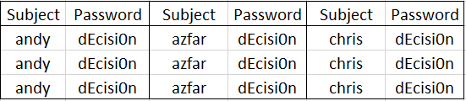
Experiment 4: EIGHT-LETTERS PASSWORD DATASET
1st Stage: Same
2nd Stage: Own
3rd Stage: Combine
11
220
Train
1100 fixed-text rows
Participants
Features for Original dataset
Test
55 fixed-text rows
Same Password Training Dataset
Same Password Dataset
Password: dEcisi0n
Same Password Testing Dataset
Notes:
In Experiment 4, we will attempt to use a longer password length than the previous experiment to provide more features to sieve out patterns. In addition, a more restrictive dataset than the one used in the previous 3 experiments will be utilised which is a fixed-text dataset. Since we are utilising password for a fixed-text dataset, the scenario for the experiment will consist of three stages. The first stage will be to request for all participants to type the same eight-letter password which is dEcisi0n. This is to test if the model is able to detect each user even when they have the same eight-letter password.

Slide 51
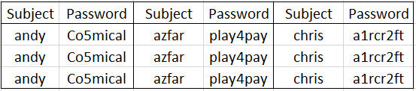
Experiment 4: EIGHT-LETTERS PASSWORD DATASET
1st Stage: Same
2nd Stage: Own
3rd Stage: Combine
11
220
Train
1100 fixed-text rows
Participants
Features for Original dataset
Test
55 fixed-text rows
Own Password Training Dataset
Own Password Dataset
Own Password Testing Dataset
Notes:
The second stage will be to request for all participants to generate their own eight-letter password. The second stage aims to test if the model is able to detect each user by their own password.

Slide 52
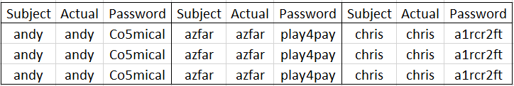
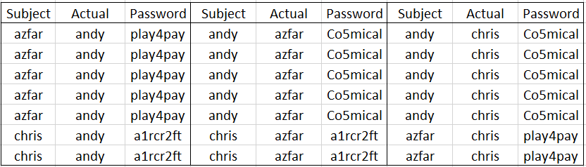
Experiment 4: EIGHT-LETTERS PASSWORD DATASET
1st Stage: Same
2nd Stage: Own
3rd Stage: Combine
11
220
Train
1100 fixed-text rows
Participants
Features for Original dataset
Test
55 legit and 550 fake rows
Own Password
Training Dataset
Combine Password Dataset
Legit Password Testing Dataset
Combine Password Testing Dataset
Fake Password Testing Dataset
Notes:
The last stage will be to ask all participants to key in the each of the participants’ password in the first stage as a testing dataset and tested against the first stage’s model. The last stage is to test if the model is able to detect the right user typing the right password and differentiating the wrong password.

Slide 53
Experiment 4: EIGHT-LETTERS PASSWORD DATASET
Exp | Experiment 4
Use-Case | Password
Dataset Type | Original |  |  |  | Pairing
Train Dataset | Same | Own | Combine | Combine | Same | Own | Combine | Combine
Test Dataset | Same | Own | Legit | Fake | Same | Own | Legit | Fake
Results | 44/55 (80.0%)
Notes:
The model performs great as it was capable of identifying a total of 80.0% of the subject in the testing dataset. As the accuracy of the results were significantly high, this shows that the model is capable of identifying users even when their eight-letter password is the same. This also proves that the model is able to differentiate the users based on their keystroke biometrics.

Slide 54
Experiment 4: EIGHT-LETTERS PASSWORD DATASET
Exp | Experiment 4
Use-Case | Password
Dataset Type | Original |  |  |  | Pairing
Train Dataset | Same | Own | Combine | Combine | Same | Own | Combine | Combine
Test Dataset | Same | Own | Legit | Fake | Same | Own | Legit | Fake
Results | 44/55 (80.0%) | 53/55 (96.4%)
Notes:
In the own-password stage, the model performs great as it was capable of identifying with a total of 96.4% in the testing dataset. As the accuracy of the results were significantly high, this shows that the model is capable of identifying users based on their eight-letter password even when it is different between each participant. This also proves that the model is able to differentiate the users based on their keystroke biometrics.

Slide 55
Experiment 4: EIGHT-LETTERS PASSWORD DATASET
Exp | Experiment 4
Use-Case | Password
Dataset Type | Original |  |  |  | Pairing
Train Dataset | Same | Own | Combine | Combine | Same | Own | Combine | Combine
Test Dataset | Same | Own | Legit | Fake | Same | Own | Legit | Fake
Results | 44/55 (80.0%) | 53/55 (96.4%) | 51/55 (92.7%) | 430/550 (78.2%)
Notes:
For the combine-password stage, the model performs great as it was capable of identifying with a total of 92.7% in the legit-password dataset. Meanwhile, the model performs fairly well as it was capable of not identifying a total of 78.2% in the fake-password testing dataset. As the accuracy of the results were significantly high for both, this shows that the model is capable of identifying users even when users were to key in other participants’ password.

Slide 56
Experiment 4: EIGHT-LETTERS PASSWORD DATASET
Exp | Experiment 4
Use-Case | Password
Dataset Type | Original |  |  |  | Pairing
Train Dataset | Same | Own | Combine | Combine | Same | Own | Combine | Combine
Test Dataset | Same | Own | Legit | Fake | Same | Own | Legit | Fake
Results | 44/55 (80.0%) | 53/55 (96.4%) | 51/55 (92.7%) | 430/550 (78.2%) | 193/220 (87.7%) | 220/220 (99.1%) | 220/220 (100.0%) | 1632/2200 (74.2%)
Notes:
For pairing dataset of Experiment 4, the results showcase similar high results as the original dataset.

Slide 57
Conclusion
Exp | Experiment 4
Use-Case | Password
Dataset Type | Original | Pairing
Train Dataset | Same | Same
Test Dataset | Same | Same
Results | 44/55 (80.0%) | 193/220 (87.7%)
Notes:
Based on the results performed across all experiments, Experiment 4 seems to showcase the perfect use-case for keystroke biometrics when utilising for MFA. This can be seen with the high accuracy obtained from the model based on the specific scenario crafted. As seen from the same-password dataset, the model is able to verify each participant that typed the same password with a high accuracy as shown in Table X. This proves that the model can be utilise in keystroke biometrics as it is able to distinguish between participants even when they are keying in the same data.

Slide 58
Conclusion
Exp | Experiment 4
Use-Case | Password
Dataset Type | Original |  |  | Pairing
Train Dataset | Own | Combine | Combine | Own | Combine | Combine
Test Dataset | Own | Legit | Fake | Own | Legit | Fake
Results | 53/55 (96.4%) | 51/55 (92.7%) | 430/550 (78.2%) | 220/220 (99.1%) | 220/220 (100.0%) | 1632/2200 (74.2%)
Notes:
Moving on to the own-password and combine-password dataset, the model is able to verify each participant that typed their own password with a high accuracy and each imposter participant that typed other people password with a relatively high accuracy as well as shown in Table X. This proves that the model can be utilise in keystroke biometrics for multifactor authentication but would need better improvements to detect imposter.
In conclusion, pairing the master password with keystroke biometrics as a multifactor authentication method has proven to have an overwhelming high accuracy in distinguishing the right person with the right password. However, there is still a form of security risks as there is still a significant rate where a model could authenticate a wrong person with the right password.
Hence, there could be a few plausible reasons such as there is a need for more data to train the model or that there is a need for more participants to increase the spatial space for the model to better differentiate between people. However, the experiment definitely have shown conclusive evidence that it is possible to work towards having keystroke biometrics with deep learning to act as a multifactor authentication.

