Slide 1
Assignment 11:
Critters
  reading: HW11 assignment spec

Slide 2
Critters
A simulation world with animal objects with behavior:
  fight animal fighting
  getColor color to display
  getMove movement
  toString letter to display
  eat eat food?
You must implement:
  Ant
  Bird
  Vulture
  Hippo
  Longhorn (Wins and Creative)

Slide 3
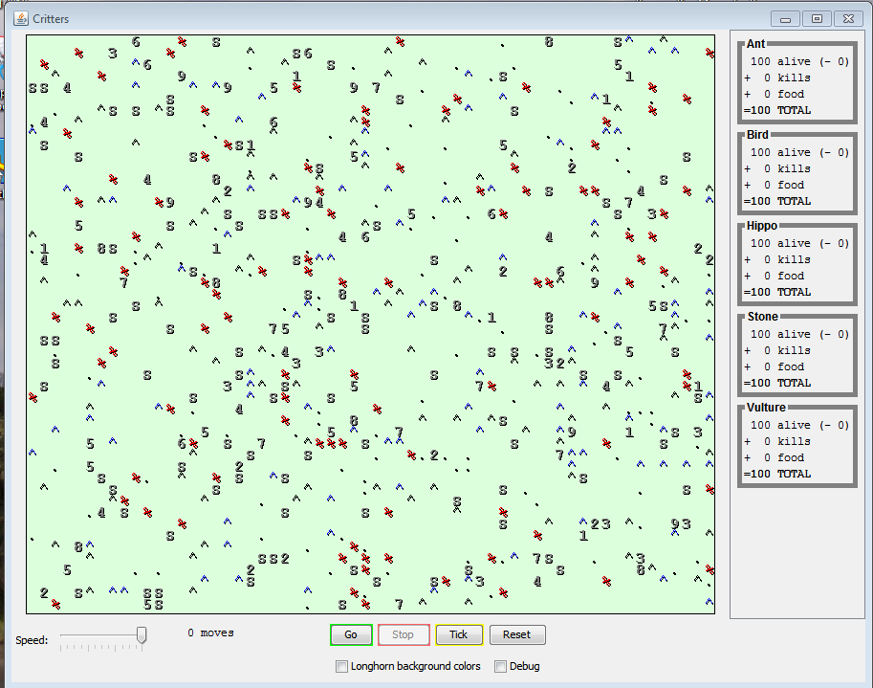

Slide 4
Food
Simulator places food randomly around world
Eating food increases score for species, but …
Critters sleep after eating
  simulator (CritterMain) handles this
A Critter that gets in a fight while sleeping always loses
  simulator handles this

Slide 5
A Critter class
public class name extends Critter {
...
}
extends Critter tells the simulator your class is a critter
override methods from Critter based on Critter spec
Critter has a number of methods not required by the 4 simple Critter classes (Ant, Bird, Vulture, Hippo)
… but you should use them to create a killer Longhorn

Slide 6
Scoring
Score for each species:
For all animals of that species
Number of animals alive
Number of fights won
Pieces of food eaten

Slide 7
Mating
Two Critters of same species next to each other mate and produce a baby Critter
Simulator handles this
Critters not asked if they want to mate
Critters vulnerable while mating (heart graphic indicates mating)
  automatically lose fight
The Simulator handles all of this
  You don't write any code to deal with mating

Slide 8
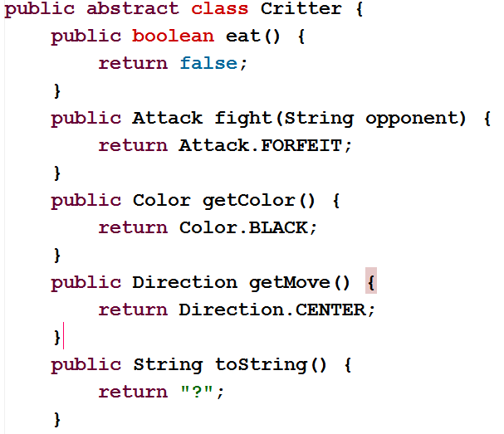
Critter
Class

Slide 9
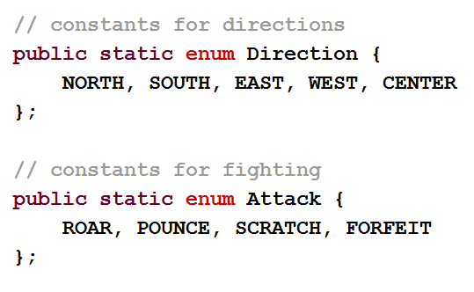
Enums
Critter class has two nested Enums for Direction of movement and how to fight

Slide 10
Nested Enums
To access a Direction or Attack a class external to Critter would use the following syntax:
Critter.Direction.NORTH
Critter.ATTACK.POUNCE
Classes that are desecdants of Critter (like the ones you implement) do not have to use the Critter.
  it is implicit
Direction.SOUTH, Attack.ROAR

Slide 11
How the simulator works
When you press "Go", the simulator enters a loop:
  move each animal once (getMove), in random order
  if the animal has moved onto an occupied square, fight!
Key concept: The simulator is in control, NOT your animal.
  Example: getMove can return only one move at a time.
  getMove can't use loops to return a sequence of moves.
    It wouldn't be fair to let one animal make many moves in one turn!
  Your animal must keep state (as fields, instance variables) so that it can make a single move, and know what moves to make later.

Slide 12
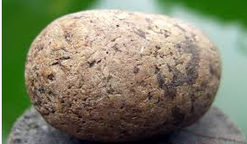
Critter exercise: Stone
Write a critter class Stone(the dumbest of all critters):
Method | Behavior
constructor | public Stone()
fight | Always Attack.ROAR
getColor | Always Color.GRAY
getMove | Always Direction.CENTER
toString | "S"
eat | Always false

Slide 13
Ideas for state
You must not only have the right state, but update that state properly when relevant actions occur.
Counting is helpful:
  How many total moves has this animal made?
  How many times has it fought?
Remembering recent actions in fields is helpful:
  Which direction did the animal move last?
    How many times has it moved that way?

Slide 14
Keeping state
How can a critter move west until it fights?
  public Direction getMove() {
  while (animal has not fought) {
  return Direction.EAST;
  }
  while (animal has not fought a second time) {
  return Direction.EAST;
  }
  }
  private int fights; // total times Critter has fought
  public int getMove() {
  if (fights % 2 == 0) {
  return Direction.WEST;
  } else {
  return Direction.EAST;
  }
  }

Slide 15
Testing critters
Use the MiniMain to create String based on actions and print those out
Focus on one specific critter of one specific type
  Only spawn 1 of each animal, for debugging
Make sure your fields update properly
  Use println statements to see field values
Look at the behavior one step at a time
  Use "Tick" rather than "Go"

Slide 16
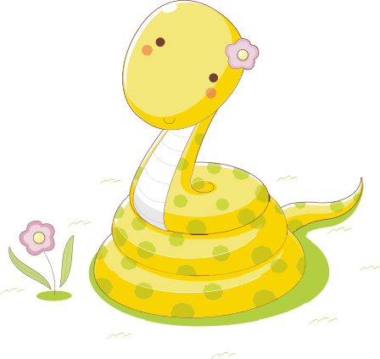
Critter exercise: Snake
Method | Behavior
constructor | public Snake(boolean northSnake)
fight | alternates between SCRATCH and POUNCE
getColor | Yellow
getMove | north snakes: 5 steps north, pause 5 ticks, 5 steps north, pause 5 ticks, … otherwise: 5 steps west, pause 5 ticks, 5 steps west, pause 5 ticks, …
eat | always eats
toString | "K"

Slide 17
Determining necessary fields
Information required to decide what move to make?
  Direction to go in
  Length of current cycle
  Number of moves made in current cycle
Remembering things you've done in the past:
  an int counter?
  a boolean flag?

