Slide 1
Building Java Programs Chapter 12
Recursion
Copyright (c) Pearson 2013. All rights reserved.

Slide 2
Recursion
recursion: The definition of an operation in terms of itself.
Solving a problem using recursion depends on solving smaller occurrences of the same problem.
recursive programming: Writing methods that call themselves to solve problems recursively.
An equally powerful substitute for iteration (loops)
Particularly well-suited to solving certain types of problems

Slide 3
Why learn recursion?
"cultural experience" - A different way of thinking of problems
Can solve some kinds of problems better than iteration
Leads to elegant, simplistic, short code (when used well)
Many programming languages ("functional" languages such as Scheme, ML, and Haskell) use recursion exclusively (no loops)

Slide 4

Exercise
(To a student in the front row) How many students total are directly behind you in your "column" of the classroom?
You have poor vision, so you can see only the people right next to you. So you can't just look back and count.
But you are allowed to ask questions of the person next to you.
How can we solve this problem? (recursively )

Slide 5
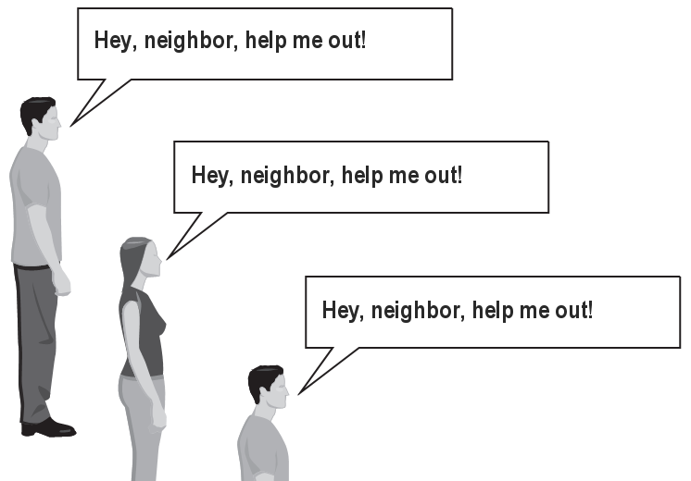
The idea
Recursion is all about breaking a big problem into smaller occurrences of that same problem.
Each person can solve a small part of the problem.
What is a small version of the problem that would be easy to answer?
What information from a neighbor might help me?

Slide 6
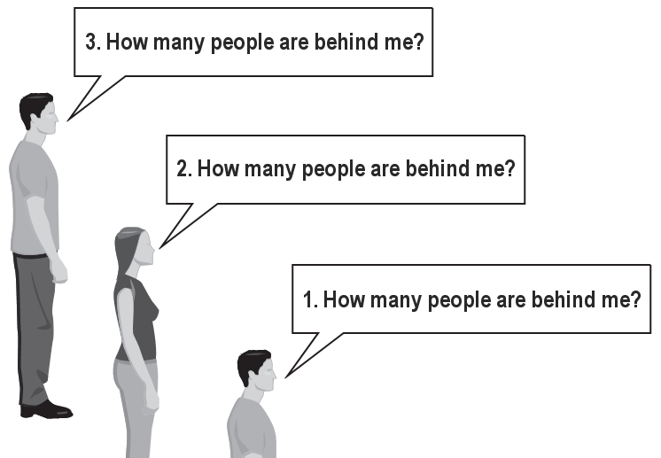
Recursive algorithm
Number of people behind me:
If there is someone behind me, ask him/her how many people are behind him/her.
When they respond with a value N, then I will answer N + 1.
If there is nobody behind me, I will answer 0.

Slide 7
Recursion and cases
Every recursive algorithm involves at least 2 cases:
base case: A simple occurrence that can be answered directly.
recursive case: A more complex occurrence of the problem that cannot be directly answered, but can instead be described in terms of smaller occurrences of the same problem.
Some recursive algorithms have more than one base or recursive case, but all have at least one of each.
A crucial part of recursive programming is identifying these cases.

Slide 8
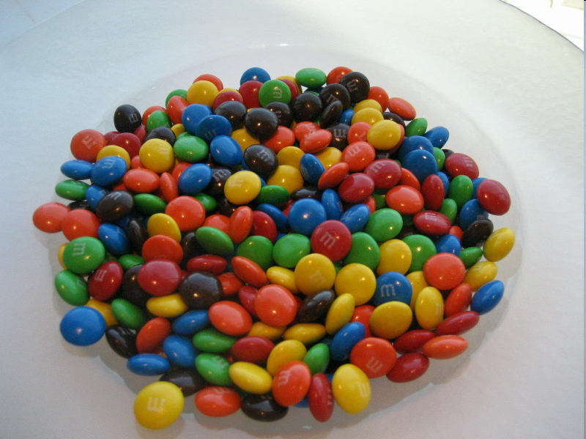
Another recursive task
How can we remove exactly half of the M&M's in a large bowl, without dumping them all out or being able to count them?
What if multiple people help out with solving the problem? Can each person do a small part of the work?
What is a number of M&M's that it is easy to double, even if you can't count? (What is a "base case"?)

Slide 9
Recursion in Java
Consider the following method to print a line of * characters:
// Prints a line containing the given number of stars.
// Precondition: n >= 0
public static void printStars(int n) {
for (int i = 0; i < n; i++) {
System.out.print("*");
}
System.out.println(); // end the line of output
}
Write a recursive version of this method (that calls itself).
Solve the problem without using any loops.
Hint: Your solution should print just one star at a time.

Slide 10
A basic case
What are the cases to consider?
What is a very easy number of stars to print without a loop?
public static void printStars(int n) {
if (n == 1) {
// base case; just print one star
System.out.println("*");
} else {
...
}
}

Slide 11
Handling more cases
Handling additional cases, with no loops (in a bad way):
public static void printStars(int n) {
if (n == 1) {
// base case; just print one star
System.out.println("*");
} else if (n == 2) {
System.out.print("*");
System.out.println("*");
} else if (n == 3) {
System.out.print("*");
System.out.print("*");
System.out.println("*");
} else if (n == 4) {
System.out.print("*");
System.out.print("*");
System.out.print("*");
System.out.println("*");
} else ...
}

Slide 12
Handling more cases 2
Taking advantage of the repeated pattern (somewhat better):
public static void printStars(int n) {
if (n == 1) {
// base case; just print one star
System.out.println("*");
} else if (n == 2) {
System.out.print("*");
printStars(1); // prints "*"
} else if (n == 3) {
System.out.print("*");
printStars(2); // prints "**"
} else if (n == 4) {
System.out.print("*");
printStars(3); // prints "***"
} else ...
}

Slide 13
Using recursion properly
Condensing the recursive cases into a single case:
public static void printStars(int n) {
if (n == 1) {
// base case; just print one star
System.out.println("*");
} else {
// recursive case; print one more star
System.out.print("*");
printStars(n - 1);
}
}

Slide 14
"Recursion Zen"
The real, even simpler, base case is an n of 0, not 1:
public static void printStars(int n) {
if (n == 0) {
// base case; just end the line of output
System.out.println();
} else {
// recursive case; print one more star
System.out.print("*");
printStars(n - 1);
}
}
Recursion Zen: The art of properly identifying the best set of cases for a recursive algorithm and expressing them elegantly.

Slide 15
Recursive tracing
Consider the following recursive method:
public static int mystery(int n) {
if (n < 10) {
return n;
} else {
int a = n / 10;
int b = n % 10;
return mystery(a + b);
}
}
What is the result of the following call?
mystery(648)

Slide 16
A recursive trace
mystery(648):
int a = 648 / 10; // 64
int b = 648 % 10; // 8
return mystery(a + b); // mystery(72)
mystery(72):
int a = 72 / 10; // 7
int b = 72 % 10; // 2
return mystery(a + b); // mystery(9)
mystery(9):
return 9;

Slide 17
Recursive tracing 2
Consider the following recursive method:
public static int mystery(int n) {
if (n < 10) {
return (10 * n) + n;
} else {
int a = mystery(n / 10);
int b = mystery(n % 10);
return (100 * a) + b;
}
}
What is the result of the following call?
mystery(348)

Slide 18
A recursive trace 2
mystery(348)
int a = mystery(34);
int a = mystery(3);
return (10 * 3) + 3; // 33
int b = mystery(4);
return (10 * 4) + 4; // 44
return (100 * 33) + 44; // 3344
int b = mystery(8);
return (10 * 8) + 8; // 88
return (100 * 3344) + 88; // 334488
What is this method really doing?

Slide 19
Exercise
Write a recursive method pow accepts an integer base and exponent and returns the base raised to that exponent.
Example: pow(3, 4) returns 81
Solve the problem recursively and without using loops.

Slide 20
pow solution
// Returns base ^ exponent.
// Precondition: exponent >= 0
public static int pow(int base, int exponent) {
if (exponent == 0) {
// base case; any number to 0th power is 1
return 1;
} else {
// recursive case: x^y = x * x^(y-1)
return base * pow(base, exponent - 1);
}
}

Slide 21
An optimization
Notice the following mathematical property:
3¹² = 531441 = 9⁶
= (3²)⁶
531441 = (9²)³
= ((3²)²)³
When does this "trick" work?
How can we incorporate this optimization into our pow method?
What is the benefit of this trick if the method already works?

Slide 22
pow solution 2
// Returns base ^ exponent.
// Precondition: exponent >= 0
public static int pow(int base, int exponent) {
if (exponent == 0) {
// base case; any number to 0th power is 1
return 1;
} else if (exponent % 2 == 0) {
// recursive case 1: x^y = (x^2)^(y/2)
return pow(base * base, exponent / 2);
} else {
// recursive case 2: x^y = x * x^(y-1)
return base * pow(base, exponent - 1);
}
}

Slide 23
Exercise
Write a recursive method printBinary that accepts an integer and prints that number's representation in binary (base 2).
Example: printBinary(7) prints 111
Example: printBinary(12) prints 1100
Example: printBinary(42) prints 101010
Write the method recursively and without using any loops.
place | 10 | 1 |  | 32 | 16 | 8 | 4 | 2 | 1
value | 4 | 2 |  | 1 | 0 | 1 | 0 | 1 | 0

Slide 24
Case analysis
Recursion is about solving a small piece of a large problem.
What is 69743 in binary?
Do we know anything about its representation in binary?
Case analysis:
What is/are easy numbers to print in binary?
Can we express a larger number in terms of a smaller number(s)?
Suppose we are examining some arbitrary integer N.
if N's binary representation is 10010101011
(N / 2)'s binary representation is 1001010101
(N % 2)'s binary representation is 1

Slide 25
printBinary solution
// Prints the given integer's binary representation.
// Precondition: n >= 0
public static void printBinary(int n) {
if (n < 2) {
// base case; same as base 10
System.out.println(n);
} else {
// recursive case; break number apart
printBinary(n / 2);
printBinary(n % 2);
}
}
Can we eliminate the precondition and deal with negatives?

Slide 26
printBinary solution 2
// Prints the given integer's binary representation.
public static void printBinary(int n) {
if (n < 0) {
// recursive case for negative numbers
System.out.print("-");
printBinary(-n);
} else if (n < 2) {
// base case; same as base 10
System.out.println(n);
} else {
// recursive case; break number apart
printBinary(n / 2);
printBinary(n % 2);
}
}

Slide 27
Exercise
Write a recursive method isPalindrome accepts a String and returns true if it reads the same forwards as backwards.
isPalindrome("madam") → true
isPalindrome("racecar") → true
isPalindrome("step on no pets") → true
isPalindrome("able was I ere I saw elba") → true
isPalindrome("Java") → false
isPalindrome("rotater") → false
isPalindrome("byebye") → false
isPalindrome("notion") → false

Slide 28
Exercise solution
// Returns true if the given string reads the same
// forwards as backwards.
// Trivially true for empty or 1-letter strings.
public static boolean isPalindrome(String s) {
if (s.length() < 2) {
return true; // base case
} else {
char first = s.charAt(0);
char last = s.charAt(s.length() - 1);
if (first != last) {
return false;
} // recursive case
String middle = s.substring(1, s.length() - 1);
return isPalindrome(middle);
}
}

Slide 29
Exercise solution 2
// Returns true if the given string reads the same
// forwards as backwards.
// Trivially true for empty or 1-letter strings.
public static boolean isPalindrome(String s) {
if (s.length() < 2) {
return true; // base case
} else {
return s.charAt(0) == s.charAt(s.length() - 1)
&& isPalindrome(s.substring(1, s.length() - 1));
}
}

Slide 30
Exercise
Write a recursive method reverseLines that accepts a file Scanner and prints the lines of the file in reverse order.
Example input file: Expected console output:
Roses are red, Are belong to you.
Violets are blue. All my base
All my base Violets are blue.
Are belong to you. Roses are red,
What are the cases to consider?
How can we solve a small part of the problem at a time?
What is a file that is very easy to reverse?

Slide 31
Reversal pseudocode
Reversing the lines of a file:
Read a line L from the file.
Print the rest of the lines in reverse order.
Print the line L.
If only we had a way to reverse the rest of the lines of the file....

Slide 32
Reversal solution
public static void reverseLines(Scanner input) {
if (input.hasNextLine()) {
// recursive case
String line = input.nextLine();
reverseLines(input);
System.out.println(line);
}
}
Where is the base case?

Slide 33

Tracing our algorithm
call stack: The method invocations running at any one time.
reverseLines(new Scanner("poem.txt"));
public static void reverseLines(Scanner input) {
if (input.hasNextLine()) {
String line = input.nextLine(); // "Roses are red,"
reverseLines(input);
System.out.println(line);
}
}
public static void reverseLines(Scanner input) {
if (input.hasNextLine()) {
String line = input.nextLine(); // "Violets are blue."
reverseLines(input);
System.out.println(line);
}
}
public static void reverseLines(Scanner input) {
if (input.hasNextLine()) {
String line = input.nextLine(); // "All my base"
reverseLines(input);
System.out.println(line);
}
}
public static void reverseLines(Scanner input) {
if (input.hasNextLine()) {
String line = input.nextLine(); // "Are belong to you."
reverseLines(input);
System.out.println(line);
}
}
public static void reverseLines(Scanner input) {
if (input.hasNextLine()) { // false
...
}
}
input file:
output:
Roses are red,
Violets are blue.
All my base
Are belong to you.
Are belong to you.
All my base
Violets are blue.
Roses are red,

Slide 34
Exercise
Write a method crawl accepts a File parameter and prints information about that file.
If the File object represents a normal file, just print its name.
If the File object represents a directory, print its name and information about every file/directory inside it, indented.
cse143
handouts
syllabus.doc
lecture_schedule.xls
homework
1-sortedintlist
ArrayIntList.java
SortedIntList.java
index.html
style.css
recursive data: A directory can contain other directories.

Slide 35
File objects
A File object (from the java.io package) represents a file or directory on the disk.
Constructor/method | Description
File(String) | creates File object representing file with given name
canRead() | returns whether file is able to be read
delete() | removes file from disk
exists() | whether this file exists on disk
getName() | returns file's name
isDirectory() | returns whether this object represents a directory
length() | returns number of bytes in file
listFiles() | returns a File[] representing files in this directory
renameTo(File) | changes name of file

Slide 36
Public/private pairs
We cannot vary the indentation without an extra parameter:
public static void crawl(File f, String indent) {
Often the parameters we need for our recursion do not match those the client will want to pass.
In these cases, we instead write a pair of methods:
1) a public, non-recursive one with the parameters the client wants
2) a private, recursive one with the parameters we really need

Slide 37
Exercise solution 2
// Prints information about this file,
// and (if it is a directory) any files inside it.
public static void crawl(File f) {
crawl(f, ""); // call private recursive helper
}
// Recursive helper to implement crawl/indent behavior.
private static void crawl(File f, String indent) {
System.out.println(indent + f.getName());
if (f.isDirectory()) {
// recursive case; print contained files/dirs
for (File subFile : f.listFiles()) {
crawl(subFile, indent + " ");
}
}
}

Slide 38
Recursive Backtracking

Slide 39
Exercise: Permutations
Write a method permute that accepts a string as a parameter and outputs all possible rearrangements of the letters in that string. The arrangements may be output in any order.
Example: permute("MARTY") outputs the following sequence of lines:
MARTY MARYT MATRY MATYR MAYRT MAYTR MRATY MRAYT MRTAY MRTYA MRYAT MRYTA MTARY MTAYR MTRAY MTRYA MTYAR MTYRA MYART MYATR | MYRAT MYRTA MYTAR MYTRA AMRTY AMRYT AMTRY AMTYR AMYRT AMYTR ARMTY ARMYT ARTMY ARTYM ARYMT ARYTM ATMRY ATMYR ATRMY ATRYM | ATYMR ATYRM AYMRT AYMTR AYRMT AYRTM AYTMR AYTRM RMATY RMAYT RMTAY RMTYA RMYAT RMYTA RAMTY RAMYT RATMY RATYM RAYMT RAYTM | RTMAY RTMYA RTAMY RTAYM RTYMA RTYAM RYMAT RYMTA RYAMT RYATM RYTMA RYTAM TMARY TMAYR TMRAY TMRYA TMYAR TMYRA TAMRY TAMYR | TARMY TARYM TAYMR TAYRM TRMAY TRMYA TRAMY TRAYM TRYMA TRYAM TYMAR TYMRA TYAMR TYARM TYRMA TYRAM YMART YMATR YMRAT YMRTA | YMTAR YMTRA YAMRT YAMTR YARMT YARTM YATMR YATRM YRMAT YRMTA YRAMT YRATM YRTMA YRTAM YTMAR YTMRA YTAMR YTARM YTRMA YTRAM

Slide 40
Examining the problem
Think of each permutation as a set of choices or decisions:
Which character do I want to place first?
Which character do I want to place second?
...
solution space: set of all possible sets of decisions to explore
We want to generate all possible sequences of decisions.
for (each possible first letter):
for (each possible second letter):
for (each possible third letter):
...
print!
This is called a depth-first search

Slide 41
Decision trees
chosen | available
 | M A R T Y
M | A R T Y
A | M R T Y
...
M A | R T Y
M R | A T Y
M T | A R Y
M Y | A R T
...
...
M A R | T Y
M A T | R Y
M A Y | R T
...
M Y A | R T
...
...
M A R T | Y
M A R Y | T
M A Y R | T
M A Y T | R
M A R T Y
M A R Y T
M A Y R T
M A Y T R

Slide 42
Backtracking
backtracking: A general algorithm for finding solution(s) to a computational problem by trying partial solutions and then abandoning them ("backtracking") if they are not suitable.
a "brute force" algorithmic technique (tries all paths; not clever)
often (but not always) implemented recursively
Applications:
producing all permutations of a set of values
parsing languages
games: anagrams, crosswords, word jumbles, 8 queens
combinatorics and logic programming

Slide 43
Backtracking algorithms
A general pseudo-code algorithm for backtracking problems:
explore(choices):
if there are no more choices to make: stop.
else:
Make a single choice C from the set of choices.
Remove C from the set of choices.
explore the remaining choices.
Un-make choice C.
Backtrack!

Slide 44
Backtracking strategies
When solving a backtracking problem, ask these questions:
What are the "choices" in this problem?
What is the "base case"? (How do I know when I'm out of choices?)
How do I "make" a choice?
Do I need to create additional variables to remember my choices?
Do I need to modify the values of existing variables?
How do I explore the rest of the choices?
Do I need to remove the made choice from the list of choices?
Once I'm done exploring the rest, what should I do?
How do I "un-make" a choice?

Slide 45
Permutations revisited
Write a method permute that accepts a string as a parameter and outputs all possible rearrangements of the letters in that string. The arrangements may be output in any order.
Example: permute("MARTY") outputs the following sequence of lines:
MARTY MARYT MATRY MATYR MAYRT MAYTR MRATY MRAYT MRTAY MRTYA MRYAT MRYTA MTARY MTAYR MTRAY MTRYA MTYAR MTYRA MYART MYATR | MYRAT MYRTA MYTAR MYTRA AMRTY AMRYT AMTRY AMTYR AMYRT AMYTR ARMTY ARMYT ARTMY ARTYM ARYMT ARYTM ATMRY ATMYR ATRMY ATRYM | ATYMR ATYRM AYMRT AYMTR AYRMT AYRTM AYTMR AYTRM RMATY RMAYT RMTAY RMTYA RMYAT RMYTA RAMTY RAMYT RATMY RATYM RAYMT RAYTM | RTMAY RTMYA RTAMY RTAYM RTYMA RTYAM RYMAT RYMTA RYAMT RYATM RYTMA RYTAM TMARY TMAYR TMRAY TMRYA TMYAR TMYRA TAMRY TAMYR | TARMY TARYM TAYMR TAYRM TRMAY TRMYA TRAMY TRAYM TRYMA TRYAM TYMAR TYMRA TYAMR TYARM TYRMA TYRAM YMART YMATR YMRAT YMRTA | YMTAR YMTRA YAMRT YAMTR YARMT YARTM YATMR YATRM YRMAT YRMTA YRAMT YRATM YRTMA YRTAM YTMAR YTMRA YTAMR YTARM YTRMA YTRAM

Slide 46
Exercise solution
// Outputs all permutations of the given string.
public static void permute(String s) {
permute(s, "");
}
private static void permute(String s, String chosen) {
if (s.length() == 0) {
// base case: no choices left to be made
System.out.println(chosen);
} else {
// recursive case: choose each possible next letter
for (int i = 0; i < s.length(); i++) {
char c = s.charAt(i); // choose
s = s.substring(0, i) + s.substring(i + 1);
chosen += c;
permute(s, chosen); // explore
s = s.substring(0, i) + c + s.substring(i + 1);
chosen = chosen.substring(0, chosen.length() - 1);
} // un-choose
}
}

Slide 47
Exercise solution 2
// Outputs all permutations of the given string.
public static void permute(String s) {
permute(s, "");
}
private static void permute(String s, String chosen) {
if (s.length() == 0) {
// base case: no choices left to be made
System.out.println(chosen);
} else {
// recursive case: choose each possible next letter
for (int i = 0; i < s.length(); i++) {
String ch = s.substring(i, i + 1); // choose
String rest = s.substring(0, i) + // remove
s.substring(i + 1);
permute(rest, chosen + ch); // explore
}
} // (don't need to "un-choose" because
} // we used temp variables)

Slide 48
Exercise: Combinations
Write a method combinations that accepts a string s and an integer k as parameters and outputs all possible k -letter words that can be formed from unique letters in that string. The arrangements may be output in any order.
Example: combinations("GOOGLE", 3) outputs the sequence of lines at right.
To simplify the problem, you may assume that the string s contains at least k unique characters.
EGL EGO ELG ELO EOG EOL GEL GEO GLE GLO GOE GOL | LEG LEO LGE LGO LOE LOG OEG OEL OGE OGL OLE OLG

Slide 49
Initial attempt
public static void combinations(String s, int length) {
combinations(s, "", length);
}
private static void combinations(String s, String chosen, int length) {
if (length == 0) {
System.out.println(chosen); // base case: no choices left
} else {
for (int i = 0; i < s.length(); i++) {
String ch = s.substring(i, i + 1);
if (!chosen.contains(ch)) {
String rest = s.substring(0, i) + s.substring(i + 1);
combinations(rest, chosen + ch, length - 1);
}
}
}
}
Problem: Prints same string multiple times.

Slide 50
Exercise solution
public static void combinations(String s, int length) {
Set<String> all = new TreeSet<String>();
combinations(s, "", all, length);
for (String comb : all) {
System.out.println(comb);
}
}
private static void combinations(String s, String chosen,
Set<String> all, int length) {
if (length == 0) {
all.add(chosen); // base case: no choices left
} else {
for (int i = 0; i < s.length(); i++) {
String ch = s.substring(i, i + 1);
if (!chosen.contains(ch)) {
String rest = s.substring(0, i) + s.substring(i + 1);
combinations(rest, chosen + ch, all, length - 1);
}
}
}
}

Slide 51
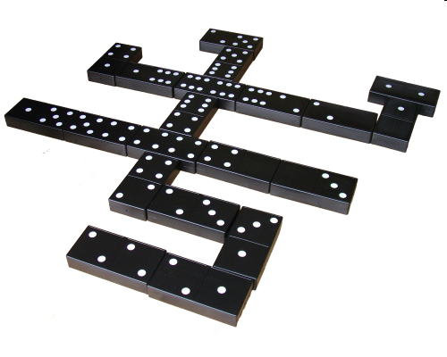
Exercise: Dominoes
The game of dominoes is played with small black tiles, each having 2 numbers of dots from 0-6. Players line up tiles to match dots.
Given a class Domino with the following methods:
public int first() // first dots value
public int second() // second dots value
public String toString() // e.g. "(3|5)"
Write a method hasChain that takes a List of dominoes and a starting/ending dot value, and returns whether the dominoes can be made into a chain that starts/ends with those values.
If the chain's start/end are the same, the answer is always true.

Slide 52
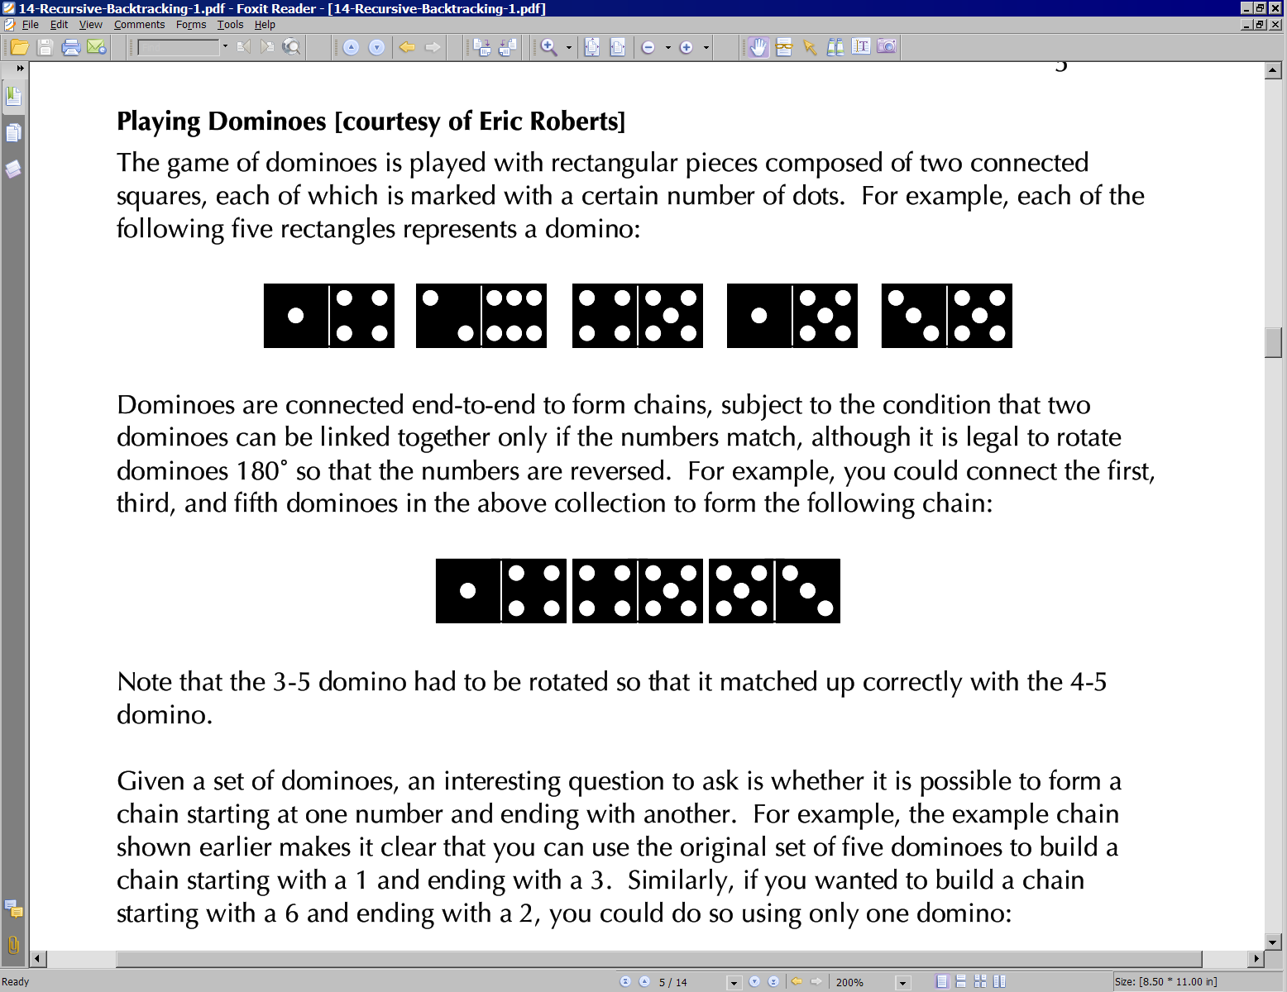
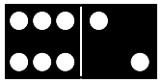
Domino chains
Suppose we have the following dominoes:
We can link them into a chain from 1 to 3 as follows:
Notice that the 3|5 domino had to be flipped.
We can "link" one domino into a "chain" from 6 to 2 as follows:

Slide 53
Exercise client code
import java.util.*; // for ArrayList
public class SolveDominoes {
public static void main(String[] args) {
// [(1|4), (2|6), (4|5), (1|5), (3|5)]
List<Domino> dominoes = new ArrayList<Domino>();
dominoes.add(new Domino(1, 4));
dominoes.add(new Domino(2, 6));
dominoes.add(new Domino(4, 5));
dominoes.add(new Domino(1, 5));
dominoes.add(new Domino(3, 5));
System.out.println(hasChain(dominoes, 5, 5)); // true
System.out.println(hasChain(dominoes, 1, 5)); // true
System.out.println(hasChain(dominoes, 1, 3)); // true
System.out.println(hasChain(dominoes, 1, 6)); // false
System.out.println(hasChain(dominoes, 1, 2)); // false
}
public static boolean hasChain(List<Domino> dominoes,
int start, int end) {
...
}
}

Slide 54
Exercise solution
public static boolean hasChain(List<Domino> dominoes,
int start, int end) {
if (start == end) {
return true; // base case
} else {
for (int i = 0; i < dominoes.size(); i++) {
Domino d = dominoes.remove(i); // choose
if (d.first() == start) { // explore
if (hasChain(dominoes, d.second(), end)) {
return true;
}
} else if (d.second() == start) {
if (hasChain(dominoes, d.first(), end)) {
return true;
}
}
dominoes.add(i, d); // un-choose
}
return false;
}
}

Slide 55
Exercise: Print chain
Write a variation of your hasChain method that also prints the chain of dominoes that it finds, if any.
hasChain(dominoes, 1, 3);
[(1|4), (4|5), (5|3)]

Slide 56
Exercise solution
public static boolean hasChain(List<Domino> dominoes, int start, int end) {
Stack<Domino> chosen = new Stack<Domino>();
return hasChain(dominoes, chosen, start, end);
}
private static boolean hasChain(List<Domino> dominoes,
Stack<Domino> chosen, int start, int end) {
if (start == end) {
System.out.println(chosen);
return true; // base case
} else {
for (int i = 0; i < dominoes.size(); i++) {
Domino d = dominoes.remove(i); // choose
if (d.first() == start) { // explore
chosen.push(d);
if (hasChain(dominoes, chosen, d.second(), end)) {
return true;
}
chosen.pop();
} else if (d.second() == start) {
d.flip();
chosen.push(d);
if (hasChain(dominoes, chosen, d.second(), end)) {
return true;
}
chosen.pop();
}
dominoes.add(i, d); // un-choose
}
return false;
}
}

Slide 57
The "8 Queens" problem
Consider the problem of trying to place 8 queens on a chess board such that no queen can attack another queen.
What are the "choices"?
How do we "make" or "un-make" a choice?
How do we know when to stop?
Q
 |  |  |  |  | Q
 |  |  |  |  |  |  | Q
 |  | Q
 |  |  |  |  |  | Q
 |  |  | Q
 | Q
 |  |  |  | Q

Slide 58
Naive algorithm
for (each square on board):
Place a queen there.
Try to place the rest of the queens.
Un-place the queen.
How large is the solution space for this algorithm?
64 * 63 * 62 * ...
 | 1 | 2 | 3 | 4 | 5 | 6 | 7 | 8
1 | Q | ... | ... | ... | ... | ... | ... | ...
2 | ... | ... | ... | ... | ... | ... | ... | ...
3 | ...
4
5
6
7
8

Slide 59
Better algorithm idea
Observation: In a working solution, exactly 1 queen must appear in each row and in each column.
Redefine a "choice" to be valid placement of a queen in a particular column.
How large is the solution space now?
8 * 8 * 8 * ...
 | 1 | 2 | 3 | 4 | 5 | 6 | 7 | 8
1 | Q | ... | ...
2 |  | ... | ...
3 |  | Q | ...
4 |  |  | ...
5 |  |  | Q
6
7
8

Slide 60
Exercise
Suppose we have a Board class with the following methods:
Write a method solveQueens that accepts a Board as a parameter and tries to place 8 queens on it safely.
Your method should stop exploring if it finds a solution.
Method/Constructor | Description
public Board(int size) | construct empty board
public boolean isSafe(int row, int column) | true if queen can be safely placed here
public void place(int row, int column) | place queen here
public void remove(int row, int column) | remove queen from here
public String toString() | text display of board

Slide 61
Exercise solution
// Searches for a solution to the 8 queens problem
// with this board, reporting the first result found.
public static void solveQueens(Board board) {
if (!explore(board, 1)) {
System.out.println("No solution found.");
} else {
System.out.println("One solution is as follows:");
System.out.println(board);
}
}
...

Slide 62
Exercise solution, cont'd.
// Recursively searches for a solution to 8 queens on this
// board, starting with the given column, returning true if a
// solution is found and storing that solution in the board.
// PRE: queens have been safely placed in columns 1 to (col-1)
public static boolean explore(Board board, int col) {
if (col > board.size()) {
return true; // base case: all columns are placed
} else {
// recursive case: place a queen in this column
for (int row = 1; row <= board.size(); row++) {
if (board.isSafe(row, col)) {
board.place(row, col); // choose
if (explore(board, col + 1)) { // explore
return true; // solution found
}
b.remove(row, col); // un-choose
}
}
return false; // no solution found
}
}

