Slide 1

Topic 27 classes and objects, state and behavior
"A 'class' is where we teach an 'object' to behave."
-Rich Pattis
Copyright Pearson Education, 2010_x000b_Based on slides by Marty Stepp and Stuart Reges _x000b_from http://www.buildingjavaprograms.com/

Slide 2
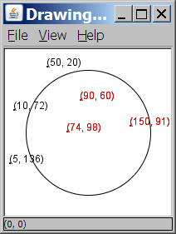
A programming problem
Given a file of cities' (x, y) coordinates,
which begins with the number of cities:
  6
  50 20
  90 60
  10 72
  74 98
  5 136
  150 91
Write a program to draw the cities on a DrawingPanel, then drop a "bomb" that turns all cities red that are within a given radius:
  Blast site x? 100
  Blast site y? 100
  Blast radius? 75
  Kaboom!

Slide 3
A solution
  Scanner input
  = new Scanner(new File("cities.txt"));
  int cityCount = input.nextInt();
  int[] xCoords = new int[cityCount];
  int[] yCoords = new int[cityCount];
  for (int i = 0; i < cityCount; i++) {
  xCoords[i] = input.nextInt();
  yCoords[i] = input.nextInt();
  }
  ...
  parallel arrays: 2+ arrays with related data at same indexes.
    Considered poor style. (relationship in programmers mind, but not explicit in program)

Slide 4
Observations
The data in this problem is a set of points.
It would be better stored as Point objects.
  A Point would store a city's x/y data.
  We could compare distances between Points
  to see whether the bomb hit a given city.
  Each Point would know how to draw itself.
  The overall program would be shorter and cleaner.

Slide 5

Clients of objects
client program: A program that uses objects.
  Example: Bomb is a client of DrawingPanel and Graphics.
Bomb.java (client program)
public class Bomb {
main(String[] args) {
new DrawingPanel(...)
new DrawingPanel(...)
...
}
}
DrawingPanel.java (class)
public class DrawingPanel {
...
}

Slide 6
Classes and objects
class: A program entity that represents either:
  1. A program / module, or
  2. A template for a new type of objects.
  The DrawingPanel class is a template for creating DrawingPanel objects.
  Other classes: String, Random, Scanner, File, …
object: An entity that combines state and behavior.
  object-oriented programming (OOP): Programs that perform their behavior as interactions between objects.

Slide 7
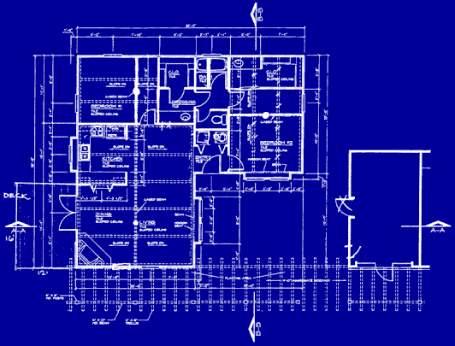
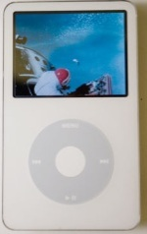
Blueprint analogy
iPod blueprint
state:
current song
volume
battery life
behavior:
power on/off
change station/song
change volume
choose random song
creates
iPod #1
state:
song = "1,000,000 Miles"
volume = 17
battery life = 2.5 hrs
behavior:
power on/off
change station/song
change volume
choose random song
iPod #2
state:
song = "Letting You"
volume = 9
battery life = 3.41 hrs
behavior:
power on/off
change station/song
change volume
choose random song
iPod #3
state:
song = "Discipline"
volume = 24
battery life = 1.8 hrs
behavior:
power on/off
change station/song
change volume
choose random song

Slide 8

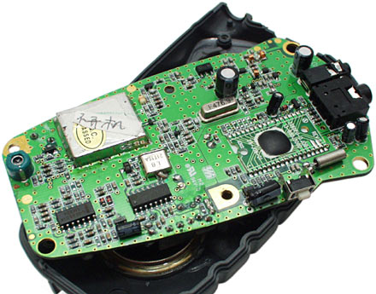
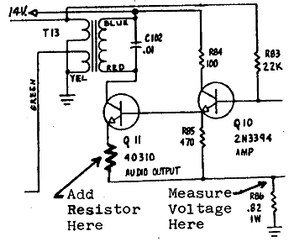
Abstraction
abstraction: A distancing between ideas and details.
  We can use objects without knowing how they work.
abstraction in an iPod:
  You understand its external behavior (buttons, screen).
  You may not understand its inner details,
  and you don't need to.

Slide 9
Our task
In the following slides, we will implement a Point class as a way of learning about defining classes.
  We will define a type of objects named Point.
  Each Point object will contain x/y data called fields.
  Each Point object will contain behavior called methods.
  Client programs will use the Point objects.

Slide 10
Point objects (desired)
  Point p1 = new Point(5, -2);
  Point p2 = new Point(); // origin, (0, 0)
Data in each Point object:
Methods in each Point object:
Field name | Description
x | the point's x-coordinate
y | the point's y-coordinate
Method name | Description
setLocation(x, y) | sets the point's x and y to the given values
translate(dx, dy) | adjusts the point's x and y by the given amounts
distance(p) | how far away the point is from point p
draw(g) | displays the point on a drawing panel

Slide 11
Point class as blueprint
  The class (blueprint) will describe how to create objects.
  Each object will contain its own data and methods.
Point class
state:
int x, y
behavior:
setLocation(int x, int y)
translate(int dx, int dy)
distance(Point p)
draw(Graphics g)
Point object #1
state:
x = 5, y = -2
behavior:
setLocation(int x, int y)
translate(int dx, int dy)
distance(Point p)
draw(Graphics g)
Point object #2
state:
x = -245, y = 1897
behavior:
setLocation(int x, int y)
translate(int dx, int dy)
distance(Point p)
draw(Graphics g)
Point object #3
state:
x = 18, y = 42
behavior:
setLocation(int x, int y)
translate(int dx, int dy)
distance(Point p)
draw(Graphics g)

Slide 12
What is output by the following code?
Point p1 = new Point();
Point p2 = new Point();
boolean b1 = p1 == p2;
System.out.print(b1);
Syntax error
Runtime error
false
true
no output

Slide 13
Object state:
Fields

Slide 14
Point class, version 1
  public class Point {
  int x;
  int y;
  }
  Save this code into a file named Point.java.
The above code creates a new type named Point.
  Each Point object contains two pieces of data:
    an int named x, and
    an int named y.
  Point objects do not contain any behavior (yet).

Slide 15
Fields
field: A variable inside an object that is part of its state.
  Each object has its own copy of each field.
Declaration syntax:
  type name;
  Example:
  public class Student {
  String name; // each Student object has a
  double gpa; // name and gpa field
  }

Slide 16
Accessing fields
Other classes can access/modify an object's fields.
  depending on the access modifier
  access: variable.field
  modify: variable.field = value;
Example:
  Point p1 = new Point();
  Point p2 = new Point();
  System.out.println("the x-coord is " + p1.x); // access
  p2.y = 13; // modify

Slide 17
A class and its client
Point.java is not, by itself, a runnable program.
  A class can be used by client programs.
Point.java (class of objects)
public class Point {
int x;
int y;
}
PointMain.java (client program)
public class PointMain {
main(String args) {
Point p1 = new Point();
p1.x = 7;
p1.y = 2;
Point p2 = new Point();
p2.x = 4;
p2.y = 3;
...
}
}
x | 7 | y | 2
x | 4 | y | 3

Slide 18
PointMain client example
public class PointMain {
public static void main(String[] args) {
// create two Point objects
Point p1 = new Point();
p1.y = 2;
Point p2 = new Point();
p2.x = 4;
System.out.println(p1.x + ", " + p1.y); // 0, 2
// move p2 and then print it
p2.x += 2;
p2.y++;
System.out.println(p2.x + ", " + p2.y); // 6, 1
}
}

Slide 19
Object behavior:
Methods

Slide 20
Client code redundancy
Suppose our client program wants to draw Point objects:
  // draw each city
  Point p1 = new Point();
  p1.x = 15;
  p1.y = 37;
  g.fillOval(p1.x, p1.y, 3, 3);
  g.drawString("(" + p1.x + ", " + p1.y + ")", p1.x, p1.y);
To draw other points, the same code must be repeated.
  We can remove this redundancy using a method.

Slide 21
Eliminating redundancy, v1
We can eliminate the redundancy with a static method:
  // Draws the given point on the DrawingPanel.
  public static void draw(Point p, Graphics g) {
  g.fillOval(p.x, p.y, 3, 3);
  g.drawString("(" + p.x + ", " + p.y + ")", p.x, p.y);
  }
main would call the method as follows:
  draw(p1, g);

Slide 22
Problems with static solution
We are missing a major benefit of objects: code reuse.
  Every program that draws Points would need a draw method.
The syntax doesn't match how we're used to using objects.
  draw(p1, g); // static (bad)
The point of classes is to combine state and behavior.
  The draw behavior is closely related to a Point's data.
  The method belongs inside each Point object.
  p1.draw(g); // inside the object (better)

Slide 23
Instance methods
instance method (or object method): Exists inside each object of a class and gives behavior to each object.
  public type name(parameters) {
  statements;
  }
  same syntax as static methods, but without static keyword
  Example:
  public void shout() {
  System.out.println("HELLO THERE!");
  }

Slide 24
Instance method example
public class Point {
int x;
int y;
// Draws this Point object with the given pen.
public void draw(Graphics g) {
...
}
}
The draw method no longer has a Point p parameter.
How will the method know which point to draw?
  How will the method access that point's x/y data?

Slide 25
Point objects w/ method
Each Point object has its own copy of the draw method, which operates on that object's state:
  Point p1 = new Point();
  p1.x = 7;
  p1.y = 2;
  Point p2 = new Point();
  p2.x = 4;
  p2.y = 3;
  p1.draw(g);
  p2.draw(g);
p1
public void draw(Graphics g) {
// this code can see p1's x and y
}
x | 7 | y | 2
public void draw(Graphics g) {
// this code can see p2's x and y
}
x | 4 | y | 3
p2

Slide 26
The implicit parameter
implicit parameter:
The object on which an instance method is called.
  During the call p1.draw(g);
  the object referred to by p1 is the implicit parameter.
  During the call p2.draw(g);
  the object referred to by p2 is the implicit parameter.
  The instance method can refer to that object's fields.
    We say that it executes in the context of a particular object.
    draw can refer to the x and y of the object it was called on.

Slide 27
Point class, version 2
  public class Point {
  int x;
  int y;
  // Changes the location of this Point object.
  public void draw(Graphics g) {
  g.fillOval(x, y, 3, 3);
  g.drawString("(" + x + ", " + y + ")", x, y);
  }
  }
  Each Point object contains a draw method that draws that point at its current x/y position.

Slide 28
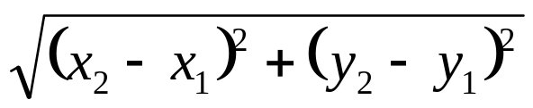
method questions
Write a method translate that changes a Point's location by a given dx, dy amount.
Write a method distanceFromOrigin that returns the distance between a Point and the origin, (0, 0).
Use the formula:
  Modify the Point and client code to use these methods.

Slide 29
Class method answers
public class Point {
int x;
int y;
public void translate(int dx, int dy) {
x = x + dx;
y = y + dy;
}
public double distanceFromOrigin() {
return Math.sqrt(x * x + y * y);
}
}

