Slide 1
Topic 28 classes and objects, part 2
Copyright Pearson Education, 2010_x000b_Based on slides bu Marty Stepp and Stuart Reges _x000b_from http://www.buildingjavaprograms.com/

Slide 2

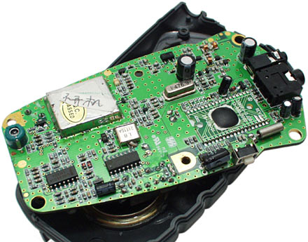
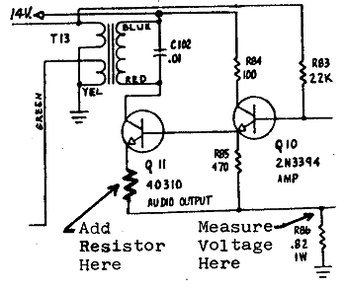
Encapsulation
encapsulation: Hiding implementation details from clients.
  Encapsulation forces abstraction.
    separates external view (behavior) from internal view (state)
    protects the integrity of an object's data

Slide 3
Private fields
A field that cannot be accessed from outside the class
  private type name;
  Examples:
  private int id;
  private String name;
Client code won't compile if it accesses private fields:
  PointMain.java:11: x has private access in Point
  System.out.println(p1.x);
  ^

Slide 4
Accessing private state
  // A "read-only" access to the x field ("accessor")
  public int getX() {
  return x;
  }
  // Allows clients to change the x field ("mutator")
  public void setX(int newX) {
  x = newX;
  }
  Client code will look more like this:
  System.out.println(p1.getX());
  p1.setX(14);

Slide 5
Point class, version 4
  // A Point object represents an (x, y) location.
  public class Point {
  private int x;
  private int y;
  public Point(int initialX, int initialY) {
  x = initialX;
  y = initialY;
  }
  public int getX() {
  return x;
  }
  public int getY() {
  return y;
  }
  public double distanceFromOrigin() {
  return Math.sqrt(x * x + y * y);
  }
  public void setLocation(int newX, int newY) {
  x = newX;
  y = newY;
  }
  public void translate(int dx, int dy) {
  setLocation(x + dx, y + dy);
  }
  }

Slide 6
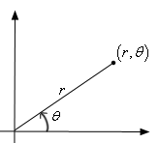
Benefits of encapsulation
Abstraction between object and clients
Protects object from unwanted access
  Example: Can't fraudulently increase an Account's balance.
Can change the class implementation later
  Example: Point could be rewritten in polar
  coordinates (r, θ) with the same methods.
Can constrain objects' state (invariants)
  Example: Only allow Accounts with non-negative balance.
  Example: Only allow Dates with a month from 1-12.

Slide 7
The keyword this
  reading: 8.3

Slide 8
The this keyword
this : Refers to the implicit parameter inside your class.
  (a variable that stores the object on which a method is called)
  Refer to a field: this.field
  Call a method: this.method(parameters);
  One constructor this(parameters);
  can call another:

Slide 9
Variable shadowing
shadowing: 2 variables with same name in same scope.
  Normally illegal, except when one variable is a field.
  public class Point {
  private int x;
  private int y;
  ...
  // this is legal
  public void setLocation(int x, int y) {
  ...
  }
  In most of the class, x and y refer to the fields.
  In setLocation, x and y refer to the method's parameters.

Slide 10
Fixing shadowing
  public class Point {
  private int x;
  private int y;
  ...
  public void setLocation(int x, int y) {
  this.x = x;
  this.y = y;
  }
  }
Inside setLocation,
  To refer to the data field x, say this.x
  To refer to the parameter x, say x

Slide 11
Calling another constructor
  public class Point {
  private int x;
  private int y;
  public Point() {
  this(0, 0);// calls (x, y) constructor
  }
  public Point(int x, int y) {
  this.x = x;
  this.y = y;
  }
  ...
  }
    Avoids redundancy between constructors
    Only a constructor (not a method) can call another constructor

