Slide 1
Topic 32 - Polymorphism

Slide 2
Polymorphism
polymorphism: Ability for the same code to be used with different types of objects and behave differently with each.
  System.out.println can print any type of object.
    Each one displays in its own way on the console.
  CritterMain can interact with any type of critter.
    Each one moves, fights, etc. in its own way.

Slide 3
Coding with polymorphism
A variable of type T can refer to an object of
any subclass of T.
  Employee ed = new Lawyer();
  You can call any methods from the Employee class on ed.
When a method is called on ed, it behaves as a Lawyer.
  System.out.println(ed.getSalary()); // 50000.0
  System.out.println(ed.getVacationForm()); // pink

Slide 4
Polymorphism and parameters
You can pass any subtype of a parameter's type.
  public class EmployeeMain {
  public static void main(String[] args) {
  Lawyer lisa = new Lawyer();
  Secretary steve = new Secretary();
  printInfo(lisa);
  printInfo(steve);
  }
  public static void printInfo(Employee empl) {
  System.out.println("salary: " + empl.getSalary());
  System.out.println("v.days: " + empl.getVacationDays());
  System.out.println("v.form: " + empl.getVacationForm());
  System.out.println();
  }
  }
  OUTPUT:
  salary: 50000.0 salary: 50000.0
  v.days: 15 v.days: 10
  v.form: pink v.form: yellow

Slide 5
Polymorphism and arrays
Arrays of superclass types can store any subtype as elements.
  public class EmployeeMain2 {
  public static void main(String[] args) {
  Employee[] e = { new Lawyer(), new Secretary(),
  new Marketer(), new LegalSecretary() };
  for (int i = 0; i < e.length; i++) {
  System.out.println("salary: " + e[i].getSalary());
  System.out.println("v.days: " + e[i].getVacationDays());
  System.out.println();
  }
  }
  }
  Output:
  salary: 50000.0
  v.days: 15
  salary: 50000.0
  v.days: 10
  salary: 60000.0
  v.days: 10
  salary: 55000.0
  v.days: 10

Slide 6
A polymorphism problem
Suppose that the following four classes have been declared:
  public class Foo {
  public void method1() {
  System.out.println("foo 1");
  }
  public void method2() {
  System.out.println("foo 2");
  }
  public String toString() {
  return "foo";
  }
  }
  public class Bar extends Foo {
  public void method2() {
  System.out.println("bar 2");
  }
  }

Slide 7
A polymorphism problem
  public class Baz extends Foo {
  public void method1() {
  System.out.println("baz 1");
  }
  public String toString() {
  return "baz";
  }
  }
  public class Mumble extends Baz {
  public void method2() {
  System.out.println("mumble 2");
  }
  }
What would be the output of the following client code?
  Foo[] pity = {new Baz(), new Bar(), new Mumble(), new Foo()};
  for (int i = 0; i < pity.length; i++) {
  System.out.println(pity[i]);
  pity[i].method1();
  pity[i].method2();
  System.out.println();
  }

Slide 8
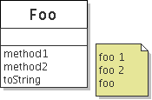
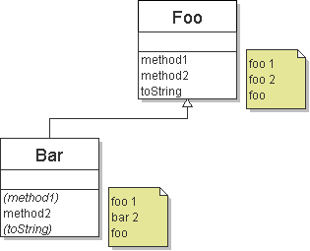
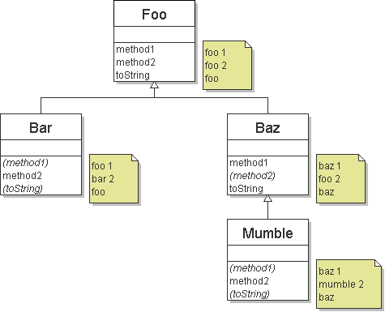
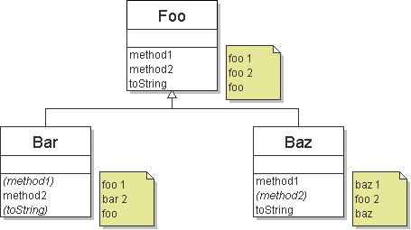
Diagramming the classes
Add classes from top (superclass) to bottom (subclass).
Include all inherited methods.

Slide 9
Finding output with tables
method | Foo | Bar | Baz | Mumble
method1
method2
toString
method | Foo | Bar | Baz | Mumble
method1 | foo 1 | foo 1 | baz 1 | baz 1
method2 | foo 2 | bar 2 | foo 2 | mumble 2
toString | foo | foo | baz | baz
method | Foo | Bar | Baz | Mumble
method1 | foo 1 |  | baz 1
method2 | foo 2 | bar 2 |  | mumble 2
toString | foo |  | baz
Notes:
It's annoying to flip back and forth between slides here. I suggest putting the classes into a text editor so you can switch windows back and forth to fill in the table.

Slide 10
Polymorphism answer
Foo[] pity = {new Baz(), new Bar(), new Mumble(), new Foo()};
for (int i = 0; i < pity.length; i++) {
System.out.println(pity[i]);
pity[i].method1();
pity[i].method2();
System.out.println();
}
Output:
  baz
  baz 1
  foo 2
  foo
  foo 1
  bar 2
  baz
  baz 1
  mumble 2
  foo
  foo 1
  foo 2

Slide 11
Another problem
The order of the classes is jumbled up.
The methods sometimes call other methods (tricky!).
  public class Lamb extends Ham {
  public void b() {
  System.out.print("Lamb b ");
  }
  }
  public class Ham {
  public void a() {
  System.out.print("Ham a ");
  b();
  }
  public void b() {
  System.out.print("Ham b ");
  }
  public String toString() {
  return "Ham";
  }
  }

Slide 12
Another problem 2
  public class Spam extends Yam {
  public void b() {
  System.out.print("Spam b ");
  }
  }
  public class Yam extends Lamb {
  public void a() {
  System.out.print("Yam a ");
  super.a();
  }
  public String toString() {
  return "Yam";
  }
  }
What would be the output of the following client code?
  Ham[] food = {new Lamb(), new Ham(), new Spam(), new Yam()};
  for (int i = 0; i < food.length; i++) {
  System.out.println(food[i]);
  food[i].a();
  System.out.println(); // to end the line of output
  food[i].b();
  System.out.println(); // to end the line of output
  System.out.println();
  }

Slide 13
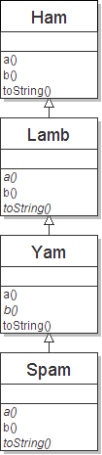
Class diagram

Slide 14
Polymorphism at work
Lamb inherits Ham's a. a calls b. But Lamb overrides b...
  public class Ham {
  public void a() {
  System.out.print("Ham a ");
  b();
  }
  public void b() {
  System.out.print("Ham b ");
  }
  public String toString() {
  return "Ham";
  }
  }
  public class Lamb extends Ham {
  public void b() {
  System.out.print("Lamb b ");
  }
  }
Lamb's output from a:
  Ham a Lamb b

Slide 15
The table
method | Ham | Lamb | Yam | Spam
a
b
toString
method | Ham | Lamb | Yam | Spam
a | Ham a b() |  | Yam a Ham a b()
b | Ham b | Lamb b |  | Spam b
toString | Ham |  | Yam
method | Ham | Lamb | Yam | Spam
a | Ham a b() | Ham a b() | Yam a Ham a b() | Yam a Ham a b()
b | Ham b | Lamb b | Lamb b | Spam b
toString | Ham | Ham | Yam | Yam

Slide 16
The answer
Ham[] food = {new Lamb(), new Ham(), new Spam(), new Yam()};
for (int i = 0; i < food.length; i++) {
System.out.println(food[i]);
food[i].a();
food[i].b();
System.out.println();
}
Output:
  Ham
  Ham a Lamb b
  Lamb b
  Ham
  Ham a Ham b
  Ham b
  Yam
  Yam a Ham a Spam b
  Spam b
  Yam
  Yam a Ham a Lamb b
  Lamb b

Slide 17
Overriding Object's equals Method
The Object class contains this method:
public boolean Object(equals obj)
many classes override this method
many students mistakenly overload the method
many headaches when placing objects in data structures

Slide 18
Overriding Object's equals Method
overriding equals correctly follows a pattern
So, it isn't that hard, if you follow the pattern
Override equals for
a Standard Playing Card

