Slide 1
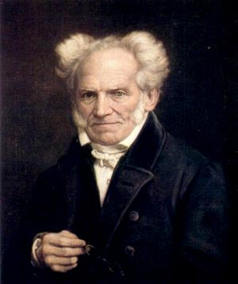
Topic 5 for loops and nested loops
“Always to see the general in the particular is the very foundation of genius.”
-Arthur Schopenhauer
Based on slides by Marty Stepp and Stuart Reges _x000b_from http://www.buildingjavaprograms.com/

Slide 2
Repetition with for loops
So far, repeating a statement is redundant:
  System.out.println("Homer says:");
  System.out.println("I am so smart");
  System.out.println("I am so smart");
  System.out.println("I am so smart");
  System.out.println("I am so smart");
  System.out.println("S-M-R-T... I mean S-M-A-R-T");
Java's for loop statement performs a task many times.
  System.out.println("Homer says:");
  for (int i = 1; i <= 4; i++) { // repeat 4 times
  System.out.println("I am so smart");
  }
  System.out.println("S-M-R-T... I mean S-M-A-R-T");
Notes:
also related to book exercise 1.10 about printing 1000 copies of "All work and no play makes Jack a dull boy"

Slide 3
for loop syntax
  for (<initialization>; <test>; <update>) {
  <statement>;
  <statement>;
  ...
  <statement>;
  }
  Perform <initialization> once.
  Repeat the following:
    Check if the <test> is true. If not, stop.
    Execute the <statement>s.
    Perform the <update>.
header
body

Slide 4
Initialization
  for(int i = 1; i <= 4; i++) {
  System.out.println("I am so smart");
  }
Tells Java compiler what variable to use in the loop
  Performed once as the loop begins
  The variable is called a loop counter
    can use any name, not just i
    can start at any value, not just 1

Slide 5
Test
  for (int i = 1; i <= 4; i++) {
  System.out.println("I am so smart");
  }
Tests the loop counter variable against a limit
  Uses comparison operators:
  < less than
  <= less than or equal to
  > greater than
  >= greater than or equal to

Slide 6
Increment and decrement
shortcuts to increase or decrease a variable's value by 1
  Shorthand Equivalent longer version
  <variable>++; <variable> = <variable> + 1;
  <variable>--; <variable> = <variable> - 1;
  int x = 2;
  x++; // x = x + 1;
  // x now stores 3
  double gpa = 2.5;
  gpa--; // gpa = gpa - 1;
  // gpa now stores 1.5

Slide 7
Modify-and-assign operators
shortcuts to modify a variable's value
  Shorthand Equivalent longer version
  <variable> += <exp>; <variable> = <variable> + (<exp>);
  <variable> -= <exp>; <variable> = <variable> - (<exp>);
  <variable> *= <exp>; <variable> = <variable> * (<exp>);
  <variable> /= <exp>; <variable> = <variable> / (<exp>);
  <variable> %= <exp>; <variable> = <variable> % (<exp>);
  x += 3; // x = x + 3;
  gpa -= 0.5; // gpa = gpa - 0.5;
  number *= 2 + 1; // number = number * (2 + 1);

Slide 8
for loop is NOT a method
The for loop is a control structure—a syntactic structure that controls the execution of other statements.
Example:
  “Shampoo hair. Rinse. Repeat.”

Slide 9
Repetition over a range
  System.out.println("1 squared = " + 1 * 1);
  System.out.println("2 squared = " + 2 * 2);
  System.out.println("3 squared = " + 3 * 3);
  System.out.println("4 squared = " + 4 * 4);
  System.out.println("5 squared = " + 5 * 5);
  System.out.println("6 squared = " + 6 * 6);
  Intuition: "I want to print a line for each number from 1 to 6"
The for loop does exactly that!
  for (int i = 1; i <= 6; i++) {
  System.out.println(i + " squared = " + (i * i));
  }
  "For each integer i from 1 through 6, print ..."

Slide 10
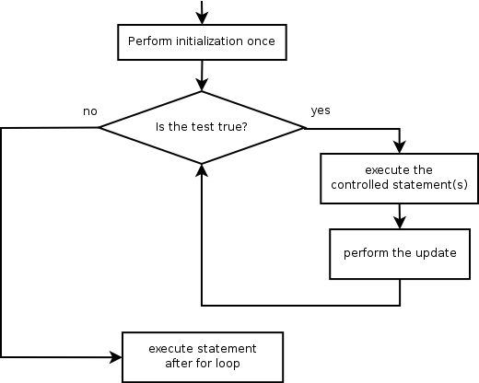
Loop walkthrough
1
2
4
for (int i = 1; i <= 4; i++) {
System.out.println(i + " squared = " + (i * i));
}
System.out.println("Whoo!");
Output:
1 squared = 1
2 squared = 4
3 squared = 9
4 squared = 16
Whoo!
3
5
1
2
3
4
5

Slide 11
Multi-line loop body
  System.out.println("+----+");
  for (int i = 1; i <= 3; i++) {
  System.out.println("\\ /");
  System.out.println("/ \\");
  }
  System.out.println("+----+");
  Output:
  +----+
  \ /
  / \
  \ /
  / \
  \ /
  / \
  +----+

Slide 12
Expressions for counter
int highTemp = 5;
for (int i = -3; i <= highTemp / 2; i++) {
System.out.println(i * 1.8 + 32);
}
  This computes the Fahrenheit equivalents for -3 degrees Celsius to 2 degrees Celsius.
  Output:
  26.6
  28.4
  30.2
  32.0
  33.8
  35.6

Slide 13
System.out.print
Prints without moving to a new line
  allows you to print partial messages on the same line
int highestTemp = 5;
for (int i = -3; i <= highestTemp / 2; i++) {
System.out.print((i * 1.8 + 32) + " ");
}
  Output:
  26.6 28.4 30.2 32.0 33.8 35.6
    Concatenate " " to separate the numbers

Slide 14
Clicker Question
How many asterisks are output by the following code?
for(int i = -2; i <= 13; i++) {
System.out.print("*");
System.out.print("**");
}
A. 0 B. 15 C. 45
D. 48 E. 68

Slide 15
Counting down
The <update> can use -- to make the loop count down.
  The <test> must say > instead of < (or logic error)
  System.out.print("T-minus ");
  for (int i = 10; i >= 1; i--) {
  System.out.print(i + ", ");
  }
  System.out.println("blastoff!");
  System.out.println("The end.");
  Output:
  T-minus 10, 9, 8, 7, 6, 5, 4, 3, 2, 1, blastoff!
  The end.

Slide 16
Practice Problem
Newton's method for approximating square roots adapted from the Dr. Math website
The goal is to find the square root of a number. Let's call it num
1. Choose a rough approximation of the square root of num, call it approx.
How to choose?
2. Divide num by approx and then average the quotient with approx,
in other words we want to evaluate the
expression ((num/approx)+approx)/2
3. How close are we? In programming we would store the result of the expression back into the variable approx.
4. How do you know if you have the right answer?

Slide 17
Sample of Newton's Method
num approx ((num/approx)+approx)/2 approx*approx
12 6 (12 / 6 + 6) / 2 = 4 16
12 4 (12 / 4 + 4) / 2 = 3.5 12.25
12 3.5 (12 / 3.5 + 3.5) / 2 = 3.4642857… 12.0012..
12 3.4642857 = 3.46410162… 12.00000003
12 3.46410162 = 3.46410161… 11.9999999999
3.4641016151377544 after 5 steps
3.4641016151377545870548926830117 (from calculator)

Slide 18
Nested loops
reading: 2.3

Slide 19
Nested loops
nested loop: A loop placed inside another loop.
  for (int i = 1; i <= 5; i++) {
  for (int j = 1; j <= 10; j++) {
  System.out.print("*");
  }
  System.out.println(); // to end the line
  }
Output:
  **********
  **********
  **********
  **********
  **********
The outer loop repeats 5 times; the inner one 10 times.
  "sets and reps" exercise analogy
Notes:
How would we print a multiplication table?
try printing each of the following inside the inner loop:
System.out.print(i + " ");
System.out.print(j + " ");
System.out.print((i * j) + " ");

Slide 20
Nested for loop exercise
What is the output of the following nested for loops?
  for (int i = 1; i <= 5; i++) {
  for (int j = 1; j <= i; j++) {
  System.out.print("*");
  }
  System.out.println();
  }
Output:
  *
  **
  ***
  ****
  *****

Slide 21
Nested for loop exercise
What is the output of the following nested for loops?
  for (int i = 1; i <= 5; i++) {
  for (int j = 1; j <= i; j++) {
  System.out.print(i);
  }
  System.out.println();
  }
Output:
  1
  22
  333
  4444
  55555

Slide 22
clicker Question
What is output by the following code?
int total = 0;
for(int i = 1; i <= 4; i++) {
for(int j = 1; j <= i; j++) {
total += i;
}
}
System.out.println(total);
A. 10 B. 20 C. 30 D. 40 E. 50

Slide 23
Common errors
Both of the following sets of code produce infinite loops:
  for (int i = 1; i <= 5; i++) {
  for (int j = 1; i <= 10; j++) {
  System.out.print("*");
  }
  System.out.println();
  }
  for (int i = 1; i <= 5; i++) {
  for (int j = 1; j <= 10; i++) {
  System.out.print("*");
  }
  System.out.println();
  }
Notes:
Both cases produce infinite loops.

Slide 24
Complex output
Write a nested for loop to produce the following output.
  ....1
  ...2
  ..3
  .4
  5
We must build multiple complex lines of output using:
  an outer "vertical" loop for each of the lines
  inner "horizontal" loop(s) for the patterns within each line
inner loop (repeated characters on each line)
outer loop (loops 5 times because there are 5 lines)

Slide 25
Outer and inner loop
First write the outer loop, from 1 to the number of lines.
for (int line = 1; line <= 5; line++) {
  ...
}
Now look at the line contents. Each line has a pattern:
  some dots (0 dots on the last line), then a number
  ....1
  ...2
  ..3
  .4
  5
  Observation: the number of dots is related to the line number.

Slide 26
Mapping loops to numbers
for (int count = 1; count <= 5; count++) {
System.out.print( ... );
}
  What statement in the body would cause the loop to print:
  4 7 10 13 16
for (int count = 1; count <= 5; count++) {
System.out.print(3 * count + 1 + " ");
}

Slide 27
Loop tables
What statement in the body would cause the loop to print:
  2 7 12 17 22
To see patterns, make a table of count and the numbers.
  Each time count goes up by 1, the number should go up by 5.
  But count * 5 is too great by 3, so we subtract 3.
count | number to print | 5 * count
1 | 2 | 5
2 | 7 | 10
3 | 12 | 15
4 | 17 | 20
5 | 22 | 25
5 * count - 3
2
7
12
17
22

Slide 28
Loop tables question
What statement in the body would cause the loop to print:
  17 13 9 5 1
Let's create the loop table together.
  Each time count goes up 1, the number printed should ...
  But this multiple is off by a margin of ...
count | number to print
1 | 17
2 | 13
3 | 9
4 | 5
5 | 1
-4 * count | -4 * count + 21
-4 | 17
-8 | 13
-12 | 9
-16 | 5
-20 | 1
-4 * count
-4
-8
-12
-16
-20

Slide 29
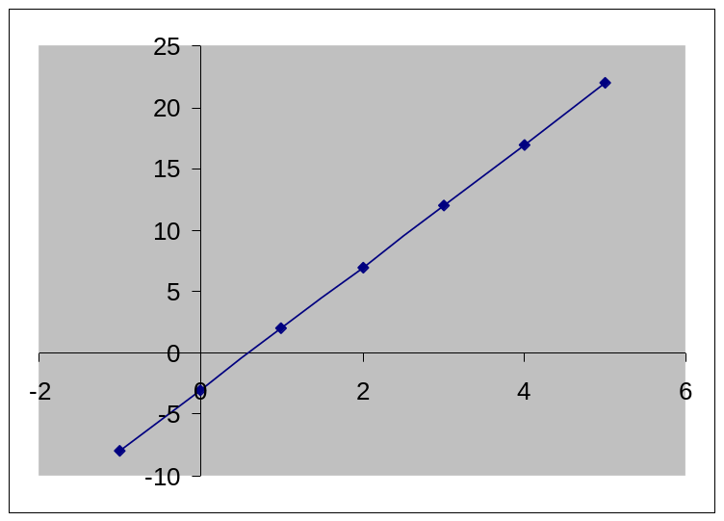
Another view: Slope-intercept
The next three slides present the mathematical basis for the loop tables.
count (x) | number to print (y)
1 | 2
2 | 7
3 | 12
4 | 17
5 | 22

Slide 30
Another view: Slope-intercept
Caution: This is algebra, not assignment!
Recall: slope-intercept form (y = mx + b)
Slope is defined as “rise over run” (i.e. rise / run). Since the “run” is always 1 (we increment along x by 1), we just need to look at the “rise”. The rise is the difference between the y values. Thus, the slope (m) is the difference between y values; in this case, it is +5.
To compute the y-intercept (b), plug in the value of y at x = 1 and solve for b. In this case, y = 2.
  y = m * x + b
  2 = 5 * 1 + b
  Then b = -3
So the equation is
  y = m * x + b
  y = 5 * x – 3
  y = 5 * count - 3
count (x) | number to print (y)
1 | 2
2 | 7
3 | 12
4 | 17
5 | 22

Slide 31
Another view: Slope-intercept
Algebraically, if we always take the value of y at
x = 1, then we can solve for b as follows:
  y = m * x + b
  y₁ = m * 1 + b
  y₁ = m + b
  b = y₁ – m
In other words, to get the y-intercept, just subtract the slope from the first y value (b = 2 – 5 = -3)
  This gets us the equation
  y = m * x + b
  y = 5 * x – 3
  y = 5 * count – 3
  (which is exactly the equation from the previous slides)

Slide 32
Nested for loop exercise
Make a table to represent any patterns on each line.
  ....1
  ...2
  ..3
  .4
  5
To print a character multiple times, use a for loop.
  for (int j = 1; j <= 4; j++) {
  System.out.print("."); // 4 dots
  }
line | # of dots
1 | 4
2 | 3
3 | 2
4 | 1
5 | 0
-1 * line
-1
-2
-3
-4
-5
-1 * line + 5
4
3
2
1
0

Slide 33
Nested for loop solution
Answer:
for (int line = 1; line <= 5; line++) {
for (int j = 1; j <= (-1 * line + 5); j++) {
System.out.print(".");
}
System.out.println(line);
}
Output:
  ....1
  ...2
  ..3
  .4
  5

Slide 34
Nested for loop exercise
What is the output of the following nested for loops?
for (int line = 1; line <= 5; line++) {
for (int j = 1; j <= (-1 * line + 5); j++) {
System.out.print(".");
}
for (int k = 1; k <= line; k++) {
System.out.print(line);
}
System.out.println();
}
Answer:
  ....1
  ...22
  ..333
  .4444
  55555

Slide 35
Nested for loop exercise
Modify the previous code to produce this output:
  ....1
  ...2.
  ..3..
  .4...
  5....
for (int line = 1; line <= 5; line++) {
for (int j = 1; j <= (-1 * line + 5); j++) {
System.out.print(".");
}
System.out.print(line);
for (int j = 1; j <= (line - 1); j++) {
System.out.print(".");
}
System.out.println();
}
Notes:
If you have time left over at this point (you probably won't), you could ask them how to make the loop print 12 lines instead of 5. (leads in to constants in next lecture)

