Slide 1
Topic 13
Recursive Backtracking
"In ancient times, before computers were invented, alchemists studied the mystical properties of numbers. Lacking computers, they had to rely on dragons to do their work for them. The dragons were clever beasts, but also lazy and bad-tempered. The worst ones would sometimes burn their keeper to a crisp with a single fiery belch. But most dragons were merely uncooperative, as violence required too much energy. This is the story of how Martin, an alchemist’s apprentice, discovered recursion by outsmarting a lazy dragon."
- David S. Touretzky, Common Lisp: A Gentle Introduction to Symbolic Computation

Slide 2
Backtracking
Start
Success!
Success!
Failure
Problem space consists of states (nodes) and actions
(paths that lead to new states). When in a node can
can only see paths to connected nodes
If a node only leads to failure go back to its "parent"
node. Try other alternatives. If these all lead to failure
then more backtracking may be necessary.
CS314
Recursive Backtracking

Slide 3
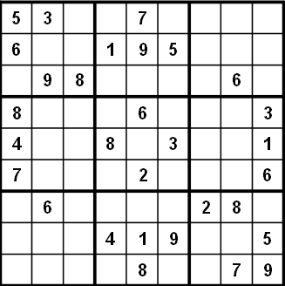
A More Concrete Example
Sudoku
9 by 9 matrix with some numbers filled in
all numbers must be between 1 and 9
Goal: Each row, each column, and each mini matrix must contain the numbers between 1 and 9 once each
  no duplicates in rows, columns, or mini matrices
CS314
Recursive Backtracking

Slide 4
Solving Sudoku – Brute Force
A brute force algorithm is a simple but general approach
Try all combinations until you find one that works
This approach isn’t clever, but computers are fast
Then try and improve on the brute force resuts
CS314
Recursive Backtracking

Slide 5
Solving Sudoku
Brute force Sudoku Soluton
  if not open cells, solved
  scan cells from left to right, top to bottom for first open cell
  When an open cell is found start cycling through digits 1 to 9.
  When a digit is placed check that the set up is legal
  now solve the board
1
CS314
Recursive Backtracking

Slide 6
Attendance Question 1
After placing a number in a cell is the remaining problem very similar to the original problem?
Yes
No
CS314
Recursive Backtracking

Slide 7
Solving Sudoku – Later Steps
1
1
2
1
2
4
1
2
4
8
1
2
4
8
9
uh oh!
CS314
Recursive Backtracking

Slide 8
Sudoku – A Dead End
We have reached a dead end in our search
With the current set up none of the nine digits work in the top right corner
1
2
4
8
9
CS314
Recursive Backtracking

Slide 9
Backing Up
When the search reaches a dead end in backs up to the previous cell it was trying to fill and goes onto to the next digit
We would back up to the cell with a 9 and that turns out to be a dead end as well so we back up again
  so the algorithm needs to remember what digit to try next
Now in the cell with the 8. We try and 9 and move forward again.
1
2
4
8
9
1
2
4
9
CS314
Recursive Backtracking

Slide 10
Characteristics of Brute Force and Backtracking
Brute force algorithms are slow
The don't employ a lot of logic
  For example we know a 6 can't go in the last 3 columns of the first row, but the brute force algorithm will plow ahead any way
But, brute force algorithms are fairly easy to implement as a first pass solution
  many backtracking algorithms are brute force algorithms
CS314
Recursive Backtracking

Slide 11
Key Insights
After trying placing a digit in a cell we want to solve the new sudoku board
  Isn't that a smaller (or simpler version) of the same problem we started with?!?!?!?
After placing a number in a cell the we need to remember the next number to try in case things don't work out.
We need to know if things worked out (found a solution) or they didn't, and if they didn't try the next number
If we try all numbers and none of them work in our cell we need to report back that things didn't work
CS314
Recursive Backtracking

Slide 12
Recursive Backtracking
Problems such as Suduko can be solved using recursive backtracking
recursive because later versions of the problem are just slightly simpler versions of the original
backtracking because we may have to try different alternatives
CS314
Recursive Backtracking

Slide 13
Recursive Backtracking
Pseudo code for recursive backtracking algorithms
If at a solution, report success
for( every possible choice from current state / node)
Make that choice and take one step along path
Use recursion to solve the problem for the new node / state
If the recursive call succeeds, report the success to the next lower level
Back out of the current choice to restore the state at the beginning of the loop.
Report failure
CS314
Recursive Backtracking

Slide 14
Goals of Backtracking
Possible goals
  Find a path to success
  Find all paths to success
  Find the best path to success
Not all problems are exactly alike, and finding one success node may not be the end of the search
Start
Success!
Success!
CS314
Recursive Backtracking

Slide 15

The 8 Queens Problem
CS314
Recursive Backtracking

Slide 16
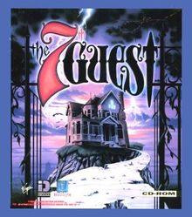
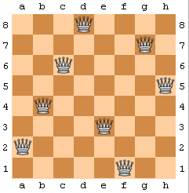
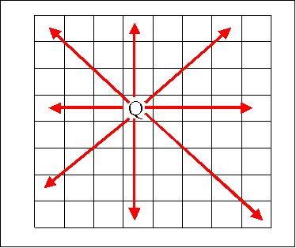
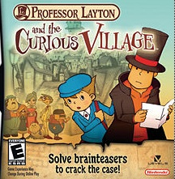
The 8 Queens Problem
A classic chess puzzle
  Place 8 queen pieces on a chess board so that none of them can attack one another
CS314
Recursive Backtracking

Slide 17
The N Queens Problem
Place N Queens on an N by N chessboard so that none of them can attack each other
Number of possible placements?
In 8 x 8
  64 * 63 * 62 * 61 * 60 * 59 * 58 * 57
  = 178,462, 987, 637, 760 / 8!
  = 4,426,165,368
  n choose k
  How many ways can you choose k things from a
  set of n items?
  In this case there are 64 squares and we want to choose 8 of them to put queens on
CS314
Recursive Backtracking

Slide 18
Attendance Question 2
For valid solutions how many queens can be placed in a give column?
0
1
2
3
4
Any number
CS314
Recursive Backtracking

Slide 19
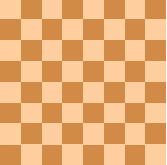
Reducing the Search Space
The previous calculation includes set ups like this one
Includes lots of set ups with
multiple queens in the same
column
How many queens can there be
in one column?
Number of set ups
8 * 8 * 8 * 8 * 8 * 8 * 8 * 8 = 16,777,216
We have reduced search space by two orders of magnitude by applying some logic
Q
Q
Q
Q
Q
Q
Q
Q
CS314
Recursive Backtracking

Slide 20
A Solution to 8 Queens
If number of queens is fixed and I realize there can't be more than one queen per column I can iterate through the rows for each column
for(int r0 = 0; r0 < 8; r0++){
board[r0][0] = 'q';
for(int r1 = 0; r1 < 8; r1++){
board[r1][1] = 'q';
for(int r2 = 0; r2 < 8; r2++){
board[r2][2] = 'q';
// a little later
for(int r7 = 0; r7 < 8; r7++){
board[r7][7] = 'q';
if( queensAreSafe(board) )
printSolution(board);
board[r7][7] = ' '; //pick up queen
}
board[r6][6] = ' '; // pick up queen
CS314
Recursive Backtracking

Slide 21
N Queens
The problem with N queens is you don't know how many for loops to write.
Do the problem recursively
Write recursive code with class and demo
  show backtracking with breakpoint and debugging option
CS314
Recursive Backtracking

Slide 22
Recursive Backtracking
You must practice!!!
Learn to recognize problems that fit the pattern
Is a kickoff method needed?
All solutions or a solution?
Reporting results and acting on results
CS314
Recursive Backtracking

Slide 23
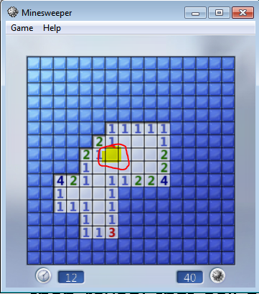
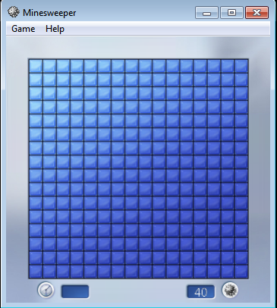
Minesweeper
CS314
Recursive Backtracking

Slide 24
Minesweeper Reveal Algorithm
Minesweeper
click a cell
  if bomb game over
  if cell that has 1 or more bombs on border
  then reveal the number of bombs that border cell
  if a cell that has 0 bombs on border
  then reveal that cell as a blank and click on the 8 surrounding cells
CS314
Recursive Backtracking

Slide 25
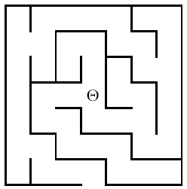
Another Backtracking Problem
A Simple Maze
Search maze until way
out is found. If no way
out possible report that.
CS314
Recursive Backtracking

Slide 26
The Local View
Which way do
I go to get
out?
North
West
East
Behind me, to the South
is a door leading South
CS314
Recursive Backtracking

Slide 27
Modified Backtracking Algorithm for Maze
If the current square is outside, return TRUE to indicate that a solution has been found.
If the current square is marked, return FALSE to indicate that this path has been tried.
Mark the current square.
for (each of the four compass directions)
{ if ( this direction is not blocked by a wall )
{ Move one step in the indicated direction from the current square.
Try to solve the maze from there by making a recursive call.
If this call shows the maze to be solvable, return TRUE to indicate that fact.
}
}
Unmark the current square.
Return FALSE to indicate that none of the four directions led to a solution.
CS314
Recursive Backtracking

Slide 28
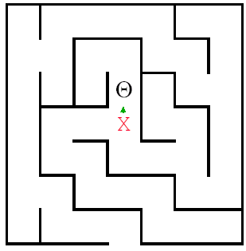
Backtracking in Action
The crucial part of the
algorithm is the for loop
that takes us through the
alternatives from the current
square. Here we have moved
to the North.
for (dir = North; dir <= West; dir++)
{ if (!WallExists(pt, dir))
{if (SolveMaze(AdjacentPoint(pt, dir)))
return(TRUE);
}
CS314
Recursive Backtracking

Slide 29
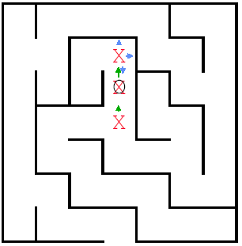
Backtracking in Action
Here we have moved
North again, but there is
a wall to the North .
East is also
blocked, so we try South.
That call discovers that
the square is marked, so
it just returns.
CS314
Recursive Backtracking

Slide 30
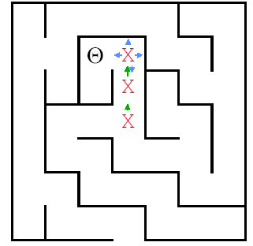
So the next move we
can make is West.
Where is this leading?
CS314
Recursive Backtracking

Slide 31
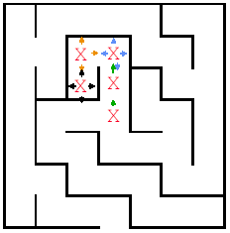
This path reaches
a dead end.
Time to backtrack!
Remember the
program stack!
CS314
Recursive Backtracking

Slide 32
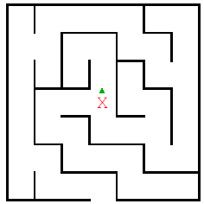
The recursive calls
end and return until
we find
ourselves back here.
CS314
Recursive Backtracking

Slide 33
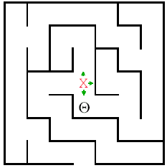
And now we try
South
CS314
Recursive Backtracking

Slide 34
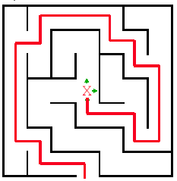
Path Eventually Found
CS314
Recursive Backtracking

Slide 35
More Backtracking Problems
CS314
Recursive Backtracking

Slide 36
Other Backtracking Problems
Knight's Tour
Regular Expressions
Knapsack problem / Exhaustive Search
  Filling a knapsack. Given a choice of items with various weights and a limited carrying capacity find the optimal load out. 50 lb. knapsack. items are 1 40 lb, 1 32 lb. 2 22 lbs, 1 15 lb, 1 5 lb. A greedy algorithm would choose the 40 lb item first. Then the 5 lb. Load out = 45lb. Exhaustive search 22 + 22 + 5 = 49.
CS314
Recursive Backtracking

Slide 37
The CD problem
We want to put songs on a Compact Disc. 650MB CD and a bunch of songs of various sizes.
If there are no more songs to consider return result
else{
Consider the next song in the list.
Try not adding it to the CD so far and use recursion to evaluate best without it.
Try adding it to the CD, and use recursion to evaluate best with it
Whichever is better is returned as absolute best from here
}
CS314
Recursive Backtracking

Slide 38
Another Backtracking Problem
Airlines give out frequent flier miles as a way to get people to always fly on their airline.
Airlines also have partner airlines. Assume if you have miles on one airline you can redeem those miles on any of its partners.
Further assume if you can redeem miles on a partner airline you can redeem miles on any of its partners and so forth...
  Airlines don't usually allow this sort of thing.
Given a list of airlines and each airlines partners determine if it is possible to redeem miles on a given airline A on another airline B.
CS314
Recursive Backtracking

Slide 39
Airline List – Part 1
Delta
  partners: Air Canada, Aero Mexico, OceanAir
United
  partners: Aria, Lufthansa, OceanAir, Quantas, British Airways
Northwest
  partners: Air Alaska, BMI, Avolar, EVA Air
Canjet
  partners: Girjet
Air Canda
  partners: Areo Mexico, Delta, Air Alaska
Aero Mexico
  partners: Delta, Air Canda, British Airways
CS314
Recursive Backtracking

Slide 40
Airline List - Part 2
Ocean Air
  partners: Delta, United, Quantas, Avolar
AlohaAir
  partners: Quantas
Aria
  partners: United, Lufthansa
Lufthansa
  partners: United, Aria, EVA Air
Quantas
  partners: United, OceanAir, AlohaAir
BMI
  partners: Northwest, Avolar
Maxair
  partners: Southwest, Girjet
CS314
Recursive Backtracking

Slide 41
Airline List - Part 3
Girjet
  partners: Southwest, Canjet, Maxair
British Airways
  partners: United, Aero Mexico
Air Alaska
  partners: Northwest, Air Canada
Avolar
  partners: Northwest, Ocean Air, BMI
EVA Air
  partners: Northwest, Luftansa
Southwest
  partners: Girjet, Maxair
CS314
Recursive Backtracking

Slide 42
Problem Example
If I have miles on Northwest can I redeem them on Aria?
Partial graph:
Ocean Air
BMI
Avolar
Northwest
Air Alaska
EVA Air
CS314
Recursive Backtracking

