Slide 1

Topic 17 Fast Sorting
"The bubble sort seems to have nothing to recommend it, except a catchy name and the fact that it leads to some interesting theoretical problems."
- Don Knuth

Slide 2
Previous Sorts
Insertion Sort and Selection Sort are both average case O(N²)
Today we will look at two faster sorting algorithms.
quicksort
mergesort

Slide 3
Stable Sorting
A property of sorts
If a sort guarantees the relative order of equal items stays the same then it is a stable sort
[7₁, 6, 7₂, 5, 1, 2, 7₃, -5]
subscripts added for clarity
[-5, 1, 2, 5, 6, 7₁, 7₂, 7₃]
result of stable sort
Real world example:
sort a table in Wikipedia by one criteria, then another
sort by country, then by major wins

Slide 4

Quicksort
Invented by C.A.R. (Tony) Hoare
A divide and conquer approach that uses recursion
If the list has 0 or 1 elements it is sorted
otherwise, pick any element p in the list. This is called the pivot value
Partition the list minus the pivot into two sub lists according to values less than or greater than the pivot. (equal values go to either)
return the quicksort of the first list followed by the quicksort of the second list

Slide 5
Quicksort in Action
39 23 17 90 33 72 46 79 11 52 64 5 71
Pick middle element as pivot: 46
Partition list
23 17 5 33 39 11 46 79 72 52 64 90 71
quick sort the less than list
Pick middle element as pivot: 33
23 17 5 11 33 39
quicksort the less than list, pivot now 5
{} 5 23 17 11
quicksort the less than list, base case
quicksort the greater than list
Pick middle element as pivot: 17 and so on….

Slide 6
Quicksort on Another Data Set
0 1 2 3 4 5 6 7 8 9 10 11 12 13 14 15
44 68 191 119 119 37 83 82 191 45 158 130 76 153 39 25
Big O of Quicksort?

Slide 7
private static void swapReferences( Object[] a, int index1, int index2 ) {
Object tmp = a[index1];
a[index1] = a[index2];
a[index2] = tmp;
}
private void quicksort( Comparable[] list, int start, int stop ) {
if(start >= stop)
return; //base case list of 0 or 1 elements
int pivotIndex = (start + stop) / 2;
// Place pivot at start position
swapReferences(list, pivotIndex, start);
Comparable pivot = list[start];
// Begin partitioning
int i, j = start;
// from first to j are elements less than or equal to pivot
// from j to i are elements greater than pivot
// elements beyond i have not been checked yet
for(i = start + 1; i <= stop; i++ )
{ //is current element less than or equal to pivot
if(list[i].compareTo(pivot) <= 0)
{ // if so move it to the less than or equal portion
j++;
swapReferences(list, i, j);
}
}
//restore pivot to correct spot
swapReferences(list, start, j);
quicksort( list, start, j - 1 ); // Sort small elements
quicksort( list, j + 1, stop ); // Sort large elements
}

Slide 8
Clicker Question 1
What are the best case and worst case Orders (Big O) for quicksort? Best Worst
O(NlogN) O(N²)
O(N²) O(N²)
O(N²) O(N!)
O(NlogN) O(NlogN)
O(N) O(NlogN)

Slide 9
Clicker Question 2
Is quicksort always stable?
A. Yes
B. No

Slide 10
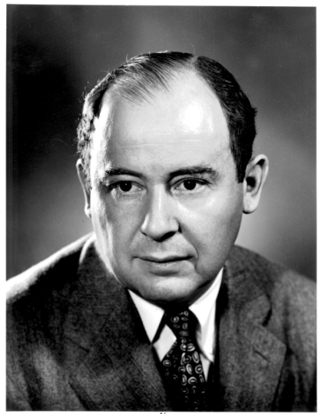

Merge Sort Algorithm
Don Knuth cites John von Neumann as the creator of this algorithm
If a list has 1 element or 0 elements it is sorted
If a list has more than 1 split into into 2 separate lists
Perform this algorithm on each of those smaller lists
Take the 2 sorted lists and merge them together

Slide 11
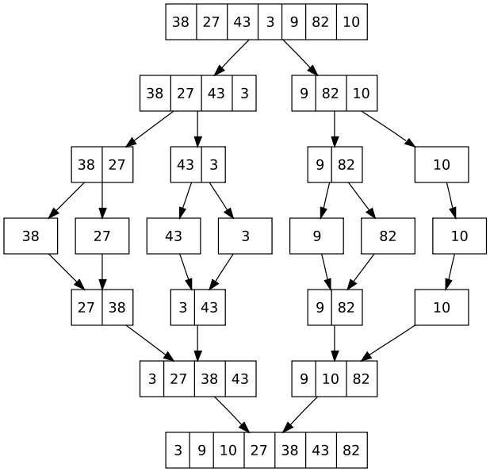
Merge Sort
When implementing
one temporary array
is used instead of
multiple temporary
arrays.
Why?

Slide 12
Merge Sort code
/**
* perform a merge sort on the data in c
* @param c c != null, all elements of c
* are the same data type
*/
public static void mergeSort(Comparable[] c) {
Comparable[] temp = new Comparable[ c.length ];
sort(c, temp, 0, c.length - 1);
}
private static void sort(Comparable[] list, Comparable[] temp, int low, int high) {
if( low < high) {
int center = (low + high) / 2;
sort(list, temp, low, center);
sort(list, temp, center + 1, high);
merge(list, temp, low, center + 1, high);
}
}

Slide 13
Merge Sort Code
private static void merge( Comparable[] list, Comparable[] temp,
int leftPos, int rightPos, int rightEnd) {
int leftEnd = rightPos - 1;
int tempPos = leftPos;
int numElements = rightEnd - leftPos + 1;
//main loop
while( leftPos <= leftEnd && rightPos <= rightEnd){
if( list[ leftPos ].compareTo(list[rightPos]) <= 0) {
temp[ tempPos ] = list[ leftPos ];
leftPos++;
}
else{
temp[ tempPos ] = list[ rightPos ];
rightPos++;
}
tempPos++;
}
//copy rest of left half
while( leftPos <= leftEnd){
temp[ tempPos ] = list[ leftPos ];
tempPos++;
leftPos++;
}
//copy rest of right half
while( rightPos <= rightEnd){
temp[ tempPos ] = list[ rightPos ];
tempPos++;
rightPos++;
}
//Copy temp back into list
for(int i = 0; i < numElements; i++, rightEnd--)
list[ rightEnd ] = temp[ rightEnd ];
}

Slide 14
Clicker Question 3
What are the best case and worst case Orders (Big O) for mergesort? Best Worst
O(NlogN) O(N²)
O(N²) O(N²)
O(N²) O(N!)
O(NlogN) O(NlogN)
O(N) O(NlogN)

Slide 15
Clicker Question 4
Is mergesort always stable?
A. Yes
B. No

Slide 16
Clicker Question 5
You have 1,000,000 items that you will be searching. How many searches need to be performed before the data is changed to make it worthwhile to sort the data before searching?
5
40
1,000
10,000
500,000

Slide 17
Comparison of Various Sorts (2001)
Num Items | Selection | Insertion | Quicksort
1000 | 16 | 5 | 0
2000 | 59 | 49 | 6
4000 | 271 | 175 | 5
8000 | 1056 | 686 | 0
16000 | 4203 | 2754 | 11
32000 | 16852 | 11039 | 45
64000 | expected? | expected? | 68
128000 | expected? | expected? | 158
256000 | expected? | expected? | 335
512000 | expected? | expected? | 722
1024000 | expected? | expected? | 1550
times in milliseconds, 1000 milliseconds = 1 second

Slide 18
Comparison of Various Sorts (2001)
Num Items | Selection | Insertion | Quicksort
1000 | 0.016 | 0.005 | 0 ??
2000 | 0.059 | 0.049 | 0.006
4000 | 0.271 | 0.175 | 0.005
8000 | 1.056 | 0.686 | 0??
16000 | 4.203 | 2.754 | 0.011
32000 | 16.852 | 11.039 | 0.045
64000 | expected? | expected? | 0.068
128000 | expected? | expected? | 0.158
256000 | expected? | expected? | 0.335
512000 | expected? | expected? | 0.722
1024000 | expected? | expected? | 1.550
times in seconds

Slide 19
Comparison of Various Sorts (2011)
Num Items | Selection | Insertion | Quicksort | Merge | Arrays.sort
1000 | 0.002 | 0.001 | - | - | -
2000 | 0.002 | 0.001 | - | - | -
4000 | 0.006 | 0.004 | - | - | -
8000 | 0.022 | 0.018 | - | - | -
16000 | 0.086 | 0.070 | 0.002 | 0.002 | 0.002
32000 | 0.341 | 0.280 | 0.004 | 0.005 | 0.003
64000 | 1.352 | 1.123 | 0.008 | 0.010 | 0.007
128000 | 5.394 | 4.499 | 0.017 | 0.022 | 0.015
256000 | 21.560 | 18.060 | 0.035 | 0.047 | 0.031
512000 | 86.083 | 72.303 | 0.072 | 0.099 | 0.066
1024000 | ??? | ??? | 0.152 | 0.206 | 0.138
2048000 |  |  | 0.317 | 0.434 | 0.287
4096000 |  |  | 0.663 | 0.911 | 0.601
8192000 |  |  | 1.375 | 1.885 | 1.246

Slide 20
Concluding Thoughts
Language libraries often have sorting algorithms in them
Java Arrays and Collections classes
C++ Standard Template Library
Python sort and sorted functions
Hybrid sorts
when size of unsorted list or portion of array is small use insertion sort, otherwise use O(N log N) sort like Quicksort or Mergesort

Slide 21
Concluding Thoughts
Sorts still being created!
Timsort (2002)
created for python version 2.3
now used in Java version 7.0
takes advantage of real world data
real world data is usually partially sorted, not totally random
Library Sort (2006)
Like insertion sort, but leaves gaps for later elements

