Slide 1
Topic 6
Generic Data Structures
"Get your data structures correct first, and the rest of the program will write itself."
- David Jones

Slide 2
Back to our Array Based List
Started with a list of ints
Don't want to have to write a new list class for every data type we want to store in lists
Moved to an array of Objects to store the elements of the list
  // from array based list
  private Object[] myCon;
CS314
Generics

Slide 3
Using Object
In Java, all classes inherit from exactly one other class except Object which is at the top of the class hierarchy
Object variables can refer to objects of their declared type and any descendants
  polymorphism
Thus, if the internal storage container is of type Object it can hold anything
  primitives handled by wrapping them in objects.
  int – Integer, char - Character
CS314
Generics

Slide 4
Difficulties with Object
Creating generic containers using the Object data type and polymorphism is relatively straight forward
Using these generic containers leads to some difficulties
  Casting
  Type checking
Code examples on the following slides
CS314
Generics

Slide 5
Clicker Question 1
What is output by the following code?
GenericList list = new GenericList(); // 1
String name = "Olivia";
list.add(name); // 2
System.out.print( list.get(0).charAt(2) );// 3
A. i
B. No output due to syntax error at line // 1
C. No output due to syntax error at line // 2
D. No output due to syntax error at line // 3
E. No output due to runtime error.
CS314
Generics

Slide 6
Code Example - Casting
Assume a list class
  GenericList li = new GenericList();
  li.add("Hi");
  System.out.println( li.get(0).charAt(0) );
  // previous line has syntax error
  // return type of get is Object
  // Object does not have a charAt method
  // compiler relies on declared type
  System.out.println(
  ((String)li.get(0)).charAt(0) );
  // must cast to a String
CS314
Generics

Slide 7
Code Example – type checking
//pre: all elements of li are Strings
public void printFirstChar(GenericList li) {
String temp;
for(int i = 0; i < li.size(); i++) {
temp = (String)li.get(i);
if( temp.length() > 0 )
System.out.println(
temp.charAt(0) );
}
}
// what happens if pre condition not met?
CS314
Generics

Slide 8
Too Generic?
Does this code compile?
GenericList list = new GenericList();
list.add( "Olivia" );
list.add( new Integer(12) );
list.add( new Rectangle() );
list.add( new GenericList() );
Yes
No
CS314
Generics

Slide 9
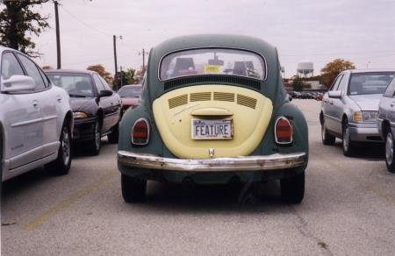
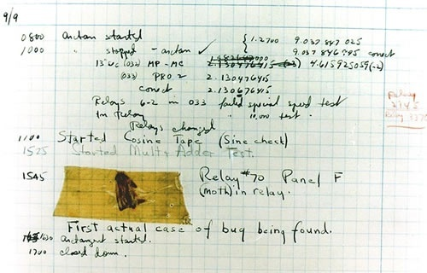
Is this a bug or a feature?
CS314
Generics

Slide 10
"Fixing" the Method
//pre: all elements of li are Strings
public void printFirstChar(GenericList li) {
String temp;
for(int i = 0; i < li.size(); i++) {
if( li.get(i) instanceof String ){
temp = (String)li.get(i);
if( temp.length() > 0 )
System.out.println(
temp.charAt(0) );
}
}
}
CS314
Generics

Slide 11
Generic Types
Java has syntax for parameterized data types
Referred to as Generic Types in most of the literature
A traditional parameter has a data type and can store various values just like a variable
public void foo(int x)
Generic Types are like parameters, but the data type for the parameter is data type
  like a variable that stores a data type
  this is an abstraction. Actually, all data type info is erased at compile time
CS314
Generics

Slide 12
Making our Array List Generic
Data type variables declared in class header
public class GenericList<E> {
The <E> is the declaration of a data type parameter for the class
  any legal identifier: Foo, AnyType, Element, DataTypeThisListStores
  Sun style guide recommends terse identifiers
The value E stores will be filled in whenever a programmer creates a new GenericList
  GenericList<String> li =
  new GenericList<String>();
CS314
Generics

Slide 13
Modifications to GenericList
instance variable
  private E[] myCon;
Parameters on
  add, insert, remove, insertAll
Return type on
  get
Changes to creation of internal storage container
  myCon = (E[])new Object[DEFAULT_SIZE];
Constructor header does not change
CS314
Generics

Slide 14
Modifications to GenericList
Careful with the equals method
Recall type information is actually erased
use of wildcard
rely on the elements equals methods
CS314
Generics

Slide 15
Using Generic Types
Back to Java's ArrayList
ArrayList list1 = new ArrayList();
  still allowed, a "raw" ArrayList
  works just like our first pass at GenericList
  casting, lack of type safety
CS314
Generics

Slide 16
Using Generic Types
ArrayList<String> list2 =
new ArrayList<String>();
  for list2 E stores String
list2.add( "Isabelle" );
System.out.println( list2.get(0).charAt(2) ); //ok
list2.add( new Rectangle() );
// syntax error
CS314
Generics

Slide 17
Parameters and Generic Types
Old version
//pre: all elements of li are Strings
public void printFirstChar(ArrayList li){
New version
//pre: none
public void printFirstChar(ArrayList<String> li){
Elsewhere
ArrayList<String> list3 = new ArrayList<String>();
printFirstChar( list3 ); // ok
ArrayList<Integer> list4 = new ArrayList<Integer>();
printFirstChar( list4 ); // syntax error
CS314
Generics

Slide 18
Generic Types and Subclasses
ArrayList<Shape> list5 =
new ArrayList<Shape>();
list5.add( new Rectangle() );
list5.add( new Square() );
list5.add( new Circle() );
// all okay
list5 can store Shape objects and any descendants of Shape
CS314
Generics

