Slide 1

Topic 8
Iterators
"First things first, but not necessarily in that order "
-Dr. Who

Slide 2
Iterators
ArrayList is part of the Java Collections Framework
Collection is an interface that specifies the basic operations every collection (data structure) should have
Some Collections don’t have a definite order
  Sets, Maps, Graphs
How to access all the items in a Collection with no specified order?
CS314
Iterators

Slide 3

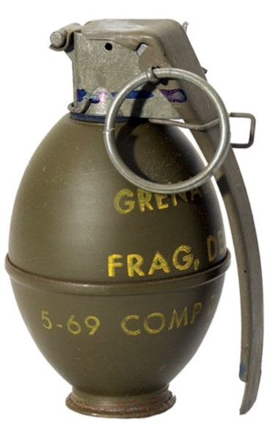
Iterator Interface
An iterator object is a “one shot” object
  it is designed to go through all the
  elements of a Collection once
  if you want to go through the
  elements of a Collection again you
  have to get another iterator object
Iterators are obtained by calling
a method from the Collection
CS314
Iterators

Slide 4
Iterator Iterface Methods
The Iterator interface specifies 3 methods:
  boolean hasNext()
  //returns true if this iteration has more elements
  E next()
  //returns the next element in this iteration
  //pre: hastNext()
  void remove()
  /*Removes from the underlying collection the last element returned by the iterator.
  pre: This method can be called only once per call to next. After calling, must call next again before calling remove again.
  */
CS314
Iterators

Slide 5
Clicker Question 1
Which of the following produces a syntax error?
ArrayList<String> list
= new ArrayList<String>();
Iterator<String> it1 = new Iterator(); // I
Iterator<String> it2 = new Iterator(list); // II
Iterator<String> it3 = list.iterator(); // III
A. I
B. II
C. III
D. I and II
E. II and III
CS314
Iterators

Slide 6
Iterator
Imagine a fence made up of fence posts and rail sections
rails
fenceposts
CS314
Iterators

Slide 7
Fence Analogy
The iterator lives on the fence posts
The data in the collection are the rails
Iterator created at the far left post
As long as a rail exists to the right of the Iterator, hasNext() is true
iterator object
CS314
Iterators

Slide 8
Fence Analogy
ArrayList<String> names =
new ArrayList<String>();
names.add(“Jan”);
names.add(“Levi”);
names.add(“Tom”);
names.add(“Jose”);
Iterator<String> it = names.iterator();
int i = 0;
“Jan” “Levi” “Tom” “Jose”
CS314
Iterators

Slide 9
Fence Analogy
while( it.hasNext() ) {
i++;
System.out.println( it.next() );
}
// when i == 1, prints out Jan
first call to next moves iterator to
next post and returns “Jan”
“Jan” “Levi” “Tom” “Jose”
CS314
Iterators

Slide 10
Fence Analogy
while( it.hasNext() ) {
i++;
System.out.println( it.next() );
}
// when i == 2, prints out Levi
“Jan” “Levi” “Tom” “Jose”
CS314
Iterators

Slide 11
Fence Analogy
while( it.hasNext() ) {
i++;
System.out.println( it.next() );
}
// when i == 3, prints out Tom
“Jan” “Levi” “Tom” “Jose”
CS314
Iterators

Slide 12
Fence Analogy
while( it.hasNext() ) {
i++;
System.out.println( it.next() );
}
// when i == 4, prints out Jose
“Jan” “Levi” “Tom” “Jose”
CS314
Iterators

Slide 13
Fence Analogy
while( it.hasNext() ) {
i++;
System.out.println( it.next() );
}
// call to hasNext returns false
// while loop stops
“Jan” “Levi” “Tom” “Jose”
CS314
Iterators

Slide 14
Typical Iterator Pattern
public void printAll(Collection<String> list) {
Iterator<String> it = list.iterator();
while( it.hasNext() ) {
String temp = it.next();
System.out.println( temp );
}
}
CS314
Iterators

Slide 15
Clicker Question 2
What is output by the following code?
ArrayList<Integer> list;
list = new ArrayList<Integer>();
list.add(3);
list.add(3);
list.add(5);
Iterator<Integer> it = list.iterator();
System.out.print(it.next() + " ");
System.out.print(it.next() + " ");
System.out.print(it.next());
3 B. 3 5 C. 3 3 5
D. 3 3 E. 3 3 then a runtime error

Slide 16
remove method
AnIterator can be used to remove things from the Collection
Can only be called once per call to next()
public void removeWordsOfLength(int len) { Iterator<String> it = myList.iterator
while( it.hasNext() ) {
String temp = it.next();
if(temp.length() == len)
it.remove();
}
}
// original list = [“dog”, “cat”, “hat”, “sat”]
// resulting list after removeWordsOfLength(3) ?
CS314
Iterators

Slide 17
Clicker Question 3
public void printTarget(ArrayList<String> names,
int len) {
Iterator<String> it = names.iterator();
while( it.hasNext() )
if( it.next().length() == len )
System.out.println( it.next() );
}
Given names = [“Jan”, “Ivan”, “Tom”, “George”] and len = 3 what is output by the printTarget method?
Jan Ivan Tom George
Jan Tom
Ivan George
No output due to syntax error
No output due to runtime error
CS314
Iterators

Slide 18
The Iterable Interface
A related interface is Iterable
One method in the interface:
  public Iterator<T> iterator()
Why?
Anything that implements the Iterable interface can be used in the for each loop.
  ArrayList<Integer> list;
  //code to create and fill list
  int total = 0;
  for( int x : list )
  total += x;
CS314
Iterators

Slide 19
Iterable
If you simply want to go through all the elements of a Collection (or Iterable thing) use the for each loop
  hides creation of the Iterator
public void printAllOfLength(ArrayList<String> names,
int len){
//pre: names != null, names only contains Strings
//post: print out all elements of names equal in
// length to len
for(String s : names){
if( s.length() == len )
System.out.println( s );
}
}
CS314
Iterators

Slide 20
Implementing an Iterator
Implement an Iterator for our GenericList class
  Nested Classes
  Inner Classes
  Example of encapsulation
  checking precondition on remove
  does our GenricList need an Iterator?
CS314
Iterators

Slide 21
Comodification
If a Collection (ArrayList) is changed while an iteration via an iterator is in progress an Exception will be thrown the next time the next() or remove() methods are called via the iterator
ArrayList<String> names =
new ArrayList<String>();
names.add(“Jan”);
Iterator<String> it = names.iterator();
names.add(“Andy”);
it.next(); // exception will occur here
CS314
Iterators

