Slide 1
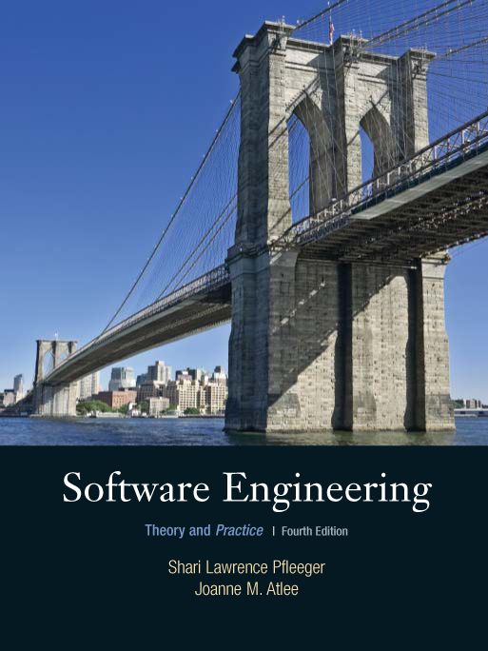
Chapter 2
Modeling the
Process and Life
Cycle
Shari L. Pfleeger
Joanne M. Atlee
4th Edition

Slide 2
Contents
2.1 The Meaning of Process
2.2 Software Process Models
2.3 Tools and Techniques for Process Modeling
2.4 Practical Process Modeling
2.5 Information System Example
2.6 Real Time Example
2.7 What this Chapter Means for You

Slide 3
Chapter 2 Objectives
What we mean by a “process”
Software development products, processes, and resources
Several models of the software development process
Tools and techniques for process modeling

Slide 4
2.1 The Meaning of Process
A process: a series of steps involving activities, constrains, and resources that produce an intended ouput of some kind
A process involves a set of tools and techniques

Slide 5
2.1 The Meaning of Process
Process Characteristics
Prescribes all major process activities
Uses resources, subject to set of constraints (such as schedule)
Produces intermediate and final products
May be composed of subprocesses with hierarchy or links
Each process activity has entry and exit criteria
Activities are organized in sequence, so timing is clear
Each process guiding principles, including goals of each activity
Constraints may apply to an activity, resource or product

Slide 6
2.1 The Meaning of Process
The Importance of Processes
Impose consistency and structure on a set of activities
Guide us to understand, control, examine, and improve the activities
Enable us to capture our experiences and pass them along

Slide 7
2.2 Software Process Models
Reasons for Modeling a Process
To form a common understanding
To find inconsistencies, redundancies, omissions
To find and evaluate appropriate activities for reaching process goals
To tailor a general process for a particular situation in which it will be used

Slide 8
2.2 Software Process Models
Software Life Cycle
When a process involves building a software, the process may be referred to as software life cycle
  Requirements analysis and definition
  System (architecture) design
  Program (detailed/procedural) design
  Writing programs (coding/implementation)
  Testing: unit, integration, system
  System delivery (deployment)
  Maintenance

Slide 9
2.2 Software Process Models
Software Development Process Models
Waterfall model
V model
Prototyping model
Operational specification
Transformational model
Phased development: increments and iteration
Spiral model
Agile methods

Slide 10
2.2 Software Process Models
Waterfall Model
One of the first process development models proposed
Works for well understood problems with minimal or no changes in the requirements
Simple and easy to explain to customers
It presents
  a very high-level view of the development process
  sequence of process activities
Each major phase is marked by milestones and deliverables (artifacts)

Slide 11
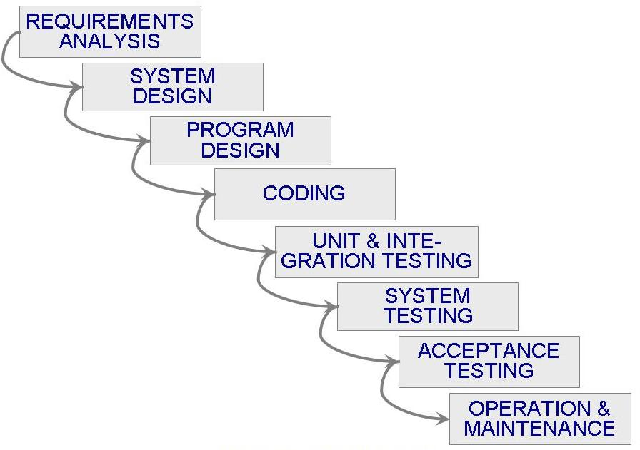
2.2 Software Process Models
Waterfall Model (continued)

Slide 12
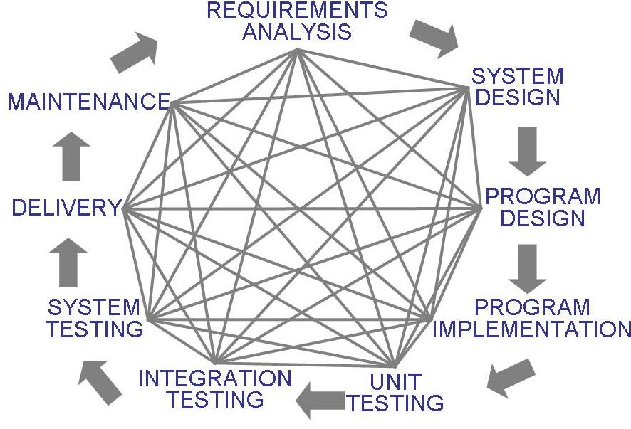
2.2 Software Process Models
Waterfall Model (continued)
There is no iteration in waterfall model
Most software developments apply a great many iterations

Slide 13
2.2 Software Process Models
Sidebar 2.1 Drawbacks of The Waterfall Model
Provides no guidance how to handle changes to products and activities during development (assumes requirements can be frozen)
Views software development as manufacturing process rather than as creative process
There is no iterative activities that lead to creating a final product
Long wait before a final product

Slide 14
2.2 Software Process Models
Waterfall Model with Prototype
A prototype is a partially developed product
Prototyping helps
  developers assess alternative design strategies (design prototype)
  users understand what the system will be like (user interface prototype)
Protopyping is useful for verification and validation

Slide 15
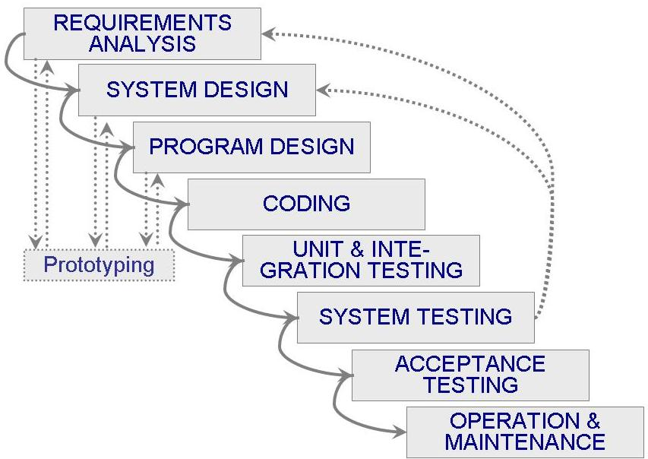
2.2 Software Process Models
Waterfall Model with Prototype (continued)
Waterfall model with prototyping

Slide 16
2.2 Software Process Models
V Model
A variation of the waterfall model
Uses unit testing to verify procedural design
Uses integration testing to verify architectural (system) design
Uses acceptance testing to validate the requirements
If problems are found during verification and validation, the left side of the V can be re-executed before testing on the right side is re-enacted

Slide 17
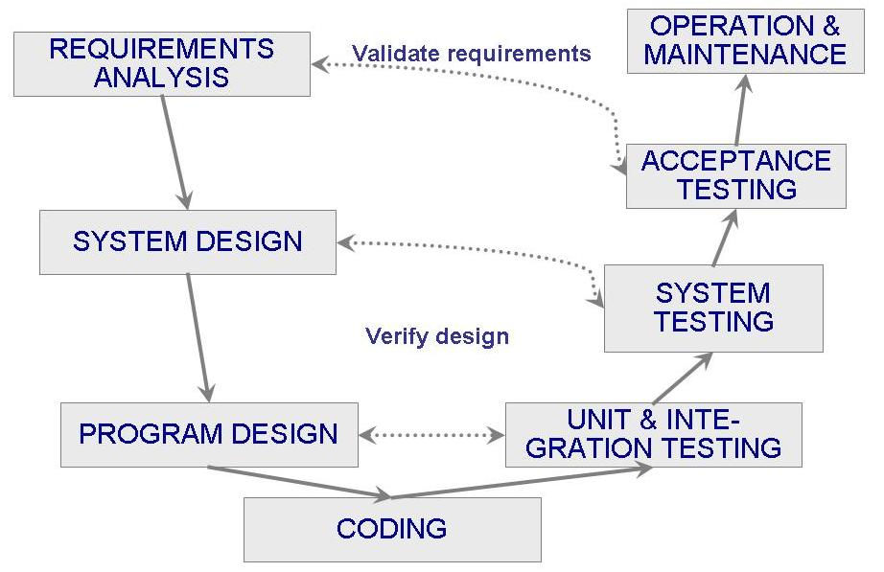
2.2 Software Process Models
V Model (continued)

Slide 18
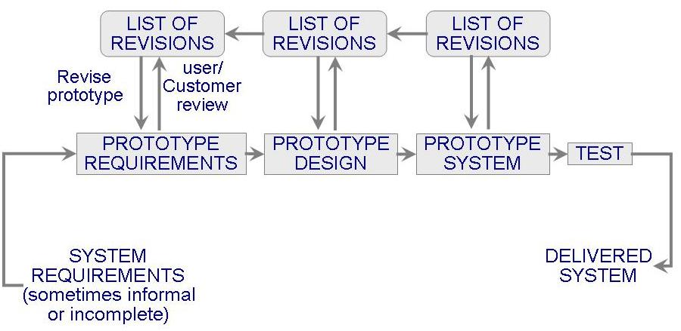
2.2 Software Process Models
Prototyping Model
Allows repeated investigation of the requirements or design
Reduces risk and uncertainty in the development

Slide 19
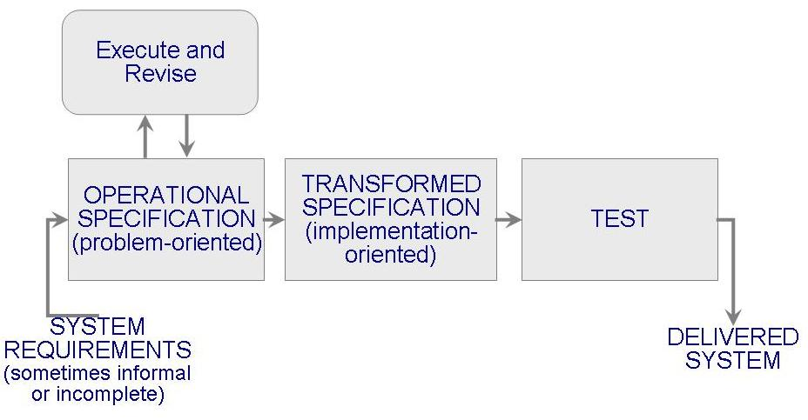
2.2 Software Process Models
Operational Specificiation Model
Requirements are executed (examined) and their implication evaluated early in the development process
Functionality and the design are allowed to be merged

Slide 20
2.2 Software Process Models
Transformational Model
Fewer major development steps
Applies a series of transformations to change a specification into a deliverable system
  Change data representation
  Select algorithms
  Optimize
  Compile
Relies on formalism
Requires formal specification (to allow transformations)

Slide 21
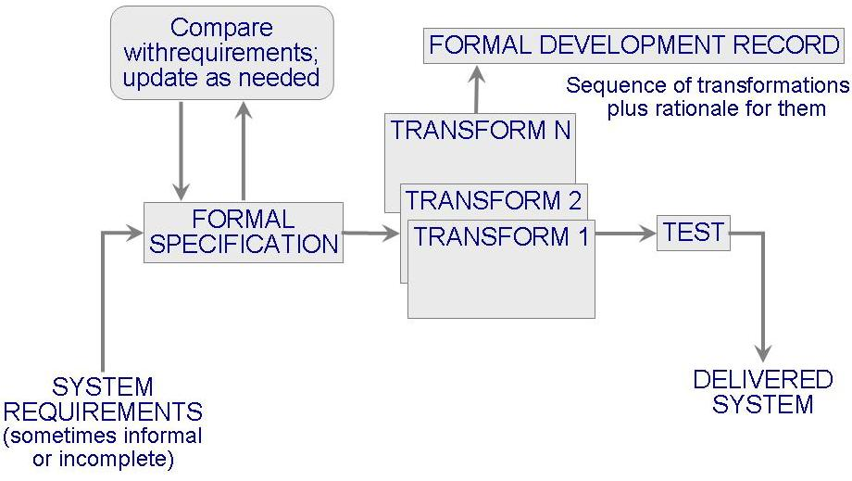
2.2 Software Process Models
Transformational Model (continued)

Slide 22
2.2 Software Process Models
Phased Development: Increments and Iterations
Shorter cycle time
System delivered in pieces
  enables customers to have some functionality while the rest is being developed
Allows two systems functioning in parallel
  the production system (release n): currently being used
  the development system (release n+1): the next version

Slide 23
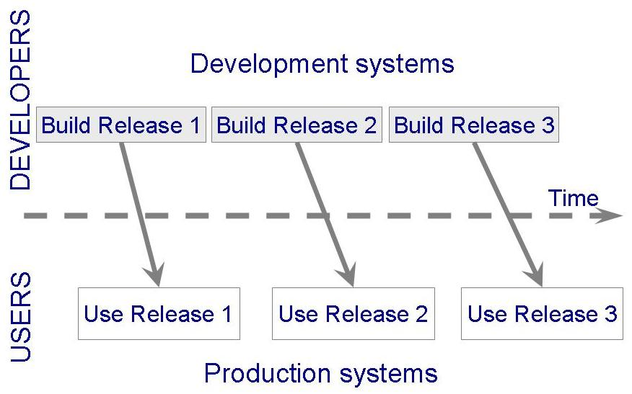
2.2 Software Process Models
Phased Development: Increments and Iterations
(continued)

Slide 24
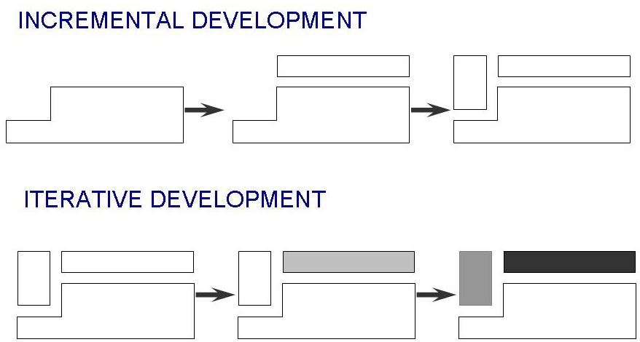
2.2 Software Process Models
Phased Development: Increments and Iterations
(continued)
Incremental development: starts with small functional subsystem and adds functionality with each new release
Iterative development: starts with full system, then changes functionality of each subsystem with each new release

Slide 25
2.2 Software Process Models
Phased Development: Increments and Iterations
(continued)
Phased development is desirable for several reasons
  Training can begin early, even though some functions are missing
  Markets can be created early for functionality that has never before been offered
  Frequent releases allow developers to fix unanticipated problems globaly and quickly
  The development team can focus on different areas of expertise with different releases

Slide 26
2.2 Software Process Models
Spiral Model
Suggested by Boehm (1988)
Combines development activities with risk management to minimize and control risks
The model is presented as a spiral in which each iteration is represented by a circuit around four major activities
  Plan
  Determine goals, alternatives and constraints
  Evaluate alternatives and risks
  Develop and test

Slide 27
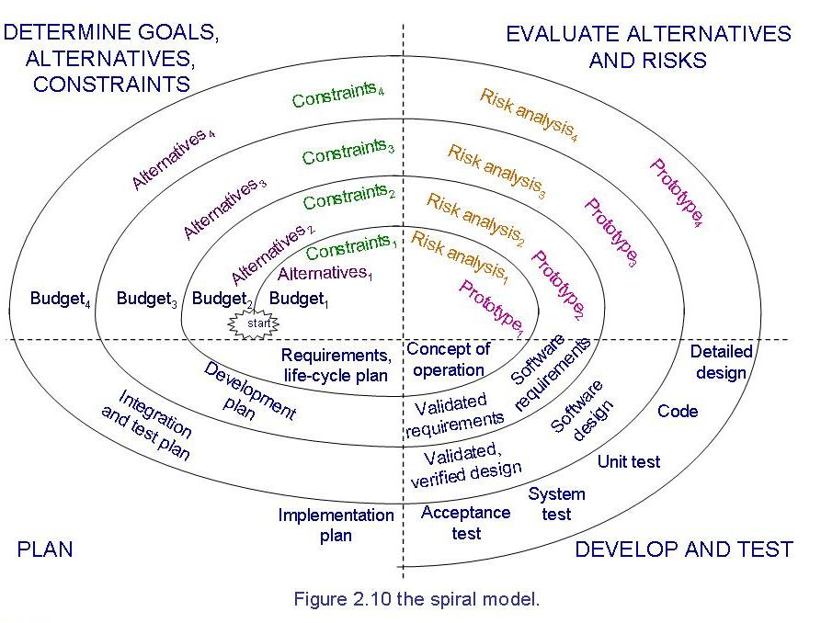
2.2 Software Process Models
Spiral Model (continued)

Slide 28
2.2 Software Process Models
Agile Methods
Emphasis on flexibility in producing software quickly and capably
Agile manifesto
  Value individuals and interactions over process and tools
  Prefer to invest time in producing working software rather than in producing comprehensive documentation
  Focus on customer collaboration rather than contract negotiation
  Concentrate on responding to change rather than on creating a plan and then following it

Slide 29
2.2 Software Process Models
Agile Methods: Examples of Agile Process
Extreme programming (XP)
Crystal: a collection of approaches based on the notion that every project needs a unique set of policies and conventions
Scrum: 30-day iterations; multiple self-organizing teams; daily “scrum” coordination
Adaptive software development (ASD)

Slide 30
2.2 Software Process Models
Agile Methods: Extreme Programming
Emphasis on four charateristics of agility
  Communication: continual interchange between customers and developers
  Simplicity: select the simplest design or implementation
  Courage: commitment to delivering functionality early and often
  Feedback: loops built into the various activitites during the development process

Slide 31
2.2 Software Process Models
Agile Methods: Twelve Facets of XP
The planning game (customer defines value)
Small release
Metaphor (common vision, common names)
Simple design
Writing tests first
Refactoring
Pair programming
Collective ownership
Continuous integration (small increments)
Sustainable pace (40 hours/week)
On-site customer
Coding standard

Slide 32
2.2 Software Process Models
Sidebar 2.2 When Extreme is Too Extreme?
Extreme programming's practices are interdependent
  A vulnerability if one of them is modified
Requirements expressed as a set of test cases must be passed by the software
  System passes the tests but is not what the customer is paying for
Refactoring issue
  Difficult to rework a system without degrading its architecture

Slide 33
2.2 Software Process Models
Sidebar 2.3 Collections of Process Models
Development process is a problem-solving activity
Curtis, Krasner, and Iscoe (1988) performed a field study to determine which problem-solving factors to captured in process model
The results suggest a layered behavioral model as supplement to the traditional model
Process model should not only describe series of tasks, but also should detail factors that contribute to a project's inherent uncertainty and risk

Slide 34
2.7 What this Chapter Means for You
Process development involves activities, resources, and product
Process model includes organizational, functional, behavioral and other prespectives
A process model is useful for guiding team behavior, coordination and collaboration

Slide 35
练习
The project team developing a new system is experienced in the domain. Although the new project is fairly large, it is not expected to vary much from applications that have been developed by this team in the past. Which Process model would be appropriate for this type of development?
  a. prototyping
  b. waterfall
  c. Incremental Delivery
  d. spiral

