Slide 1
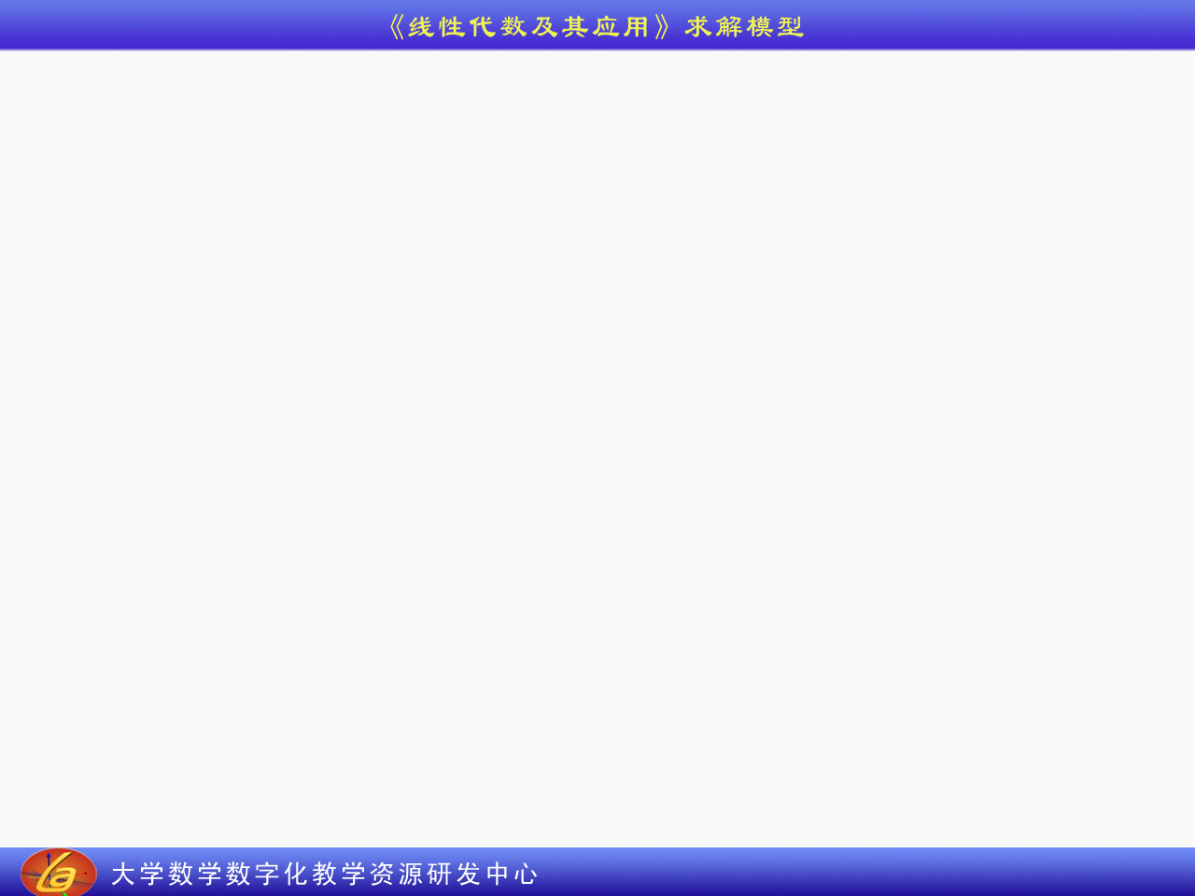
矩阵的转置模型
A =
3 × 4
A^{T} =
4 × 3

