Slide 1
What happened on 1970's
Yusuf Karaca

Slide 2

1970
The world cup 1970 was the first world cup held on North America.
The 1970 FIFA World Cup was the ninth edition of the FIFA World Cup the quadrennial international football championship for men's senior national teams. Held from 31 May to 21 June in Mexico, it was the first World Cup tournament held outside Europe and South America, and it was also the first held in North America.

Slide 3
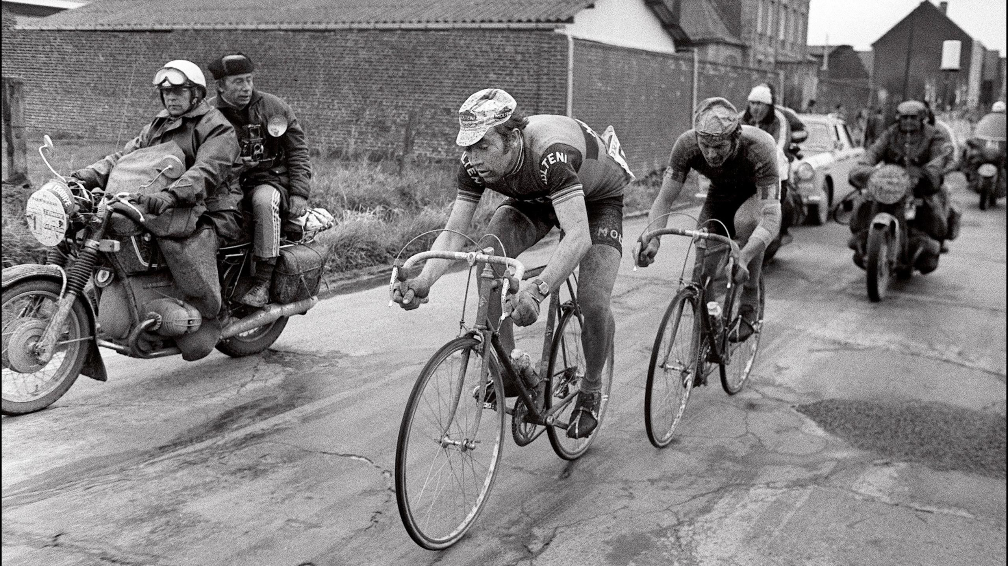
1973
The 28th Edition Vuelta a Españaal (Tour of Spain)
a long-distance bicycle stage race and one of the 3 grand tours, was held from April 26 to May 13, 1973. It consisted of 17 stages covering a total of 3,061 km, and was won by Eddy Merckx of the Molteni cycling team.

Slide 4
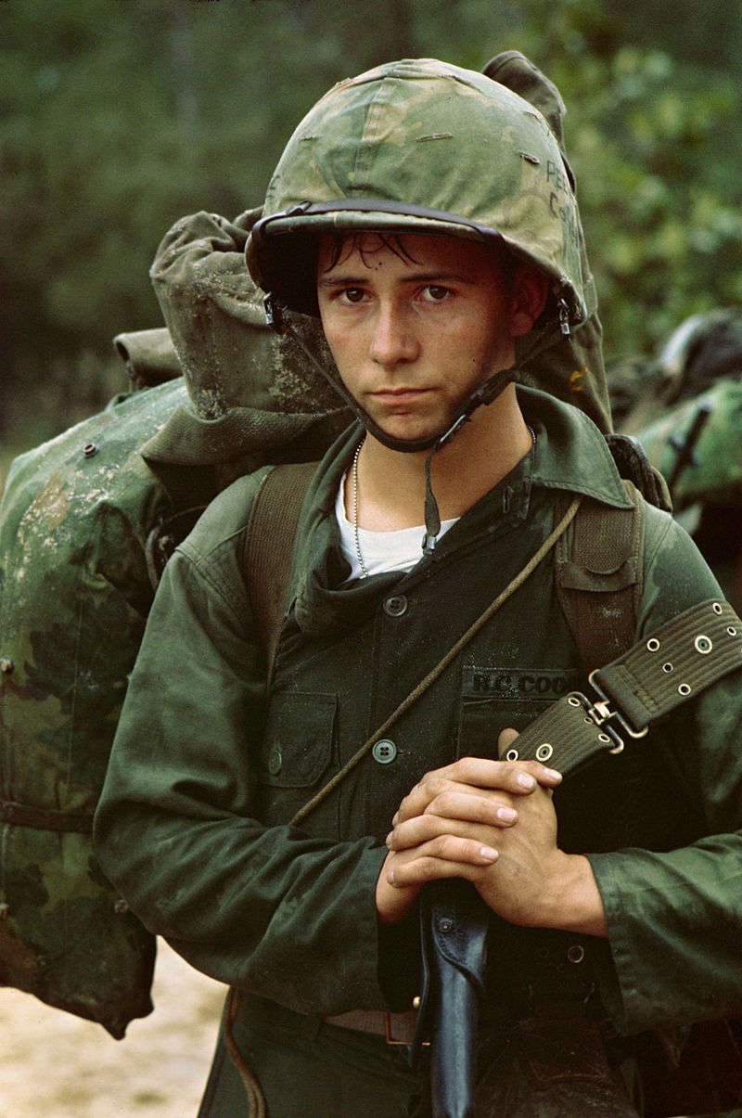
1975
Vietnam war was ended on April 30 1975.
North Vietnamese forces triggered a major offensive in the Central Highlands in March 1975. On April 30, 1975, NVA tanks rolled through the gate of the Presidential Palace in Saigon, effectively ending the war.
A teen private belongs to United States marine corps.

Slide 5
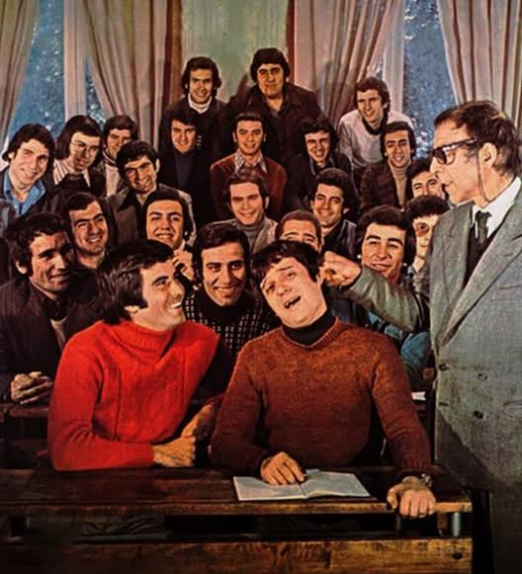
Lets talk about Turkey. Best country ever?
Hababam class, a series adapted from the book series of Rifat Ilgaz is started in 1975.
For me, it is one of the best Turkish cinema structures. Despite the conditions of the period, the film has a good story and humorous elements. selfish mother, child and father figures push us to think philosophicallyphilosophically.

Slide 6
References. Most important thing for us.
https://tr.m.wikipedia.org/wiki/Vietnam_Sava%C5%9F%C4%B1 (I know our teacher doesn’t love this subject.)
https://en.m.wikipedia.org/wiki/1973_Vuelta_a_Espa%C3%B1a
https://en.m.wikipedia.org/wiki/1970_FIFA_World_Cup
https://tr.m.wikipedia.org/wiki/Hababam_S%C4%B1n%C4%B1f%C4%B1

Slide 7
License? What is that?
All information is taken from publicly available sources. Public domain including images, all content can be taken without license restrictions. It can be re-licensed and distributed with closed or open licenses. For moore information, please visit this page => \n https://commons.m.wikimedia.org/wiki/Commons:Licensing.
Thank you for reading this work. Have a good day.

