Slide 1
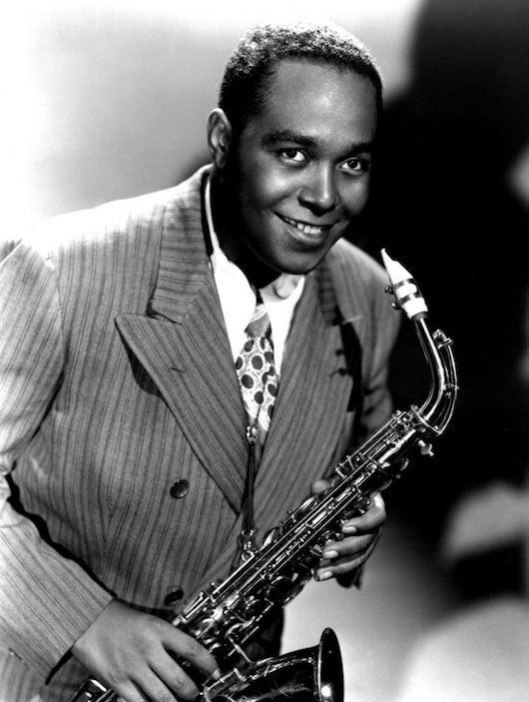
Why Jazz becomes less attractive to people?
Project1 for 5243
Xin Gao

Slide 2
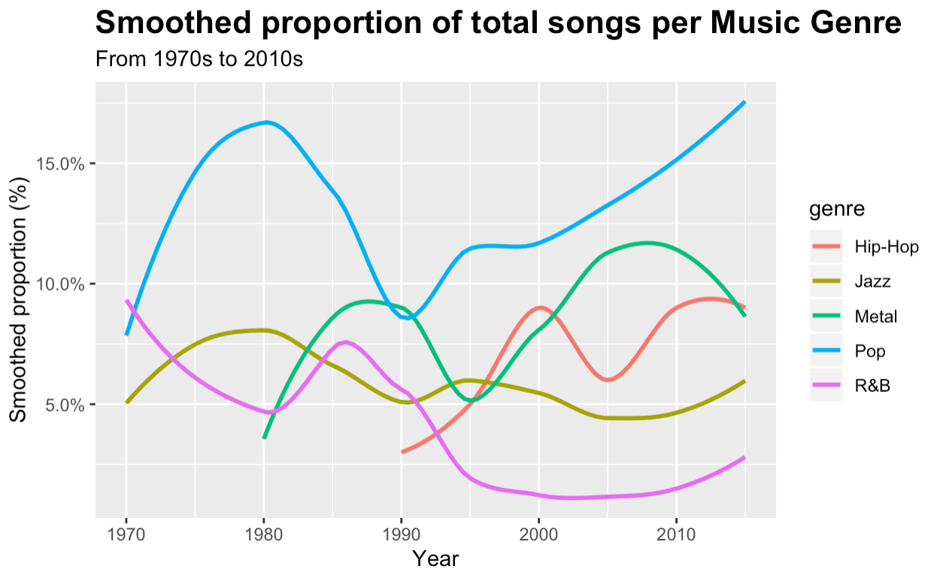
Reason 1: The emergence and rise of other types of music.

Slide 3
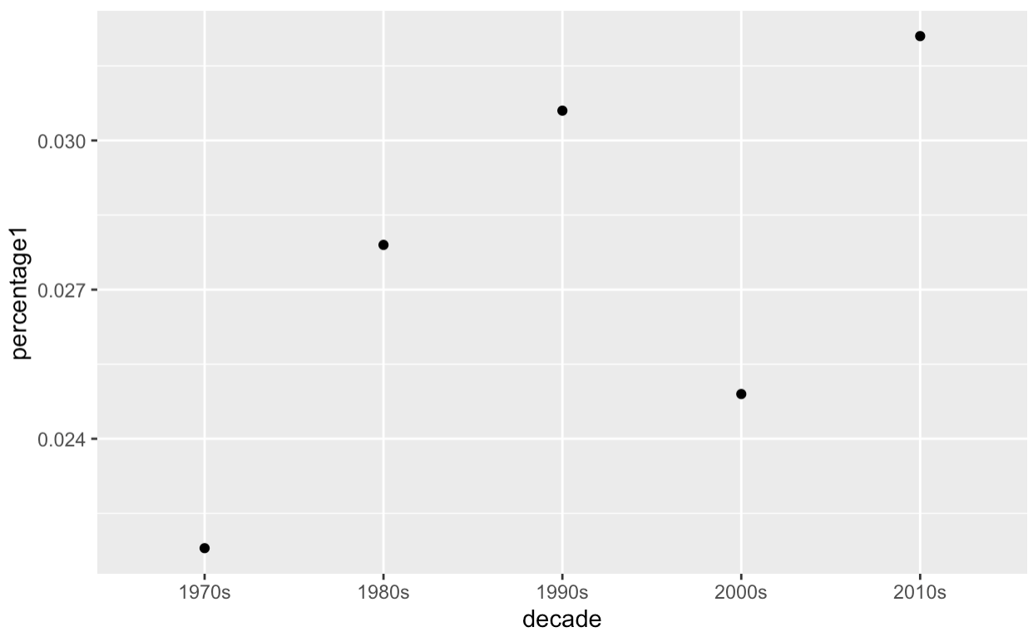
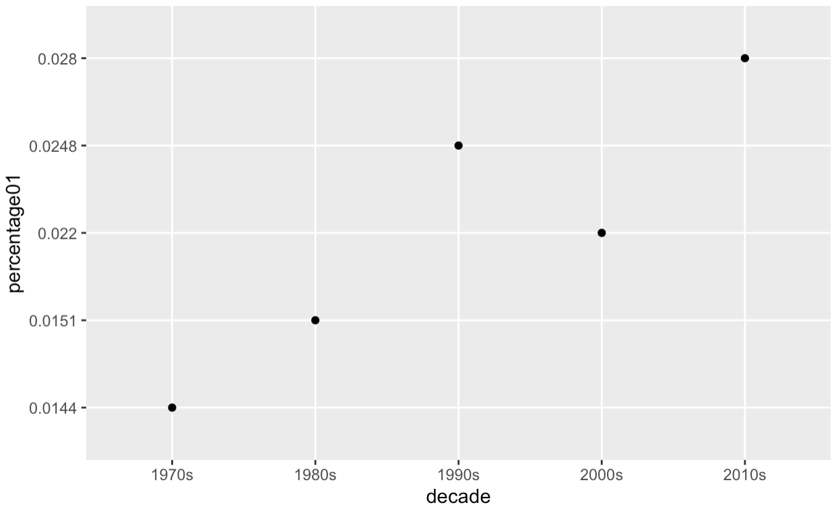
Reason 2: Today's music express deeper unhappiness than the songs of the past.
joyful
Positive feelings
fear
Negative feelings

Slide 4
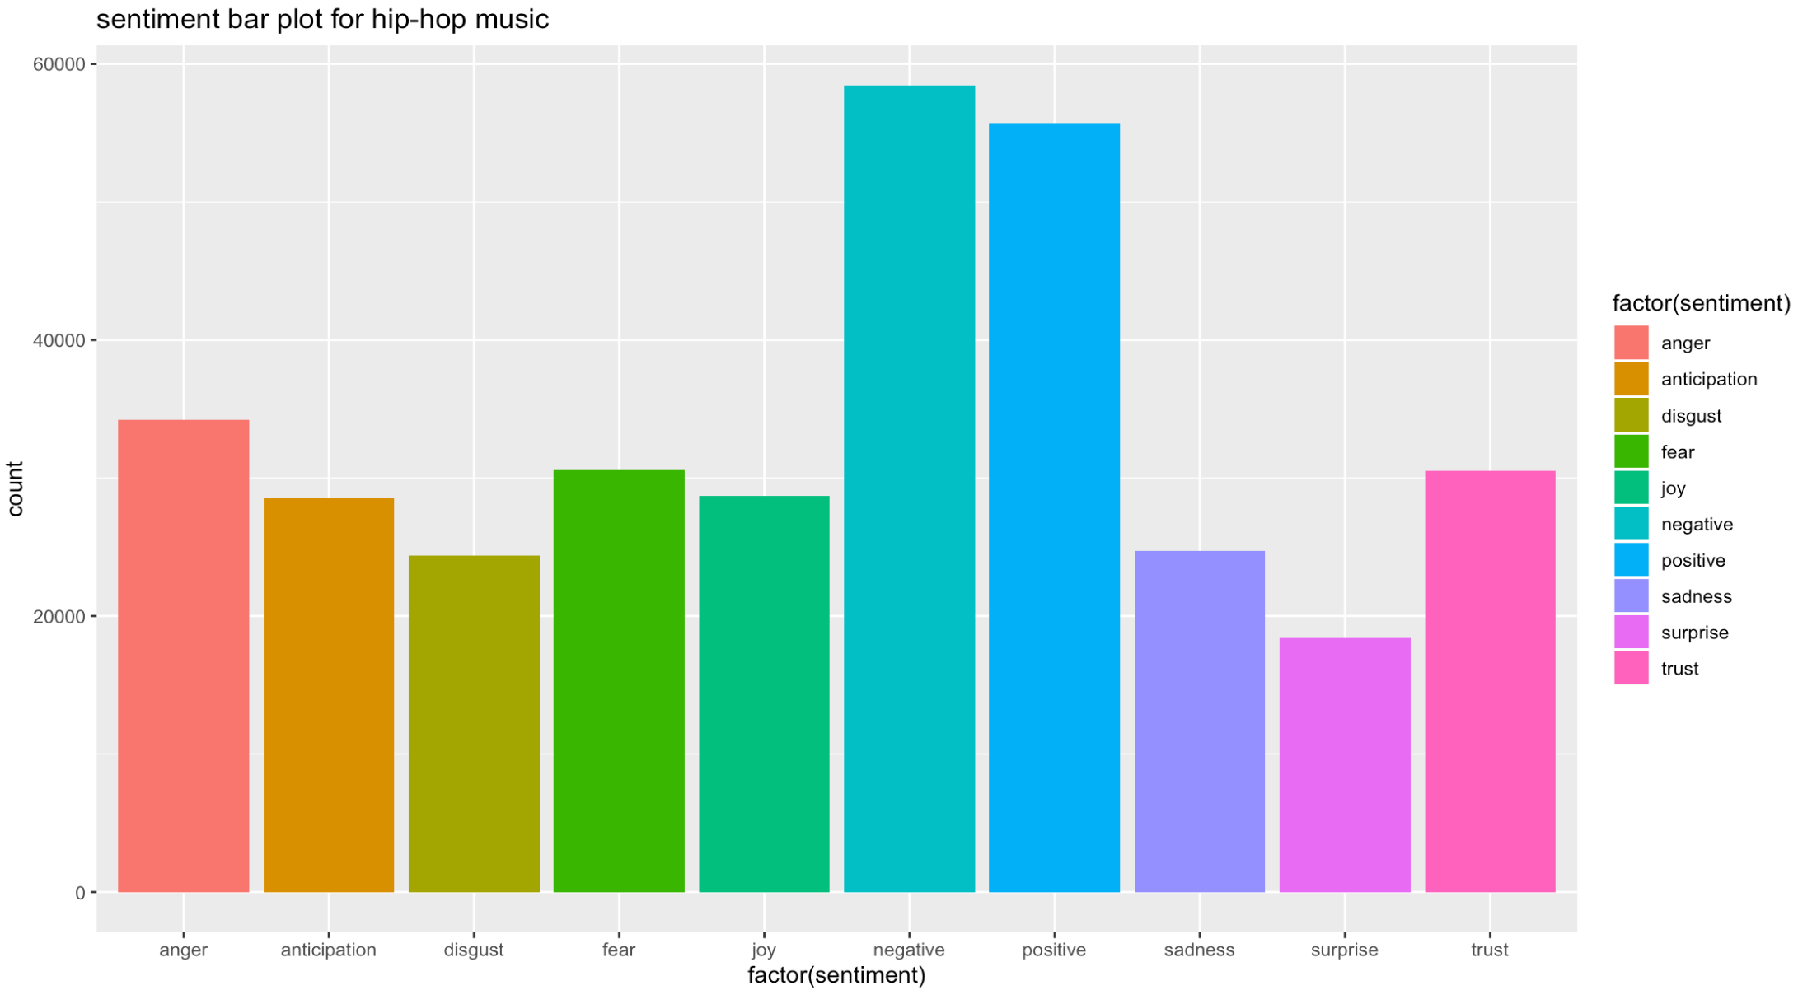
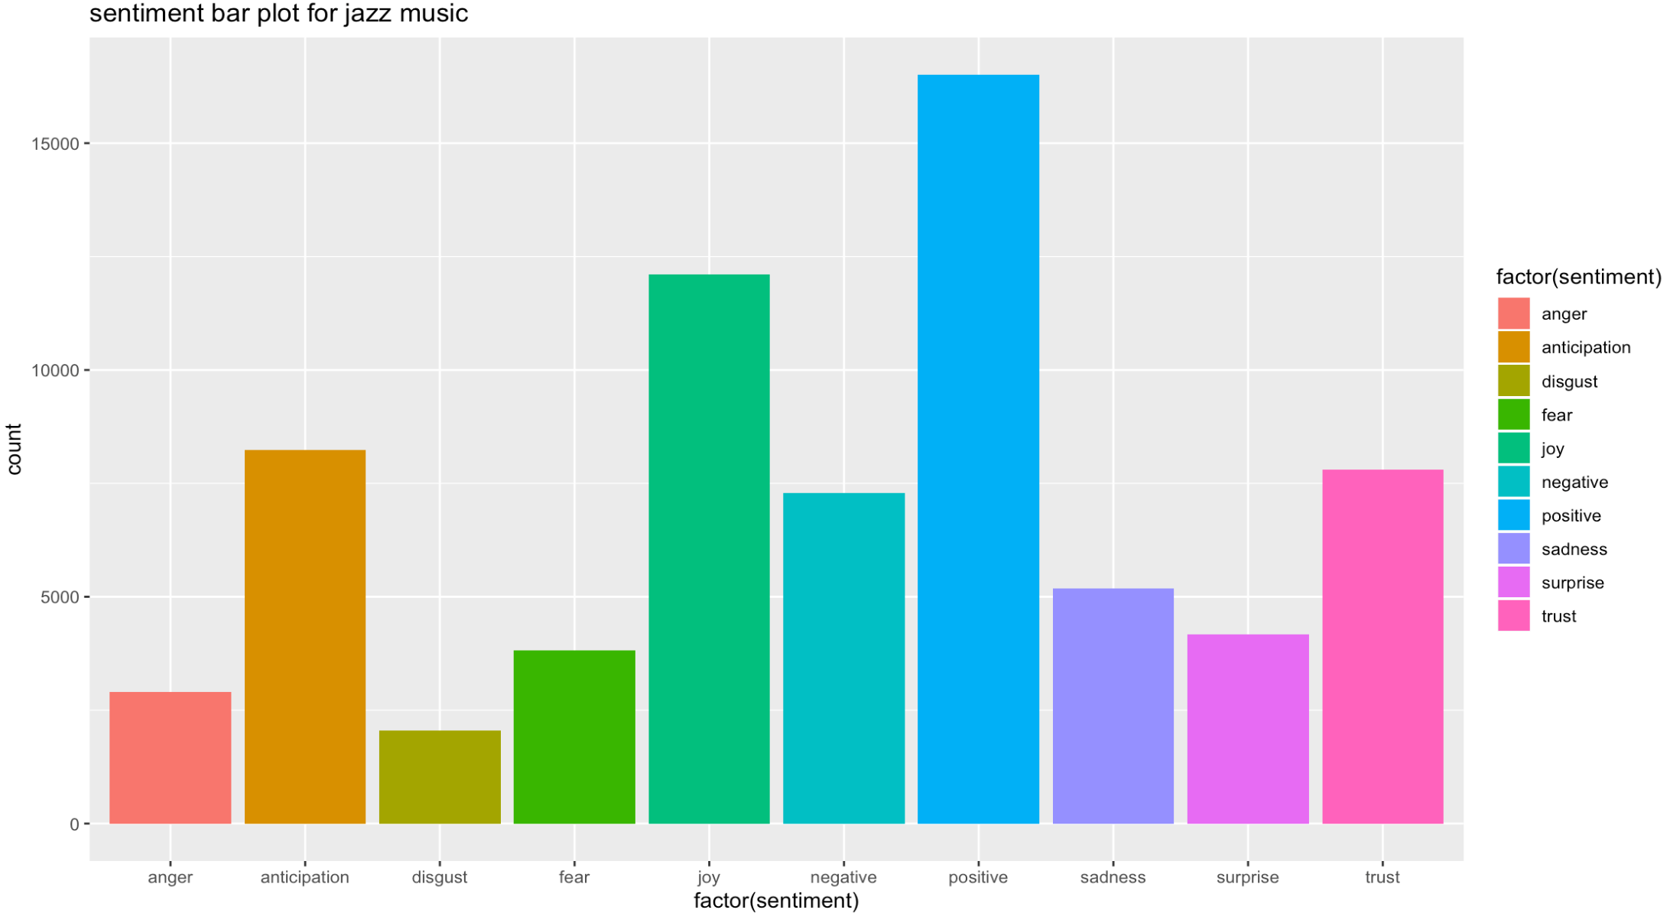

Slide 5
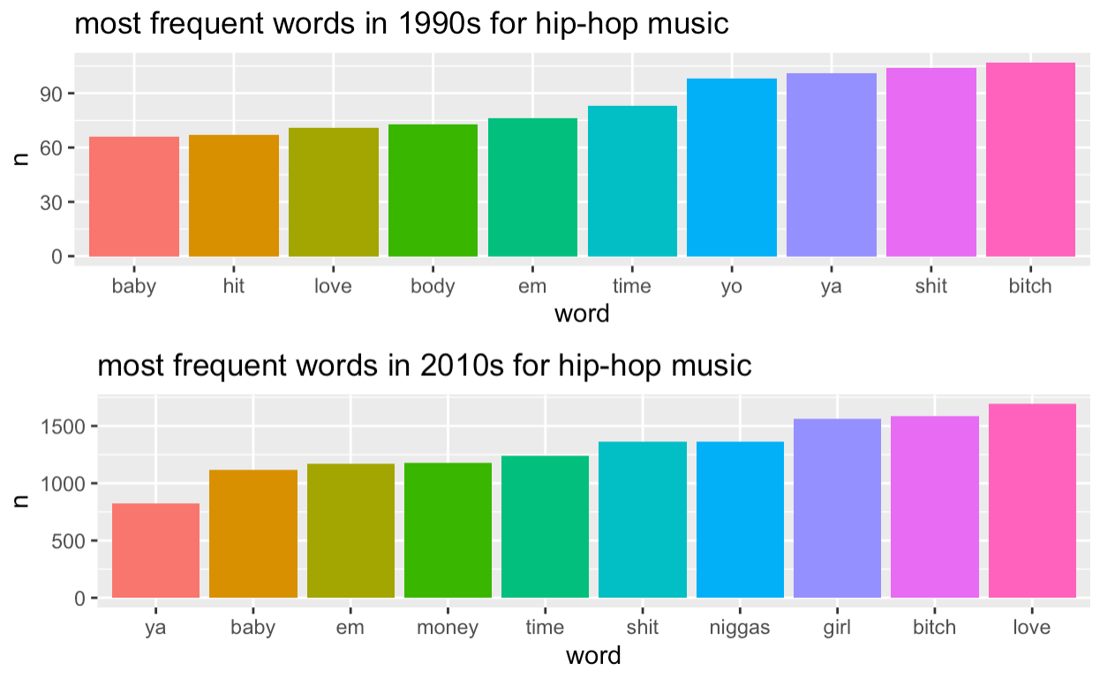
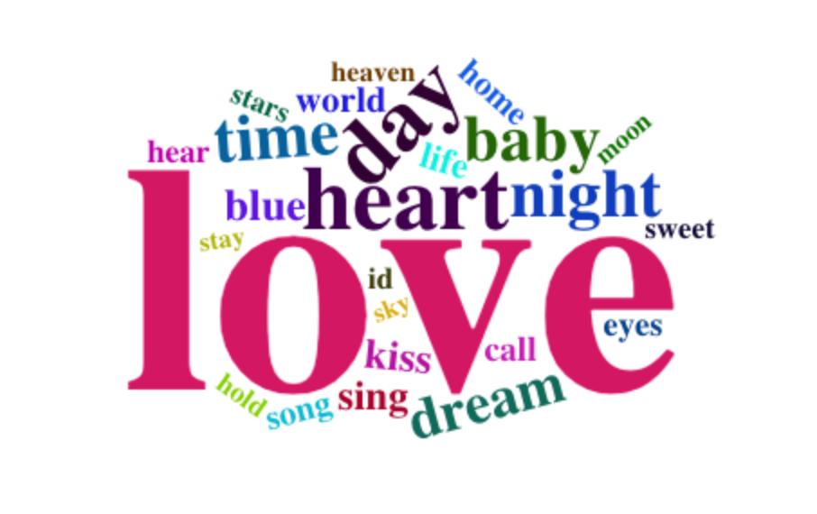
Reason 3:Due to the curiousness of new stuff, people prefer other types of music instead of jazz-- an old fashioned genre of music.
Wordcloud for jazz

Slide 6



Slide 7
conclusions
The rise of other types of music which occupy the market.
Recently, people prefer to express negative feelings more. Jazz music is not their first choice to listen.
People like to try out the new things. Using slangs make them feel cool.

