Slide 1
Web API A Crash Course
Xiaokang Guo

Slide 2
HyperText Transportation Protocol
HTTP messages are how data is exchanged between a server and a client. There are two types of messages: requests sent by the client to trigger an action on the server, and responses, the answer from the server.
HTTP is an application layer protocol.
https://developer.mozilla.org/en-US/docs/Web/HTTP/Messages

Slide 3
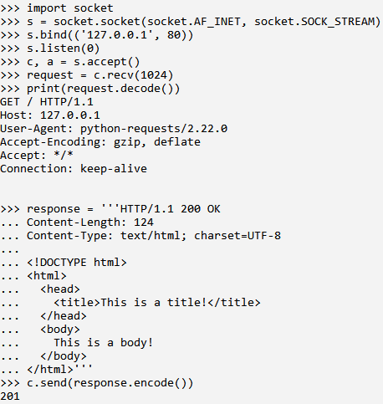
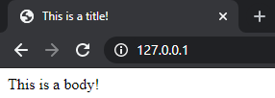
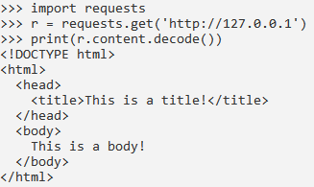
HyperText Transportation Protocol
Open browser, type in url, enter, and BOOM~
Two blank lines
User
Server

Slide 4
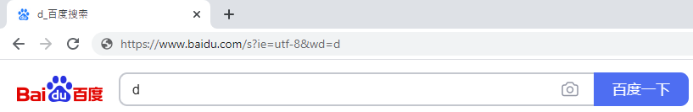
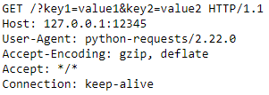

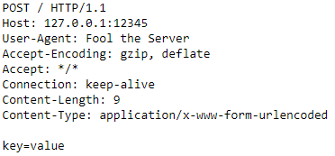
More Complicated Requests

Slide 5
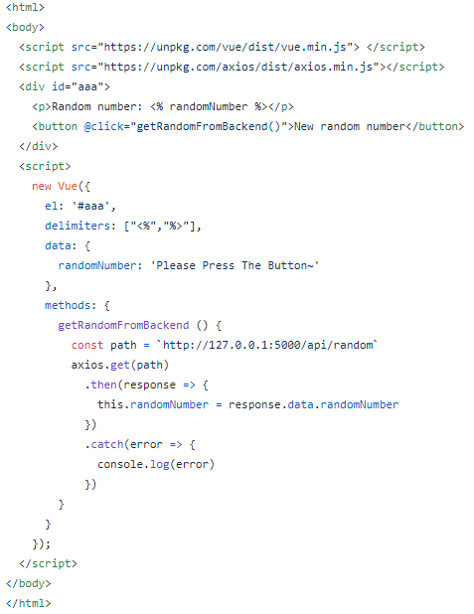
Javascript Sends Request

Slide 6

Response Changes DOM

