Slide 1
Games App ranking and reviews website
https://games-app-hotness.herokuapp.com/index.html

Slide 2
What’s the most hot games app in the past week
When you want to make a decision on installing or deleting a game app.
Popular games vs games are not hot
Twitterscraper library to query data
The rankings are based on posts information

Slide 3
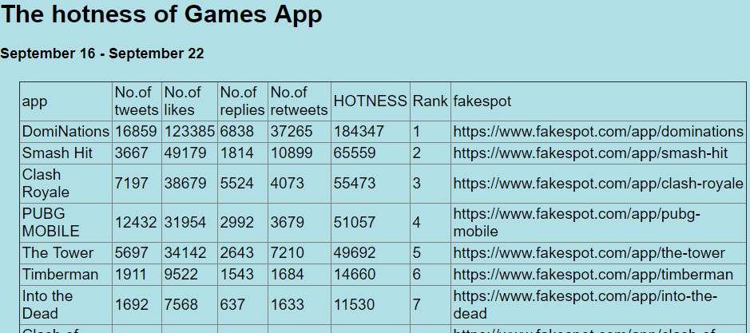
Website screenshot

Slide 4
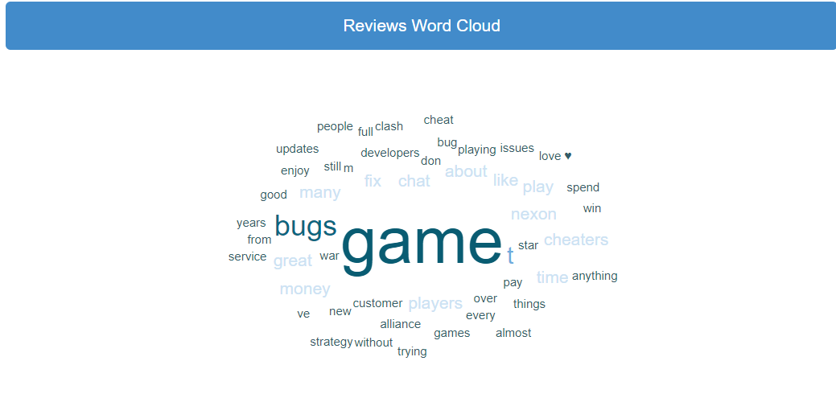
Dominations on Fakespot.com

Slide 5
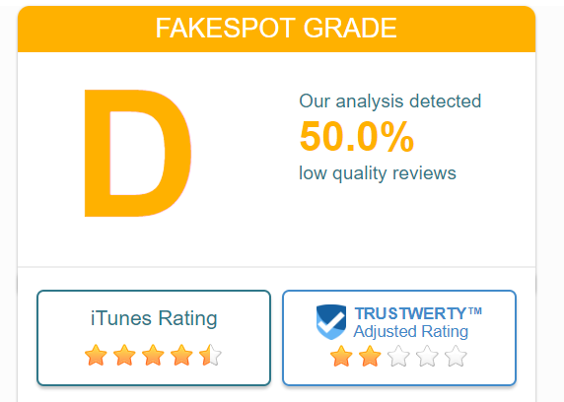
New Ratings

