Slide 1
LDA for Lyrics Analysis
CSE 291 Presentation
Daryl Lim

Slide 2
Overview
LDA overview
Motivation
Data Acquisition
Results
LDA vs PCA
Results
Conclusion

Slide 3
Latent Dirichlet Allocation
Generative probabilistic model of a corpus
Documents are represented as random mixtures over latent topics
Topic is characterized by a distribution over words
Notes:
Large text docs like wikipedia, scientific documents
Sparse BOW representation

Slide 4
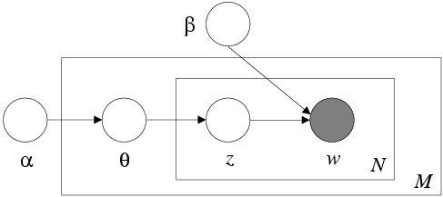
The graphical model

Slide 5
Motivation
Investigate whether we can have semantic interpretations of the topic-word distributions which LDA learns (i.e. β in the LDA model)
Investigate the use of LDA for dimensionality reduction of lyrics features
  Comparison with PCA

Slide 6
Motivation
In many text-based applications, LDA is usually learned on a training set of large text documents
  Investigate whether LDA still holds for lyrics which are much shorter in length (i.e. sparse histograms)
Notes:
Large text docs like wikipedia, scientific documents
Sparse BOW representation

Slide 7
Acquiring Lyrics
Traditionally been pretty difficult
Popular databases with APIs (e.g. LyricsFly, AZlyrics)
  rely on self-submitted lyrics which are noisy,
  not robust to search
  Questionable legality
MusixMatch - New company set up this year to commercialize lyrics so it has clean(er) lyrics/robust API

Slide 8
Acquiring Lyrics
Obtained lyrics using MusixMatch API
Wrote code in Python to query API and scrape song lyrics
Obtained a total of 15,000 song lyrics from the Million Song Dataset to build the LDA model

Slide 9
Building Bag-of-words model
Preprocessing of text data
  Stopword/punctuation removal
  Stemmed words using the PorterStemmer algorithm
  Removed words which only appeared in a few songs (misspellings, slang, names etc)

Slide 10
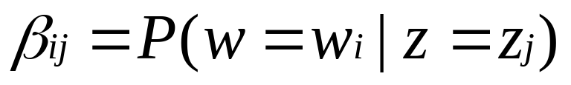
Learning the LDA parameters
Given that there are z_{n} topics, our target is to estimate β in the LDA model where
A Matlab implementation of the variational EM algorithm in the original LDA paper was used for this purpose

Slide 11
Learning the LDA parameters
Variational E-step
  Initialize φ_{ni} := 1/k for all i,n (k = num words)
  Initialize γ_{i} := α_{i} +N/k for all i
    For n = 1:N,
      For i = 1:k
      φ_{ni}^{t+1} = β_{iwn} exp(Ψ(γ_{i}^{t}))
      Normalize φ_{n}^{t+1} to sum to 1
    γ^{t+1} := α +∑ φ_{n}^{t+1}
  Until convergence

Slide 12
Learning the LDA parameters
Variational M-step
  β ∝ ∑_{d} ∑_{n} φ_{dni}* w_{dn}^{j} (normalize)
    d = sum over docs n = sum over words/doc
  α is found using a linear-time Newton-Rhapson algorithm as its Hessian has special structure

Slide 13
Learning the LDA parameters
Learned LDA for {4,8,16,32,64} topics
For each topic z_{i}, we sorted the vector p(w|z_{i}) in order of decreasing probability to get the top words

Slide 14
Top words (4 topics)
T1 | T2 | T3 | T4
time day way live life only thing long nothing away | light eye world life god soul sun burn dream sky | come little just home said look man got old good | know want let baby yeah just love make say wanna

Slide 15
Top words (4 of 16 topics)
T1 | T2 | T3 | T4
love oh baby yeah girl like hey got good Feel | light night dream run eye fall sun sky rain cold | away long gone always only alone dream time believe forever | god burn kill lie soul blood dead fear black death

Slide 16
Top words for selected topics (64 topics)
T1 |  | T2
god lord save heaven angel soul jesus pray faith king | born hand cross shall grace prayer knee holy raise bless | dance shake everybody music baby floor let body thing house | blow party bop groove shout sexy em till play mind

Slide 17
Top words for selected topics (64 topics)
T3 |  | T4
burn kill die blood dead death black hell pain bleed | soul scream devil evil flame rise breath skin dark sick | sun sky wind fly sea water moon cold wave blow | river stone cloud rain sail wing ocean swim rise flow

Slide 18
Top words for selected topics (64 topics)
T5 |  | T6
hear sing song play long music word listen sound voice | write strang box loud band guitar sure tune radio say | fight stand war land future before brother gun speak law | freedom peace space sister world battle seed race rule history

Slide 19
Top words for selected topics (64 topics)
T7 |  | T8
love kiss heart sweet lover true touch need hold arm | feel darling strong tender surrender woman till bring someone about | heart cry leave alone break tear lonely left eye hurt | inside goodbye broken die apart empty close anymore before cold

Slide 20
Learning the LDA parameters
With 4 topics, no clear semantic interpretation can be discerned
With 16 topics, some topics have some discernible structure
With 64 topics, we can see some topics with clearly identifiable semantic information
However, some topics still have no discernible semantic structure

Slide 21
Comparison of LDA to PCA
Compared the use of LDA vs PCA for dimensionality reduction from raw BOW representation
Evaluated using song retrieval of relevant songs from a training set

Slide 22
Comparison of LDA to PCA
Dataset of ~1500 songs from CAL10K using a 80% training / 20% test split over 10 folds
Songs represented as bag-of-words histogram over dictionary of ~5000 words

Slide 23
Comparison of LDA to PCA
Dimensionality reduction (to target dimension d = {16, 32, 64, 128, 256, 512})
  For LDA-based dimensionality reduction, we used α_{d}, β_{d} for inference on each document in the test set
  Each document w was represented as a d-dimensional vector where w_{i} = p(z_{i}|w)

Slide 24
Comparison of LDA to PCA
Dimensionality reduction (to target dimension d = {16, 32, 64, 128, 256, 512})
  For PCA-based dimensionality reduction, we found the first d principal components of the training set and projected the test vectors onto those

Slide 25

Comparison of LDA to PCA
Retrieval performance evaluation
  Song similarity was defined using collaborative filtering data obtained from Last.fm
  Similarity between songs i,j was defined as
  where F[i] is the set of users who listened to song i and
  F[j] is the set of users who listened to song j.

Slide 26
Comparison of LDA to PCA
Retrieval performance evaluation
  For retrieval evaluation, we set the positive examples of each song in the test set to be the top 10 similar songs
  For each test song, we rank the training songs in order of increasing distance where the distance measure is cosine similarity
  Evaluate ranking using precision-at-k, mean reciprocal rank, mean average precision measures.

Slide 27
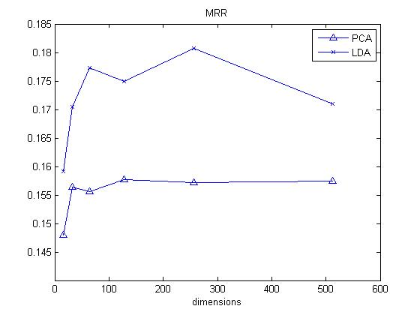
Results (average over 10 folds)

Slide 28
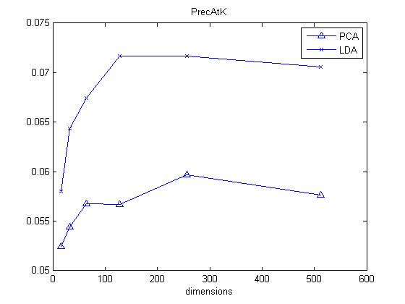
Results (average over 10 folds)

Slide 29
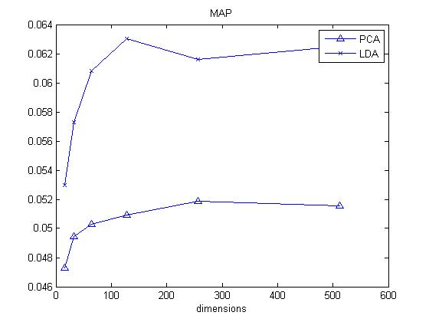
Comparison of LDA to PCA

Slide 30
Conclusion
LDA gives semantic interpretation for some topics but this is dependent on number of topics
Some topics are representative of genre and subject matter so using lyrics-based LDA features may be good for genre identification

Slide 31
Conclusion
LDA outperforms PCA for the song retrieval task but we have to learn α, β over a large representative dataset to obtain a good set of posterior features
15,000 songs may be too few to be a representative model since the dictionary has ~5000 words

Slide 32
Conclusion
The End

