Slide 1
Finding Errors in .NET with Feedback-Directed Random Testing
Carlos Pacheco (MIT)
Shuvendu Lahiri (Microsoft)
Thomas Ball (Microsoft)
July 22, 2008

Slide 2
Feedback-directed random testing (FDRT)
classes
under test
feedback-directed random test generator
failing
test cases
properties
to check

Slide 3
Feedback-directed random testing (FDRT)
classes
under test
feedback-directed random test generator
failing
test cases
properties
to check
java.util.Collections
java.util.ArrayList
java.util.TreeSet
java.util.LinkedList
...

Slide 4
Feedback-directed random testing (FDRT)
classes
under test
feedback-directed random test generator
failing
test cases
properties
to check
Reflexivity of equality:
∀ o != null : o.equals(o) == true
java.util.Collections
java.util.ArrayList
java.util.TreeSet
java.util.LinkedList
...

Slide 5
Feedback-directed random testing (FDRT)
classes
under test
feedback-directed random test generator
failing
test cases
properties
to check
Reflexivity of equality:
∀ o != null : o.equals(o) == true
public void test() {
Object o = new Object();
ArrayList a = new ArrayList();
a.add(o);
TreeSet ts = new TreeSet(a);
Set us = Collections.unmodifiableSet(ts);
// Fails at runtime.
assertTrue(us.equals(us));
}
java.util.Collections
java.util.ArrayList
java.util.TreeSet
java.util.LinkedList
...

Slide 6
Technique overview
Feedback-Directed Random Test Generation
Pacheco, Lahiri, Ball and Ernst
ICSE 2007
Creates method sequences incrementally
Uses runtime information to guide the generation
Avoids illegal inputs
error
revealing
exception
throwing
normal
output as tests
discarded
used to create larger
sequences

Slide 7
Prior experimental evaluation (ICSE 2007)
Compared with other techniques
Model checking, symbolic execution, traditional random testing
On collection classes (lists, sets, maps, etc.)
FDRT achieved equal or higher code coverage in less time
On a large benchmark of programs (750KLOC)
FDRT revealed more errors
Notes:
For coverage, discuss why the result. For errors, talk about the sparse sampling of very large space.

Slide 8
Goal of the Case Study
Evaluate FDRT’s effectiveness in an industrial setting
Error-revealing effectiveness
Cost effectiveness
Usability
These are important questions to ask about any test generation technique
Notes:
How would they use it? What will their requirements be? Enough to be adopted? Can create redundant tests
Can create illegal tests
May fail to create interesting tests

Slide 9
Case study structure
Asked engineers from a test team at Microsoft to use FDRT on their code base over a period of 2 months.
We provided
A tool implementing FDRT
Technical support for the tool (bug fixes bugs, feature requests)
We met on a regular basis (approx. every 2 weeks)
Asked team for experience and results

Slide 10
Randoop
.NET assembly
FDRT
Failing C# Test Cases
Properties checked:
sequence does not lead to runtime assertion violation
sequence does not lead to runtime access violation
executing process should not crash

Slide 11
Subject program
Test team responsible for a critical .NET component
100KLOC, large API, used by all .NET applications
Highly stable, heavily tested
High reliability particularly important for this component
200 man years of testing effort (40 testers over 5 years)
Test engineer finds 20 new errors per year on average
High bar for any new test generation technique
Many automatic techniques already applied

Slide 12
Discussion outline
Results overview
Error-revealing effectiveness
Kinds of errors, examples
Comparison with other techniques
Cost effectiveness
Earlier/later stages

Slide 13
Case study results: overview
Human time spent interacting with Randoop | 15 hours
CPU time running Randoop | 150 hours
Total distinct method sequences | 4 million
New errors revealed | 30

Slide 14
Error-revealing effectiveness
Randoop revealed 30 new errors in 15 hours of human effort.
(i.e. 1 new per 30 minutes)
This time included:
interacting with Randoop
inspecting the resulting tests
discarding redundant failures
A test engineer discovers on average 1 new error per 100 hours of effort.

Slide 15
Example error 1: memory management
Component includes memory-managed and native code
If native call manipulates references, must inform garbage collector of changes
Previously untested path in native code reported a new reference to an invalid address
This error was in code for which existing tests achieved 100% branch coverage

Slide 16
Example error 2: missing resource string
When exception is raised, component finds message in resource file
Rarely-used exception was missing message in file
Attempting lookup led to assertion violation
Two errors:
Missing message in resource file
Error in tool that verified state of resource file

Slide 17
Errors revealed by expanding Randoop's scope
Test team also used Randoop’s tests as input to other tools
Used test inputs to drive other tools
Expanded the scope of the exploration and the types of errors revealed beyond those that Randoop could find.
For example, team discovered concurrency errors this way

Slide 18
Discussion outline
Results overview
Error-revealing effectiveness
Kinds of errors, examples
Comparison with other techniques
Cost effectiveness
Earlier/later stages

Slide 19
Traditional random testing
Randoop found errors not caught by fuzz testing
Fuzz testing’s domain is files, stream, protocols
Randoop’s domain is method sequences
Think of Randoop as a smart fuzzer for APIs

Slide 20
Symbolic execution
Concurrently with Randoop, test team used a method sequence generator based on symbolic execution
Conceptually more powerful than FDRT
Symbolic tool found no errors over the same period of time, on the same subject program
Symbolic approach achieved higher coverage on classes that
Can be tested in isolation
Do not go beyond managed code realm

Slide 21
Discussion outline
Results overview
Error-revealing effectiveness
Kinds of errors, examples
Comparison with other techniques
Cost effectiveness
Earlier/later stages

Slide 22
The Plateau Effect
Randoop was cost effective during the span of the study
After this initial period of effectiveness, Randoop ceased to reveal errors
After the study, test team made a parallel run of Randoop
Dozens of machines, hundreds of machine hours
Each machine with a different random seed
Found fewer errors than it first 2 hours of use on a single machine

Slide 23
Overcoming the plateau
Reasons for the plateau
Spends majority of time on subset classes
Cannot cover some branches
Work remains to be done on new random strategies
Hybrid techniques show promise
Random/symbolic
Random/enumerative

Slide 24
Conclusion
Feedback-directed random testing
Effective in an industrial setting
Randoop used internally at Microsoft
Added to list of recommended tools for other product groups
Has revealed dozens more errors in other products
Random testing techniques are effective in industry
Find deep and critical errors
Scalability yields impact

Slide 25
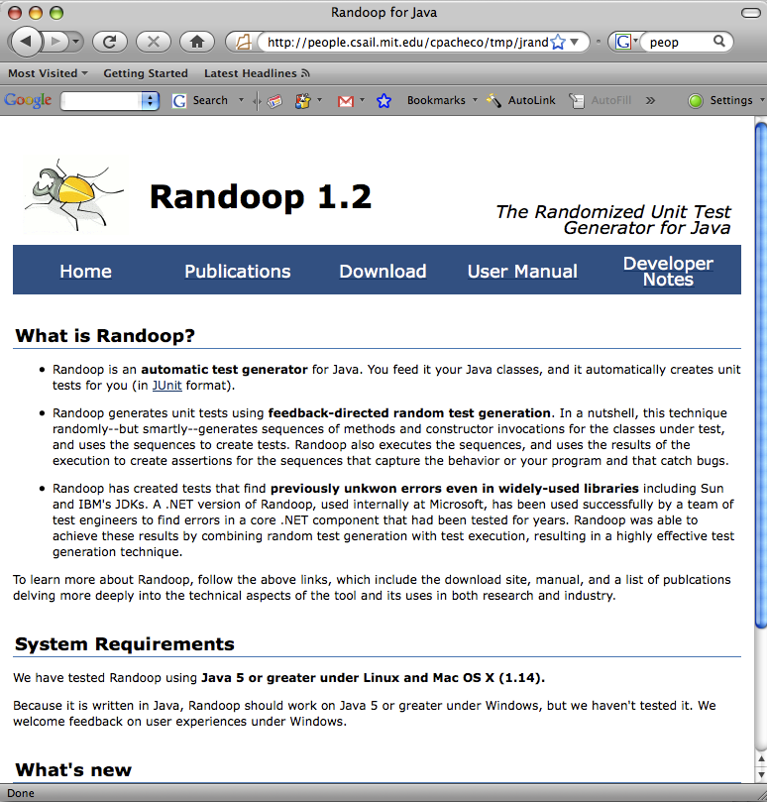
Randoop for Java
Google “randoop”
Has been used in research projects and courses
Version 1.2 just released

