Slide 1
Web User Profiling using Data Redundancy http://aminer.org/profiling
Xiaotao Gu, Hong Yang, Jie Tang, Jing Zhang
Tsinghua University
Notes:
1

Slide 2
Web User Profiling
using Data Redundancy
Introduction
Traditional Way
Basic Idea
MagicFG
Experiments
Conclusion

Slide 3
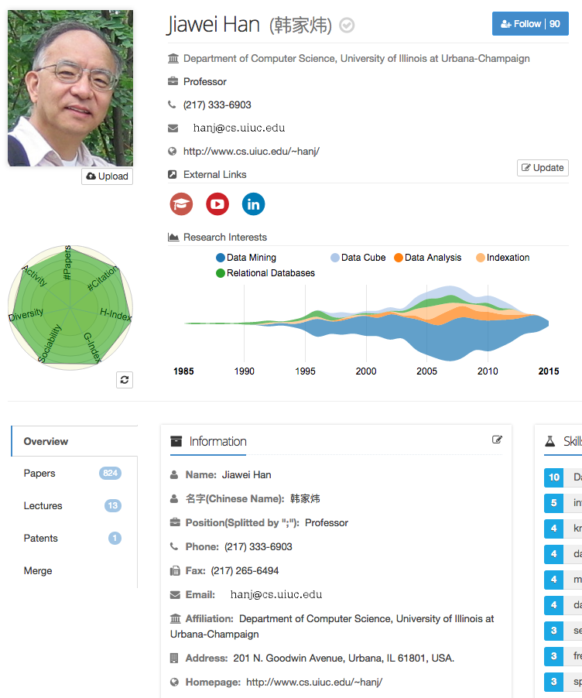
Position
Phone & Fax
Email
Homepage
Affiliation
Address
Expert Finding
Recommendation
Getting in Touch
…

Slide 4
Web User Profiling
using Data Redundancy
Introduction
Traditional Way
Basic Idea
MagicFG
Experiments
Conclusion

Slide 5
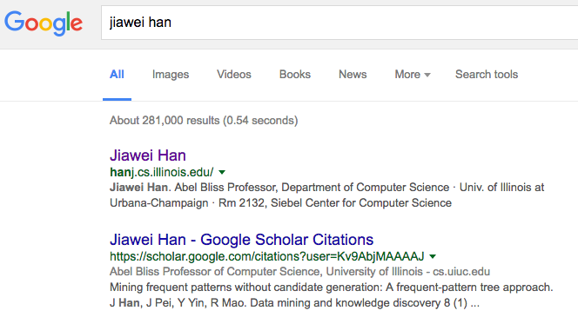
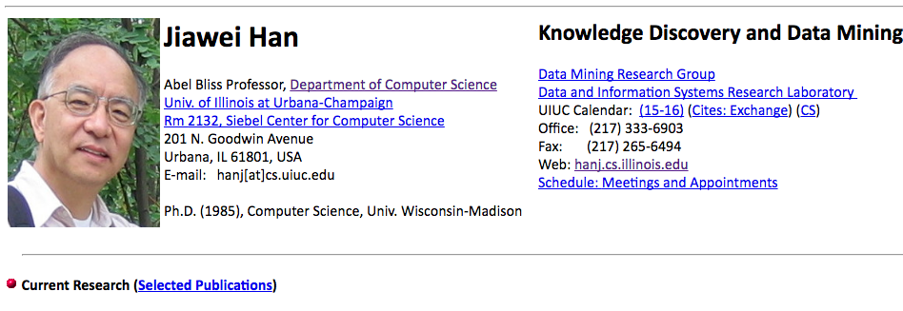
Traditional Way: Two-Step
Source Finding
Extraction

Slide 6
Traditional Way: Two-Step
Source Finding
Extraction
SVM
CRF
LR

Slide 7
Traditional Way: Two-Step
Low Recall – single data source
Low Precision – error propagation

Slide 8
Traditional Way: Two-Step
Low Recall – single data source
Low Precision – error propagation
Homepage Finding
Profile Extraction
Result
90%
*
90%
=
81%

Slide 9
Web User Profiling
using Data Redundancy
Introduction
Traditional Way
Basic Idea
MagicFG
Experiments
Conclusion

Slide 10
Basic Idea
A Uniform Framework
All in one step, avoiding error propagation
Incorporate information from different data sources: Homepage, Google Scholar, Twitter, Linkedin, Facebook, etc.

Slide 11
Basic Idea
A Uniform Framework
Search Engine as the data source

Slide 12
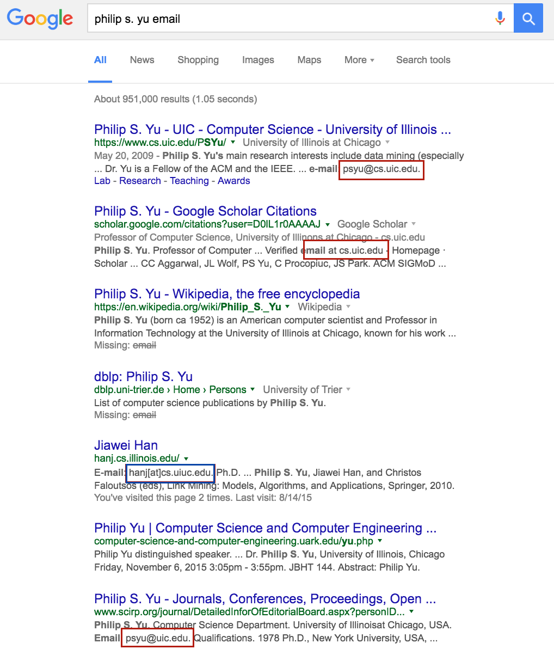
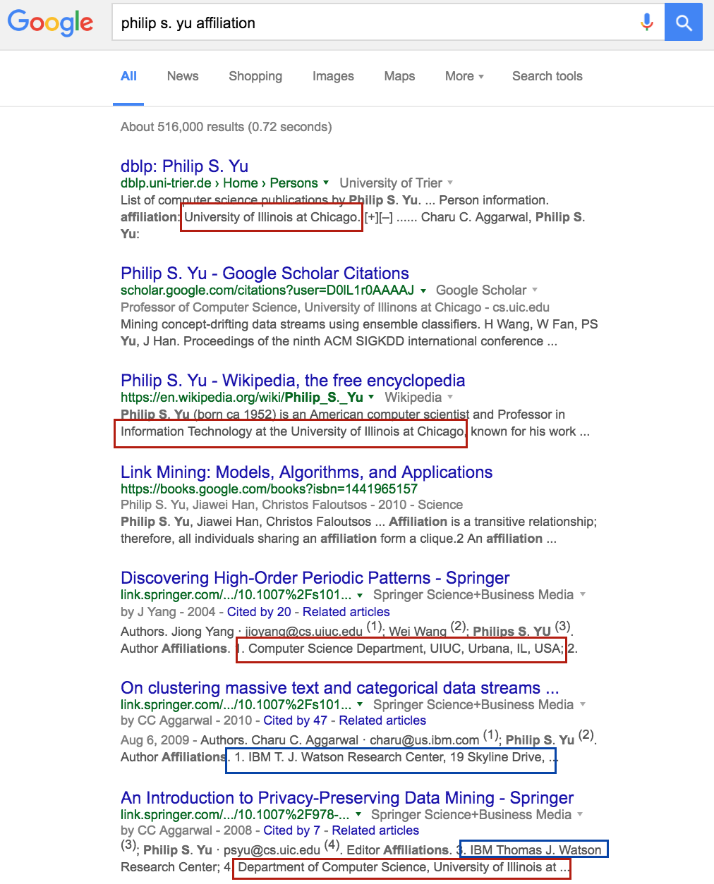
Basic Idea
Search Engine as Data Source

Slide 13
Basic Idea
- Search Engine as Data Source
Why snippets?
Efficient
Different from traditional methods that crawled each of the relevant pages, It is much faster and more stable, as different servers that host the relevant pages may have very different network speed.
Effective
we found with the constructed “smart” queries, more than 90% of the profile attributes are already contained in the snippets returned by the search engine.
Economical
One additional advantage is that we do not need to maintain a large database to record all the relevant pages for all the query persons. This is very important, as, for example, in AMiner, we have more than 130,000,000 researchers— maintaining such a big database for all researchers itself is a challenging task.

Slide 14
Basic Idea
A Uniform Framework
Search Engine as the Data Source
Smart Query Construction
Categorical : Gender, Position, Country…
Non-Categorical : Email, Affiliation, Address…
Profile Attributes

Slide 15
Query
Construction
Non-Categorical
Person_Name + Attribute_Name
Query = “Phillip S. Yu email”

Slide 16
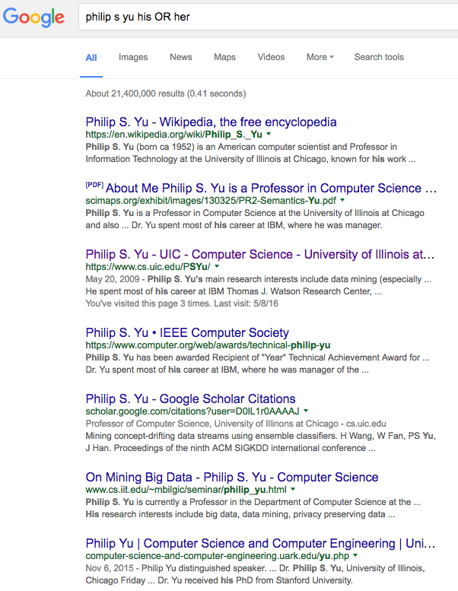
Query
Construction
Categorical
Person_Name
+ Representative Words
Query = “Phillip S. Yu his OR her”

Slide 17
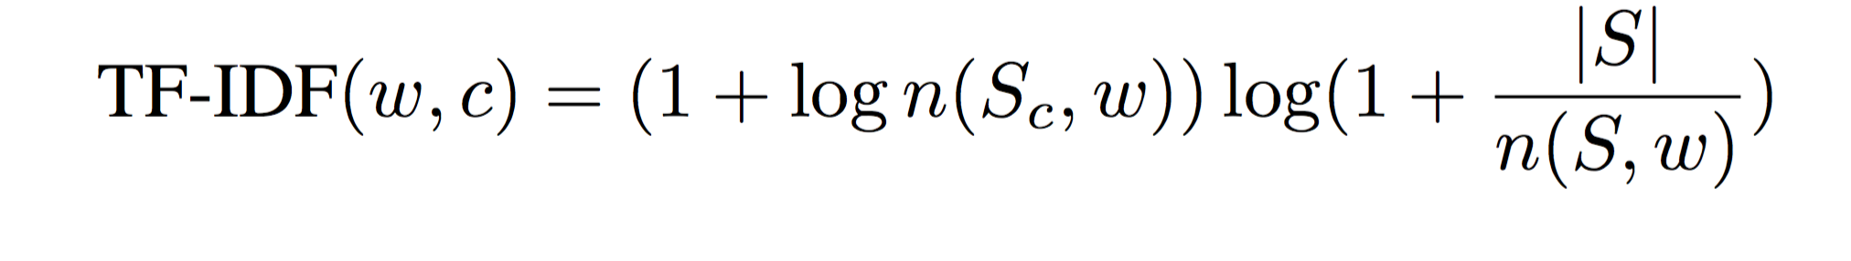
Representative Words
Male
Female
“his”
“her”
“he”
“he”
“…”
“…”
Query = “Phillip S. Yu his OR her”

Slide 18
Basic Idea
A Uniform Framework
Search Engine as the Data Source
Smart Query Construction
Basic Classification

Slide 19
Feature Definition
Email
First name in prefix
Last name in prefix
Initials in prefix
…
Gender
How many “his”
How many “her”
…

Slide 20
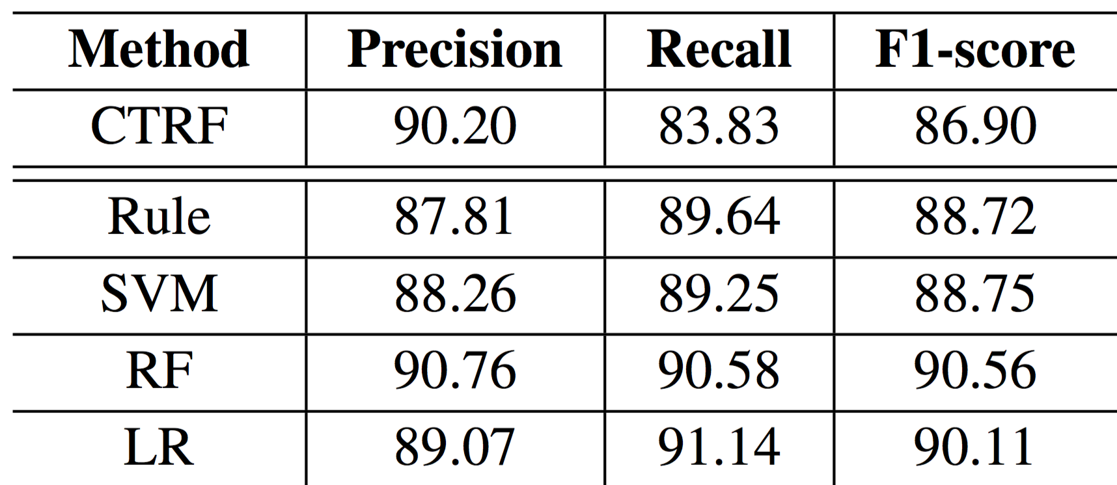
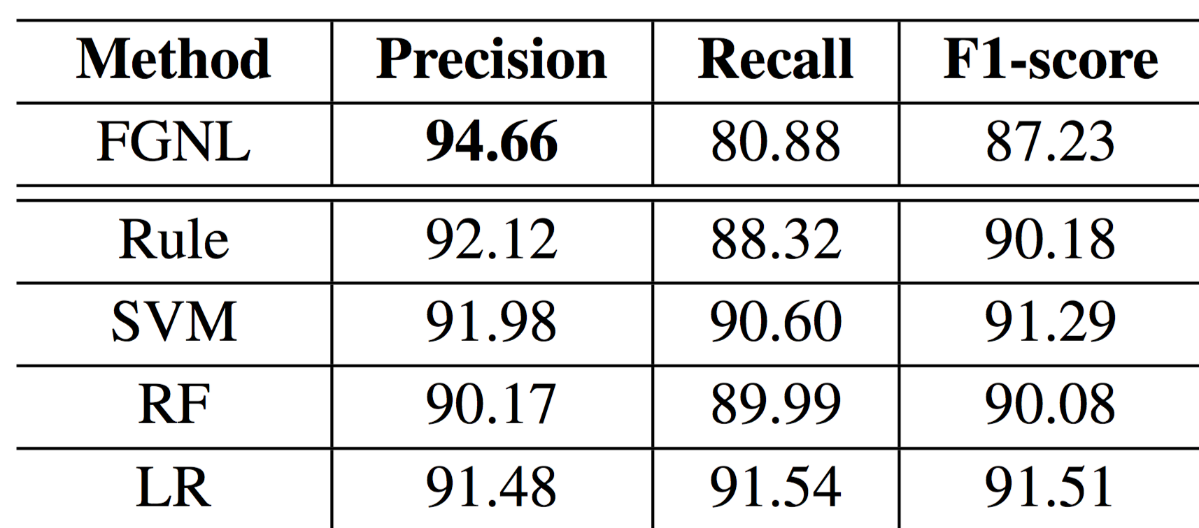
Basic Classification
Email
Gender
Uniformly outperform the baselines (CTRF, FGNL)

Slide 21
Web User Profiling
using Data Redundancy
Introduction
Traditional Way
Basic Idea
MagicFG
Experiments
Conclusion

Slide 22
MagicFG
- Markov Logic Factor Graph
Data Redundancy
Logic Factors
More Accurate Classification

Slide 23
Why logic factors?
Depict and utilize correlations between possible candidates from redundant data.
Incorporate human knowledge to guide and amend the classification model.

Slide 24
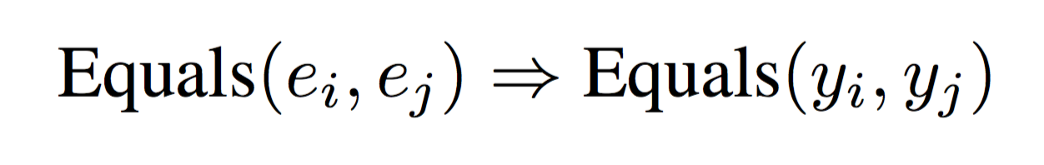
Logic Factors
Complete Consistency
Two same vertices must share the same label.
psyu@cs.uic.edu
psyu@cs.uic.edu
True
True
OR
psyu@cs.uic.edu
psyu@cs.uic.edu
False
False

Slide 25
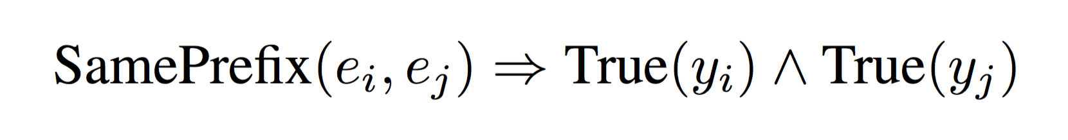
Logic Factors
Partial Consistency
Two similar vertices probably share the same (preferred) label.
e.g. Two Emails sharing the same prefix are probably both credible for the target user.
psyu@cs.uic.edu
probably
psyu@uic.edu
True
True

Slide 26
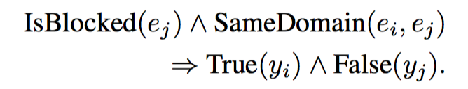
Logic Factors
Prior Knowledge
Some prior knowledge can be converted to logic factors.
e.g. Some Email addresses are modified (blocked) for some reason, whose domains are still visible and credible. Emails with the same domain with a blocked one are probably valid.
email@cs.uic.edu
probably
psyu@uic.edu
Blocked
True

Slide 27
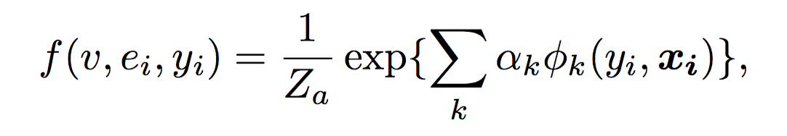
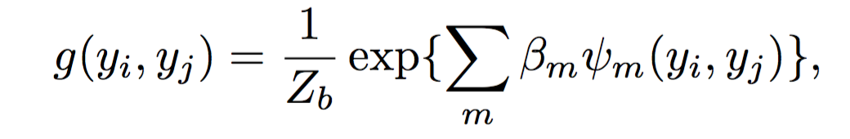
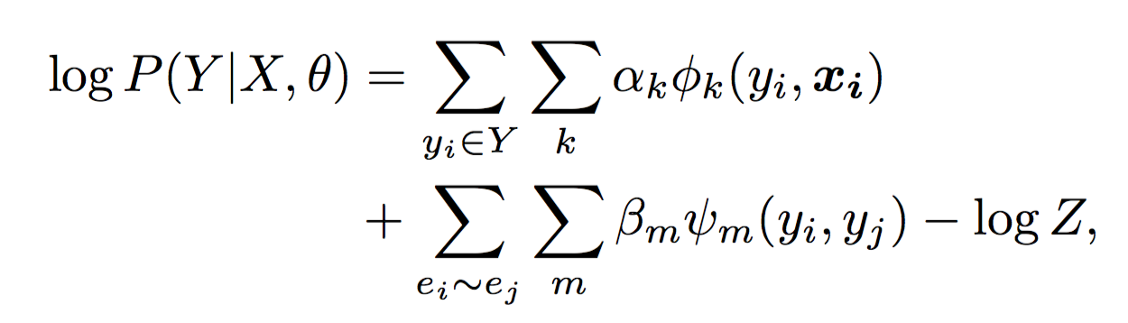
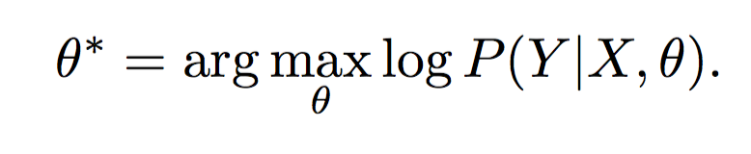
Markov Logic Factor Graph
Attribute factor function
Logic factor function
Log-likelihood function
Target parameter

Slide 28
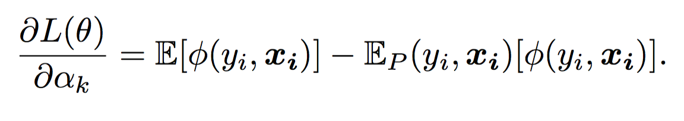
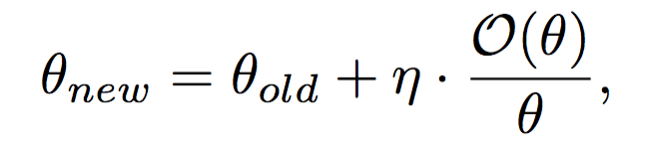
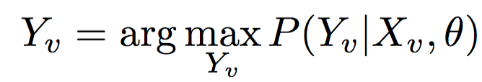
Markov Logic Factor Graph
Training: Gradient Ascent
Gradient:
Learning:
Classification:

Slide 29
Web User Profiling
using Data Redundancy
Introduction
Traditional Way
Basic Idea
MagicFG
Experiments
Conclusion

Slide 30
Accuracy Performance
Comparison between MagicFG and state-of-the-art methods for Email and Gender extraction
Email
Gender

Slide 31
Accuracy Performance
Logic factors do help!
Email
Gender

Slide 32
Web User Profiling
using Data Redundancy
Introduction
Traditional Way
Basic Idea
MagicFG
Experiments
Conclusion

Slide 33
Conclusion
Motivation
To solve the problem of low recall and error propagation in traditional two-step methods.
Basic Idea
Search engine as the data source.
MagicFG
Utilize correlations in redundant data.
Incorporate human knowledge

Slide 34
Thank you!
Code & Data
http://aminer.org/profiling
Notes:
34

