Slide 1
Galactic Grease Monkey
Group 1
Jason Gill
Ryan Taban
Zihao Xie
Luan Nguyen
2022.11.30

Slide 2

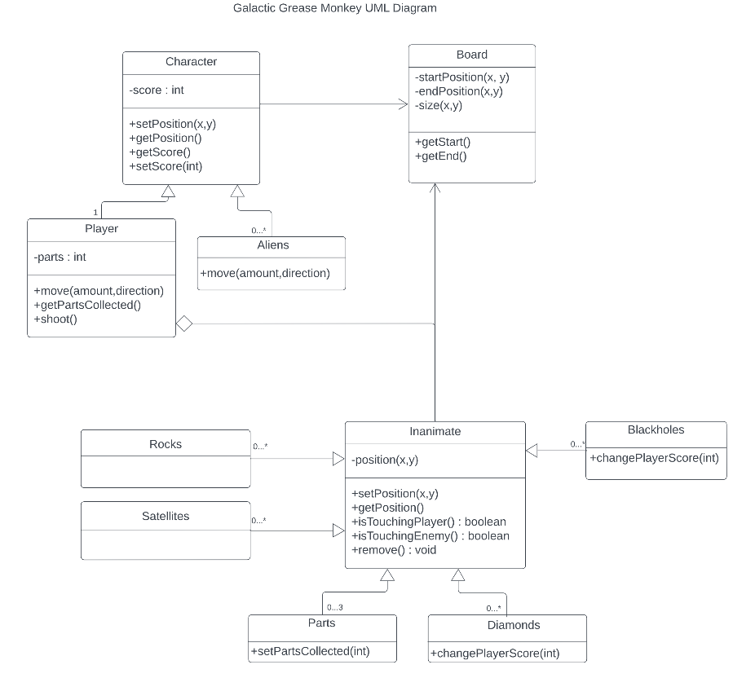
Original UML

Slide 3
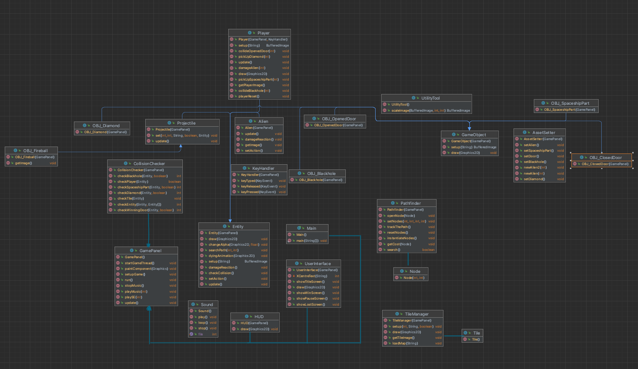
Final UML

Slide 4
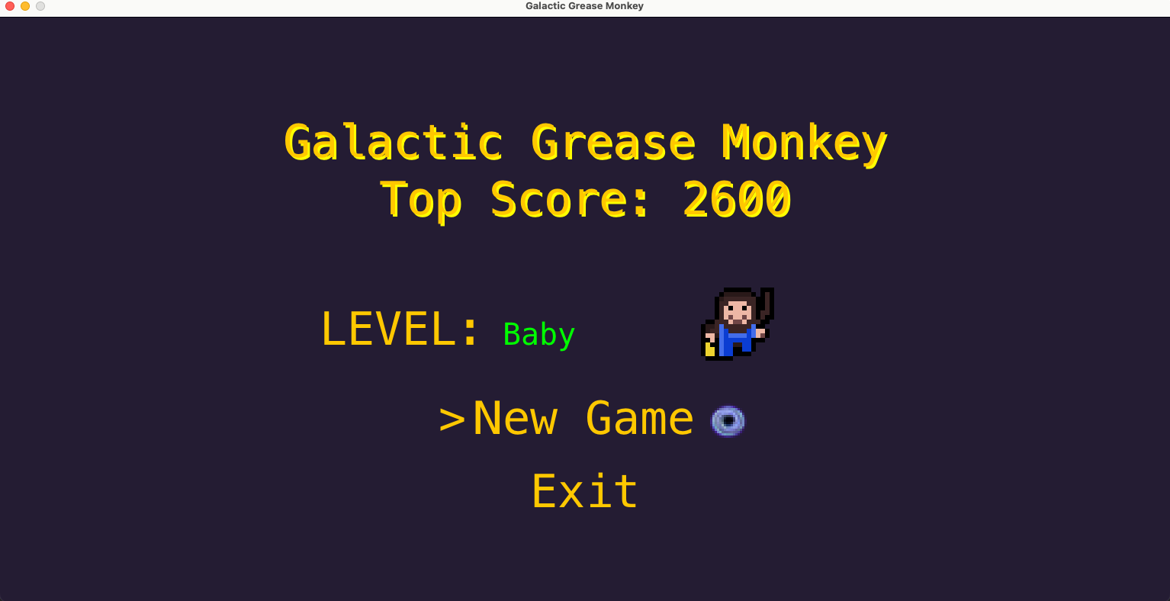
Game Design

Slide 5
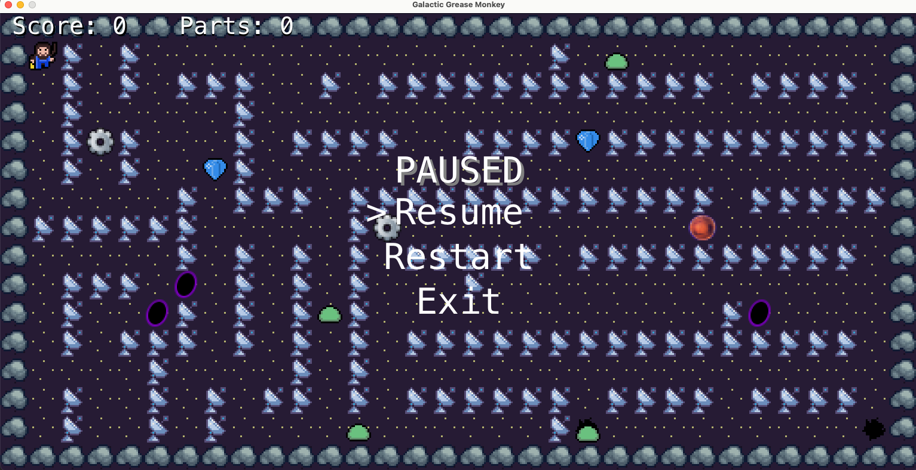
Game Design

Slide 6
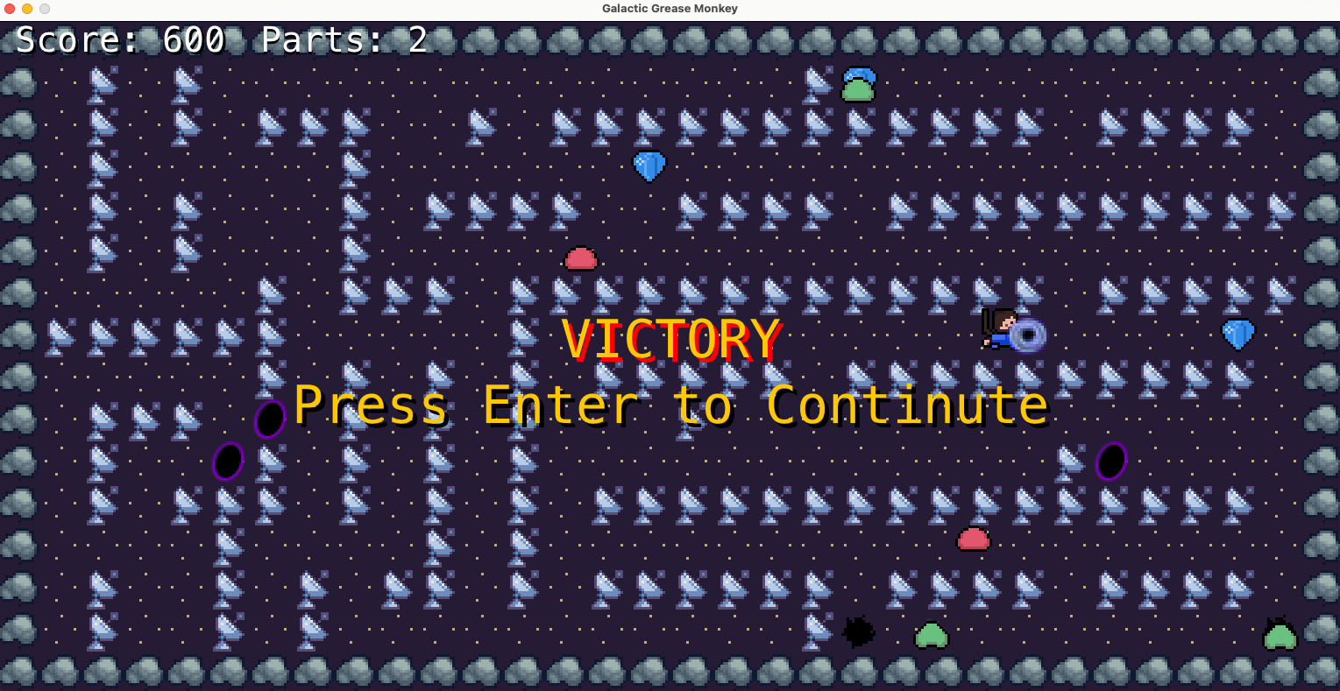
Game Design

Slide 7
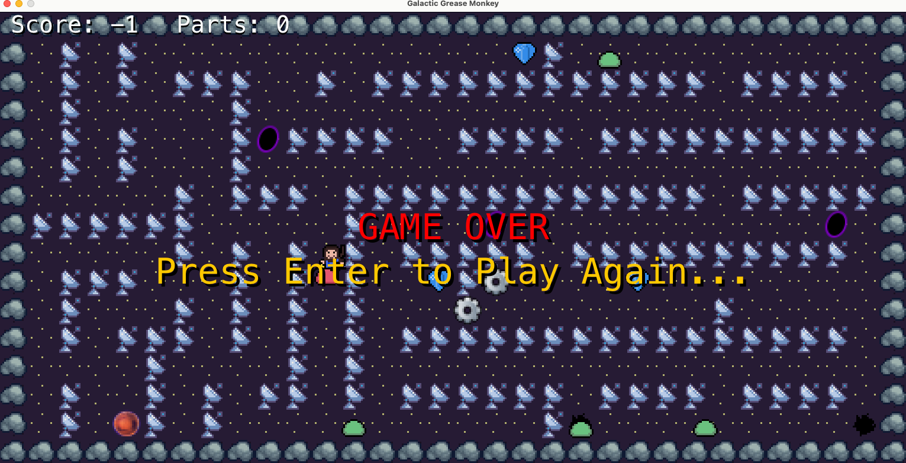
Game Design

Slide 8
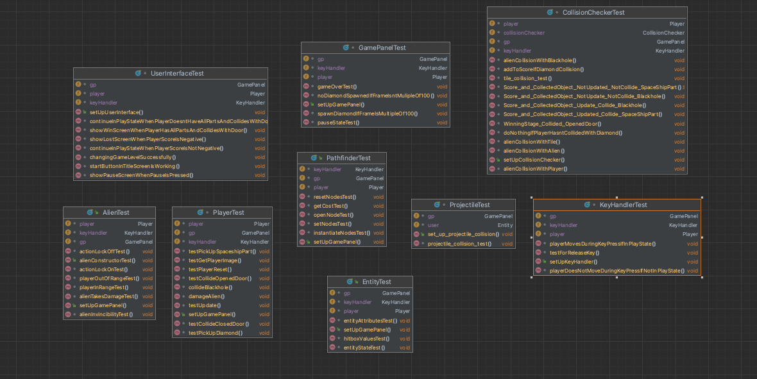
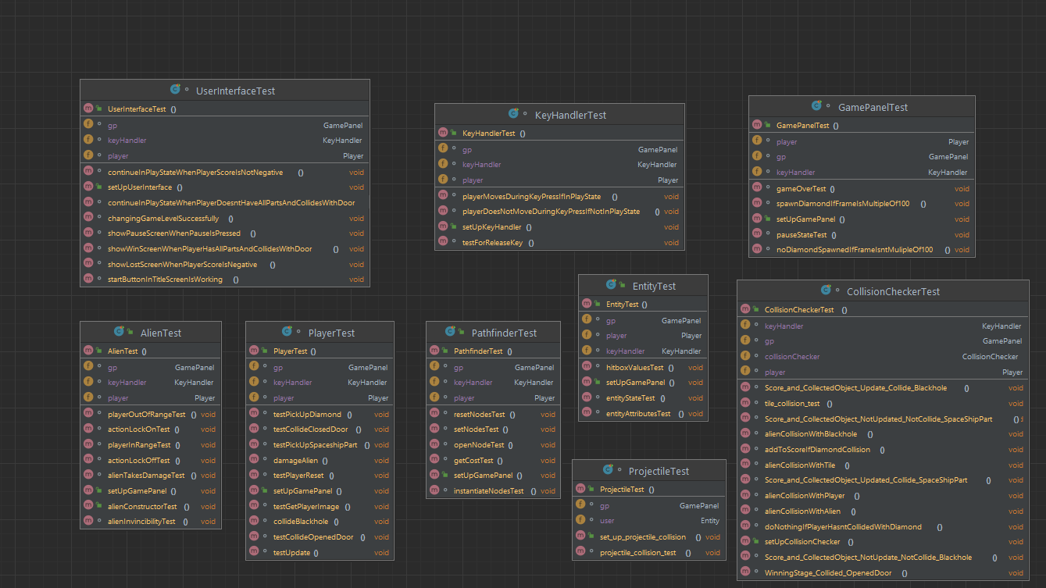
Testing Implementation

Slide 9
Team Management
Adequate communication
Set realistic deadlines and include buffer time
Having a unified understanding of the development process

Slide 10
Challenges
General and Technical
General:
Scheduling conflicts
lack of experience in game development
Technical:
Fixing buggy collision detection

Slide 11
Lessons learned
Formatting our code
How to work in a group environment
How to design a project from the ground (E.g. UML diagrams, hierarchies, etc)

Slide 12
DEMO

