Slide 1

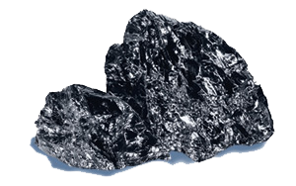
SILICON
The second most abundant element on the Earth

Slide 2
SEMICONDUCTORS
Conductivity changes based on the environment (light, heat, electric currents and fields)
Medium-size band gap: electrons can jump in the higher energy level, so the current can flow

Slide 3

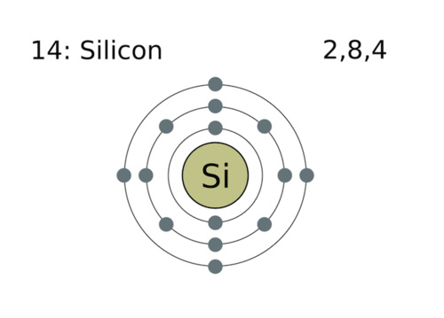
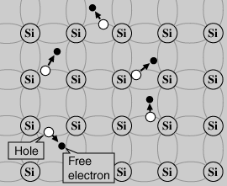
INTRINSIC SEMICONDUCTOR
The purest form in nature
Four valence electrons
It creates covalent bonds
Bonds are broken through temperature increasing
When bonds are broken, electron can flow current
Free electron leaves a positively charged empty space (hole)

Slide 4
EXTRINSIC SEMICONDUCTOR
Impurities (dopers) added to intrinsic create extrinsic, through a process called doping
Impurities improve conductivity
They are divided in p-type (trivalent) and n-type (pentavalent)

Slide 5
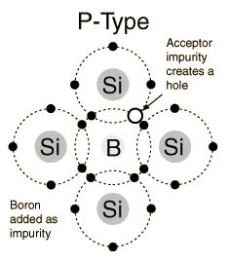
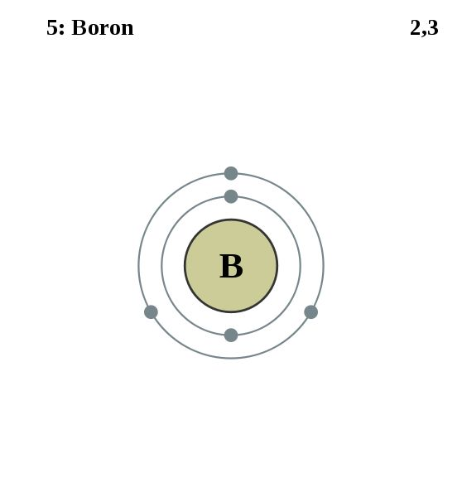

Slide 6
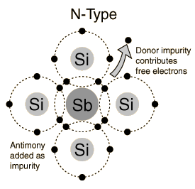
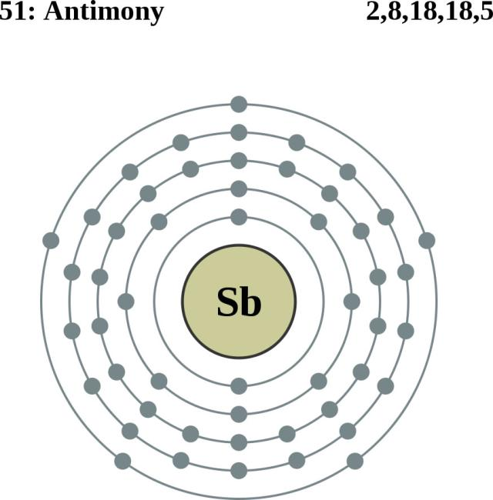

Slide 7

THANKS FOR THE ATTENTION
Ricci Andrea – Rege Cambrin Daniele

