Slide 1
TDAL_TS

Slide 2
TDAL_TS Overview
TDAL_TS manages transport stream stage of a set-top-box especially in a PVR context.
In a non PVR context, only a minimal implementation of TDAL_TS is needed.
The driver interface to manage a complete PVR application (Live, Watch’n’record, Time shifting, Trick modes …), must be of type TS producer/TS consumer.
With double tuner, PVR, IP connection platform capabilities, TS routing within a STB/OBM must identify who is the TS producer and who is the TS consumer.
NOTE: Under this training, we only describe a non PVR implementation.

Slide 3
TDAL_TS Modules
TDAL_TSROUTE:
  It gives for a client application the way to manage connections between TS inputs (tuner front-end, software entry, …) and demultiplexers.
  Only, this part must be implemented in a non PVR context.
TDAL_TSSOURCE:
  It gives for a client application the way to provide a TS coming from any kind of source (demux, HDD, IP connection, …) and can handle each kind of sources constraints and specificities.
  This part must be implemented in a PVR context.
TDAL_TSSINK:
  It gives for a client application the way to make use of a TS and link it to a producer (previously defined and configured through TDAL_TSSOURCE API calls). This driver can handle different kind of destination (Live i.e. to the MPEG decoder or memory to be written on a HDD for instance).
  This part must be implemented in a PVR context.

Slide 4
TDAL_TS Objects
The concept of TDAL_TS object is used to allow TDAL_TS modules to discuss together.
A TDAL_TS object represents different types of hardware piece (tuner, demux, memory buffer, IEEE1394) instance.
This instance is also classified as a source or destination.
TDAL_TS supports only a mono audio/video decoding platform. This implies that only one source memory buffer object instance 0 is available.
The destination demux object instance 0 is the demux which feeds the audio/video decoding hardware pieces.
The destination demux object instance 1 to n are the demuxes which are used to TDAL_TSOURCE extraction sessions.

Slide 5
TDAL_TS Objects Class, Type and coding
Object class
  An enumeration of the different object class.
  enum {
  eTDAL_TS_CLASS_SOURCE = 0 ,
  eTDAL_TS_CLASS_DESTINATION
  };
Object type
  An enumeration of the different object type.
  enum {
  eTDAL_TS_TYPE_TUNER = 0,
  eTDAL_TS_TYPE_IEEE1394 ,
  eTDAL_TS_TYPE_MEMORY ,
  eTDAL_TS_TYPE_DEMUX
  };
Coding (16 bit)
  bit[0..3] : instance
  bit[4..11] : type
  bit[12..15] : class
Examples:
  Tuner 0 = 0x0000
  Demux1 = 0x1031

Slide 6
TDAL_TS Objects Manipulation Macros
MACROS | DESCRIPITION
mTDAL_TS_GetObjectId(class , type, instance) | Get the object from its class, type and instance.
mTDAL_TS_GetObjectClass( object ) | Get the class (source or destination) of a TDAL_TS object.
mTDAL_TS_GetObjectType( object ) | Get the type (tuner, demux, memory, IEEE1394) of a TDAL_TS object.
mTDAL_TS_GetObjectInstance( object ) | Get the instance (0,…,n) of a TDAL_TS object

Slide 7
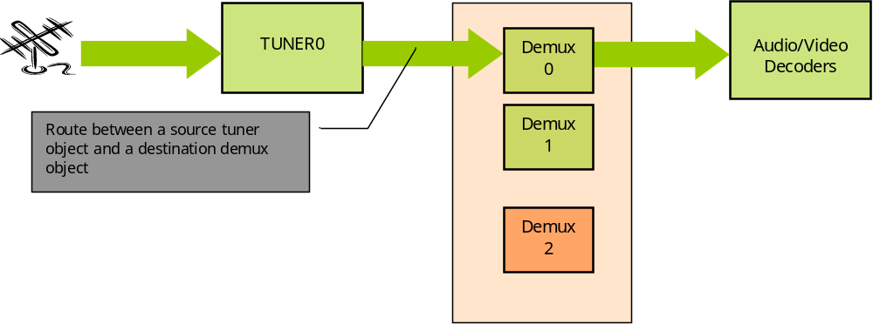
TDAL_TS Basic Zapper Overview
Watch a live program in a non PVR context

Slide 8
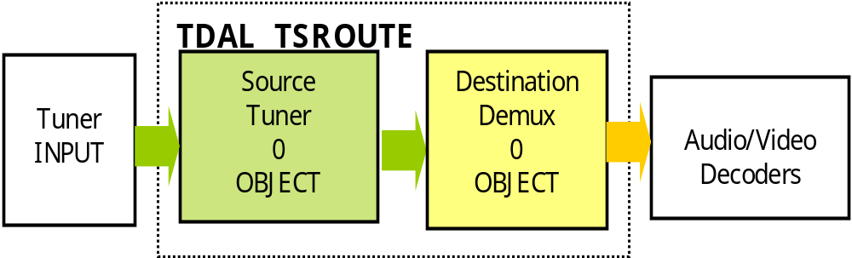
TDAL_TSROUTE Basic Zapper Objects
Basic Zapper Platform (Non PVR)

Slide 9
TDAL_TS Generic
Function list:
Function | Description
TDAL_TS_APIRevisionGet(-) | Retrieves the API revision
TDAL_TS_PlatformRevisionGet(-) | Retrieves the platform implementation revision

Slide 10
TDAL_TSROUTE
Function list:
Function | Description
TDAL_TSROUTE_Init(-) | Initialize the TDAL_TSROUTE module.
TDAL_TSROUTE_Term(-) | Terminate the TDAL_TSROUTE module.
TDAL_TSROUTE_GetCapabilities(-) | Get the capabilities of the current implementation of TDAL_TSROUTE module.
TDAL_TSROUTE_Connect(-) | Connect a source object and a destination object.
TDAL_TSROUTE_Disconnect(-) | Disconnect a source object and a destination object.
TDAL_TSROUTE_GetStatus(-) | Get the status of an object (The total number of transport packets received on connected object)

Slide 11
TDAL_TS documentation
Let’s go now deeper in “TDAL_TS Specification.doc”

