Slide 1
Mstar eCos application
Sidney Chang
2010.7.22

Slide 2
Agenda
Program the boot loader (MBoot)
Build the application
Update the application
  From USB flash disk
  From TFTPD

Slide 3
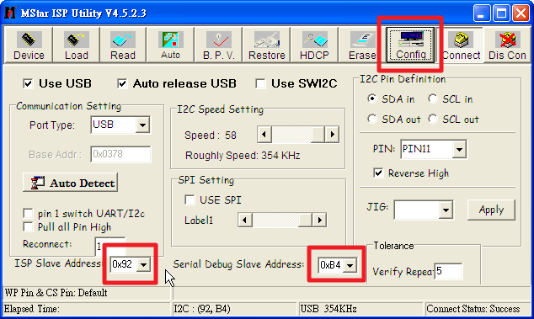
MBoot → Mstar ISP tool (1)
Config

Slide 4
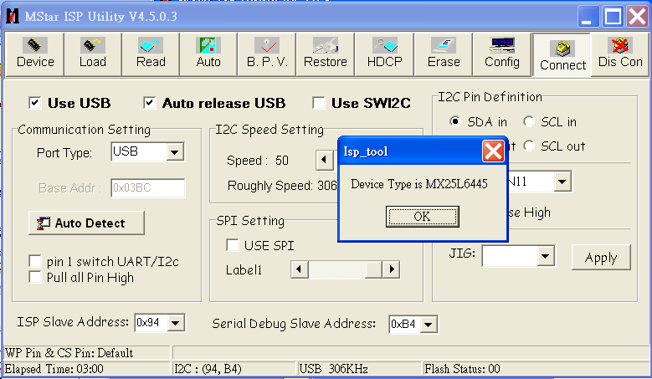
MBoot → Mstar ISP tool (2)
Connect

Slide 5
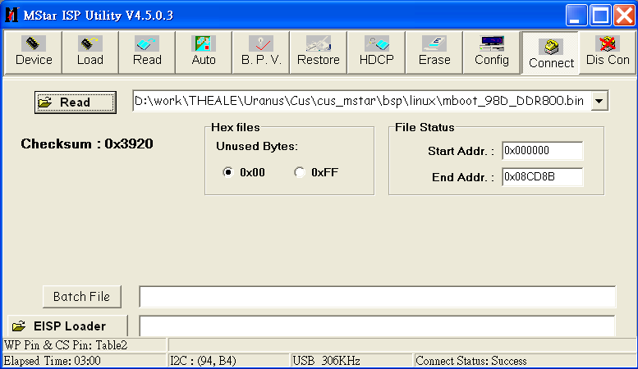
MBoot → Mstar ISP tool (3)
MBoot image
  …/ddi_pkg_ecos/bsp/ecos/K1_Mbootbin/mboot_BD_MST124A_D01A_S.bin

Slide 6
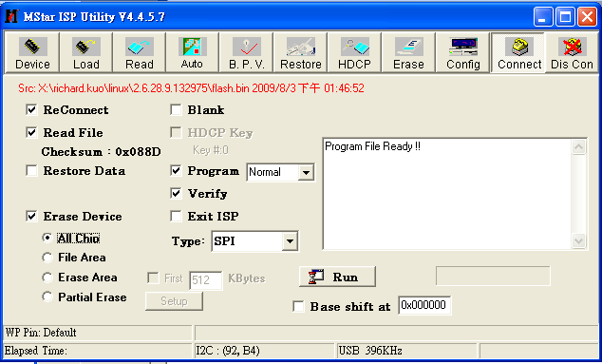
MBoot → Mstar ISP tool (4)
Write flash
Start to write flash

Slide 7
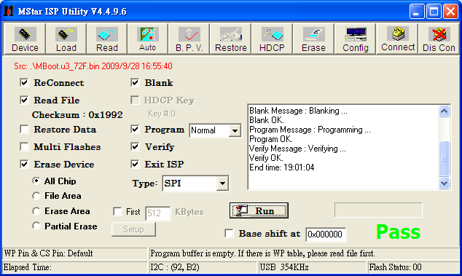
MBoot → Mstar ISP tool (5)
Write flash done

Slide 8
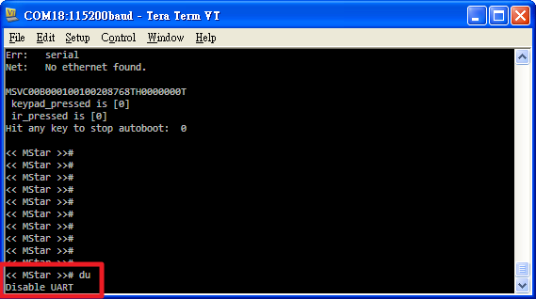
MBoot → Mstar ISP tool (5)
If connect or write flash fail, please perform the following steps
  Press down the “Enter” while booting
  Execute the command “du”
    << MStar >># du
  Un-Check the Re-Connect check box in ISP tool
  Repeat the procedure again (1~5)

Slide 9
Build the application → make
cd …/ddi_pkg_ecos/cus_mstar/project/mstar_demo
Edit the file “config”
  Select the CFG_BOARD and CFG_DVB_TYPE
make
Application → bin/k1_ecos.bin

Slide 10
Update the application from USB disk
Copy \ddi_pkg_ecos\bsp\ecos\tftp_root\usb_update\Target folder to USB disk.
Copy k1_ecos.zip file to Target\image
Replace Target\script\parameters.txt with \ddi_pkg_ecos\bsp\ecos\tftp_root\parameters.txt
Insert USB and reboot target board.
Execute the following commands on mBoot.
    << MStar >># usb start
    << MStar >># ustar usb_auto_update.txt
Remove USB after successfully update.

Slide 11
Update the application from TFTPD
Set TFTPD folder to \ddi_pkg_ecos\bsp\ecos\tftp_root
Set up serverip and ipaddr in mBoot.
    << MStar >># setenv serverip <TFTPD IP Addr>
    << MStar >># setenv ipaddr <Target IP Addr>
    << MStar >># saveenv;reset
Execute the following command
    << MStar >># mstar
Done.

