Slide 1
TDAL_OUTPUT

Slide 2
TDAL_OUTPUT Overview
control audio/video output stage of a set-top-box or of a TV set.
divide in several sub-parts in order to control different kinds of output:
  Video Analogue (DENC, HD DAC)
  Video Digital (HDMI, , video digital bus)
  Audio analogue
  Audio digital (SPDIF)
  RF modulator

Slide 3
TDAL_Output Identifiers
The output identifier tTDAL_OUTPUT_OutputId is the way used by an application to access in a single way a specific output in the list of available output.
The output identifier itself holds its own type (DENC, HD DAC, HDMI, Audio analogue, audio SPDIF).
  typedef enum
  {
  eTDAL_OUTPUT_VIDEO_DENC_ID_0,
  eTDAL_OUTPUT_VIDEO_DENC_ID_1,
  eTDAL_OUTPUT_VIDEO_DENC_ID_2,
  eTDAL_OUTPUT_VIDEO_HD_DAC_ID_0,
  eTDAL_OUTPUT_VIDEO_HD_DAC_ID_1,
  eTDAL_OUTPUT_VIDEO_HD_DAC_ID_2,
  eTDAL_OUTPUT_HDMI_ID_0,
  eTDAL_OUTPUT_HDMI_ID_1,
  eTDAL_OUTPUT_HDMI_ID_2,
  eTDAL_OUTPUT_AUDIO_ANA_ID_0,
  eTDAL_OUTPUT_AUDIO_ANA_ID_1,
  eTDAL_OUTPUT_AUDIO_ANA_ID_2,
  eTDAL_OUTPUT_AUDIO_HEADPHONE,
  eTDAL_OUTPUT_AUDIO_SPDIF_ID_0,
  eTDAL_OUTPUT_AUDIO_SPDIF_ID_1,
  eTDAL_OUTPUT_AUDIO_SPDIF_ID_2,
  eTDAL_OUTPUT_RF_MOD_ID_0,
  eTDAL_OUTPUT_RF_MOD_ID_1,
  eTDAL_OUTPUT_RF_MOD_ID_2,
  eTDAL_OUTPUT_VIDEO_DIGTIAL_ID_0,
  eTDAL_OUTPUT_VIDEO_DIGITAL_ID_1,
  eTDAL_OUTPUT_VIDEO_DIGITAL_ID_2
  } tTDAL_OUTPUT_OutputId;
  ;

Slide 4
TDAL_OUTPUT Generic
Function List:
Function | Description
TDAL_OUTPUT_Init(-) | Initialize the TDAL_OUTPUT module
TDAL_OUTPUT_Term(-) | Terminate the TDAL_OUTPUT module
TDAL_OUTPUT_CapabiltyGet(-) | Get the capabilities of the current implementation of TDAL_OUTPUT module
TDAL_OUTPUT_APIRevisionGet(-) | Get API revision
TDAL_OUTPUT_PlatformRevisionGet(-) | Get Platform revision
TDAL_OUTPUT_Enable(-) | Enable a specific output with its identifier
TDAL_OUTPUT_Disable(-) | Disable a specific output with its identifier

Slide 5
TDAL_OUTPUT Video Analogue Outputs
The video analogue Outputs is the last stage of video processing.
It consists of grouping of the following hardware modules:
  The DENC module converts the digital video uncompressed stream coming from one or several Blenders into a standard analogue video signals (Y/C, CVBS, RGB).
  The HD DAC module converts the digital video uncompressed stream coming from one or several Blenders into a standard high definition analogue video signals (YUV or RGB).
There can be more than one video analogue Output stage in a set-top-box depending on dual TV capability.

Slide 6
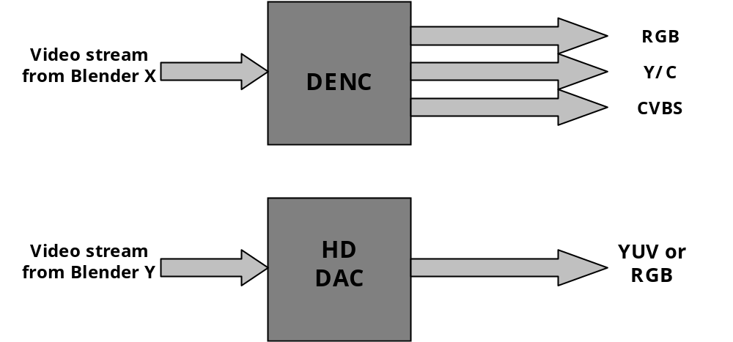
TDAL_OUTPUT Video Analogue Outputs
The following diagram shows the different module that an analogue video output stage can have:

Slide 7
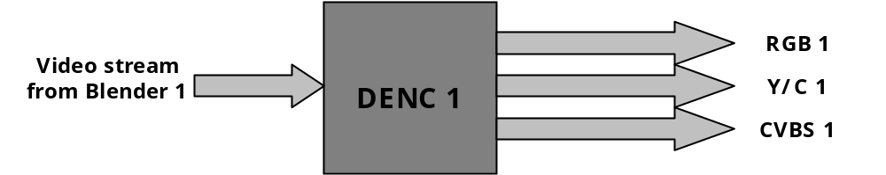
TDAL_OUTPUT Video Analogue Outputs
Example: Single video decode with single video analogue output DENC stage :

Slide 8
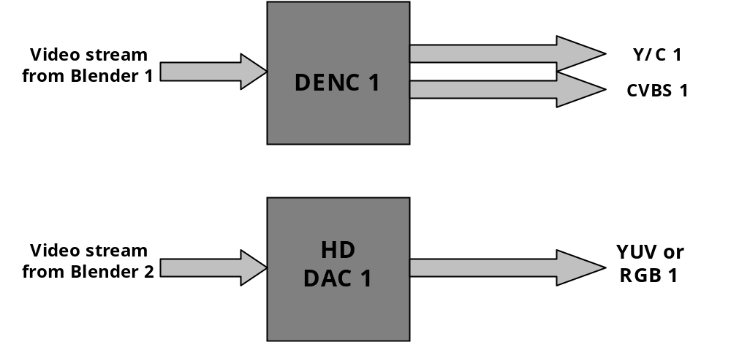
TDAL_OUTPUT Video Analogue Outputs
Example: Single video decode with video analogue output DENC and HD DAC stage:

Slide 9
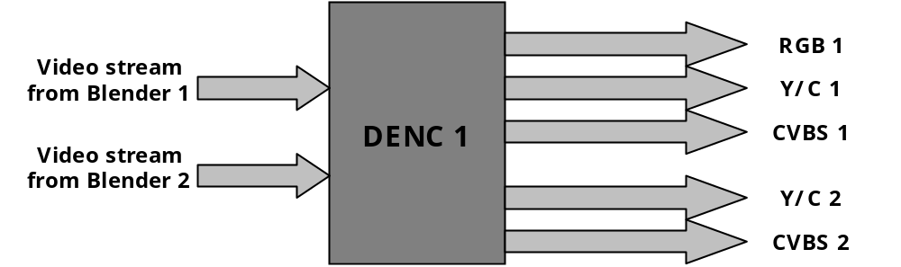
TDAL_OUTPUT Video Analogue Outputs
Example: Dual decode with single video analogue output DENC stage:

Slide 10
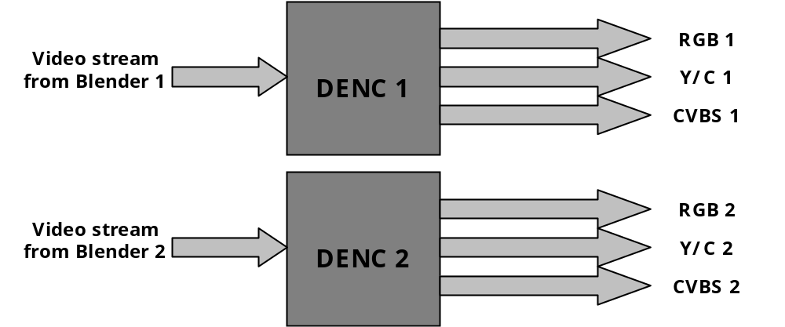
TDAL_OUTPUT Video Analogue Outputs
Example: Dual decode with dual video analogue DENC stages :

Slide 11
TDAL_OUTPUT Video Analogue Outputs
DENC Function list:
Function | Description
TDAL_OUTPUT_VideoDencCapabilityGet(-) | get the capabilities of a specific DENC output
TDAL_OUTPUT_VideoDencStandardSet(-) | set a video standard (PAL, SECAM, NTSC, …) of a specific DENC output
TDAL_OUTPUT_VideoDencFormatSet(-) | set a video format (CVBS, YC, RGB, …) of a specific DENC output
TDAL_OUTPUT_VideoDencColorBarControl(-) | control the colour bar test pattern of a specific DENC output
TDAL_OUTPUT_VideoDencBCSParamsSet(-) | set the video brightness/contrast/saturation of a specific DENC output

Slide 12
TDAL_OUTPUT Video Analogue Outputs
HD DAC Function list:
Function | Description
TDAL_OUTPUT_VideoHDDACCapabilityGet(-) | get the capabilities of a specific HD DAC output
TDAL_OUTPUT_VideoHDDACParamsSet(-) | set the parameters (colour space, HD standard, format RGB or YCbCr, …) of a specific HD DAC

Slide 13
TDAL_OUTPUT Video Digital Outputs
The video digital Outputs is the last stage of video processing.
It consists of grouping of the following hardware modules:
  The HDMI/DVI module which is directly connected to a blender.
  The Digital Video output which is directly connected to a blender
There can be more than one video digital Output stage in a set-top-box depending on dual TV capability.

Slide 14
TDAL_OUTPUT Video Digital Outputs
Function list:
Function | Description
TDAL_OUTPUT_HDMICapabilityGet(-) | get the capabilities of a specific HDMI output
TDAL_OUTPUT_HDMIParamsSet(-) | the set the parameters (format RGB888, YCbCr422 or YCbCr444, HD standard and audio compressed or not compressed mode) of a specific HDMI output
TDAL_OUTPUT_VideoDigitalCapabilityGet(-) | get the capabilities of a specific video digital output
TDAL_OUTPUT_VideoDigitalParamsSet(-) | the set the parameters (format RGB888 or YCbCr444, HD standard mode) of a specific video digital output

Slide 15
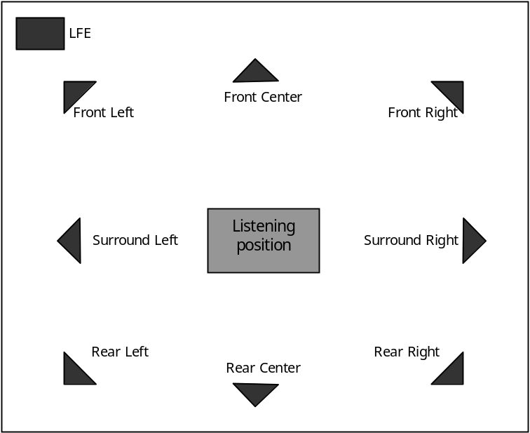
TDAL_OUTPUT Audio Analogue Outputs
The audio analogue output is responsible for converting the digital PCM stream coming from an audio decoder into a set of audio signals.
Audio analogue part is capable of supporting 8.1 speaker system as shown in the following diagram:

Slide 16
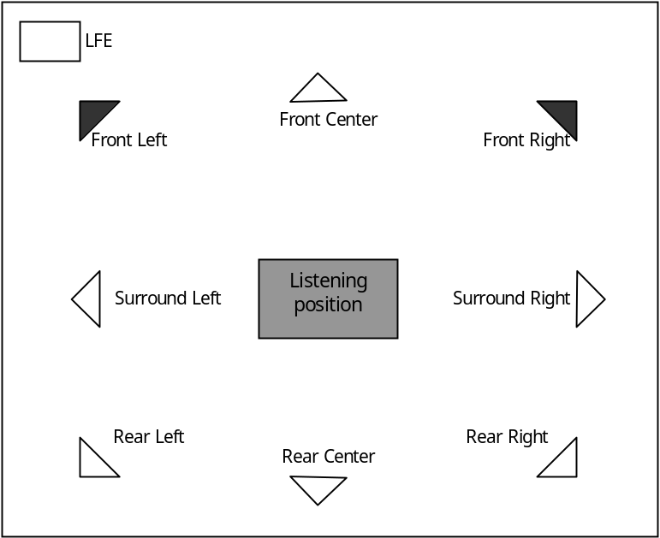
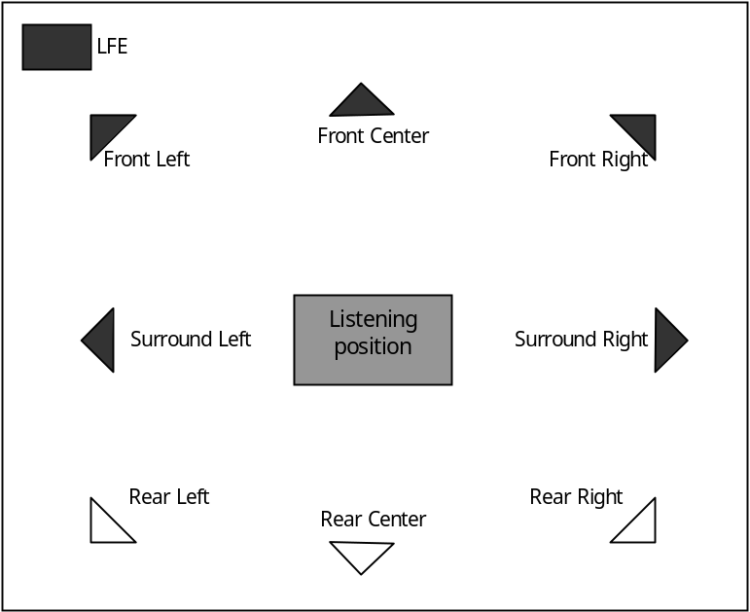
TDAL_OUTPUT Audio Analogue Outputs
Various configurations are possible depending of use cases. Here are some use case examples:
2.0 speaker system:
5.1 speaker system :

Slide 17
TDAL_OUTPUT Audio Analogue Outputs
Function list:
Function | Description
TDAL_OUTPUT_AudioAnaCapabilityGet(-) | get the capabilities of a specific audio analogue output
TDAL_OUTPUT_AudioAnaSpeakerParamsSet(-) | set the speaker parameters (type large, small or none) of a specific audio analogue output
TDAL_OUTPUT_AudioAnaSpeakerAttenuationSet(-) | set the speaker volume attenuation of a specific audio analogue output
TDAL_OUTPUT_AudioAnaSpeakerAttenuationGet(-) | get the speaker volume attenuation of a specific audio analogue output
TDAL_OUTPUT_AudioAnaSpeakerDelaySet(-) | set the speaker delays of a specific audio analogue output
TDAL_OUTPUT_AudioAnaSpeakerAdjustSet(-) | Set a volume adjustment factor of a specific audio analogue output

Slide 18
TDAL_OUTPUT Audio Digital outputs
The SPDIF audio output is responsible for reformatting digital audio stream coming from the audio decoder.
TDAL_OUTPUT supports [IEC61937] (the compressed bitstream is transmitted on the digital output and can be decoded by an external decoder) and [IEC60958] (the output are PCM data, only the left and right channels are transmitted).
The SPDIF connector type (co-axial or optical) is not in the scope of TDAL_OUTPUT

Slide 19
TDAL_OUTPUT Audio Digital Outputs
Function list:
Function | Description
TDAL_OUTPUT_AudioSPDIFModeSet (-) | set the mode (compressed or not) of a specific audio SPDIF output
TDAL_OUTPUT_AudioSPDIFDelaySet (-) | Set a delay in ms to apply on a specific audio SPDIF output
TDAL_OUTPUT_AudioSPDIFAdjustSet (-) | Set a volume adjustment factor on a specific audio SPDIF output

Slide 20
TDAL_OUTPUT RF Modulator
The RF modulator output is responsible for re-modulating of CVBS video signal and analogue right/left audio signals into UHF/VHF modulated signal.
Function List:
Function | Description
TDAL_OUTPUT_RFModCapabilityGet(-) | get the capabilities of a specific RF modulator output
TDAL_OUTPUT_RFModBandSet(-) | set the band (UHF or VHF) of a specific RF modulator output
TDAL_OUTPUT_RFModChannelSet(-) | set the channel of a specific RF modulator output
TDAL_OUTPUT_RFModStandardSet(-) | set the standard (PAL, SECAM, NTSC) of a specific RF modulator output
TDAL_OUTPUT_RFModTestGenControl(-) | generate the test pattern signal of a specific RF modulator output

Slide 21
TDAL OUTPUT Headphone
The headphone output allowed to register to hotplug detection if supported by the platfrom.
Function list:
Function | Description
TDAL_OUTPUT_HeadphoneHotplugDetectionSupported(-) | It returns the headphone hotplug capability supported or not.
TDAL_OUTPUT_HeadphoneHotplugDetectionRegister(-) | It registers the headphone hotplug notify callback function.

Slide 22
TDAL_OUTPUT documentation
Let’s go now deeper in “TDAL_OUTPUT Specification.doc”

