Slide 1
TDAL_ANA_INPUT

Slide 2
TDAL_ANA_INPUT Overview (1/2)
The function of the TDAL_ANA_INPUT is to select a specific video/audio input source to be routed thus acting as a sources selector.
TDAL_ANA_INPUT can have several multiplexers:
  Video Multiplexer: This can take either CVBS or YC or COMP as input and give one output to the video decoder (either composite or component).
  Audio Multiplexer: This can take baseband LR input and outputs digitized audio. It is used to select the audio from AV extensions.

Slide 3
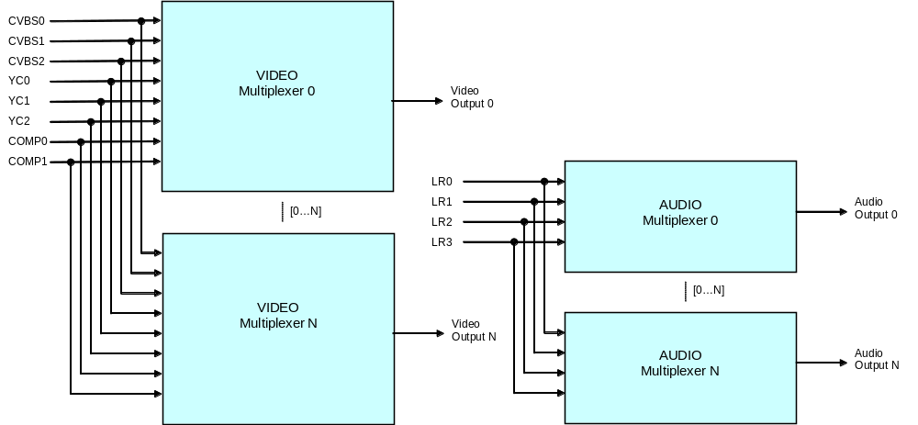
TDAL_ANA_INPUT Overview (2/2)
A schematic representation of the data flow through the TDAL_ANA_INPUT is
described in the following figure:

Slide 4
TDAL_ANA_INPUT Input object
The concept of TDAL_ANA_INPUT object is used.
A TDAL_ANA_INPUT object represents different types of hardware piece (video input, audio input, multiplexer…) instance.
This instance is also classified as a video or audio object.
Each input objects can be connected or not to several multiplexer of the same class. At a minimum, one input object has to be connected to one multiplexer..

Slide 5
TDAL_ANA_INPUT Dependency with TDAL_ANA_VID
TDAL_ANA_INPUT needs an access to the decoder of TDAL_ANA_VID to indicate in which video decoder, the video input chosen result must be sent.
For that purpose and to have a complete independence between the TDAL_ANA_VID, TDAL_ANA_INPUT and other TDAL APIs, the notion of input handle is used.
The input handle is an unique opaque value that is used as accessor to a specific input muliplexer.
This handle is used transversely between the different TDAL modules in order to authorize a TDAL module to access the low level driver that manages the decoders.

Slide 6
TDAL_ANA_INPUT Dependency with TDAL_ANA_AUD
TDAL_ANA_INPUT needs an access to the decoder of TDAL_ANA_AUD to indicate in which video decoder, the video input chosen result must be sent.
For that purpose and to have a complete independence between the TDAL_ANA_AUD, TDAL_ANA_INPUT and other TDAL APIs, the notion of input handle is used.
The input handle is an unique opaque value that is used as accessor to a specific input muliplexer.
This handle is used transversely between the different TDAL modules in order to authorize a TDAL module to access the low level driver that manages the decoders.

Slide 7
TDAL_ANA_INPUT Objects Class, Type and coding
Object class
  An enumeration of the different object class.
  enum {
  eTDAL_ANA_INPUT_CLASS_VIDEO = 0 ,
  eTDAL_ANA_INPUT_CLASS_AUDIO
  };
Object type
  An enumeration of the different object type.
  enum {
  eTDAL_ANA_INPUT_TYPE_MUX = 0, /* Multiplexer object type */
  eTDAL_ANA_INPUT_TYPE_CVBS, /* CVBS video input object type */
  eTDAL_ANA_INPUT_TYPE_YC, /* YC video input object type */
  eTDAL_ANA_INPUT_TYPE_COMP, /* Component video input object type */
  eTDAL_ANA_INPUT_TYPE_LR, /* LR baseband audio input object type */
  };
Coding (32 bit)
  bit[0..7] : instance
  bit[15..8] : type
  bit[31..16] : class
Examples:
  CVBS 0 = 0x00000100
  Mux Audio 0 = 0x00010000
  Mux Video 1 = 0x00000001
  Audio LR 0 = 0x00010400

Slide 8
TDAL_ANA_INPUT Objects Manipulation Macros
MACROS | DESCRIPITION
mTDAL_ANA_INPUT_GetObjectId(class , type, instance) | Get the object from its class, type and instance.
mTDAL_ANA_INPUT_GetObjectClass( object ) | Get the class (video or audio) of a TDAL_ANA_INPUT object.
mTDAL_ANA_INPUT_GetObjectType( object ) | Get the type (Mux, CVBS, …) of a TDAL_ANA_INPUT object.
mTDAL_ANA_INPUT_GetObjectInstance( object ) | Get the instance (0,…,n) of a TDAL_ANA_INPUT object

Slide 9
TDAL_ANA_INPUT Generic
Function List:
Function | Description
TDAL_ANA_INPUT_Init(-) | Initialize the TDAL_ANA_INPUT module
TDAL_ANA_INPUT_Term(-) | Terminate the TDAL_ANA_INPUT module
TDAL_ANA_INPUT_CapabilityGet(-) | Get the capabilities of the current implementation of TDAL_ANA_INPUT module
TDAL_ANA_INPUT_APIRevisionGet(-) | Get API revision
TDAL_ANA_INPUT_PlatformRevisionGet(-) | Get Platform revision

Slide 10
TDAL_ANA_INPUT Input management
Function List:
Function | Description
TDAL_ANA_INPUT_MuxCapabilityGet(-) | Get the capabilities of the requested multiplexer
TDAL_ANA_INPUT_HandleGet(-) | Get an opaque unique handle on a stream
TDAL_ANA_INPUT_VideoInputSelect(-) | Select the input setting of the video multiplexer
TDAL_ANA_INPUT_AudioInputSelect(-) | Select the input setting of the audio multiplexer

Slide 11
TDAL_ANA_INPUT documentation
Let’s go now deeper in “TDAL_ANA_INPUT Specification.doc”

