Slide 1
TDAL_CI

Slide 2
TDAL_CI Overview
Control DVB Common Interface (DVB-CI) driver of a set-top-box.
The CA system is embedded in PCMCIA card (aka DVB-CI module)
The decoder (aka Host) is not linked to unique embedded CA system(s)
The decoder provide resources to allow the CA system to descramble
Anti-piracy strategy can be used (extension : copy protection)
A common interface has been define to exchange data between hosts and modules : DVB-CI protocole
  CENELEC prEN 50221 (1996) : profile 1
  ETSI TS 101 699 V1.1.1 (extensions à prEN 50221, 1999) : profiles 1, 2, 3
No certification

Slide 3
TDAL_CI HW architecture
Single module example:
RF In
tuner
demod
MPEG decoder
RCU
demux
CPU
host
command
TS In
TS Out
Common Interface
CPU
demux & descrambler
module
Smart card

Slide 4
TDAL_CI HW description
Hardware characteristics
  PC Card standard (PCMCIA)
    Modules : Type I and II PC Cards
    Mandatory : 5 volts
    Optional : 3,3 volts
    Data rated at least 58 Mb/s on TS Interface
    Data rated at least 3,5 Mb/s on Command Interface
    PIN assignments
      Address
      Data in / TS out
      Command lines (RESET, CD1/2 CE1/2, WE, IORD, IOWR, …)
      IRQ
    Attribute Memory (Card Information Structure)
    I/O memory (command Interface by read/write access)
Transport Stream interface
  Routed through the module at insertion time (bypass on/off)
  Transport_scrambling_control flag set to 0 by the descrambler
  Daisy chain (multiple modules)

Slide 5
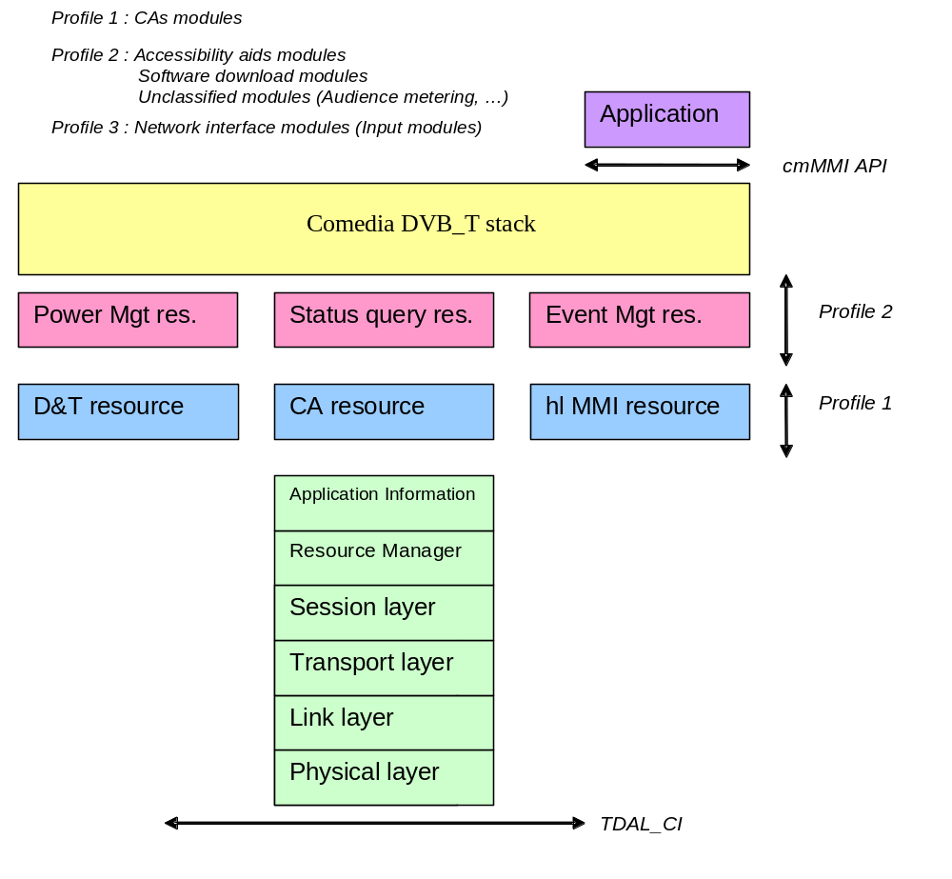
TDAL_CI Global Architecture CI software stack

Slide 6
TDAL_CI Data Information Access
When the CI driver has been initialised, the host must reset the driver and then read the Card Information Structure (CIS) and the Configuration Option Register (COR) thanks to the access of the attribute memory.
When the Host has written in COR, it may have access to the I/O memory.
The I/O memory is used to send data to the module or read data from the module
The Attributes memory is used to read the CIS and writes in COR

Slide 7
TDAL_CI Data Information Access
The driver must have access to I/O signals:
  in writing mode to modify their values,
  in reading mode to know the connection Host/Module state.
Status Register Definition:
  Bit RE: Read Error
  Bit WE: Write Error
  Bit FR: Buffer Free
  Bit DA: Data available
Command Register Definition:
  Bit HC: Host Control
  Bit SR: Size read command
  Bit SW: Size write command
  Bit RS: Reset interface
The Attributes memory and I/O Signals are addressable directly in the microprocessor memory space.

Slide 8
TDAL_CI Bypass Management
When a module is inserted in the slot of the Host, the Host requires that the PCMCIA Driver allows clear stream decoding.
The Bypass command enables the driver to make the settings for the module to enable the clear stream decoding.
The Bypass settings may be managed very differently by the hardware platform (software register configuration PIO or software command).

Slide 9
TDAL_CI Generic
Function List:
Function | Description
TDAL_CI_Init(-) | Initialize the TDAL_CI module
TDAL_CI_Terminate(-) | Terminate the TDAL_CI module
TDAL_CI_CapabilitiesGet(-) | Get the maximum number of slot available on the board.

Slide 10
TDAL_CI Client Sessions
Function List:
Function | Description
TDAL_CI_Open(-) | Open of a PCMCIA driver instance.
TDAL_CI_Close(-) | Close of a PCMCIA driver instance.

Slide 11
TDAL_CI I/O Memory
Function List:
Function | Description
TDAL_CI_Read(-) | Read a data buffer in IO memory.
TDAL_CI_Write(-) | Writing a data buffer in IO memory.
TDAL_CI_ReadStatus(-) | Read the Status register in IO memory.
TDAL_CI_WriteCmd(-) | Write the Command register in IO memory.

Slide 12
TDAL_CI Attributes Memory
Function List:
Function | Description
TDAL_CI_CheckCIS(-) | Read of the attribute memory is used to read and to check the CIS.
TDAL_CI_WriteCOR(-) | Write in the attribute memory is used to write the COR.

Slide 13
TDAL_CI I/O signal control
Function List:
Function | Description
TDAL_CI_Ctl(-) | Set or clear IO signals: - RESET, - BYPASS. Read IO signals: DETECT, - READY BUSY.

Slide 14
TDAL_CI documentation
Let’s go now deeper in “TDAL_CI Specification.doc”

